Slide 1
Sol diff eq

Slide 2
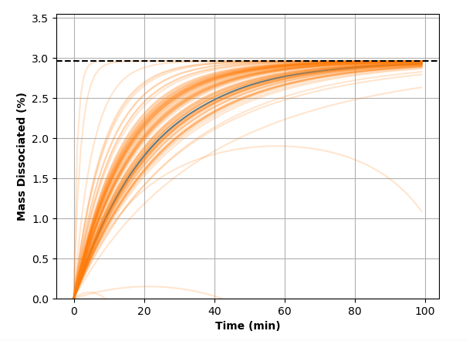
Radau Niter=100, max_step = 1e-1

Slide 3
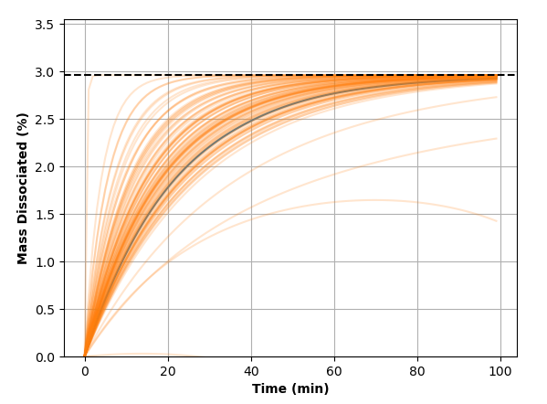
Radau Niter=100, max_step = 1e-4

