Slide 1
Optimizing WiFi access points in an office building
Sam Cowell
Léna Langer
Maciej Kilijański
12.11.2024

Slide 2
Problem Summary
The code addresses the problem of optimizing WiFi coverage in a multi-floor office building.
The goal is to minimize the number of WiFi access points (APs) installed, while ensuring that every desk in the building is within a specified distance threshold for good signal strength.

Slide 3
Problem Description
Objective:
Minimize the number of WiFi access points while ensuring full coverage.
Constraints:
Every desk must be within a certain distance (750 cm) of at least one access point.
Access points can only cover desks within this distance threshold.
Building Specifications:
Floors: 7
Rows per floor: 20
Columns per floor: 7
Floor height: 3 meters
Row length: 1.5 meters
Column width: 2.5 meters

Slide 4
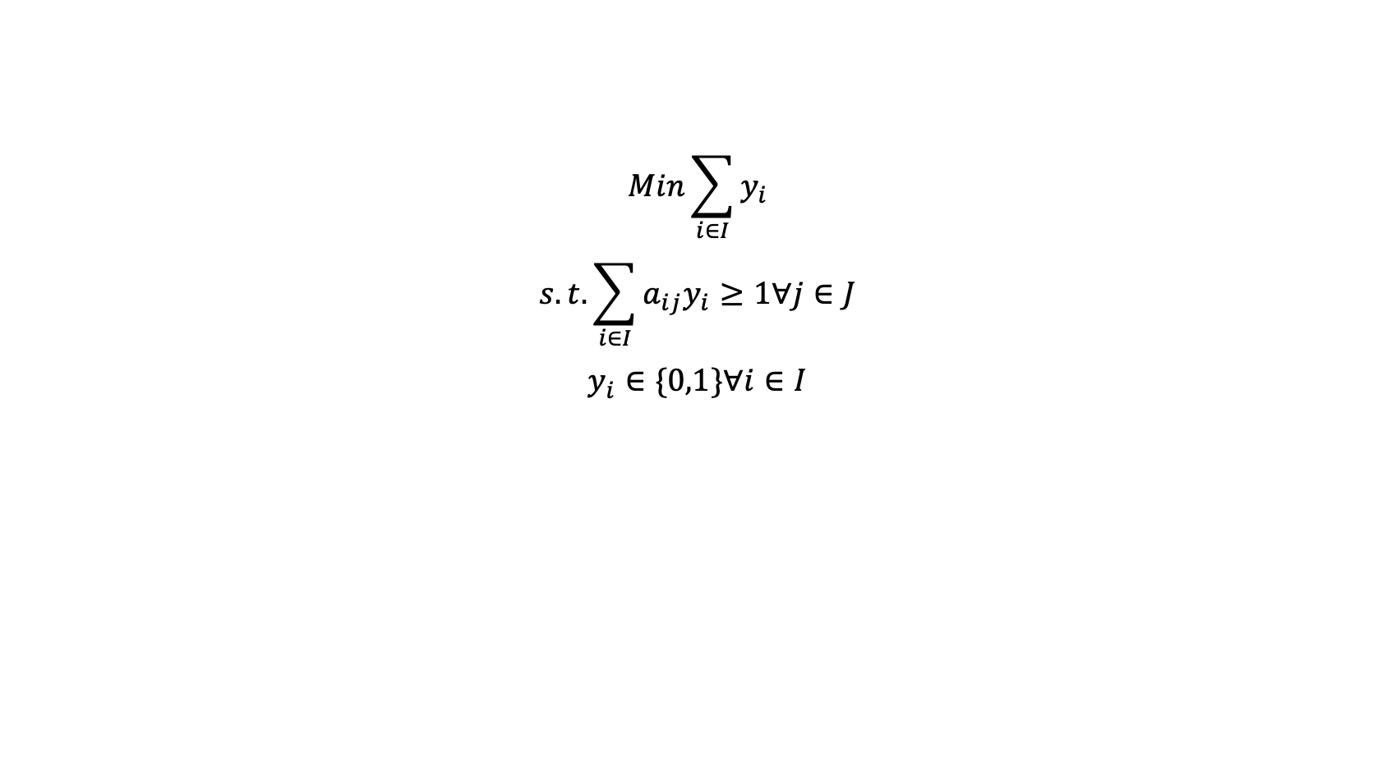
Problem formulation
$$Min\sum_{i∈I}{y_{i}}$$
$$s.t.\sum_{i∈I}{a_{ij}y_{i}≥1\text{∀}j∈J}$$
$$y_{i}∈\{0,1\}\text{∀}i∈I$$

Slide 5
Problem formulation - Python
plp = pulp.LpProblem("AssignmentProblem", pulp.LpMinimize)
# Declaring variables
y = pulp.LpVariable.dicts("y", (access_points), 0, 1, pulp.LpBinary)
# a = pulp.LpVariable.dicts("a", (access_points, desks), 0, 1, pulp.LpBinary)
# Adding objective function
plp += pulp.lpSum(y[i] for i in access_points)
# Constraints
for j in desks:
plp += pulp.lpSum(a[i][j] * y[i] for i in access_points) >= 1

Slide 6
Approach
Modeling the Building Layout: Generating the locations of all desks and potential access point positions.
Calculating Distances: Computing the Euclidean distance between every desk and every access point.
Formulating the Optimization Problem: Defining variables, objective function, and constraints.
Solving the Problem: Using PuLP to find the optimal placement of access points.
Visualizing the Solution: Plotting the desks and chosen access points in a 3D space.

Slide 7
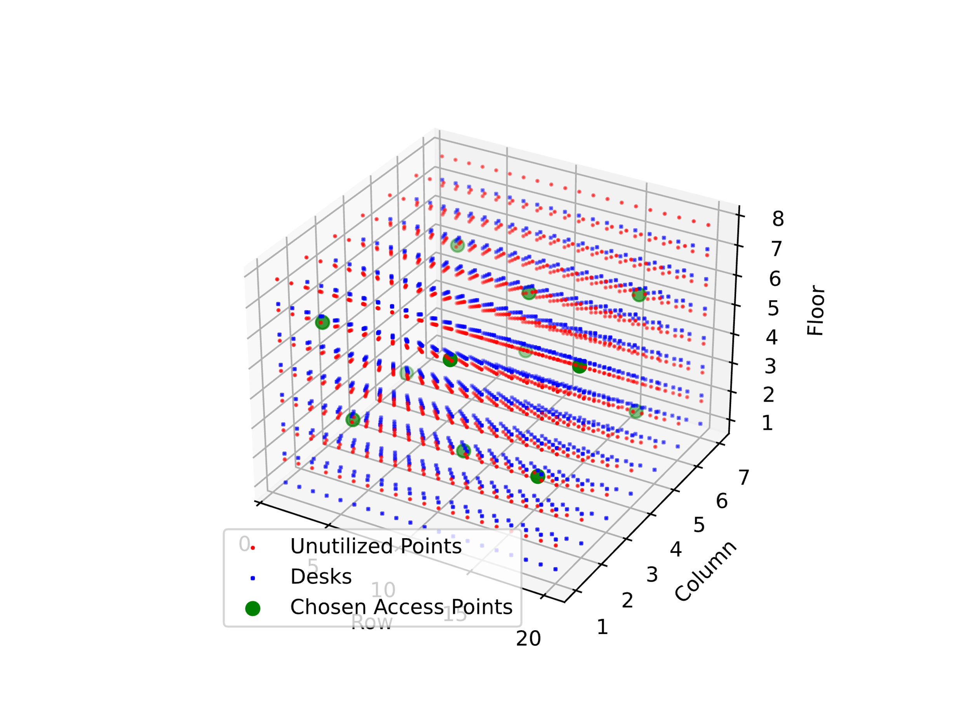
Result
From 980 access points, the minimal value to supply the whole building with WiFi, we need to install 12 routers

Slide 8
Thank you!

