Slide 1
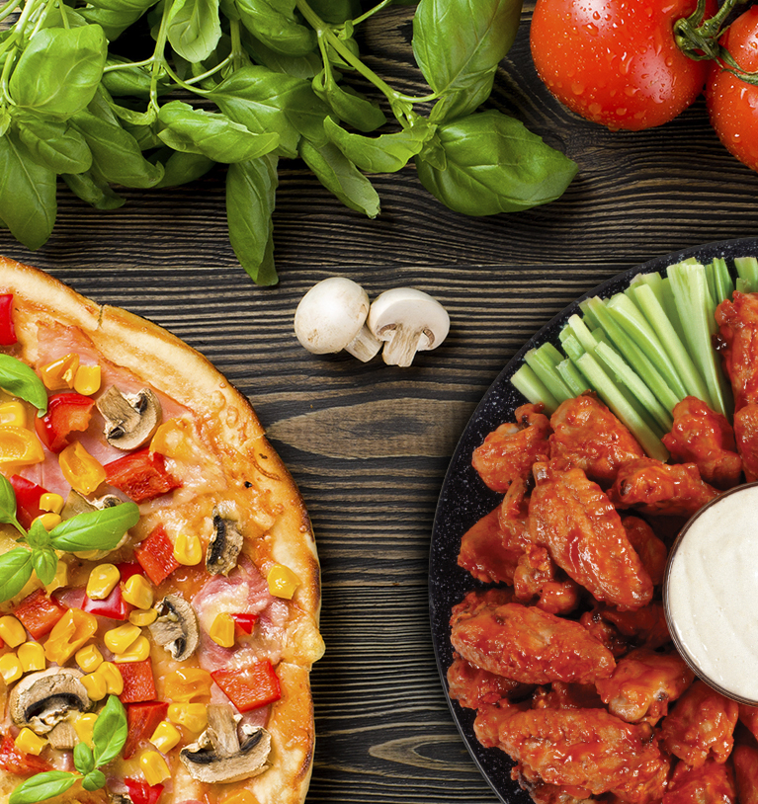
FAVE-FOODS Eat. Review. Share.
By: Michelle Ackley

Slide 2
Fave-Foods Goals
Fave-Foods is a mobile application that will allow:
Customers to review and share their dish
Future customers to see credible food reviews
Restaurants to increase customer satisfaction

Slide 3

Software Requirements
User’s Mobile Device Needs:
iOS or Android
Touchscreen
Fully Functional Keyboard
Network Connectivity
Camera (Optional)
GPS Capabilities (Optional)
Fave-Foods Needs:
Database
Web Server

Slide 4


Design Specifications
Target audience: young adults & professionals
Responsive
Crisp red logo w/ white knife & fork creating an “X”
Icons/Buttons clearly represent what they accomplish
Explicit symmetric layout throughout Fave-Foods app

Slide 5
Usability Evaluation Plan
Users Will Be Evaluated Through:
Surveys
Questionnaires
Observations
System Usability Scale:
10 question questionnaire about application usability
Outputs a score that tells ranks the apps usability

Slide 6
Usability Test Plan
Test Overview:
Step 1 – Retrieve select participants
Step 2 – Active participants sign consent form
Step 3 – Briefed on test plan
Step 4 – Receive camera and cradle for observation
Step 5 – Accomplish each task without direct distraction
Step 6 – During testing, user will take notes
Step 7 – Participants complete post test questionnaire
Step 8 – Final debrief with participants
Step 9 – Compile all data to develop a final report
Step 10 – Implement plan to resolve any exposed errors

Slide 7
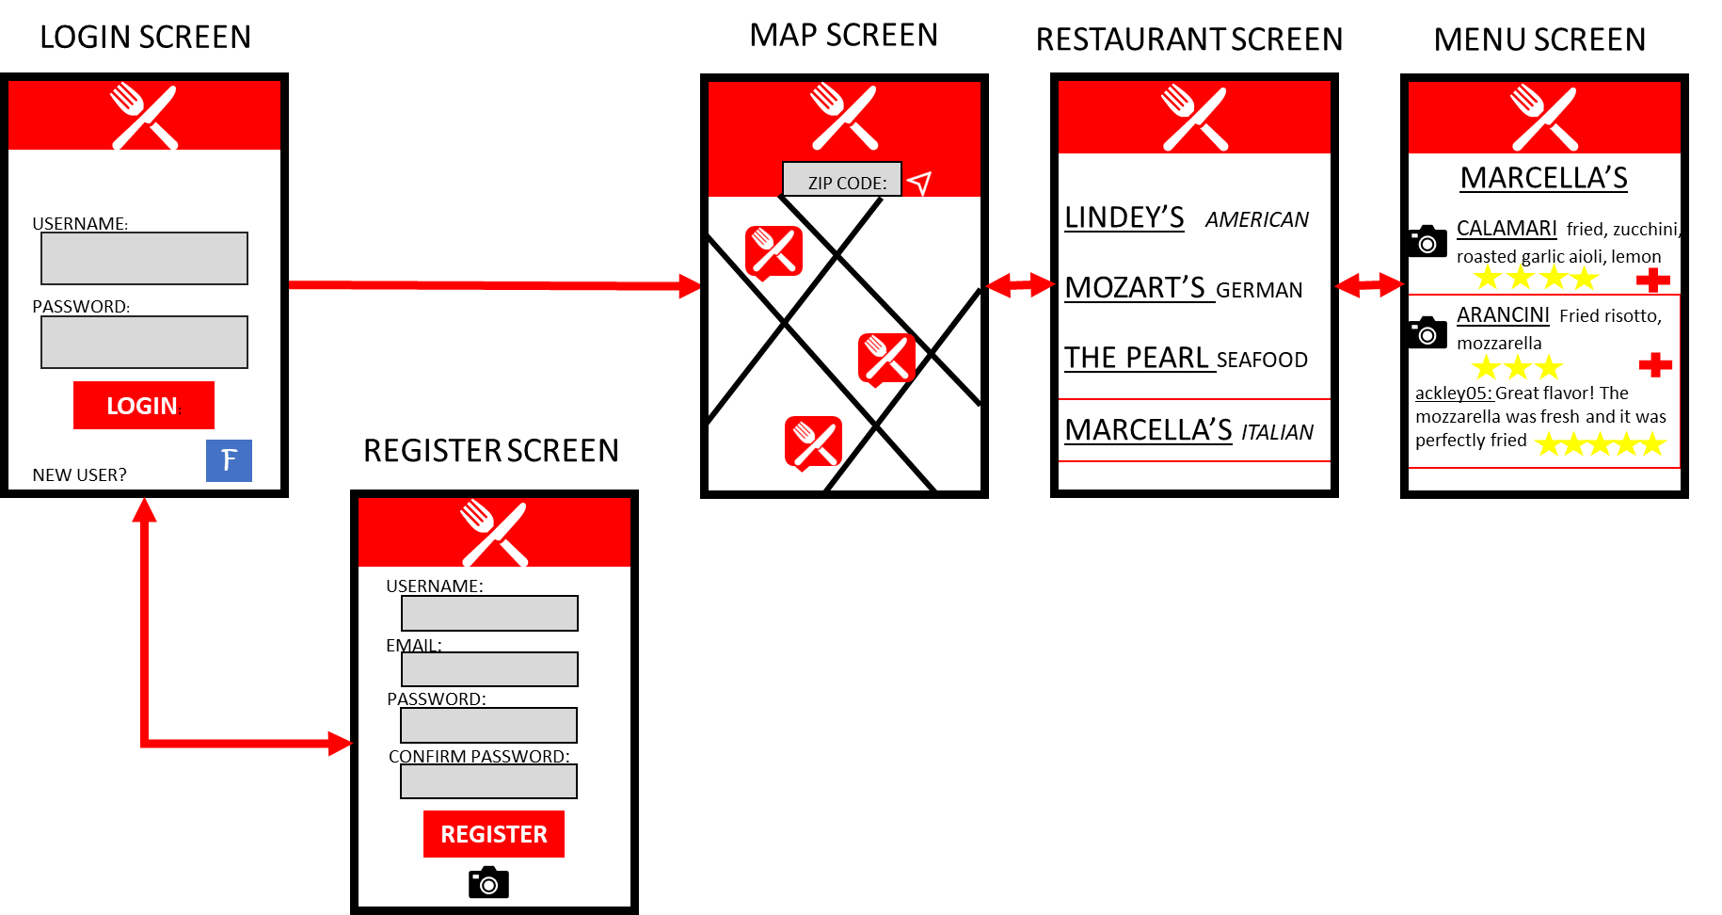
Fave-Foods Interface Screenshot

Slide 8
References
Conley, V. (2016). What is usability? Retrieved from
http://slideplayer.com/slide/7675488/
Mifsud, J. (2016, March 21). Usability testing of mobile applications. Retrieved from
https://usabilitygeek.com/usability-testing-mobile-applications/
[Photograph of Pizza, Wings, and Veggies] (2019).Retrieved from
http://prestofoods.com/
Usability.gov. (2019). System usability scale. Retrieved from
https://www.usability.gov/how-to-and-tools/methods/system-usability- scale.html
Zcool.com.cn. (n.d.). Photograph of Chicken and Fries. Retrieved from
https://all-free-download.com/free-photos/download/food- picture-03-hd-pictures_167556.html

