Slide 1
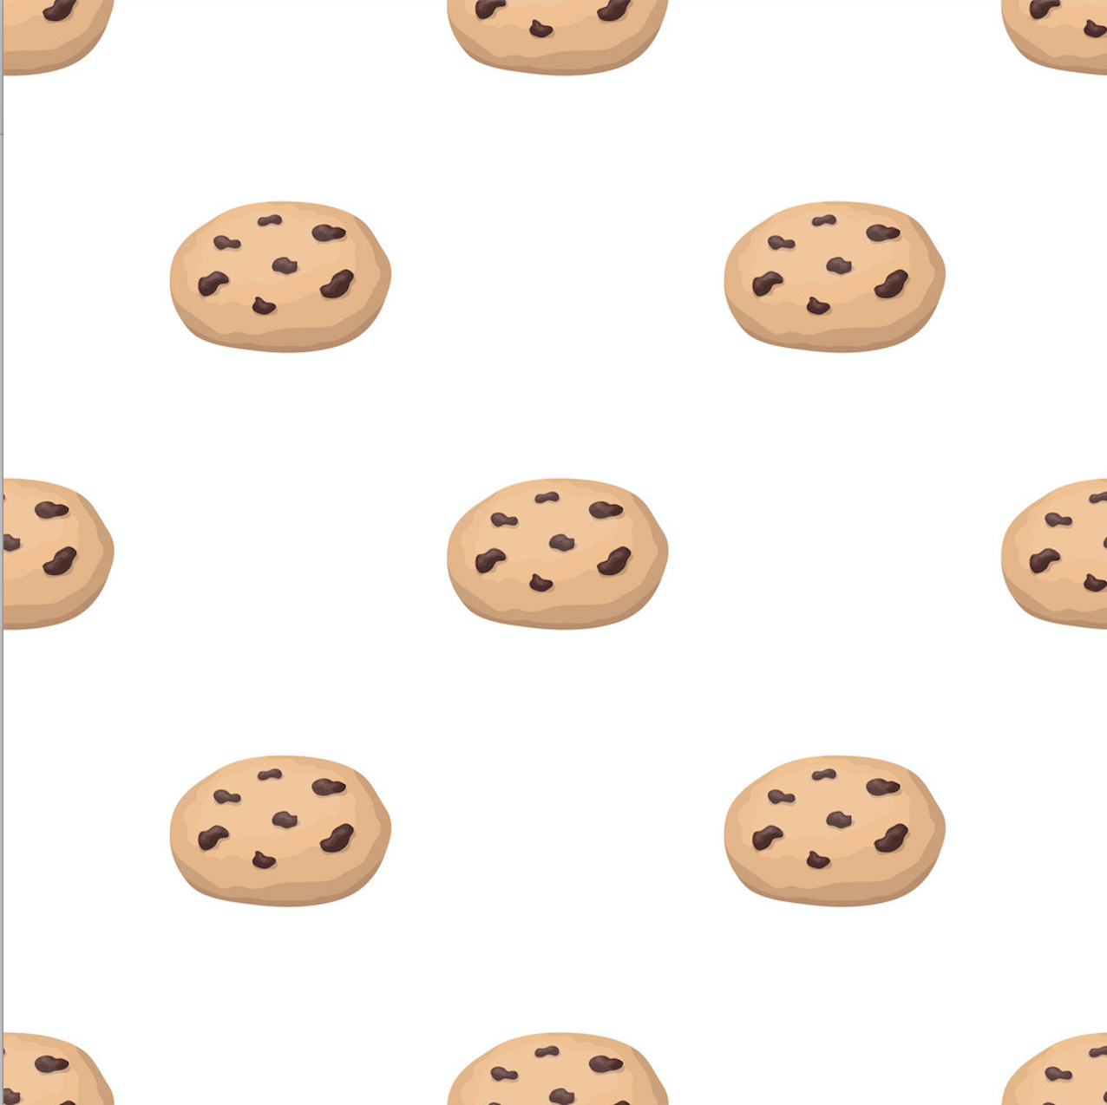
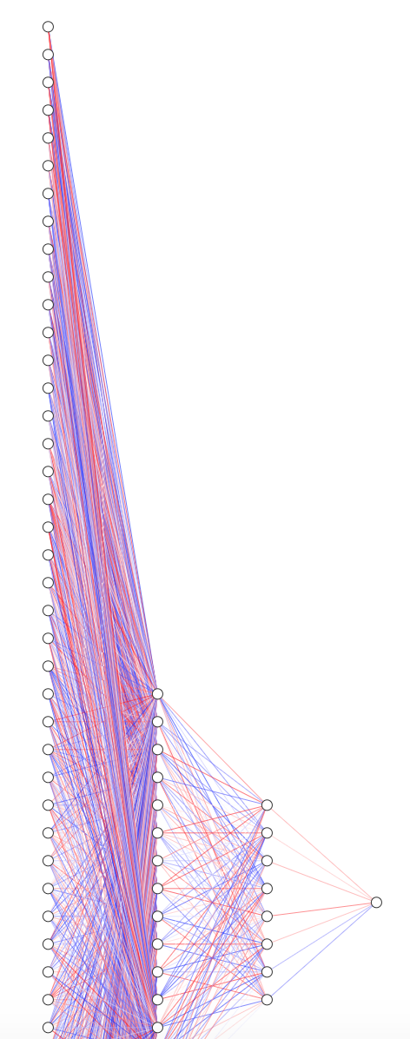

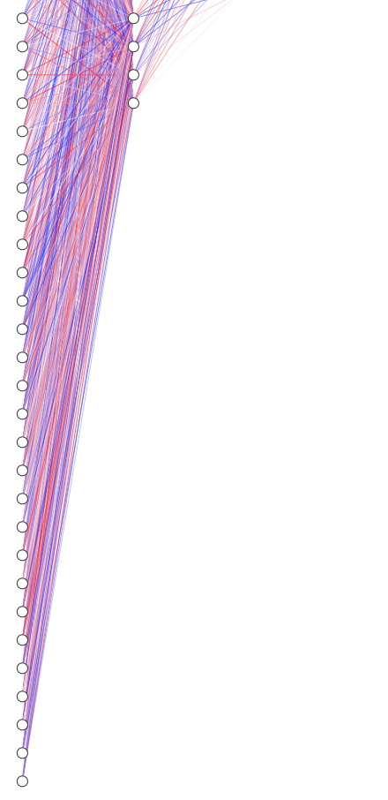
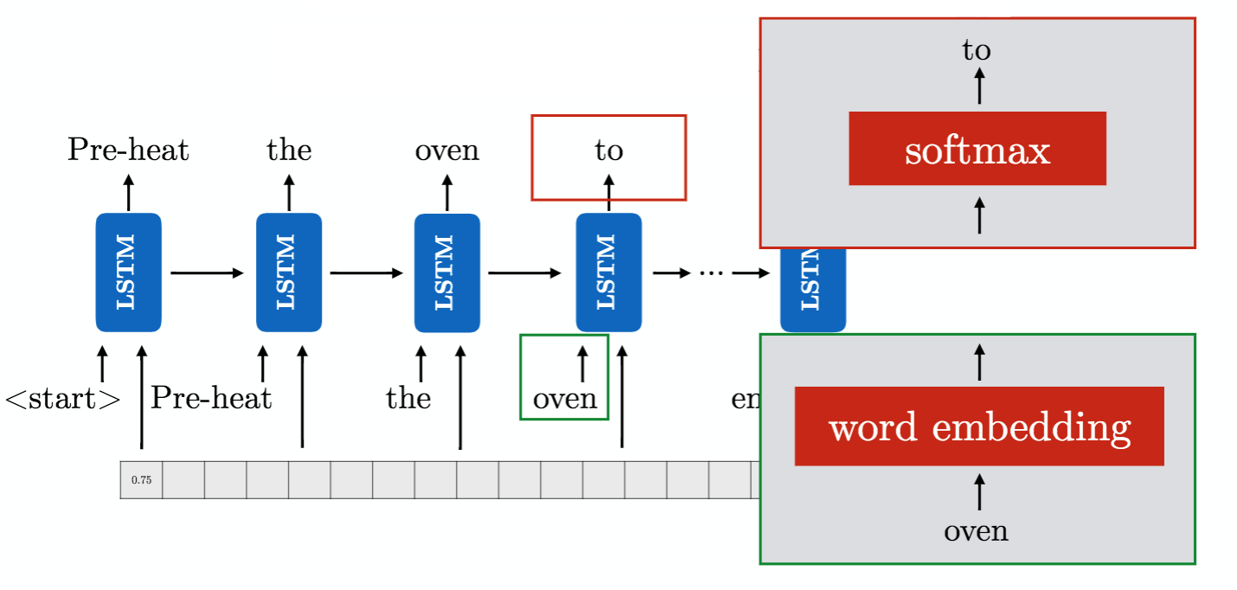
Optimizing Cookie Recipes for Ratings Using Machine Learning and Deep Vector-to-Sequence Recurrent Neural Models Mackenzie O’Brien and Dr. Pablo Rivas
Our Idea
Methodology
Results
This project employed machine learning concepts and processes in an attempt to teach a computer an algorithm that outputs a cookie recipe that is comparable to human-made recipes.
The process involved feeding the algorithms a data set of cookie recipes that included details such as ingredients, ratings, and calories. A second algorithm was used to construct instructions for a recipe once ingredients were selected based off of instructions from the dataset of recipes.
The recipes were gathered by scraping the website allrecipes.com for chocolate chip cookie recipes that were compiled in order to “teach” the computer to recognize tasty cookies by looking at things such as reviews, ingredients, and calories.
Gathering Recipes for Data Input
Python scripts were employed to scrape over 250 chocolate chip cookie recipes from allrecipes.com. This data was then cleaned and inputted into two spreadsheets, one for ingredients and one for instructions, for further use.
Ingredients Vectors
Creating Training Models For Ingredients Vectors
We began by training 9 different machine learning algorithms. After analysis of recipes produced by each, we chose 5 recipes from 3 different algorithms.
Deep Learning
Extremely Randomized Trees
The algorithm is a variant of the Random Forest regression that picks a decision boundary at random by using the entire sample at each step of the extreme tree.. It uses a plethora of decision trees and merges them to make a stable and accurate prediction.
Gradient Boosting:
The gradient boosting algorithm applies the concept of modifying a weak learner to become better at identifying good outcomes more efficiently. The model uses an ensemble of weak prediction models, typically decision trees, to make predictions. The gradient boosting algorithm attempts to minimize errors through a loss function.
Diagrams of Networks
Vector-to-Sequence Instructions
As the vector-to-sequence algorithm is previously untested in other research, the end results leave something to desire in terms of ability to finesse and actual usability. However, it is an accomplishment to have gotten a working algorithm that takes in an ingredient vector and outputs a semi-usable recipe. Improvements include ensuring that the instructions contain all ingredients in the vector that contain non-zero values and eliminating repeating loops that the algorithm gets stuck on.
Conclusion
Deep Learning Neural Network
Extreme Trees and Gradient Boosting
Vector-to-Sequence Models to Get Instructions
In order to get instructions unique to each generated recipe, we used a Long Short-Term Memory Recurrent Neural network, through which we fed in the generated recipe as an attention mechanism. The attention mechanism combined with the memory then trains the model to output a sequence of words that it believes are correct. The LSTM at each iteration outputs the word with the highest probability into a sequence and then feeds that outputted word back into the network as “memory”.
LSTM Recurrent Neural Network
Survey Questions
References
Appearance on a scale of 1 (unfit for consumption) to 5 (Excellent)
Aroma on a scale of 1 (unfit for consumption) to 5 (Excellent)
Taste on a scale of 1 (unfit for consumption) to 5 (Excellent)
Texture: crunchy, chewy, gooey, juicy, soggy, creamy, other
Overall Satisfaction on a scale of 1 (Hated It) to 10 (Loved It)
Clifford, Catherine. “Alphabet Billionaire Eric Schmidt: Google Used A.I. to
Find the Perfect Chocolate Chip Cookie Recipe.” CNBC, CNBC, 29 Jan. 2018.
Kochanski, Greg et al. “Bayesian Optimization for a Better Dessert.” (2017).
Naik, JitendraB.. “Cuisine Classification and Recipe Generation.” (2015).
Notes:
Would like to print copies of each ML recipe to distribute instead of putting on poster to save space

