Slide 1

Text Analytics and Data Mining at the NIH – RCDC Project
Overview and Lessons Learned
12/06/2011
This document is confidential and is intended solely for the use and information of the client to whom it is addressed.
Notes:
Booz Allen Hamilton Standard Colors
Colors should be used in the color pairs whenever possible. Do not mix and match colors, use pairs together as shown.
Black, White and Gray can be used with any of the other colors.
Purple Pantone 2765
R 12
G 4
B 79
Green Pantone 357
R 15
G 67
B 24
Blue Pantone 2 88
R 11
G 31
B 101
Black
Pantone Cool Gray 6
R 158
G 158
B 158
Red Pantone 485
R 252
G 5
B 14
Yellow Pantone 3965
R 232
G 244
B 4
Aqua Pantone 319
R 126
G 204
B 189
White

Slide 2
Table Of Contents
Overview of RCDC
How does RCDC Work
Managing Stakeholders
Lessons learned

Slide 3
Table Of Contents
Overview of RCDC
How does RCDC Work
Managing Stakeholders
Lessons learned

Slide 4
What is RCDC?
RCDC stands for Research, Condition and Disease Categorization
It’s mandate is to categorize ~250 research areas and funding levels for Congress, White House and NIH Senior Leadership
Be able to provide transparent access to grants and funding levels to the public
It uses text mining and analytics
Developed out of a prototype from Collexis
Currently housed within the Office of the Director/NIH within eRA (electronic research administration)

Slide 5
Why did NIH Develop RCDC?
“... It is particularly important for NIH leadership to improve the quality and analysis of its data on the allocation of NIH funds by disease for planning and priority-setting purposes. The problem requires the development of an NIH-wide agreement on what to track and publish and a single method for coding data that uses consistent definitions and deals with the uncertainties inherent in counting research that is only related but not directly applicable to a specific topic.”
-- National Research Council, 2004

Slide 6
RCDC Project Goals
Consistent Grant, Intramural, and Contract project descriptions that are appropriate for scientifically defensible categorization (i.e., Title, Abstract and Scientific Aims)
Consistent methodology for providing funding amounts for each project
Consistent and transparent trans-NIH definitions for developing and reporting categories

Slide 7
Table Of Contents
Overview of RCDC
How does RCDC Work
Managing Stakeholders
Lessons learned

Slide 8
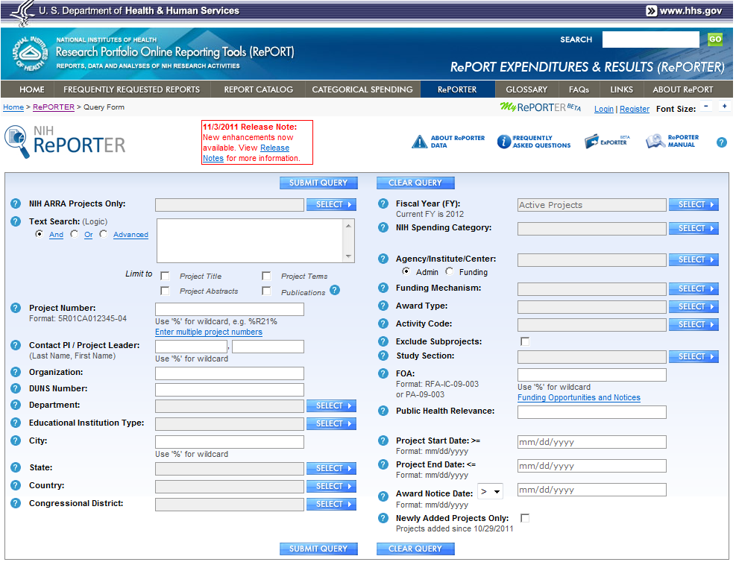

Slide 9
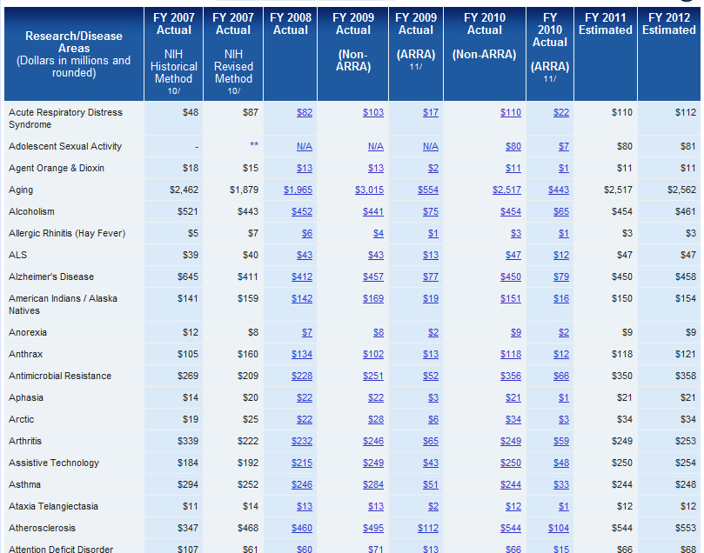

Slide 10
RCDC Data Sources
Extramural Grants: Title, Abstract, Public Health Relevance and Specific Aims
Text describes work proposed for the future
Intramural Research and Extramural R&D Contracts: Project Descriptions
Text for contracts is provided by contracts officers/project officers through the Online 1688 module
Text for intramural research is prepared by intramural investigators for yearly progress reports
Electronic applications are extracted using automated methods
Paper applications are scanned and extracted using semi-automated or manual processes

Slide 11
The Project Fingerprint

Slide 12
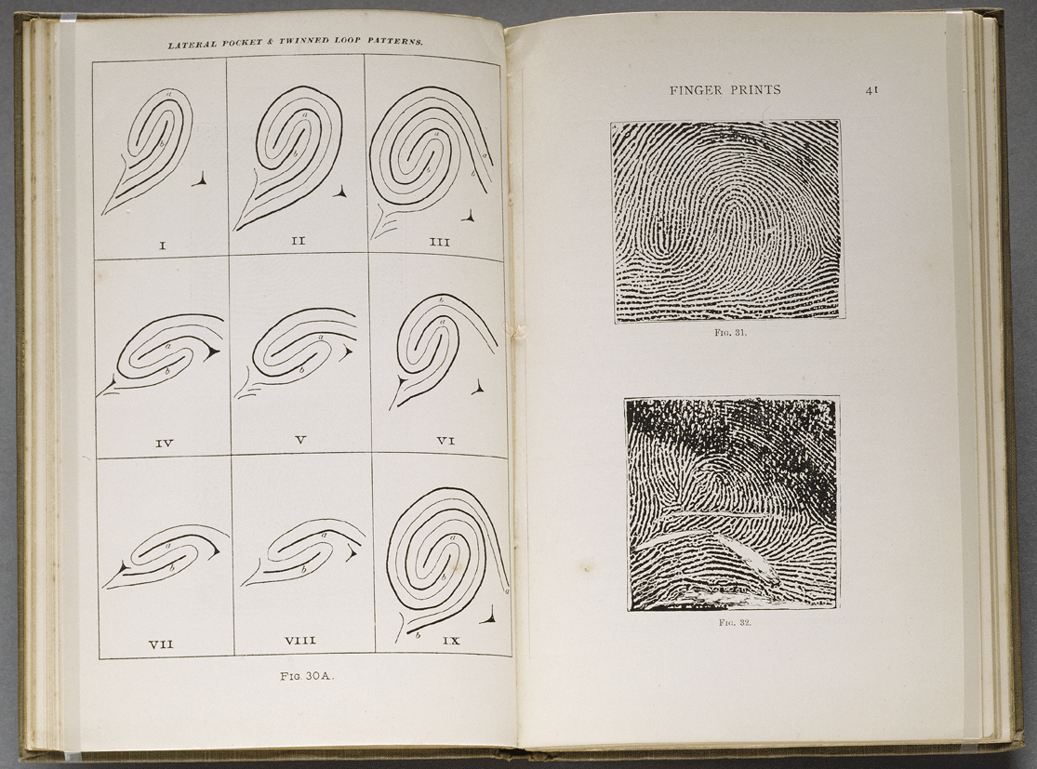
Project and Research Representations

Slide 13


Project Fingerprint Creation
Source
Document
(Grant / Project)
Text
Mining
Project
Fingerprint
Title, abstract and specific aims
Thesaurus
Project Fingerprint is a list of concepts such as fever, fatigue, breast neoplasm, etc.
Each term or concept is assigned a relative weight based on occurrence frequency.
- Fingerprint is a small but unique representation of the source document.
Specialized vocabulary of a domain, derived from:
NLM MeSH (Medical Subject Headings)
NIH CRISP thesaurus
NCI thesaurus
Metathesaurus
Jablonski’s Dictionary
Other concepts

Slide 14
Concept Normalization
Grant text reads:
“Assessments, patient’s outcomes and the efficacy of drug therapy”
Tokenizer: Identifying sentence and wor boundaries
[assessments] [patient’s] [outcomes] [and] [the] [efficacy] [of] [drug] [therapy]
Stop-word removal: Non-informative words such as: and, of, the, a, or
[assessments] [patient’s] [outcomes] [and] [the] [efficacy] [of] [drug] [therapy]
Normalization: Remaining (informative) words normalized
[assessments] [patient’s] [outcomes] [efficacy] [drug] [therapy]
Term Lookup:
[assessment] [patient] [outcome] [efficacy] [drug] [therapy]
assessment | patient | outcome | efficacy | drug | therapy

Slide 15
Concept Matching
assessment | patient | outcome | efficacy | drug | therapy
Recursive clustering: Words or word clusters in grant text are matched to concepts in the thesaurus by recursive clustering. This allows for any order of a particular set of words in a sentence to match concepts in thesaurus.
Stop criterion: complete term found
If a synonym matches it is equivalent to a concept match
Matches:
patient outcome assessment
drug efficacy
pharmacotherapy (synonym for drug therapy)
Not a match:
combination drug therapy
(combination not clustered in same sentence with drug therapy)
outcome assessment (health care)
(health care not clustered in same sentence with outcome assessment)

Slide 16
Word Order
RCDC can match concepts in the thesaurus with words that appear in close proximity to one another but in a different order (permutation).
Example: “Vision research” results in:
Research vision
Vision of this research
Vision research
Adding the word order critical tag results in:
Vision of this research
Vision research
Tagging as do not normalize”, results in:
Vision research
Adding a Word Order Critical tag to a concept is possible
ONLY prevents the terms from being permutated
Caution: Adding tags can eliminate desired matches

Slide 17
Thesaurus Update Process
The RCDC Thesaurus is routinely updated with new terms.
Unused terms are occasionally retired.
A staff of Thesaurus Curators are charged with the responsibility for researching new terms and managing the RCDC thesaurus.

Slide 18
The Category Fingerprint

Slide 19
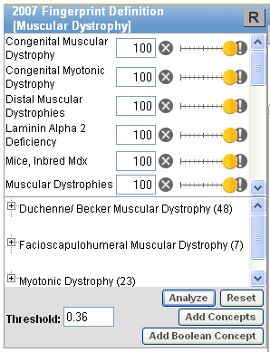
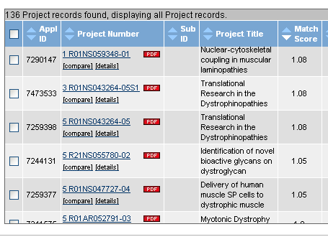
Category in the RCDC Application
Category Fingerprint
Matching
score
Analytical Tool
Threshold cut-off
for matching
Compare

Slide 20
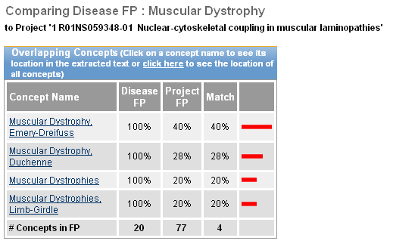
Compare Overlapping Concepts
Category Fingerprint
Grant Fingerprint
% Match Between
the 2 Fingerprints

Slide 21
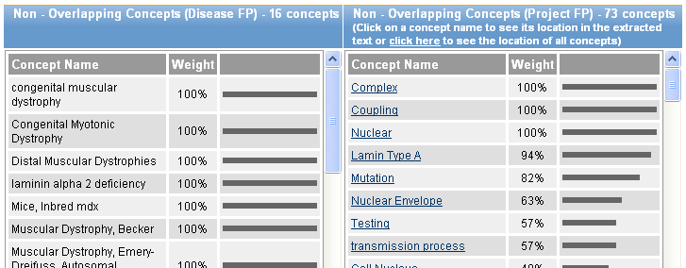
Compare Non-overlapping Concepts
Muscular Dystrophy FP Concepts
NOT Found in Grant FP
Grant FP Concepts
NOT Found in Muscular Dystrophy FP

Slide 22
Comparing a Project Fingerprint to the Category Fingerprint
Category
Fingerprints developed by NIH staff
Project Fingerprints
Matching
Process
Projects with matching categories
Matching compares individual project fingerprints to the category fingerprints – the resultant category matching score for a project is a reflection of how closely the project is related to a particular category
21

Slide 23
Effect of Threshold
Matching Score Threshold -- A value set (empirically) for a category to separate projects that are within a category from those that are not.
The Category Matching Score Threshold is set to minimize the overlap between scientifically defensible grants and non-defensible grants
Threshold
Not in category
Number of grants
In Category
Matching Score
false negative
false positive

Slide 24
Table Of Contents
Overview of RCDC
How does RCDC Work
Managing Stakeholders
Lessons learned

Slide 25
Stakeholder Management
Issue | Resolution
Strong initial pushback from NIH institute mid-level staff | Developed a clear message that the tool was not replacing them, rather would make their work more efficient
Skepticism from small vocal groups within NCI, CIT and NLM | Work closely with them. Invite them to join advisory and power user groups
Need for a project champion | High level support from NIH Director, Dr. Zerhouni, as well as, the Budget Office and smaller Institutes
Need to show scientific relevance | Scientific program staff were quick to see the potential and were key to buy-in
Need for support outside NIH | Strong Congressional support that included language written into law for the 2006 NIH Reauthorization for the creation of an NIH-wide electronic reporting system
Buy-in from Advocacy groups | We worked with several research and patient advocacy groups to show the potential of the new tool

Slide 26
Table Of Contents
Overview of RCDC
How does RCDC Work
Managing Stakeholders
Lessons learned

Slide 27
Lessons Learned
Need for faster buy-in from Institute Directors, not only from the Office of the Director
Need for better communication about the accuracy of the tool in a way that was easy to grasp for ALL stakeholders
Work closely with harshest critics
Start Change Management earlier in the process

Slide 28
Appendix

Slide 29
Example: Grant Project Fingerprints

Slide 30
Grant Indexing: From Text to Fingerprint
Extract Title, Abstract, and Specific Aims
s50 Nanocapsules for Transcutaneous DNA Vaccination
Due to anatomical similarities with humans, the porcine model is superior for evaluation of transcutaneous vaccines.
In this pilot study, using the bacterial protein 13-galactosidse as a model antigen, we propose to prepare and test in organ culture (OC) and in weanling pigs, vaccine formulations comprised of hyaluronan and aluminum or nickel ion. Demonstration of improved cellular and humoral immune responses in OC with decreased dosing will provide a strong foundation for follow-on studies in Rhesus macaques to improve mucosal immunity and T- cell responses against SIV.

Slide 31
Grant Indexing: From Text to Fingerprint
Extract Title, Abstract, and Specific Aims
s50 Nanocapsules for Transcutaneous DNA Vaccination
Due to anatomical similarities with humans, the porcine model is superior for evaluation of transcutaneous vaccines.
In this pilot study, using the bacterial protein 13-galactosidse as a model antigen, we propose to prepare and test in organ culture (OC) and in weanling pigs, vaccine formulations comprised of hyaluronan and aluminum or nickel ion. Demonstration of improved cellular and humoral immune responses in OC with decreased dosing will provide a strong foundation for follow-on studies in Rhesus macaques to improve mucosal immunity and T- cell responses against SIV.

Slide 32
Grant Indexing: From Text to Fingerprint
s50 Nanocapsules for Transcutaneous DNA Vaccination
Due to anatomical similarities with humans, the porcine model is superior for evaluation of transcutaneous vaccines.
In this pilot study, using the bacterial protein 13-galactosidse as a model antigen, we propose to prepare and test in organ culture (OC) and in weanling pigs, vaccine formulations comprised of hyaluronan and aluminum or nickel ion. Demonstration of improved cellular and humoral immune responses in OC with decreased dosing will provide a strong foundation for follow-on studies in Rhesus macaques to improve mucosal immunity and T- cell responses against SIV.
The indexer produces the most specific concepts, that do not overlap. So “mucosal immunity” and not “immunity” as well.

Slide 33
Grant Indexing: From Text to Fingerprint
s50 Nanocapsules for Transcutaneous DNA Vaccination
Due to anatomical similarities with humans, the porcine model is superior for evaluation of transcutaneous vaccines.
In this pilot study, using the bacterial protein 13-galactosidse as a model antigen, we propose to prepare and test in organ culture (OC) and in weanling pigs, vaccine formulations comprised of hyaluronan and aluminum or nickel ion. Demonstration of improved cellular and humoral immune responses in OC with decreased dosing will provide a strong foundation for follow-on studies in Rhesus macaques to improve mucosal immunity and T- cell responses against SIV.
Spelling errors are not detected: “galactosidase” is a concept in the thesaurus.

Slide 34
Grant Indexing: From Text to Fingerprint
s50 Nanocapsules for Transcutaneous DNA Vaccination
Due to anatomical similarities with humans, the porcine model is superior for evaluation of transcutaneous vaccines.
In this pilot study, using the bacterial protein 13-galactosidse as a model antigen, we propose to prepare and test in organ culture (OC) and in weanling pigs, vaccine formulations comprised of hyaluronan and aluminum or nickel ion. Demonstration of improved cellular and humoral immune responses in OC with decreased dosing will provide a strong foundation for follow-on studies in Rhesus macaques to improve mucosal immunity and T- cell responses against SIV.
Abbreviation expansion: detecting combination of a “long form” and a corresponding short form. Here “OC” is recognized as being “organ culture”, even though it is not in the thesaurus.

Slide 35
Grant Indexing: From Text to Fingerprint
s50 Nanocapsules for Transcutaneous DNA Vaccination
Due to anatomical similarities with humans, the porcine model is superior for evaluation of transcutaneous vaccines.
In this pilot study, using the bacterial protein 13-galactosidse as a model antigen, we propose to prepare and test in organ culture (OC) and in weanling pigs, vaccine formulations comprised of hyaluronan and aluminum or nickel ion. Demonstration of improved cellular and humoral immune responses in OC with decreased dosing will provide a strong foundation for follow-on studies in Rhesus macaques to improve mucosal immunity and T- cell responses against SIV.

Slide 36
Grant Indexing: From Text to Fingerprint
s50 Nanocapsules for Transcutaneous DNA Vaccination
Due to anatomical similarities with humans, the porcine model is superior for evaluation of transcutaneous vaccines.
In this pilot study, using the bacterial protein 13-galactosidse as a model antigen, we propose to prepare and test in organ culture (OC) and in weanling pigs, vaccine formulations comprised of hyaluronan and aluminum or nickel ion. Demonstration of improved cellular and humoral immune responses in OC with decreased dosing will provide a strong foundation for follow-on studies in Rhesus macaques to improve mucosal immunity and T- cell responses against SIV.
Title fingerprint
Body fingerprint
Concept | Freq
DNA | 1
Vaccination | 1
Concept | Freq
model | 2
Vaccines | 2
Organ culture techniques | 2
Macaca mulatta | 1

Slide 37
Grant Indexing: From Text to Fingerprint
s50 Nanocapsules for Transcutaneous DNA Vaccination
Due to anatomical similarities with humans, the porcine model is superior for evaluation of transcutaneous vaccines.
In this pilot study, using the bacterial protein 13-galactosidse as a model antigen, we propose to prepare and test in organ culture (OC) and in weanling pigs, vaccine formulations comprised of hyaluronan and aluminum or nickel ion. Demonstration of improved cellular and humoral immune responses in OC with decreased dosing will provide a strong foundation for follow-on studies in Rhesus macaques to improve mucosal immunity and T- cell responses against SIV.
Conversion of frequencies to ranks is based on the highest frequency, which may be of an unspecific concept.
Title fingerprint
Body fingerprint
Concept | Freq | Rank
DNA | 1 | 1
Vaccination | 1 | 1
Concept | Freq | Rank
model | 2 | 1
Vaccines | 2 | 1
Organ culture techniques | 2 | 1
Macaca mulatta | 1 | 0.71
Title concepts are given higher weight

Slide 38
Grant Indexing: Combining Title and Body Fingerprints
Title fingerprint
Body fingerprint
Concept | Freq | Rank
DNA | 1 | 1
Vaccination | 1 | 1
concept | Freq | Rank
model | 2 | 1
Vaccines | 2 | 1
Organ culture techniques | 2 | 1
Macaca mulatta | 1 | 0.71
Combined grant fingerprint
concept | Freq | Rank
DNA | 1 | 1
Vaccination | 1 | 1
model | 2 | 1
Vaccines | 2 | 1
Organ culture techniques | 2 | 1
Macaca mulatta | 1 | 0.71

Slide 39
Matching algorithm for RCDC
The algorithm used for matching is the “Basic” algorithm.
fc denotes the weight of concept c in fingerprint f (grant fingerprint)
qc denotes the weight of concept c in fingerprint q (DC fingerprint)

Slide 40
Three Category Types
Parent
B
C
A
D
A
Parent
Subset Categories
A
B
Rollup+ Parent
Parent
C
D
Additive Rollup
No Duplication of Reported dollars in children
Duplication of Reported dollars in subcategory

Slide 41
NIH Reauthorization Act of 2006
SEC. 402B: ELECTRONIC CODING OF GRANTS AND ACTIVITIES
‘‘The Secretary, acting through the Director of NIH, shall establish an electronic system to uniformly code research grants and activities of the Office of the Director and of all the national research institutes and national centers. The electronic system shall be searchable by a variety of codes, such as the type of research grant, the research entity managing the grant, and the public health area of interest. When permissible, the Secretary, acting through the Director of NIH, shall provide information on relevant literature and patents that are associated with research activities of the National Institutes of Health.”

