Slide 1
Joint emitter and mode clustering from mixed PDW streams
Markus Johnson Swegmark Supervisors: Alexander Karlsson, Elin Ohlman (Saab) · Saikat Chatterjee (KTH)
Internal briefing · Saab · KTH master's thesis · Markus Johnson Swegmark
1 / 19
Notes:
Internal walkthrough, not a defence. Data and the two attention tricks first.

Slide 2
Introduction and terminology
Electronic Support Measures (ESM)
Passively detect, intercept, and analyze electromagnetic signals.
Pulse Descriptor Word (PDW)
A discrete record of a single pulse's measured parameters.
Time of arrival (TOA)
Amplitude (A)
Carrier frequency (Frequency)
Angle of arrival (AOA)
Pulse width (PW)
This can be Euclidean incidence as well.
Internal briefing · Saab · KTH master's thesis · Markus Johnson Swegmark
2 / 19

Slide 3
Problem
A typical ESM processing chain looks roughly like:
RF environment → detection → PDW generation → preprocessing → deinterleaving → emitter identification → mode classification → tracking / threat assessment
Mode classification is done on deinterleaved streams, so it sees less information: interleaving discards other PDWs that could be relevant, especially if deinterleaving is poor.
Mode classification cannot handle new emitters naturally. A broader alternative is clustering rather than classification.
Hypothesis
Joint deinterleaving and mode clustering could be better. One model that does both.
Internal briefing · Saab · KTH master's thesis · Markus Johnson Swegmark
3 / 19

Slide 4
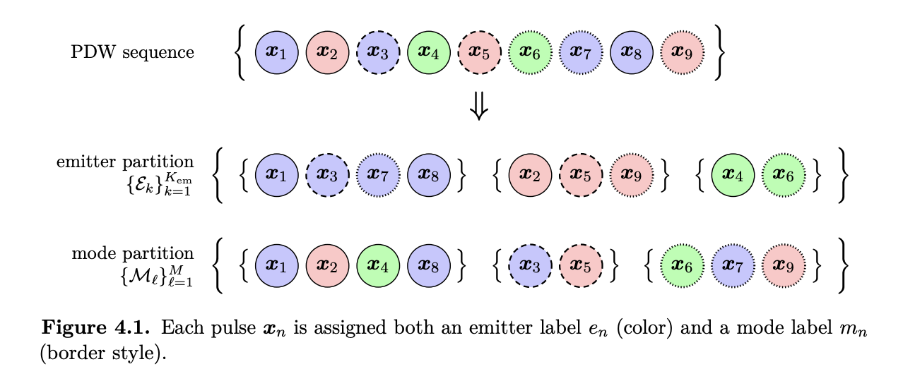
One mixed stream, two partitions
Emitter · deinterleaving
Mode · operating schedule
Physical emitter source
Operating mode
Cluster emitters
Same mode can sit on several emitters. An emitter can switch modes.
Traditional deinterleaving
Inference clusters — no catalogue needed for inference (but needed for training).
Internal briefing · Saab · KTH master's thesis · Markus Johnson Swegmark
4 / 19
Notes:
Classical chain deinterleaves first. We want both partitions from the mixed list. Answers at the end.

Slide 5
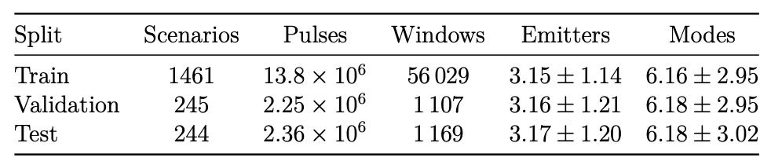
Data
Generate data with the Modesty simulator.
Generate 2000 scenarios, with at most 10 emitters and a mode catalogue of 19 selected modes.
Scenarios are cut into windows of length 2000 to fit the transformer.
Internal briefing · Saab · KTH master's thesis · Markus Johnson Swegmark
5 / 19

Slide 6
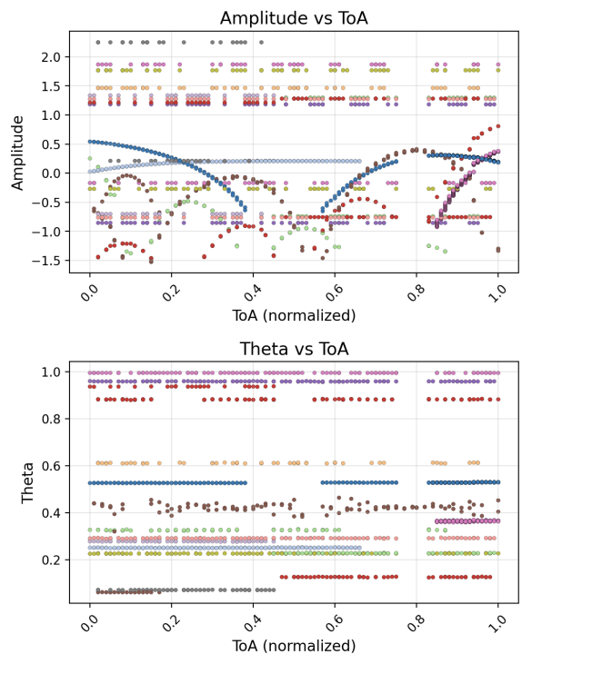
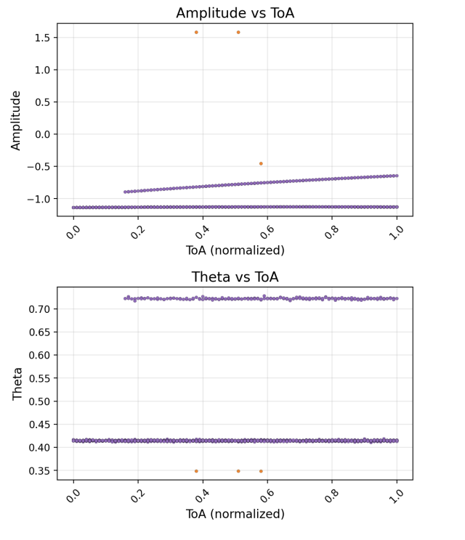
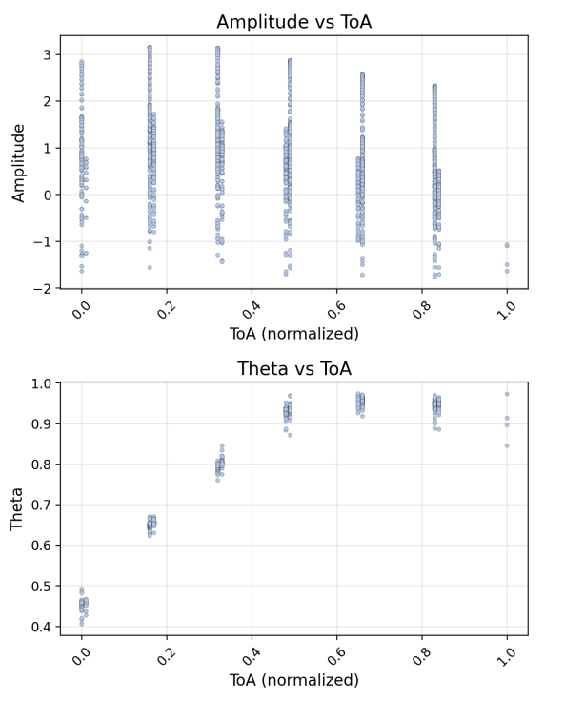
Examples of scenarios
Crowded
Imbalance
Sparse
Internal briefing · Saab · KTH master's thesis · Markus Johnson Swegmark
6 / 19
Notes:
Walk the amplitude panel. Gaps between purple lobes are the rotation.

Slide 7
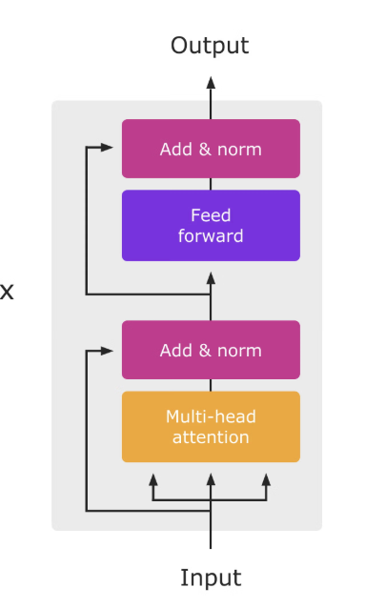
Model architecture
Transformer encoder
Input: L (sequence length) × F (feature dimension)
Output (embeddings): L × D (model dimension, typically 256)
Strengths
Weakness
Generally a strong state of the art model.
O(L^2) in memory and compute
Produces output embeddings
Can’t have to long sequences due to this, need to split up.
Popular: Lot’s of research, proved to be very effective.
Doesn’t inherently account for the order of the input.
Internal briefing · Saab · KTH master's thesis · Markus Johnson Swegmark
7 / 19

Slide 8
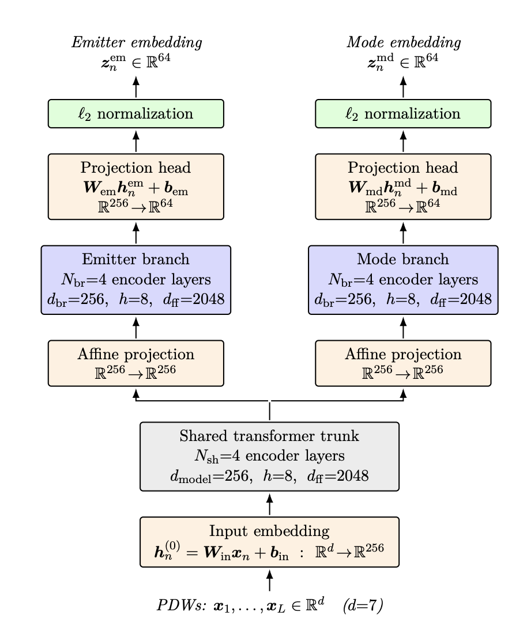
Shared trunk, two heads, two positive sets
Trunk and emitter/mode branch is transformer encoder stacks
Final projection before normalization to decrease dimension, standard practice.
~16 M parameters.
DBScan on the embeddings at inference.
Training doesn't compute DBScan, loss function use embeddings directly.
Internal briefing · Saab · KTH master's thesis · Markus Johnson Swegmark
8 / 19
Notes:
The two similarities can fight in the trunk. Do not claim a Mamba bake-off.

Slide 9
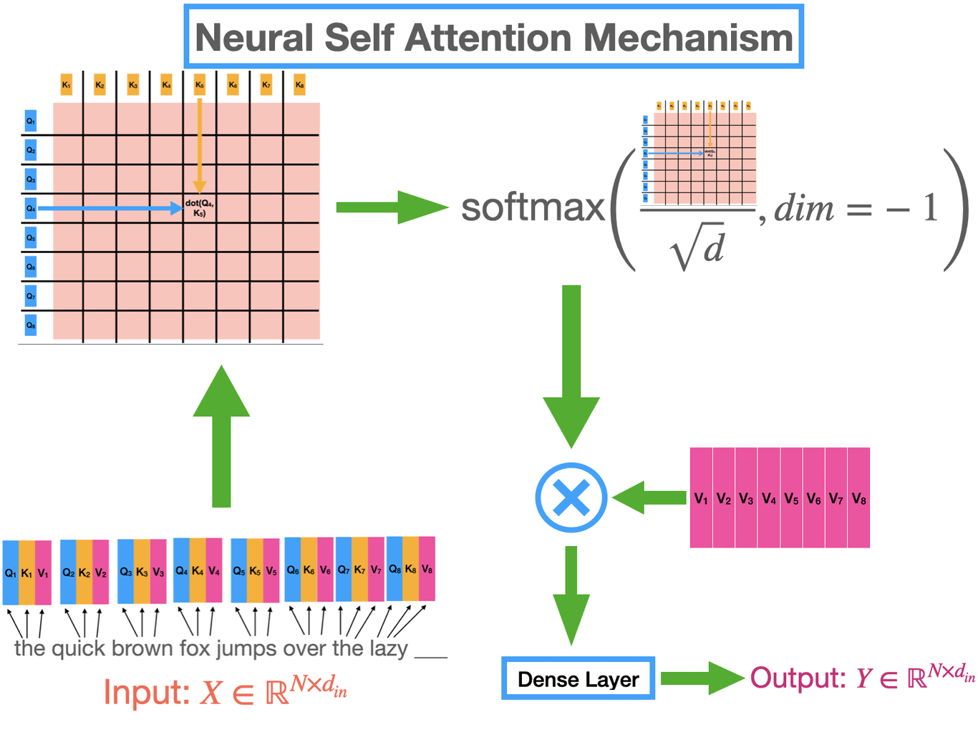
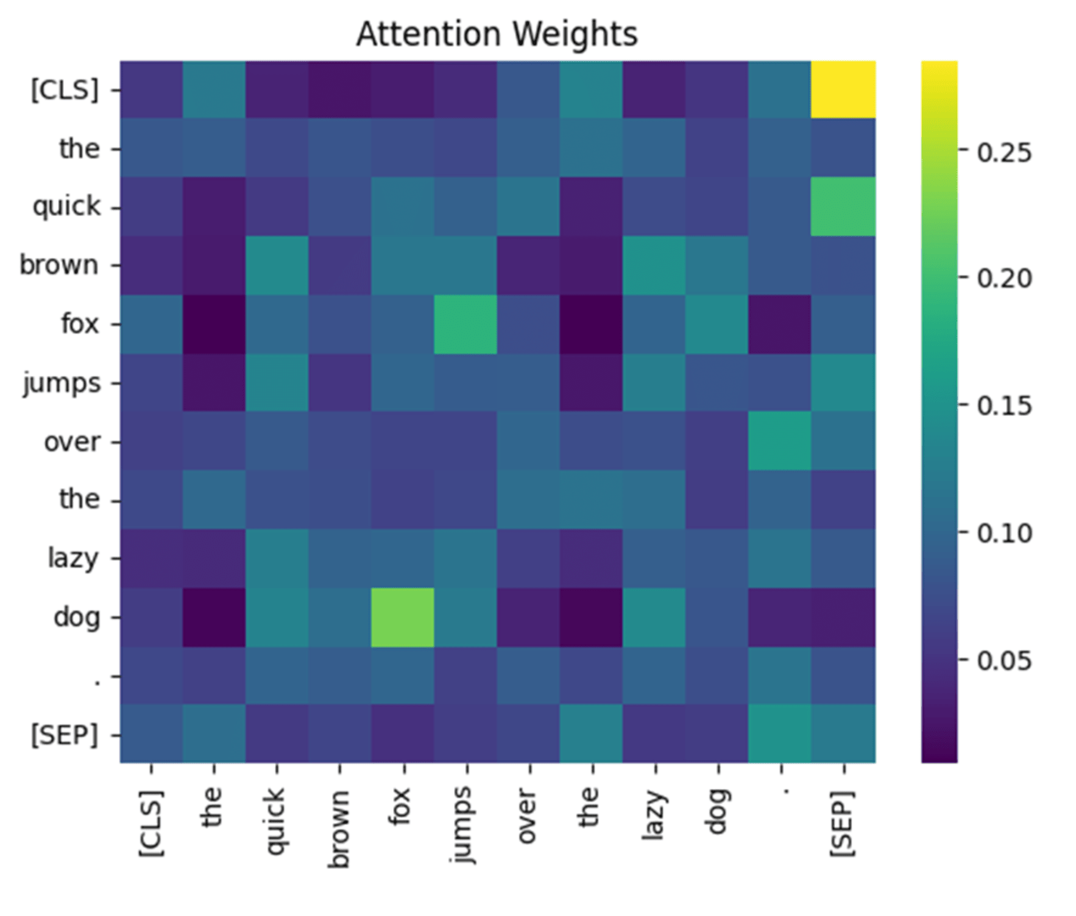
Attention mechanism
Essentially we create a similarity matrix or a fully connected weighted graph
Internal briefing · Saab · KTH master's thesis · Markus Johnson Swegmark
9 / 19
Notes:
Next two slides are the animations. Let them play once.

Slide 10
Two ways to put positional encodings into attention
Rotary positional encodings
Physical bias
Rotate Q and K in the Attention by window-local ToA.
Build B_ij = |p_i − p_j| from ToA and incidence.
The score is a dot product, so the enclosed angle matters.
Scale by learned λ, subtract from the attention matrix A.
Only the relative rotation R(Δt) enters the product.
One λ per head and per stack. So different heads can penalize or reward deltas in different features.
No extra memory required, only approx O(L) compute.
O(L^2) compute and memory, but same as attention stil.
Usually used in LLMs on the absolute position of the input. Here ToA is used instead, since PDWs are not equally spaced.
Not a traditional way to encode time in LLMs due to the L^2 compute and time scaling
Internal briefing · Saab · KTH master's thesis · Markus Johnson Swegmark
10 / 19
Notes:
Next two slides are the animations. Let them play once.

Slide 11

RoPE-TOA · each plane rotates at its own frequency
One head is split into 2D planes.
Each plane rotates at its own frequency.
Shared ToA: both arrows turn together.
This incorporates ToA into the Attention matrix
Internal briefing · Saab · KTH master's thesis · Markus Johnson Swegmark
11 / 19
Notes:
Silent clip. Four 2D planes of one head, left is fastest. Both pulses move together first (co-rotation). Then the key peels away, so only the relative time gap remains, and it twists the fast planes more.

Slide 12
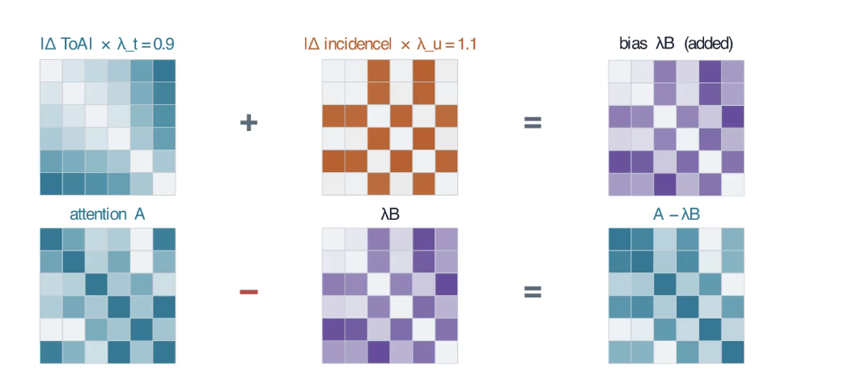
Physical bias · learned λ on delta maps, subtracted from A
|ΔToA| and |Δ incidence| from the inputs.
λ_t, λ_u: learned scalars on ToA and incidence. Unique per head.
Bias λB is subtracted from vanilla A.
Same-direction, nearby pulses stay bright.
Maps are L×L. That is the bill.
Internal briefing · Saab · KTH master's thesis · Markus Johnson Swegmark
12 / 19
Notes:
A cache skips rebuild, not the quadratic subtract. RoPE is the cheap twin.

Slide 13
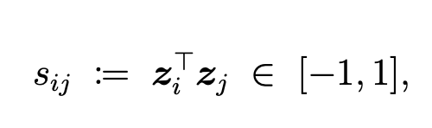
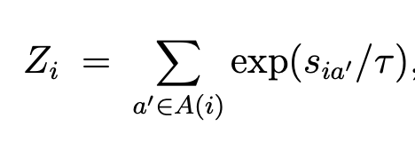
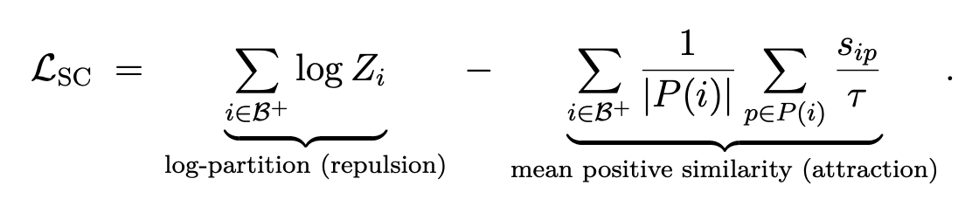
Loss function
Supervised contrastive loss. Embeddings are pushed close if they share a label, and away if they differ.
Internal briefing · Saab · KTH master's thesis · Markus Johnson Swegmark
13 / 19

Slide 14
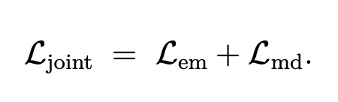
Joint training
Joint training adds two separately computed loss terms: one for emitter ID (deinterleaving) and one for mode clustering.
Task-specific models are also trained with loss from only the emitter or mode branch. That makes the model learn from emitters or modes alone. The other branch is still computed but discarded, which is equivalent to a pure mode or deinterleaving transformer.
Internal briefing · Saab · KTH master's thesis · Markus Johnson Swegmark
14 / 19

Slide 15
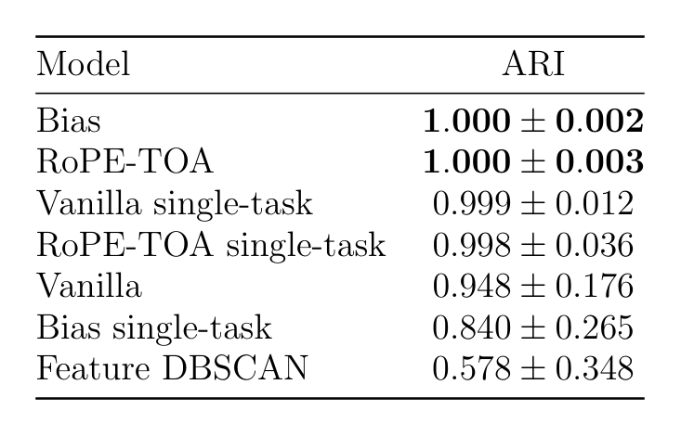
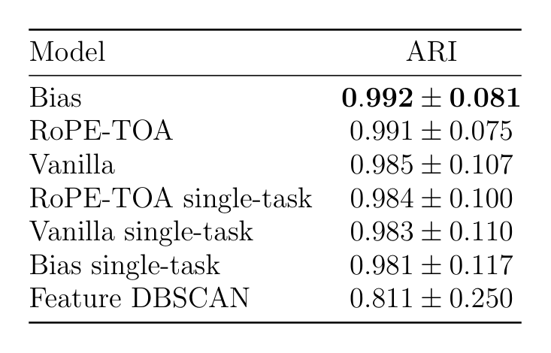
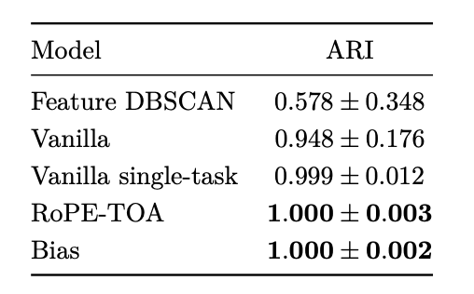
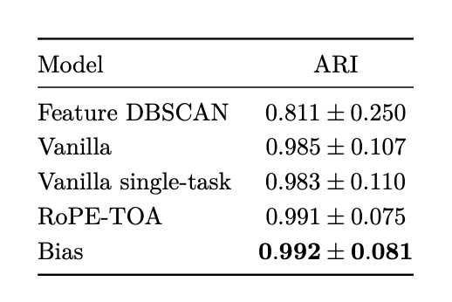
Results: mean ARI ± std over all 1169 test windows
Deinterleaving
Mode clustering
Internal briefing · Saab · KTH master's thesis · Markus Johnson Swegmark
15 / 19

Slide 16
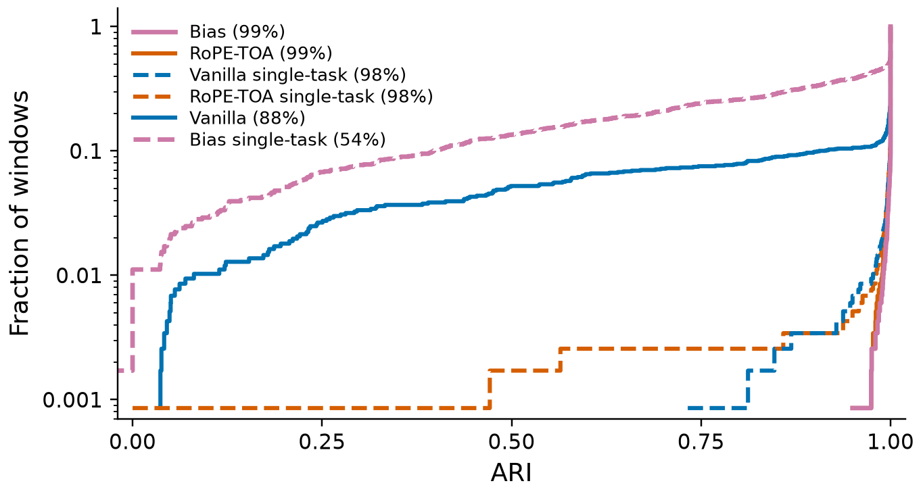
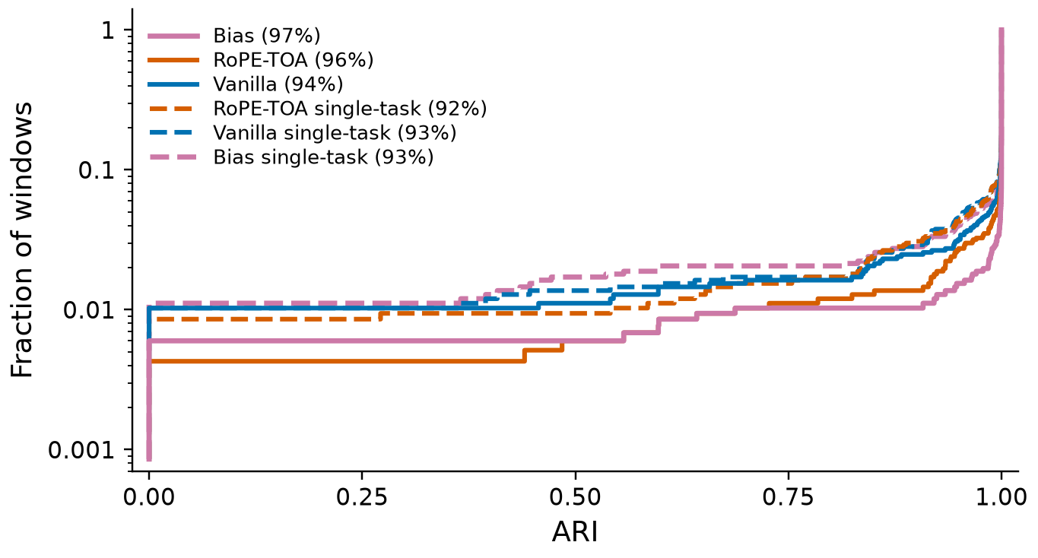
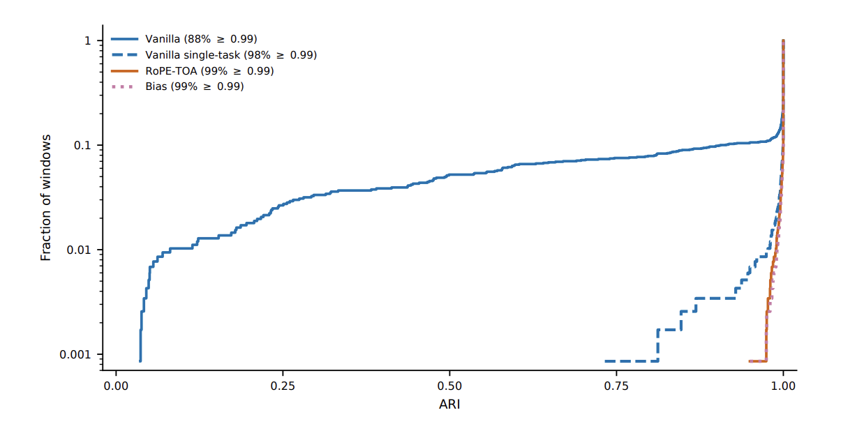
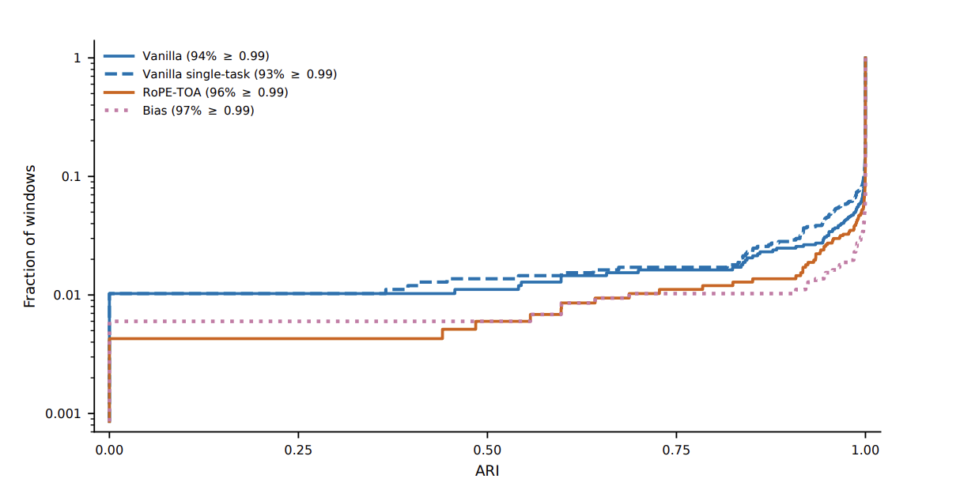
Distribution of scores over windows
Logarithmic y-axis. A curve that stays low until 1 is better. Dashed: single-task. Ordered by ARI.
Deinterleaving
Mode clustering
Internal briefing · Saab · KTH master's thesis · Markus Johnson Swegmark
16 / 19
Notes:
RQ1 is yes, with a leftover deinterleaving tail. Mode is already easier in the raw PDWs.

Slide 17
Conclusion
Deinterleaving
Joint model is weaker than single-task for deinterleaving without modification.
But with RoPE or physical bias they perform on par, even slithgl better.
Mode clustering
Mode clustering the join model actually perform slightly better, but basically on par with the single-task model
Internal briefing · Saab · KTH master's thesis · Markus Johnson Swegmark
17 / 19

Slide 18
Discussion and further work
Windows
We are not processing a whole scenario, only a window of it. Need to “sew” together.
Classification head
A second head
Mode classification head could be added to the outputted encdoings perhaps
Internal briefing · Saab · KTH master's thesis · Markus Johnson Swegmark
18 / 19

Slide 19
Questions?
Internal briefing · Saab · KTH master's thesis · Markus Johnson Swegmark
19 / 19

