Slide 1
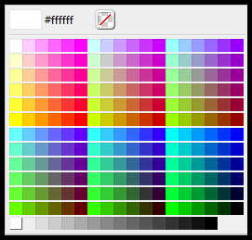

Branding
Color Picker: No Branding
Color Picker: With Branding

