Slide 1

EdiFest
Hack The Burgh V 2019
By Samuel MacLeod, Malavika Venkatesh, Ryan Schuller & Jenny Lin.

Slide 2



Challenge:
Our challenge is to make a creative and innovative application for the perfect Edinburgh Festival experience.
A product that is bizarre, amusing or useless.
A product that is the best financial hack.

Slide 3
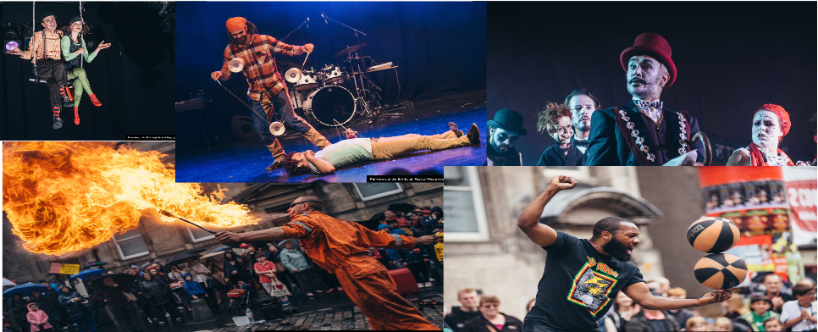
Inspiration:
Finding an easier and faster way of finding events
Replacing Fringe Staff Flyering

Slide 4

Inspiration
Notes:
We inspired Tinder User Interface

Slide 5


What we used:

Slide 6
Features:
Swipe LEFT for not interested events.
Swipe Right for interested events.
Save events that you want to book.
The events are sorted from closest to furthest away depending on the device's location.
Each event also has the price of the ticket, to help them keep track of their financial spending.

Slide 7
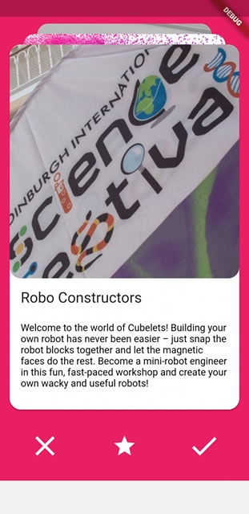
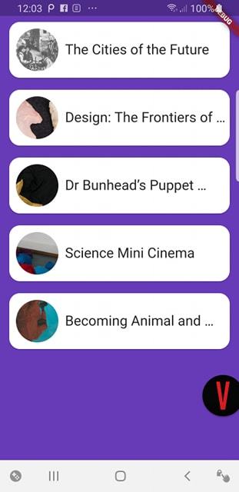
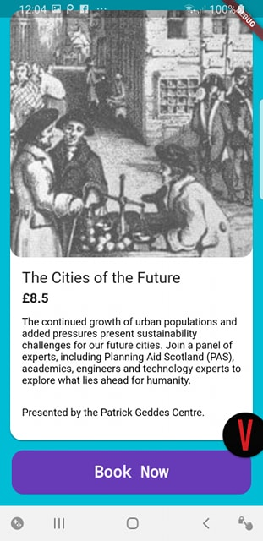
Final Product

Slide 8
Future improvements:
Include Google Maps
Include Google Calendar
Add budgeting, to track the cost of tickets.
Integrate other events from external sources.

Slide 9
Thank you!
Any Questions?

Slide 10
Appendices:
https://api.edinburghfestivalcity.com/documentation
https://cloud.google.com/maps-platform/

