Slide 1


Slide 2
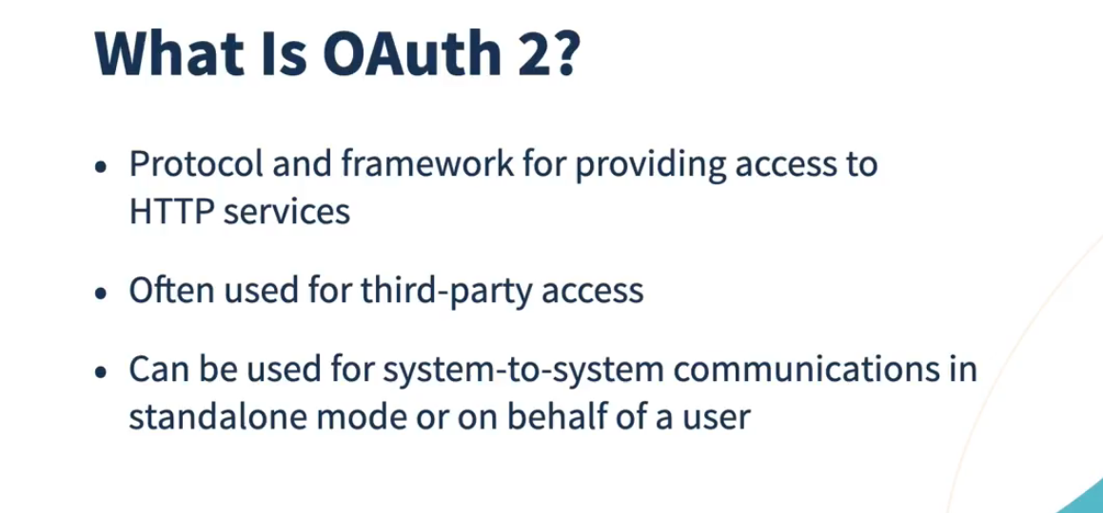

Slide 3
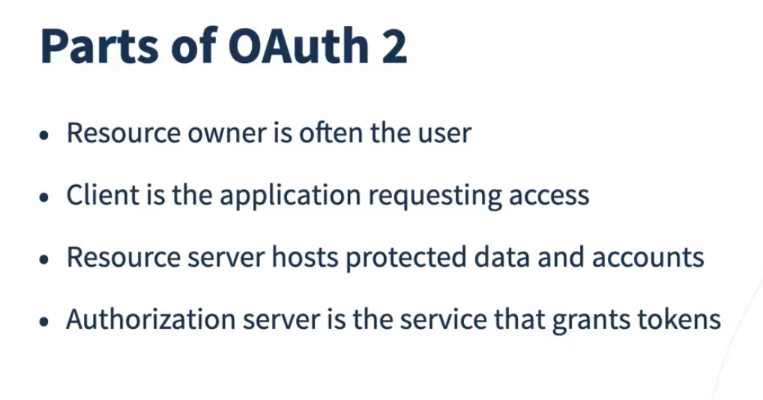

Slide 4
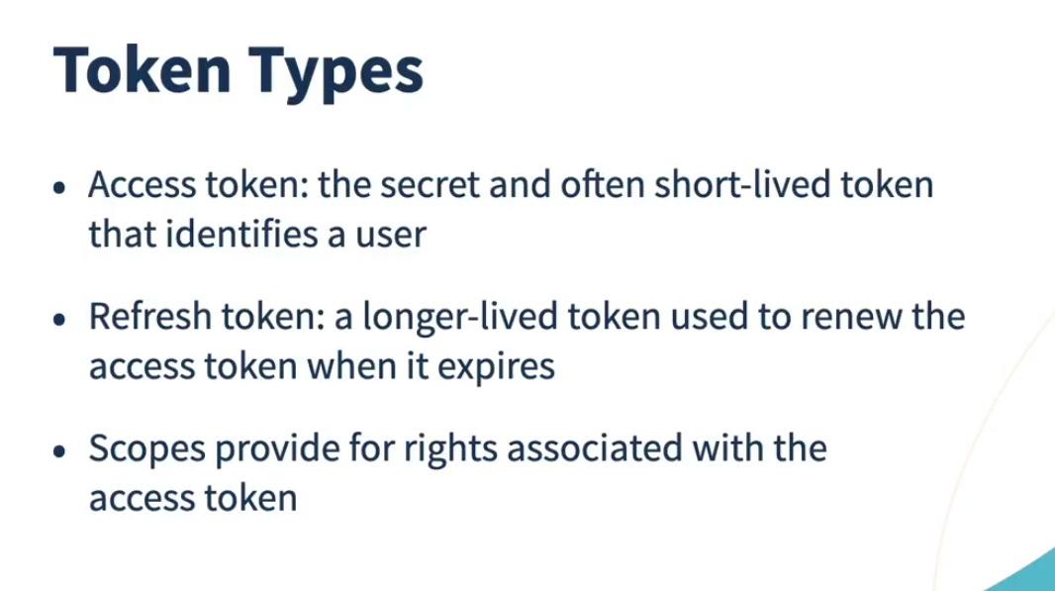

Slide 6
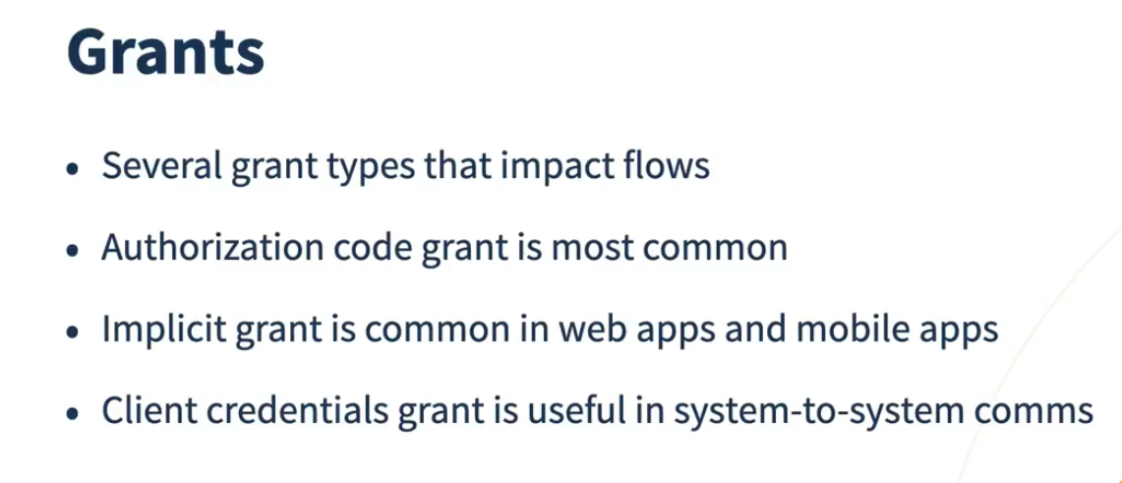

Slide 7


Slide 8
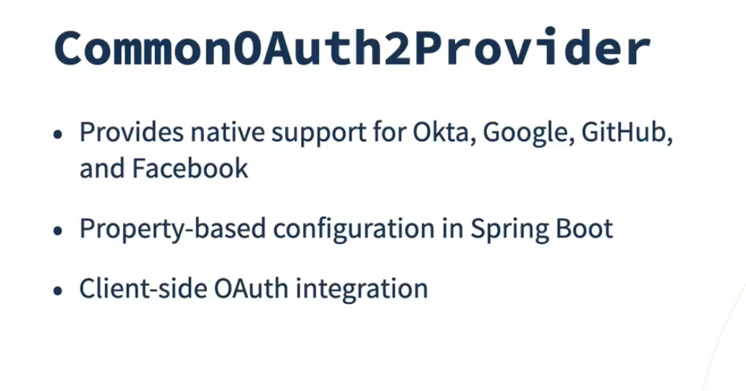

Slide 9
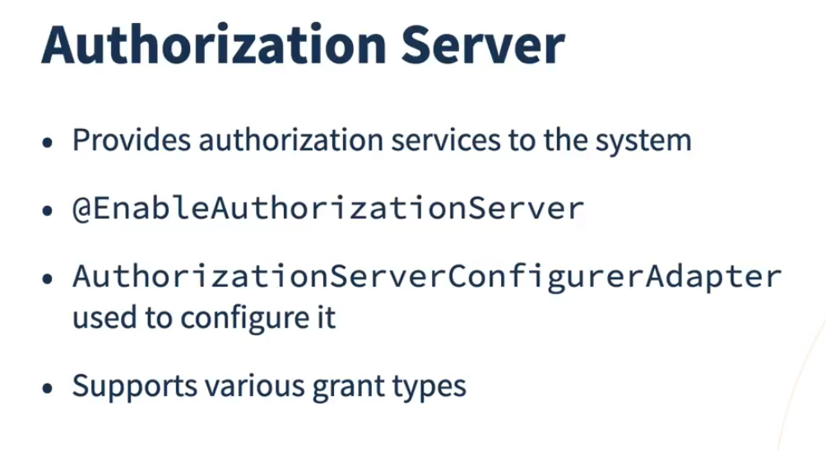

Slide 10
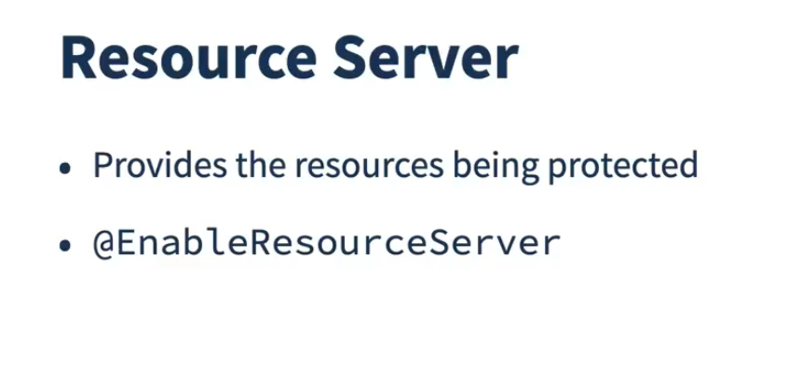

Slide 11
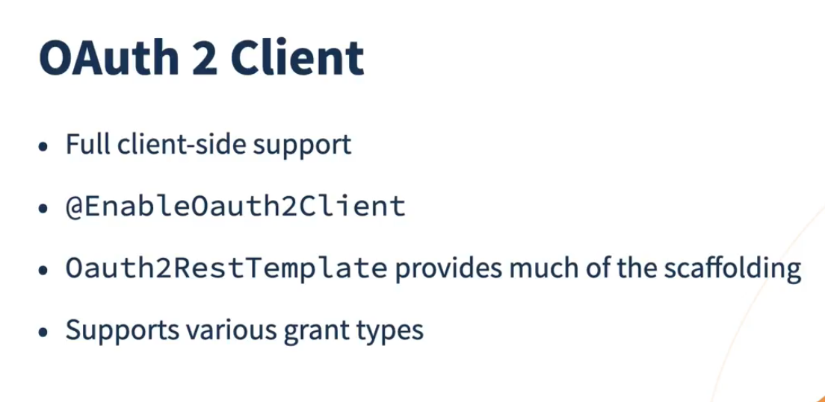

Slide 12


Slide 13
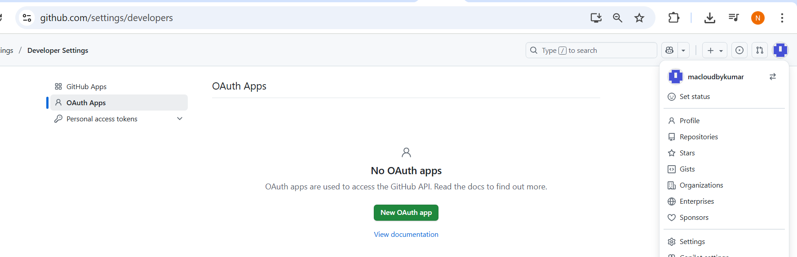

Slide 14
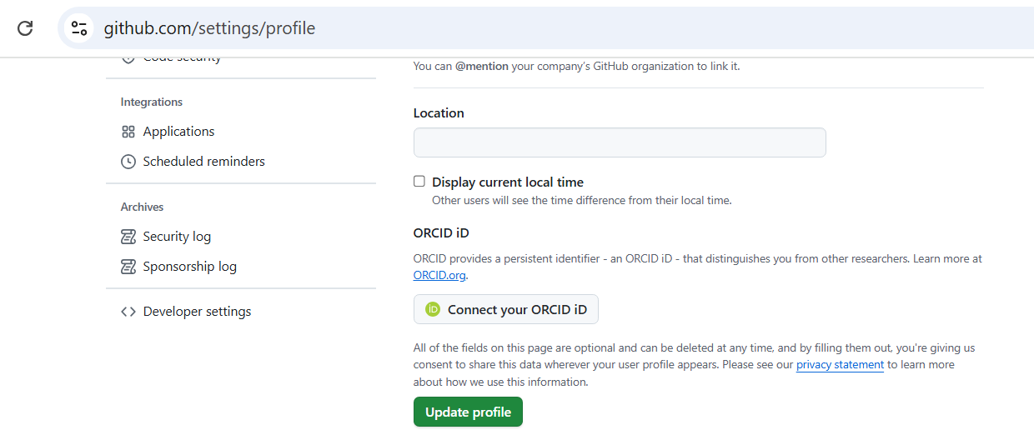

Slide 15
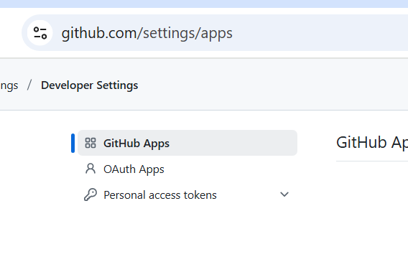

Slide 16
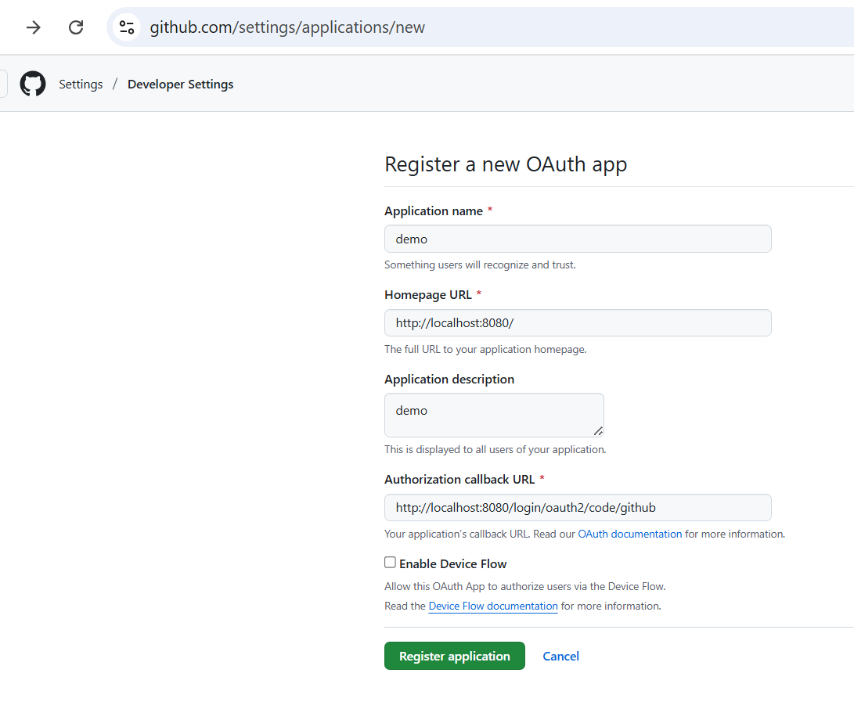

Slide 17
spring.application.name=oauth2-demo
server.port=8080
# GitHub OAuth2 Configuration
spring.security.oauth2.client.registration.github.client-name=GitHub
spring.security.oauth2.client.registration.github.client-id=Ov23liwN3l8
spring.security.oauth2.client.registration.github.client-secret=782147ad931a61e6724b4b25ffb
Notes:
C:\AWS-DevOPS\VP\All Courses\Microservices - Cloud Native\Demos\OAuthDemo\spring-6-spring-security-5985041-04_03b\spring-boot-oauth2-client

Slide 18
Notes:
C:\AWS-DevOPS\VP\All Courses\Microservices - Cloud Native\Demos\OAuthDemo\spring-6-spring-security-5985041-04_03b\spring-boot-oauth2-client

Slide 19
▶️ Run & Test
Register a new OAuth App at GitHub Developer Settings.
Homepage URL: http://localhost:8080
Authorization callback URL: http://localhost:8080/login/oauth2/code/github
Start the app:
mvn spring-boot:run
Open in browser:
http://localhost:8080
Click “Login with GitHub” → authorize → you’ll see your name and username.
Open the browser in incognito mode

