Slide 1
Spring Integration
Introduction to Spring Integration

Slide 2
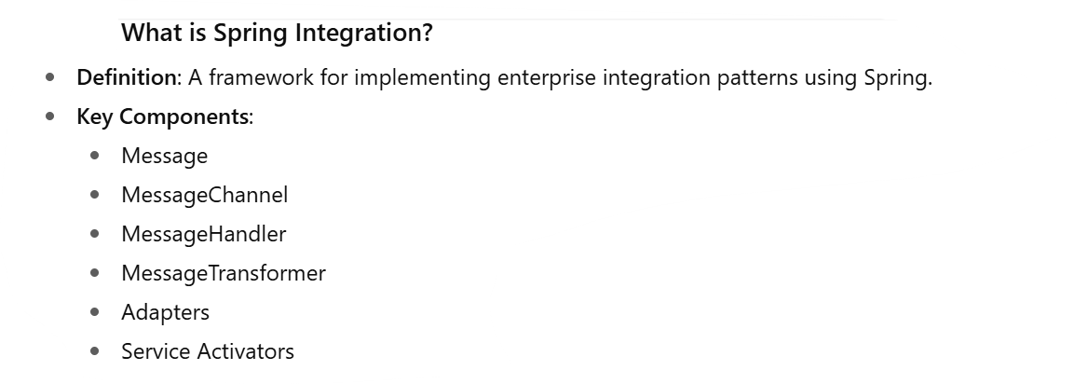

Slide 3
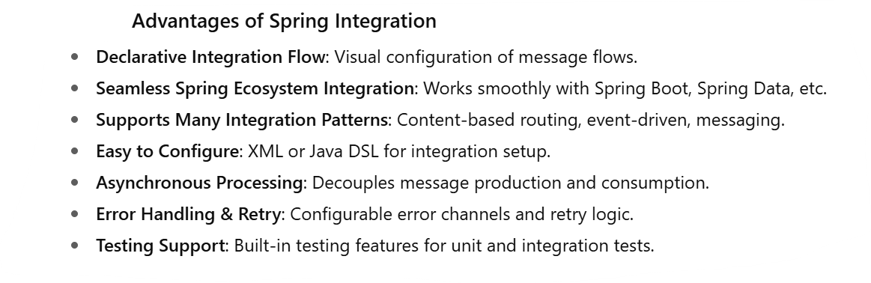

Slide 4
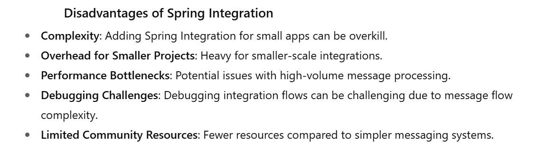

Slide 5
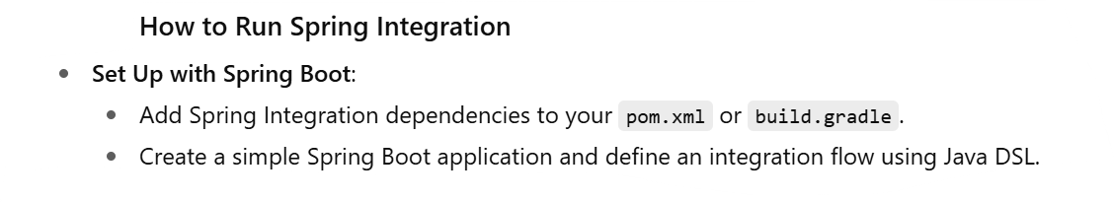

Slide 6
Demo Time
C:\AWS-DevOPS\VP\All Courses\Microservices - Cloud Native\Demos\spring-integration-demo
Notes:
C:\AWS-DevOPS\VP\All Courses\Microservices - Cloud Native\Demos\spring-integration-demo

