Slide 1
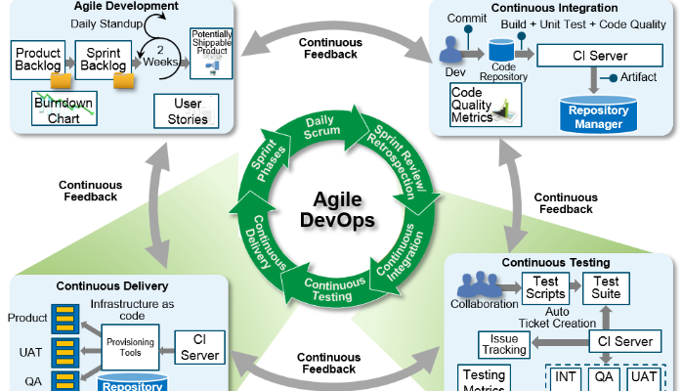

Slide 2
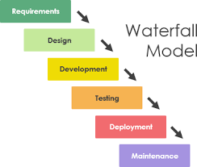

Slide 3
System and software requirements: captured in a product requirements document
Analysis: resulting in models, schema, and business rules
Design: resulting in the software architecture
Coding: the development, proving, and integration of software
Testing: the systematic discovery and debugging of defects
Operations: the installation, migration, support, and maintenance of complete systems

Slide 4
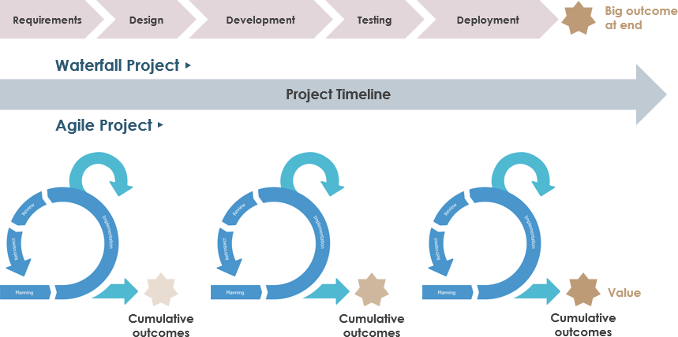

Slide 5
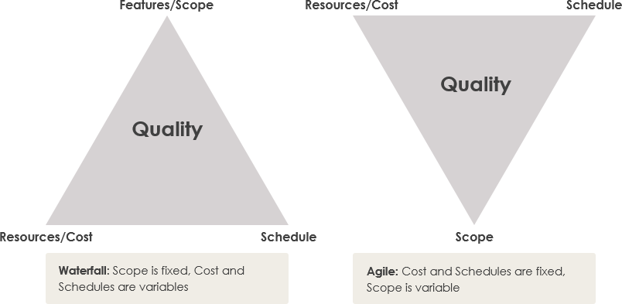

Slide 6
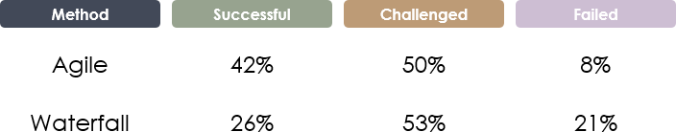

Slide 7
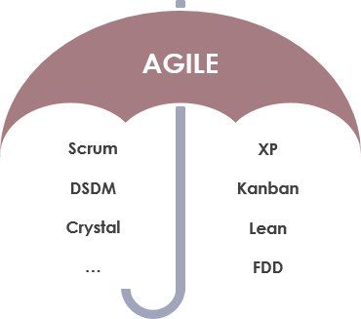

Slide 8
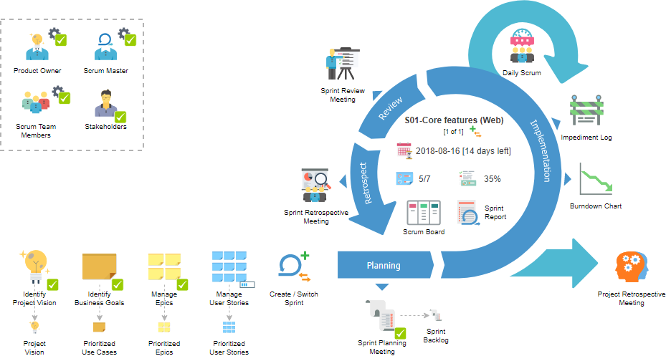

Slide 9
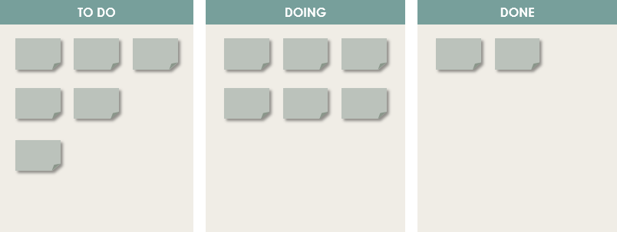

Slide 10
Kanban Approach There are four fundamental Kanban principles:
Visualize work to increase communication and collaboration.
Limit work in progress to avoid an endless chain of non-prioritized open tasks.
Measure and optimize the flow, collect metrics, predict future problems.
Aim for continuous improvement as the result of analysis.
Notes:
https://www.visual-paradigm.com/scrum/scrum-vs-waterfall-vs-agile-vs-lean-vs-kanban/

