Slide 1
Web apps development 101 Intro
Marek Czarnecki
https://github.com/macmarek/webdev101

Slide 2
Agenda
How Internet works
HTML
CSS
JS
Building app
Lunch 12.00 – 13.00 ?

Slide 3
What is web application ?
Application that can be accessed using web browser

Slide 4
Why start with web apps ?
It’s fun
It’s motivating (you quickly get visual are rewadring effects)
It’s easy to get started (but not so easy to master☺)
It’s easy to get the job

Slide 5



How do I start ?

Slide 6
What we will build ?
Demo

Slide 7
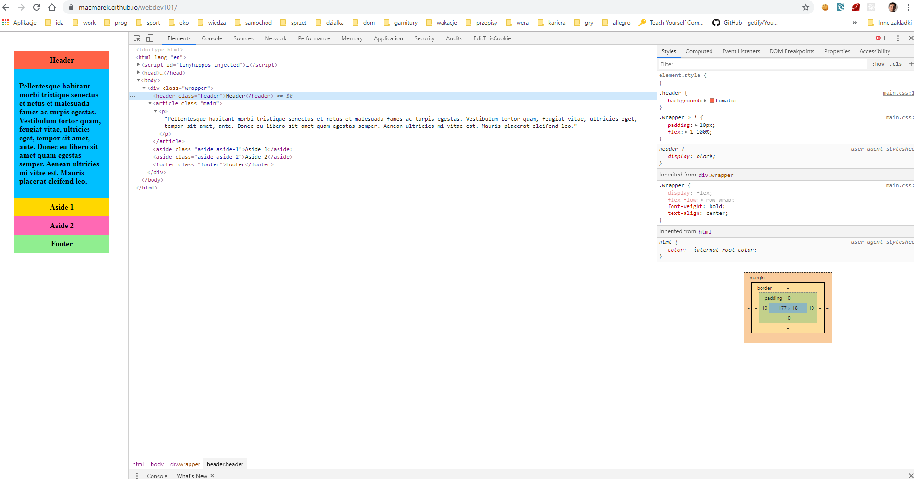
Tools

Slide 8
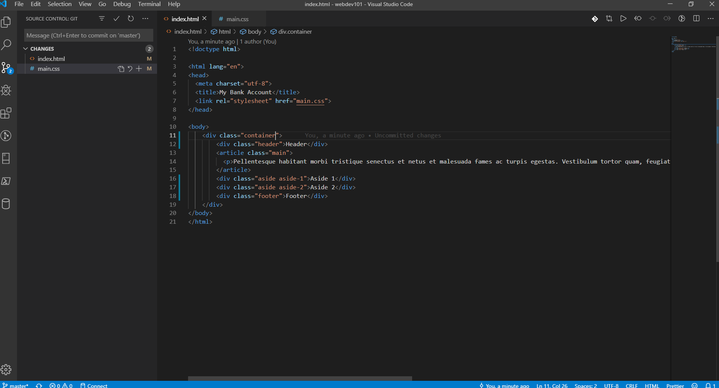
Tools

