Slide 1

Web apps development 101 HTML
Marek Czarnecki
https://github.com/macmarek/webdev101

Slide 2
What is HTML?
Hyper Text Markup Language
It’s NOT a programming language
Markup language for creating web pages/documents
Building block of the Web
Notes:
Just presentational
No logic
Examples of programming languages: js, java, python, c#
Every web app returns HTML
Pokazac
https://en.wikipedia.org/wiki/HTML
historia

Slide 3
How it works?
Web browsers receive HTML documents from a web server and render the documents into multimedia web pages. HTML describes the structure of a web page semantically.
HTML elements are the building blocks of HTML pages. With HTML constructs, images and other objects such as interactive forms may be embedded into the rendered page. HTML provides a means to create structured documents by denoting structural semantics for text such as headings, paragraphs, lists, links, quotes and other items.

Slide 4
How to start?
Web browser
Editor
Extension must be set to .html
Index.html
https://macmarek.github.io/webdev101/ -> index.html
https://macmarek.github.io/webdev101/about.html ->about.html
Notes:
Domyslna nazwa index.html

Slide 5
Tag syntax
<tagname>content</tagname>
<h1> This is title </h1>
<p> This is simple paragraph </p>
<br /> (line break)
<hr />
Element names surrounded by angle brackets
Opening tag should have corresponding closing tag
Some tags can be self closed

Slide 6
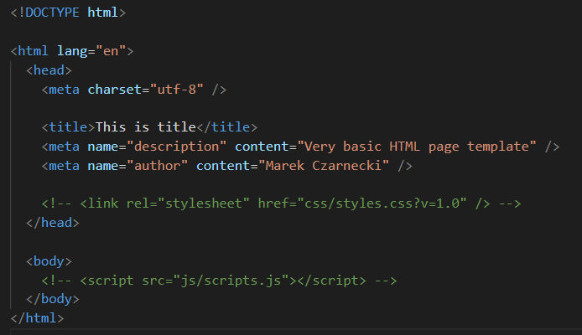
Basic HTML template
Notes:
Demo
https://github.com/macmarek/webdev101/tree/master/basic%20html
Stworzyc prosta stronke
Pokazac chrome tools
Dodac wszystkie headery i paragraf
Doctype – just declaration for HTML 5
There can be other doctypes

Slide 7
Inline vs block level elements
Inline elements
Do not start on new line
Take only necessary witdh
Block elements:
Start on new line
Take full width available
<span>, <img>, <a>,
<strong>, <em>
<div>, <h1>-<h6>, <form>
Notes:
Demo: dodac inline tagi
<strong>, <em>
<a> - pokazac z href może być lokalny ./about.html albo absolutny „http://gogle.pl”

Slide 8
Attributes
<tagname attributename= "attributevalue„>content</tagname>
<div title="some title">some text</div>
All tags can have attributes
Key/value pairs
Notes:
Doublre quotes or signel quotes – suggested double quotes
DEMO
H1-h6
P
Strong
Em
Ul
Ol
Table
Forms
Img
Blockquote
abbr

Slide 9
HTML semantic tags
<header>
<footer>
<aside>
<main>
<article>
<nav>
<section>
<details>
Notes:
Before everything was a div
DEMO: cw 1-sze stworzyć szablon strony

