Slide 1

Web apps development 101 CSS
Marek Czarnecki
https://github.com/macmarek/webdev101

Slide 2
What is CSS ?
Cascading Stylesheets
NOT a programmign language
Styling language
Used for websites layout and design

Slide 3
How it works
The browser loads the HTML (e.g. receives it from the network).
It converts the HTML into a DOM (Document Object Model). The DOM represents the document in the computer's memory.
The browser then fetches most of the resources that are linked to by the HTML document, such as embedded images and videos ... and linked CSS
The browser parses the fetched CSS, and sorts the different rules by their selector types into different "buckets", e.g. element, class, ID, and so on. Based on the selectors it finds, it works out which rules should be applied to which nodes in the DOM, and attaches style to them as required (this intermediate step is called a render tree).
The render tree is laid out in the structure it should appear in after the rules have been applied to it.
The visual display of the page is shown on the screen (this stage is called painting).

Slide 4
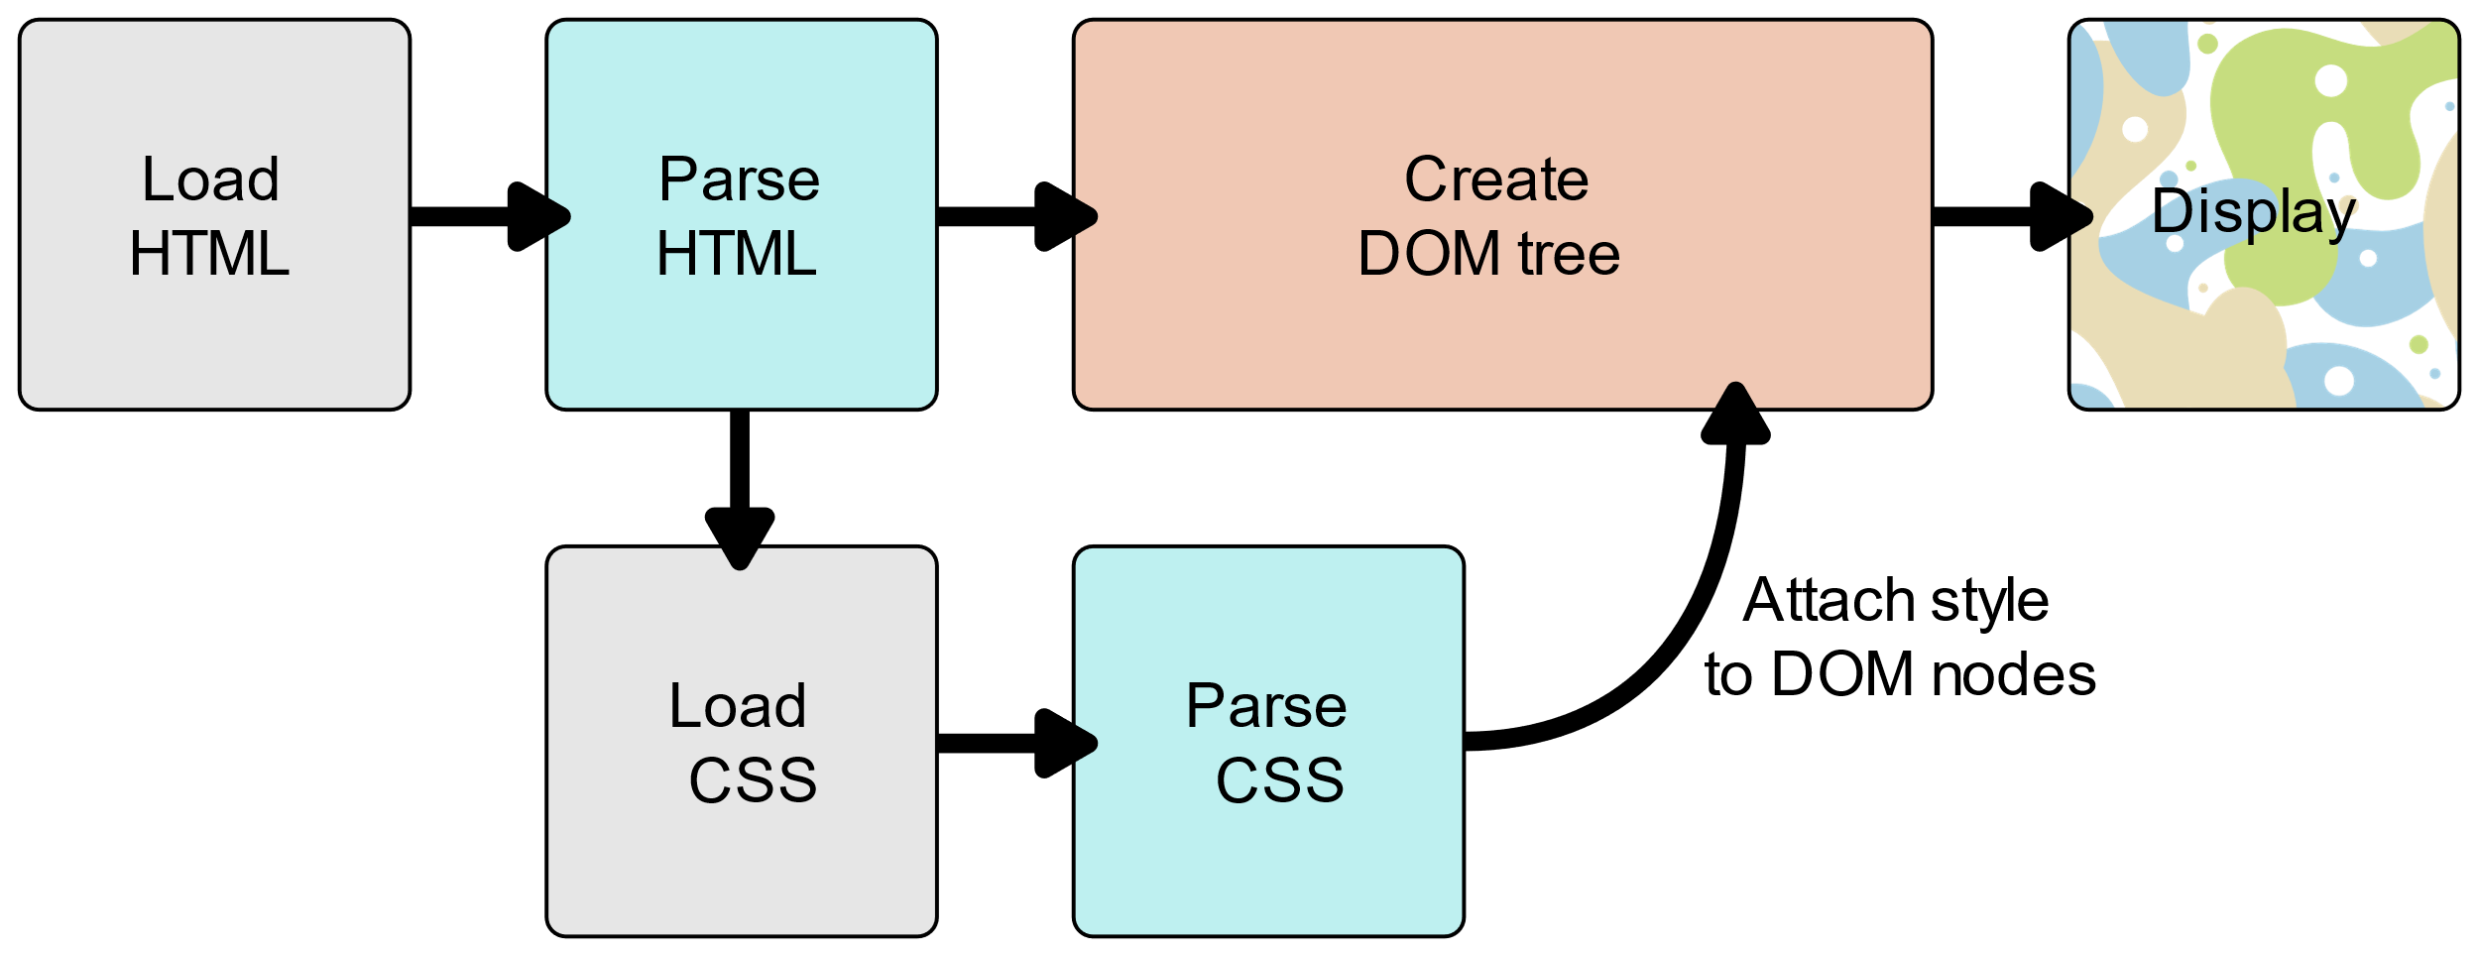
How it works

Slide 5
3 methods for adding CSS
Inline CSS (bad practice)
Internal CSS (<stryle> tags inside a HTML document)
External CSS (linking external .css file)

Slide 6
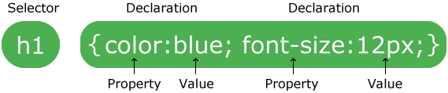
CSS Selectors

Slide 7
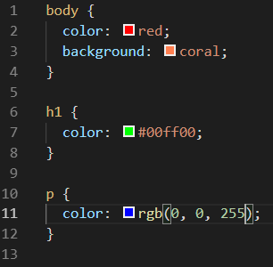
Colors in CSS
Color names
HTML5 color names
Hexadecimal
RGB

Slide 8
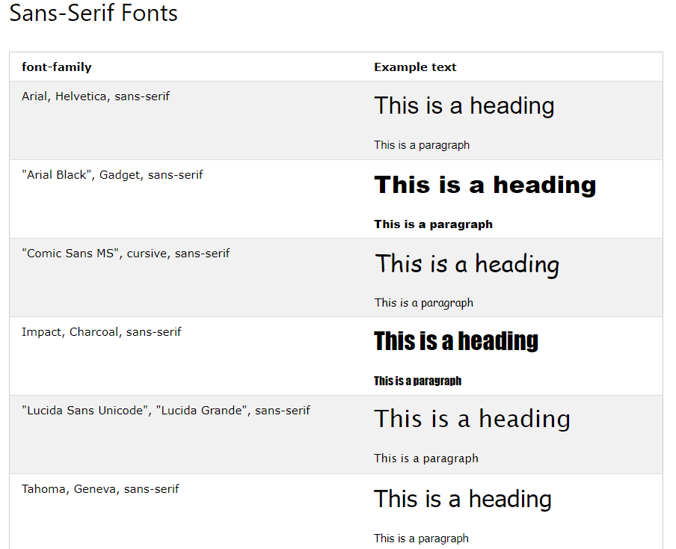

Web safe fonts

Slide 9
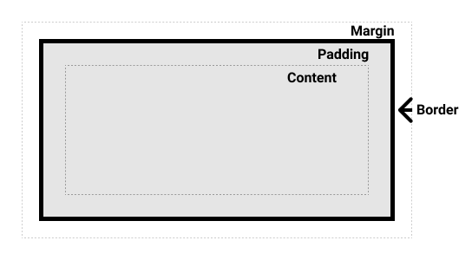
Box Model

Slide 10
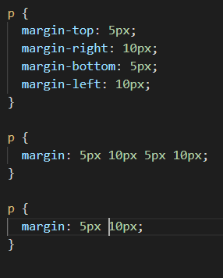
Margin and padding shorthand

Slide 11
Positioning in CSS
Static
Relative
Absolute
Fixed
Sticky

