Slide 2
Iloeje
Conservative
Conservative

Slide 3
Nwike
Optimistic
Conservative

Slide 4
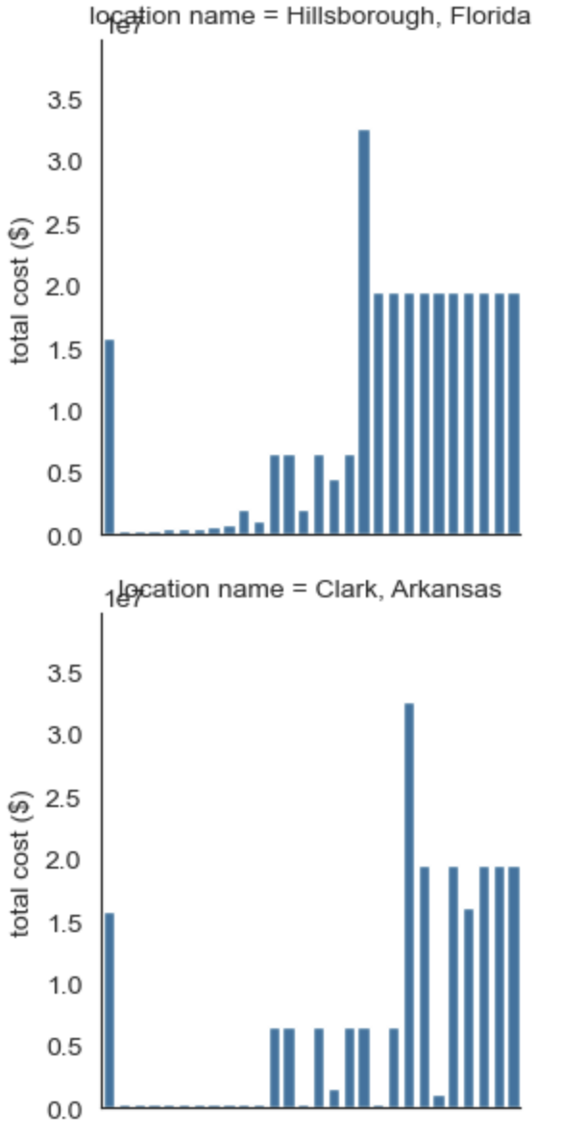
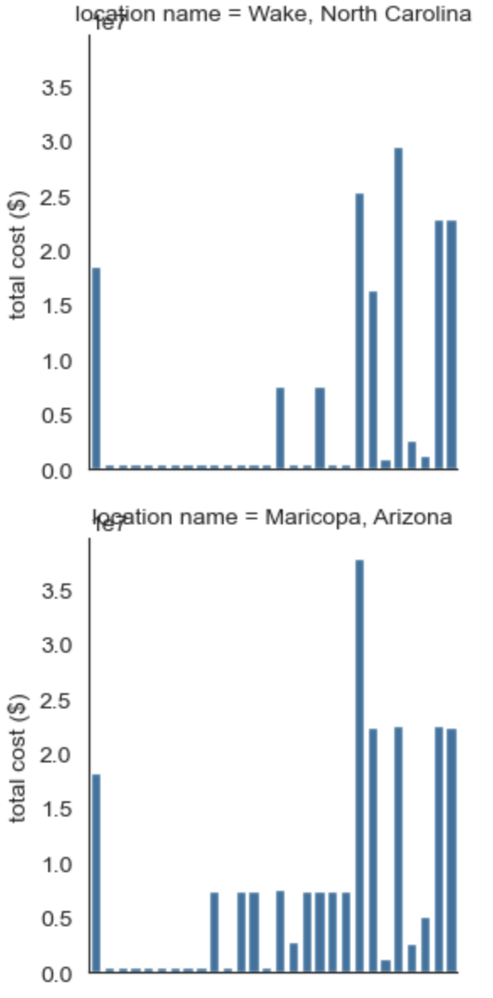
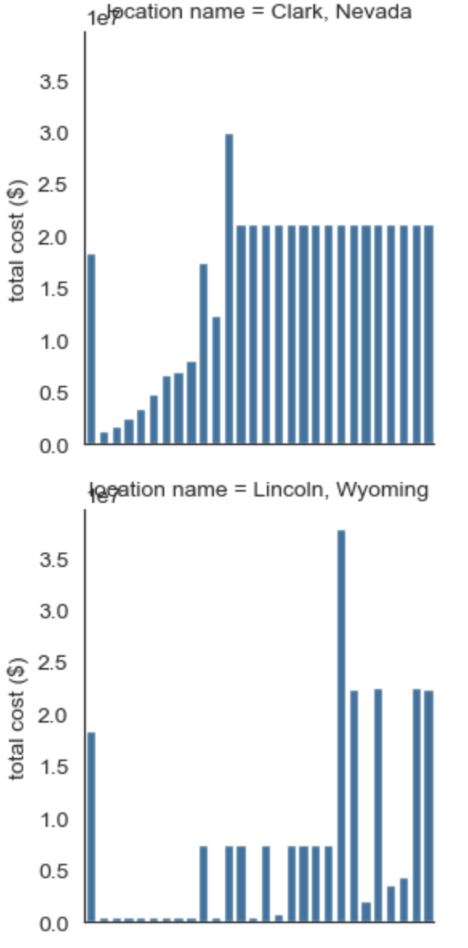
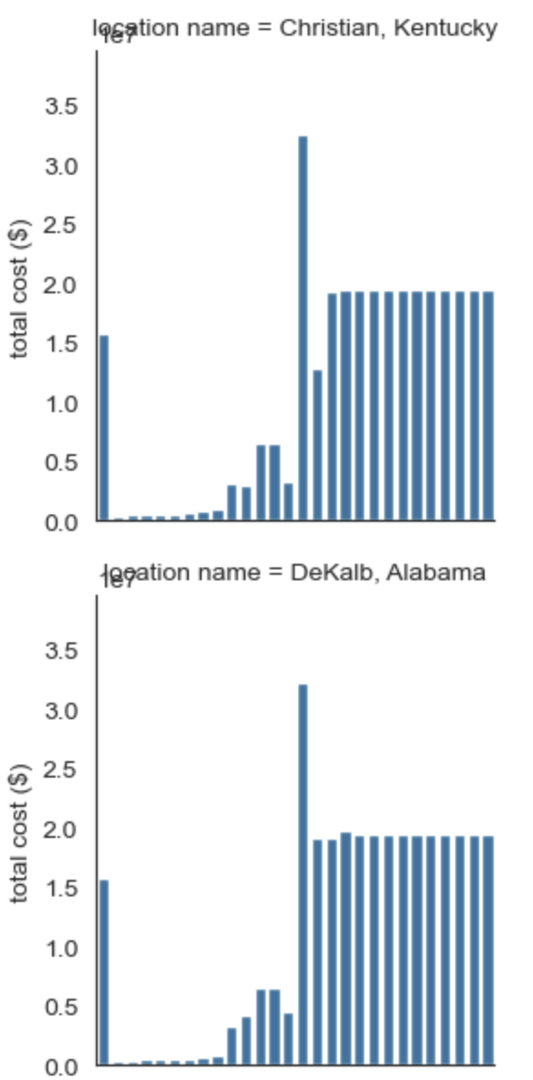
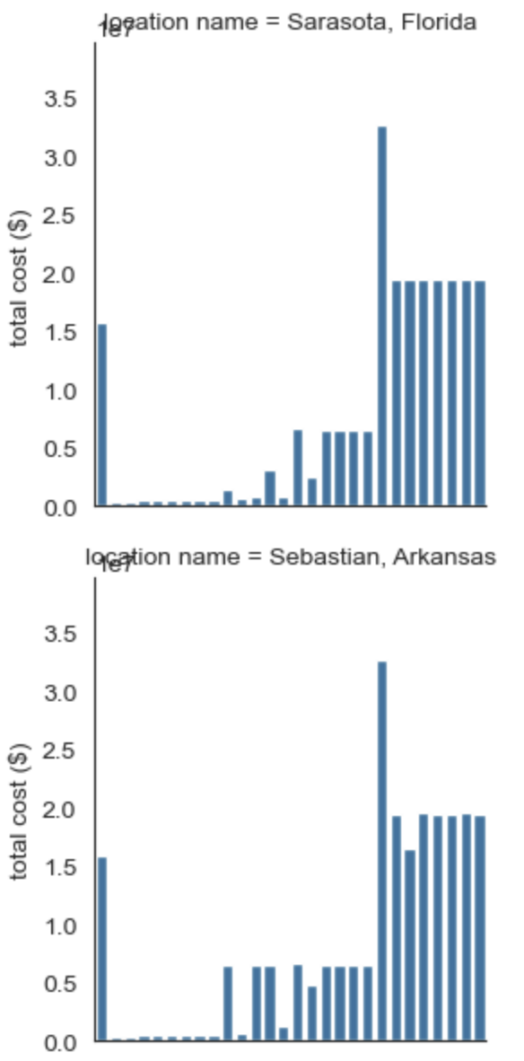
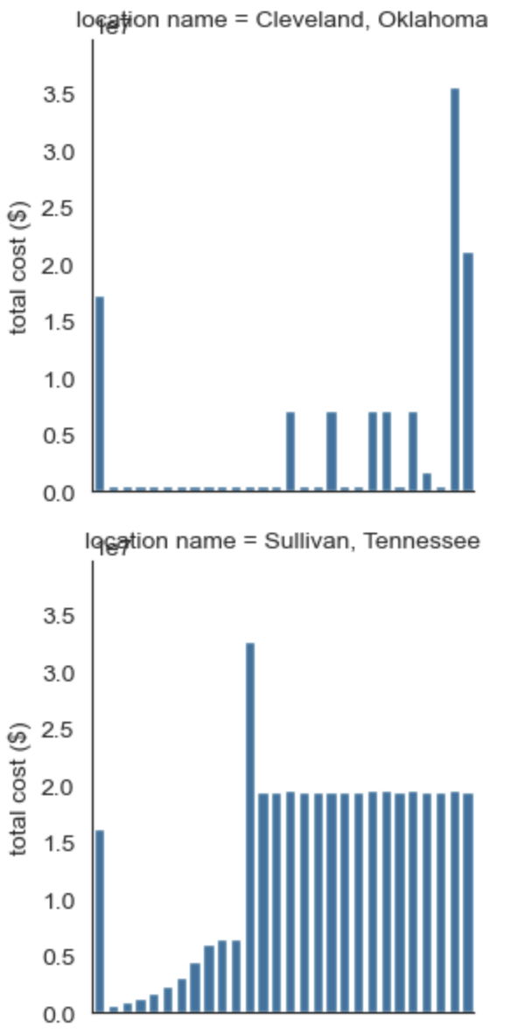
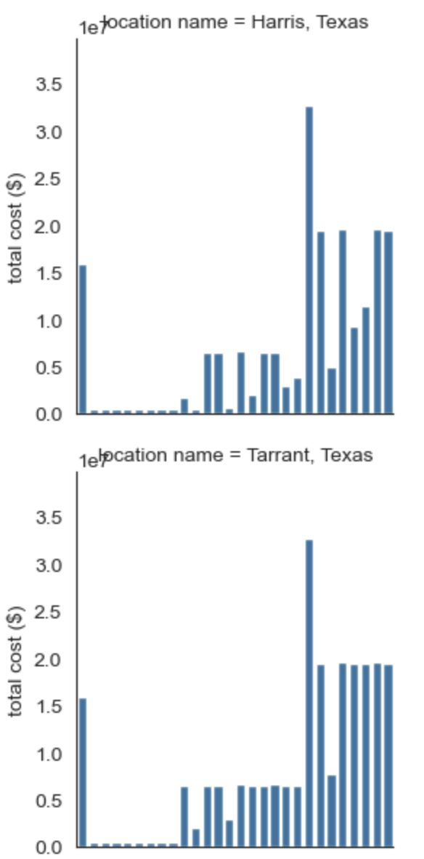
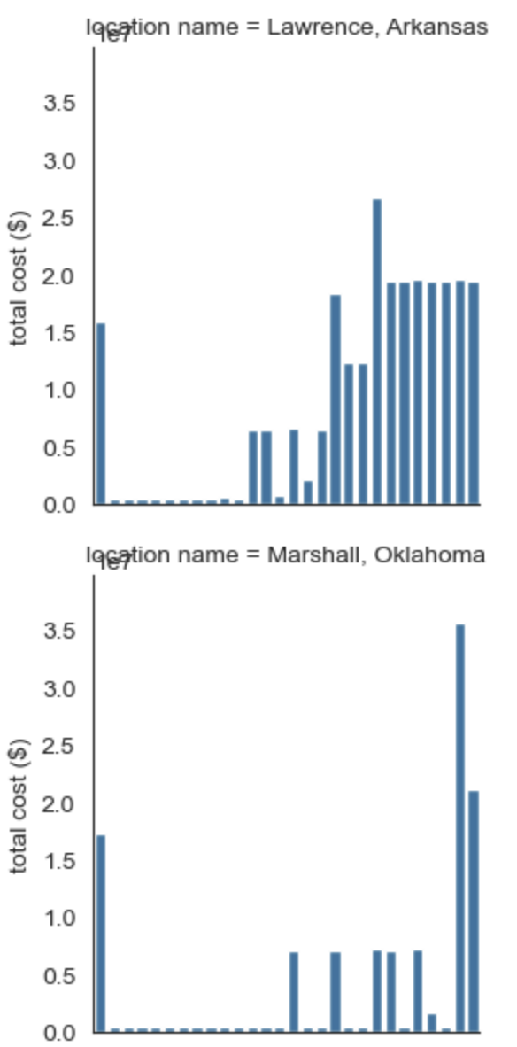
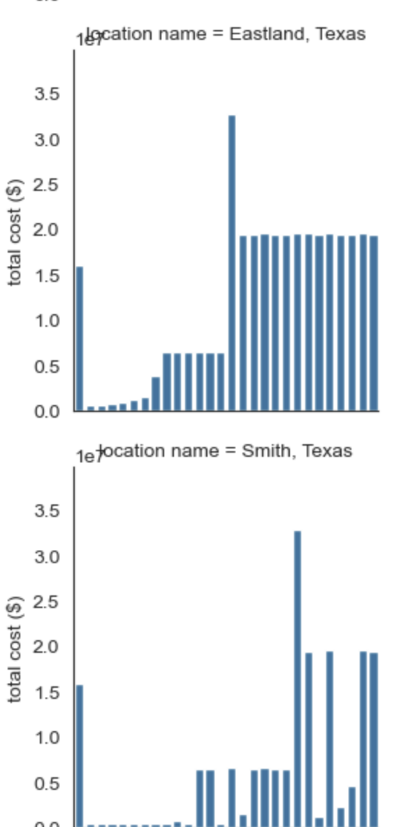
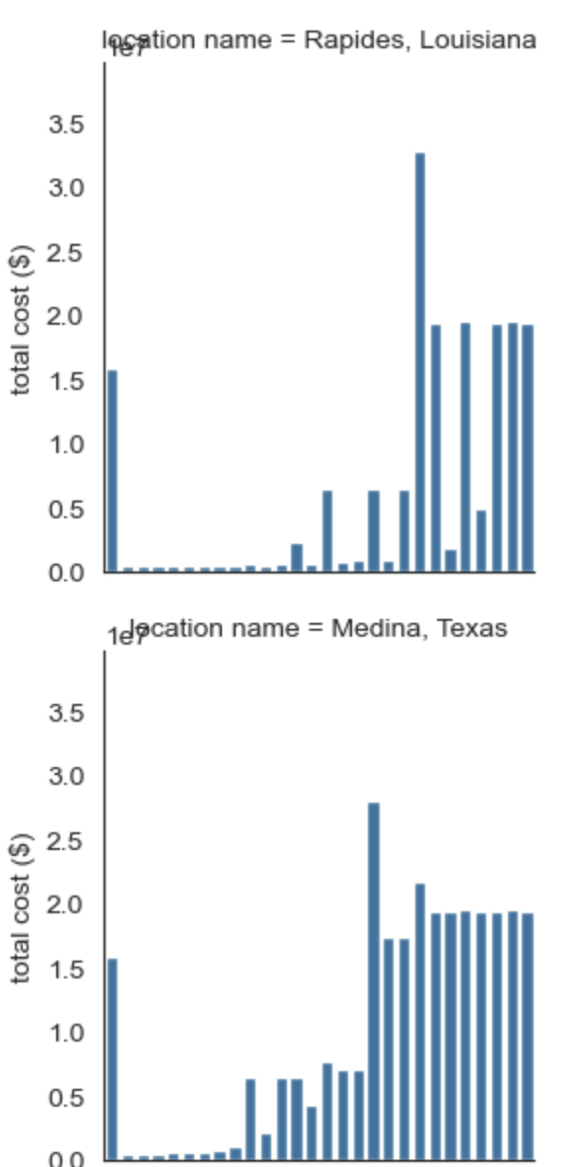
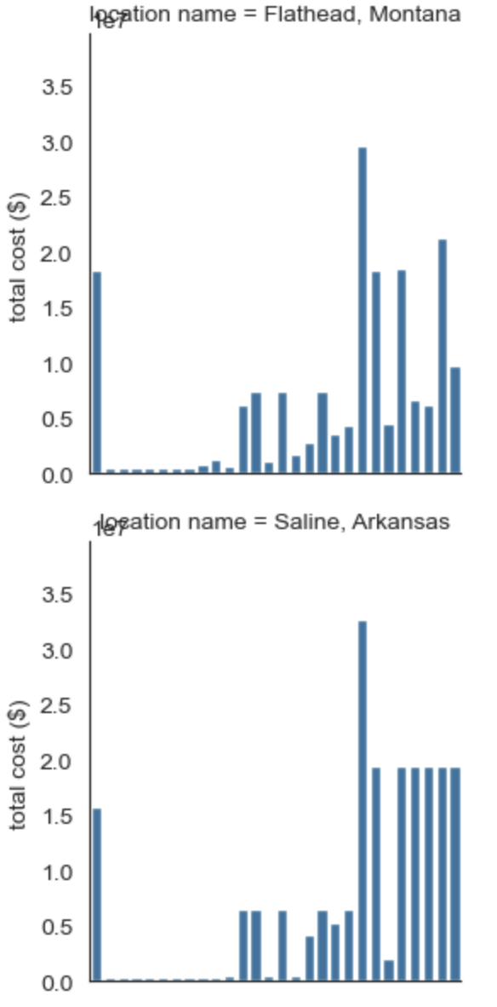
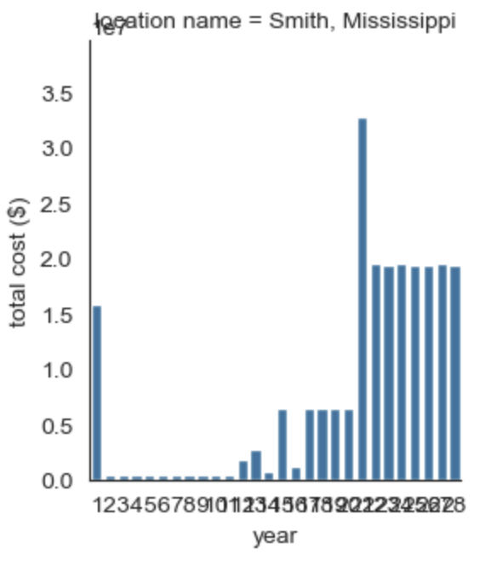
Ours

Slide 6
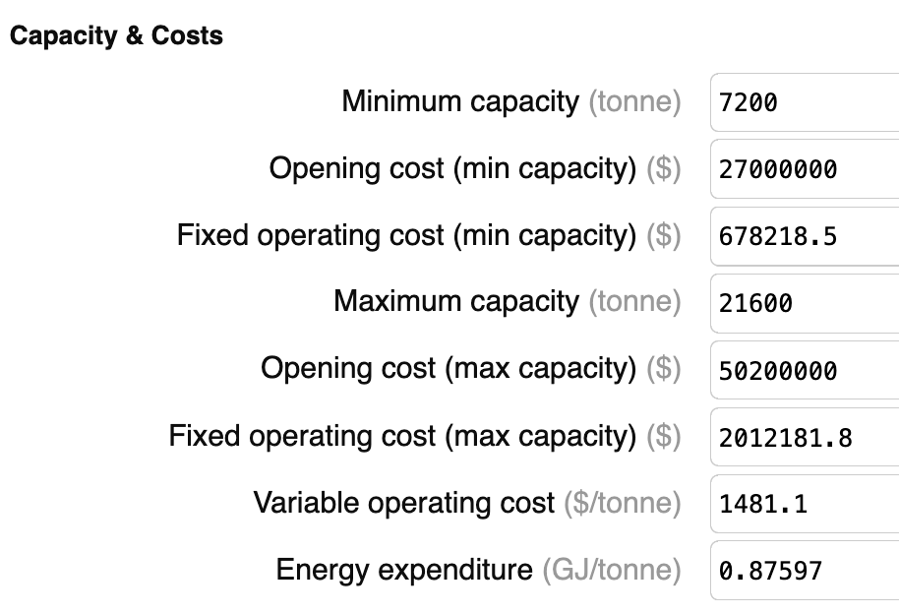
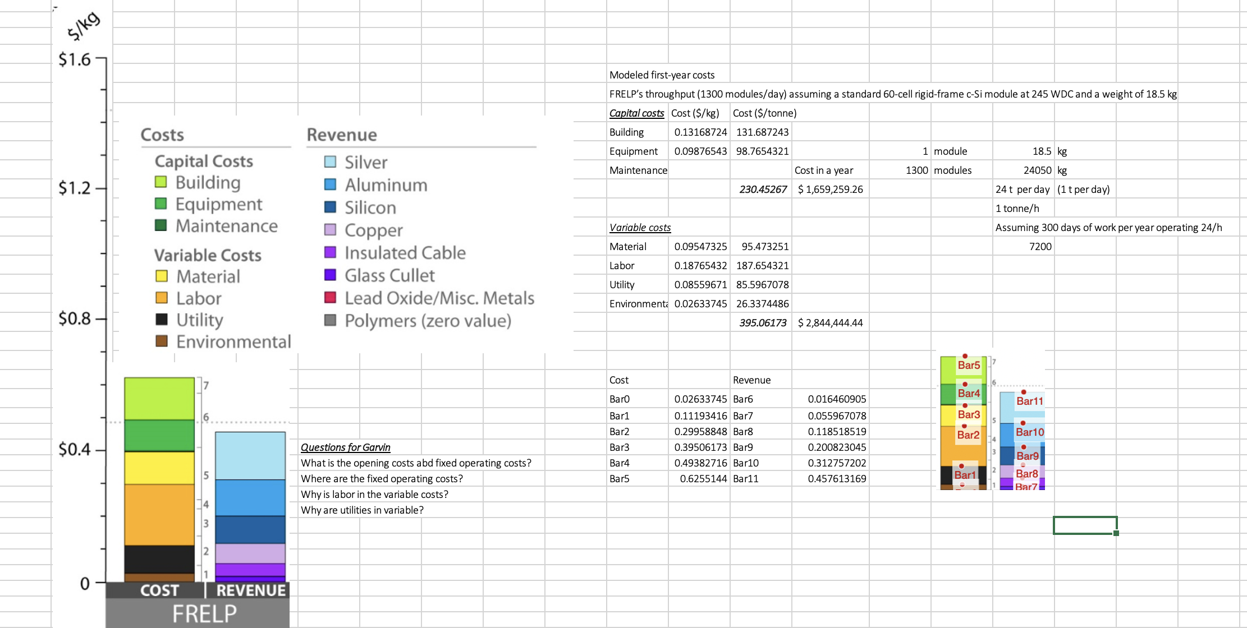
Costs
For a plant that treats 1 t/h, that’s 7200 t/year (assuming 300 working days)
From: Supplementary Materials_FRELP_cost_ewastepaper, page 12
For a plant that treats 3 t/h, that’s 21600 t/year (assuming 300 working days)
From Iloeje
This one does not add up to Cui’s wages calculation, which is USD 12.7 M,
But in his TEA paper, operating costs are 1.6 millions (check cost analysis excel)
And variable costs are 2.8M?
Varible costs include labor

