Slide 1
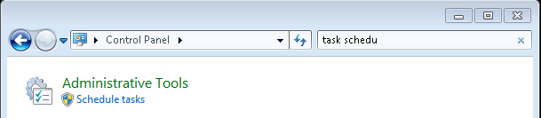
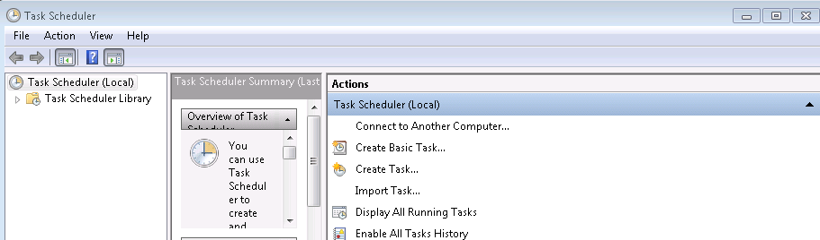
Windows : task scheduler
Go to the Control Panel :
Click on schedule tasks, this window will open :
Click on Create Task…
→ Now, you can configure your task

Slide 2
Windows : task scheduler
Configure your task :
3 main tab to describe your task :
  - General (name, description) ,
  - Triggers (How often the task is launched ?),
  - Actions (What is executed by your task?),

Slide 3
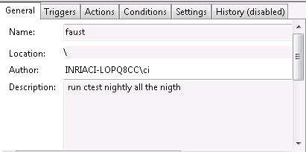
Windows : task scheduler
tab General :
→ name of the task and description

Slide 4
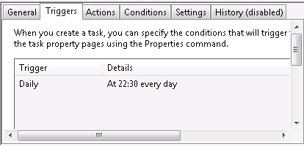
Windows : task scheduler
tab Trigger :
→ How often the task is launched ?

Slide 5
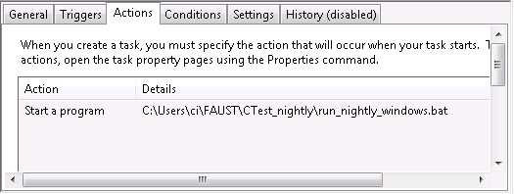
Windows : task scheduler
tab Actions :
→ What is executed by your task?

