Slide 1
Veritcal shooter
Csc-17B

Slide 2
Description
User logins
Database checks access level
Refers user to proper access level
Users can either play the game or check top scores
User can also view their own top scores
Admin can delete users and delete top 10 scores
Game tracks scores and send top score through cookie to PHP-database

Slide 3
Database
Two tables with users and users_scores
Users stores all login information
User_scores stores all score data
User.username is linked to user_scores.username for reference

Slide 4
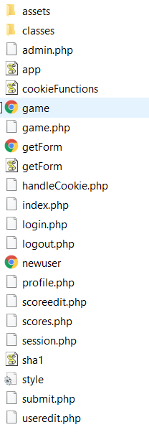
Folder Layouts
Assets contain all the sounds and the graphics for the game
Rest of program is in main folder

Slide 5
MVC
Model is the database that the user doesn’t interact with that controls updating the database with new users, as well as new scores. And adheres to admin commands.
View is the game that the user interacts with as well as the top score page
Controller is the JS handlers for the game, and the PHP that controls the form input for logging in.

Slide 6
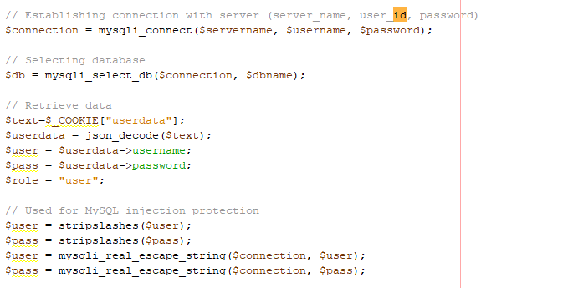
Objects Javascript to PHP
JS forms are submitted to PHP to be processed and cookies are sent to PHP.

Slide 7
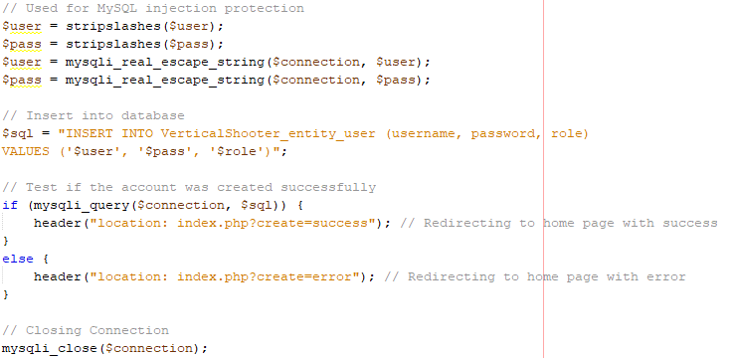
Read/write Local Storage
Forms pushed to PHP and into database

Slide 8
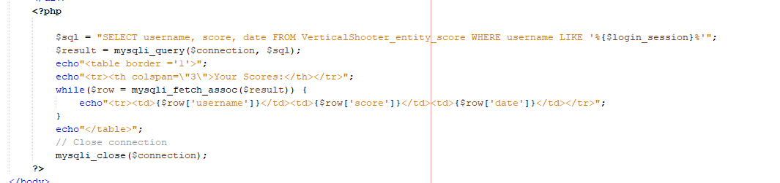
Database SQL
PHP accessing database and passing MySql code to database.

Slide 9
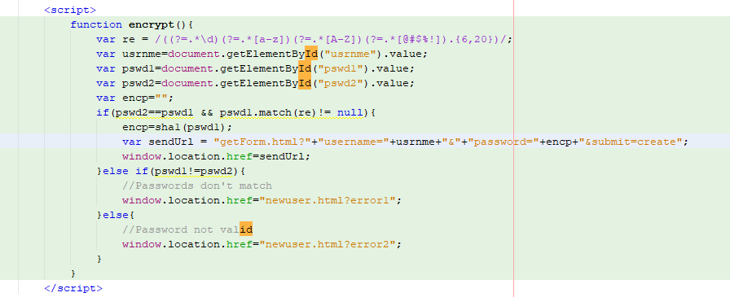
Form Validation
Form validation for registering new user

Slide 10
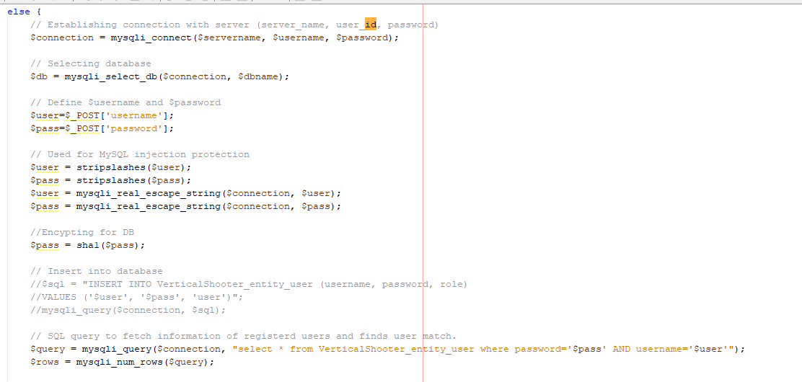
User-Admin-Login
Login page validates with user database.

Slide 11
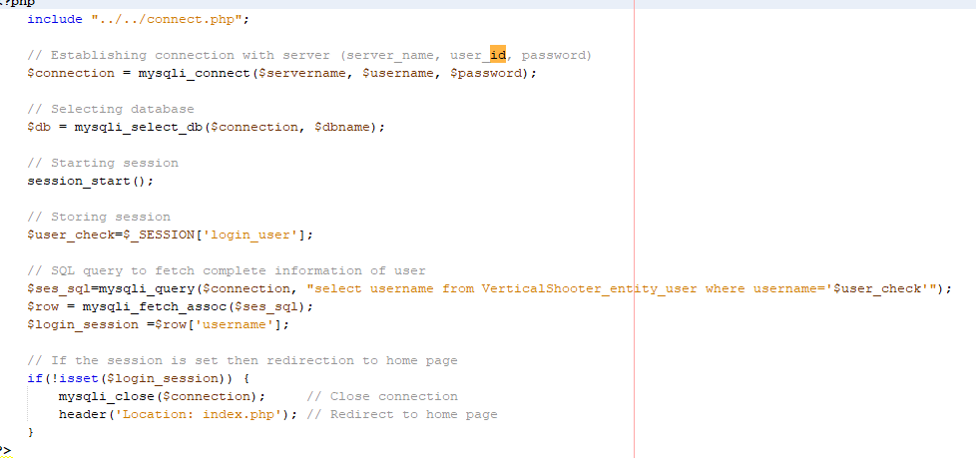
Cookies – Sessions – Securing Stage
One session is manages on sessions.php

Slide 12
Credits:
Gayle – Javascript Game
Cody – log in, cookies and session handling, and css style.
Robert – Pull score from game, display score for user, allow admin to delete score.
Nhan Mac – Allow admin to edit users and delete users from database.
Jonathan – Javascript game

Slide 13
Notes:
Extract SQL file to database
Place connect.php two layers above the webtsite files
Put address into web browser
If it doesn’t work launch the login.php
Admin log in is:
Name: admin
Password: password
Create user to test game and site

