Slide 1
Data science
RETAIL SALES ANALYSIS
By Martinos Nianios

Slide 2
Analysis goals
DATA CLEANING & PREPERATION
DATA VISUALIZATION
STATISTICAL ANALYSIS
HYPOTHESIS TESTING
PREDICTIVE MODELING
MULTIVARIABLE ANALYSIS
CLUSTERING
TECHPRO ACADEMY – DATA SCIENCE 2024

Slide 3
Data cleaning and preparation
SALES DATE
Change type from text to pd.datetime and set YYYY-MM-DD for all entries
Build three new columns, SalesYear, SalesMonth, Salesym for better statistical analyses of Sales Amount
PRODUCT CATEGORY
Fix an entry where the value of Product Category was swapped with the value on Customer Gender.
CUSTOMER LOCATION
Find and exclude for our project two Nan entries
CUSTOMER GENDER
Encapsulate the Unknown, Did not Answer and Non-binary entries into a new category (28 entries) for better representation
TECHPRO ACADEMY – DATA SCIENCE 2024

Slide 4
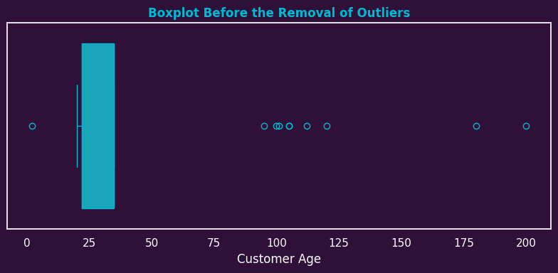
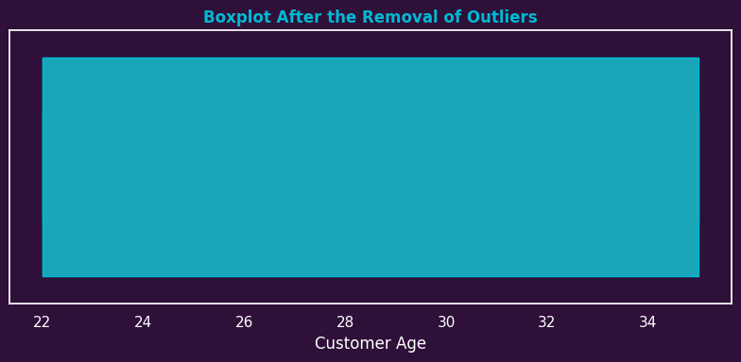
Data cleaning and preparation
CUSTOMER AGE
Find outliers with IQR method
Exclude those outliers from our project because their age numbers are unrealistic.
Encapsulate the customers aged 20 into the 22 age category for better representation.
SALES AMOUNT
Exclude entries with alphanumeric values
Exclude entry with enormous value (1,8million)
RATINGS
Change the two text values to their corresponding numeric values.
Exclude entry with value outside of our 1-5 scale.
TECHPRO ACADEMY – DATA SCIENCE 2024
Notes:
**Στο Customer Age βρήκαμε, με την μέθοδο IQR, κάποια outliers που πέρα από ακραίες περιείχαν και μη ρεαλιστικές τιμές, πχ πελάτης 2 ετών ή και 200 ετών, αυτές τιμές εξαιρέθηκαν από την συνέχεια του Project, Επίσης ενσωματώσαμε την μια και μοναδική τιμή 20 ετών στην κατηγορία των 22 ετών για καλύτερη εκπροσώπηση των δεδομένων
**Στο Sales Amount βρήκαμε και εξαιρέσαμε όλες τις αλφαριθμητικές εγγραφές που δεν έβγαζαν νόημα όπως και μια τεράστια τιμή πάνω από 1,8 εκ που αλλοίωνε τα στατιστικά μας.
**Στα Ratings διορθώσαμε τιμές που είχαν λεκτικά την καταχώρηση στο αντίστοιχο αριθμητικό τους π.χ. η λεξη two έγινε αριθμος 2 και εξαιρέσαμε μια εγγραφή που ήταν εκτός της κλίμακας βαθμολόγησης.

Slide 5
Basic statistics
stat | Sales date | Sales year | Sales month | Sales ym | Sales amount | Customer age | Customer gender | Customer location | Product category | Product ratings
COUNT | 980 | 980 | 980 | 980 | 980 | 980 | 980 | 980 | 980 | 980
UNIQUE |  |  | 12 | 24 |  | 3 | 3 | 6 | 3 | 5
MIN | 2/1/2022 | 2022 |  |  | 22
MAX | 31/12/2023 | 2023 |  |  | 1994
MODE | 16/7/2023 | 2023 | May | Dec 2023 | 609 | 22 | Female | USA | Electronics | 3
FREQ | 6 | 525 | 91 | 52 | 14 | 505 | 477 | 205 | 347 | 214
MEAN |  |  | Jun |  | 980
MEADIAN |  |  | Jun |  | 987
STD |  |  |  |  | 538
Average Customer was a 22year old female from USA. She bought 980$ of Electronics and gave a rating of 3
TECHPRO ACADEMY – DATA SCIENCE 2024

Slide 6
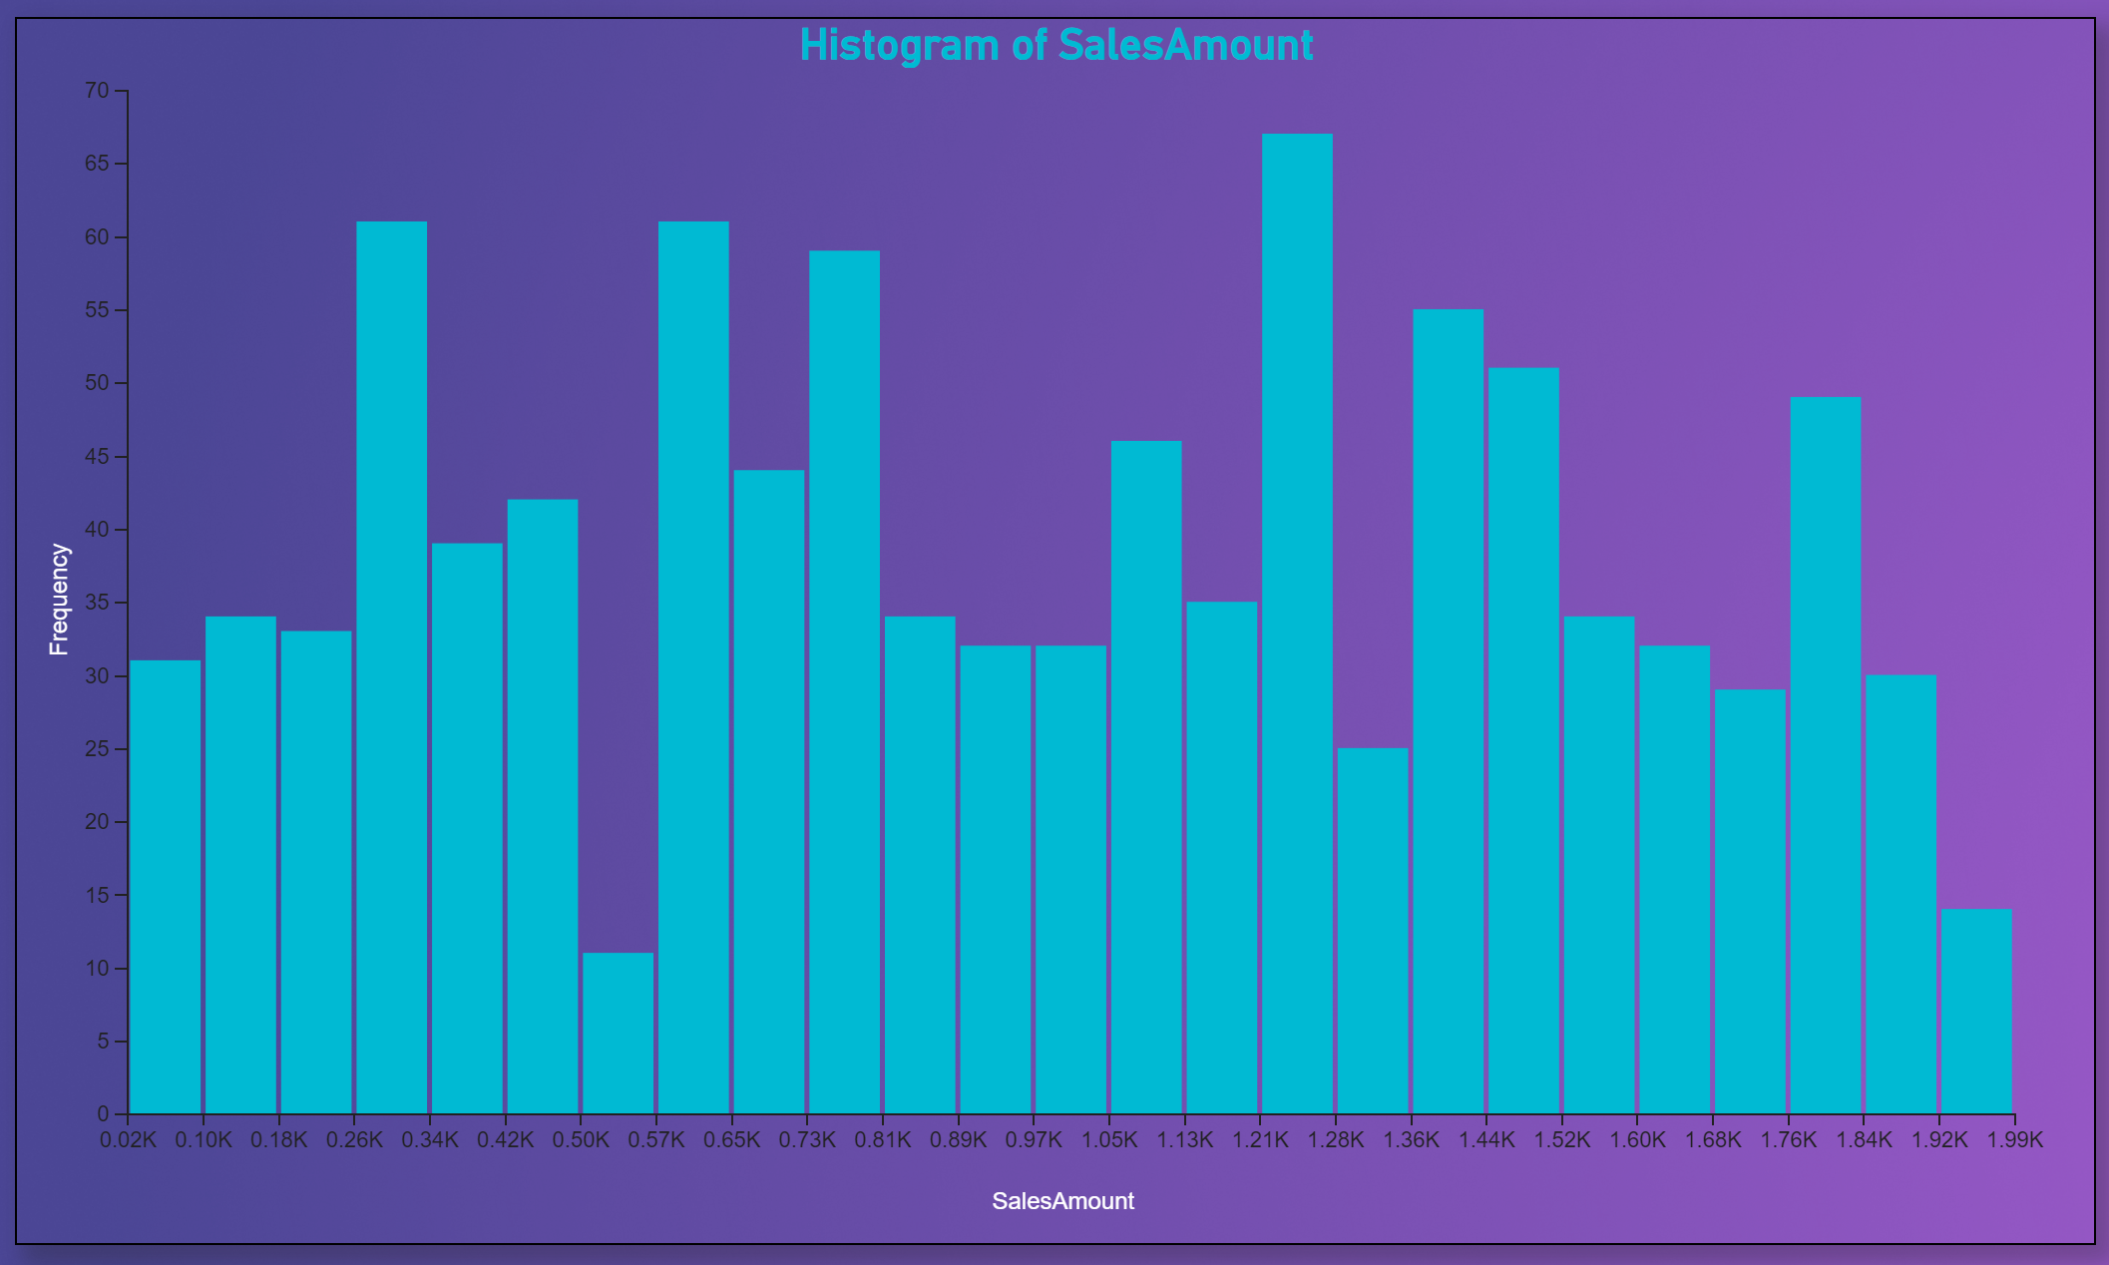
SALES AMOUNT
stat | COUNT | MIN | MAX | MODE | FREQ | MEAN | MEADIAN | STD
Sales amount | 980 | 22 | 1994 | 609 | 14 | 980 | 987 | 538
MEAN CLOSE TO MEDIAN
LARGE STD
SPREADED DATA
NOT NORMAL DISTRIBUTION
The Highest Sales Amount: 1994$ (electronics purchase on September 27th, 2023 from 35year old Female in Australia. The customer was pleased as she rated the product with 4 in a 1to5 scale)
TECHPRO ACADEMY – DATA SCIENCE 2024

Slide 7
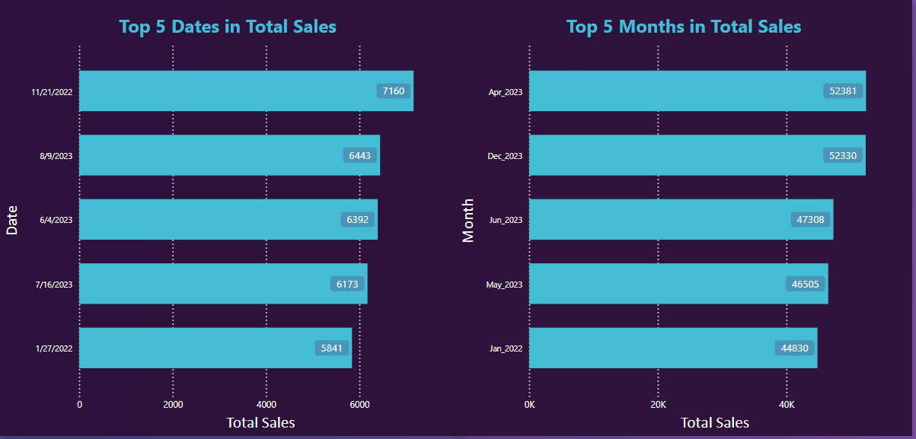
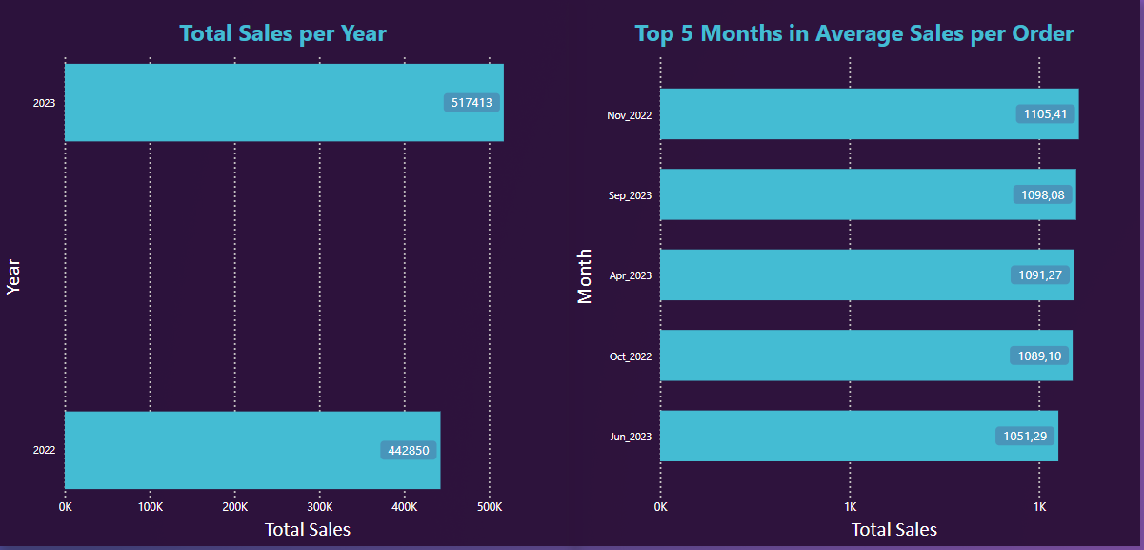
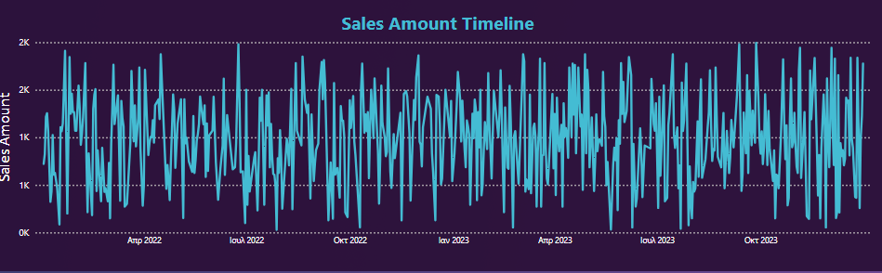
DATE-YEAR-MONTH
stat | Sales date | Sales year | Sales month | Sales ym
MODE | 16/7/2023 | 2023 | May | Dec 2023
FREQ | 6 | 525 | 91 | 52
SALES PEAK DATE: 21 NOV 2022 – 7,160
SALES PEAK MONTH: APRIL 2023 – 52,381
SALES PEAK YEAR: 2023 – 517,413
TOP MONTH IN AVG: NOV_22 – 1105
The timeline of Sales Amount doesn't show any clear trend.
TECHPRO ACADEMY – DATA SCIENCE 2024

Slide 8
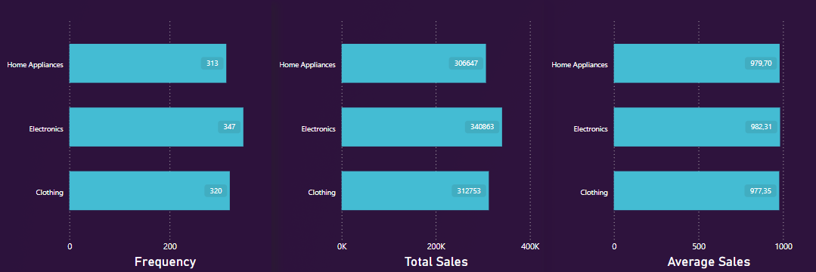
PRODUCT CATEGORY
Sales METRICS BY PRODUCT CATEGORY
ELECTRONICS BEST CATEGORY
EQUALLY DISTRIBUTED SALES ON ALL CATEGORIES
8
TECHPRO ACADEMY – DATA SCIENCE 2024
Notes:
Στο Product Category τα Electronics έχουν και τις περισσότερες παραγγελίες και τα περισσότερες πωλήσεις προϊόντων αλλά οι άλλες δυο κατηγορίες δεν διαφέρουν και πολύ κάτι που εντοπίζουμε και στο μέσο μέγεθος παραγγελιάς όπου τα νούμερα είναι σχεδόν ίδια.

Slide 9
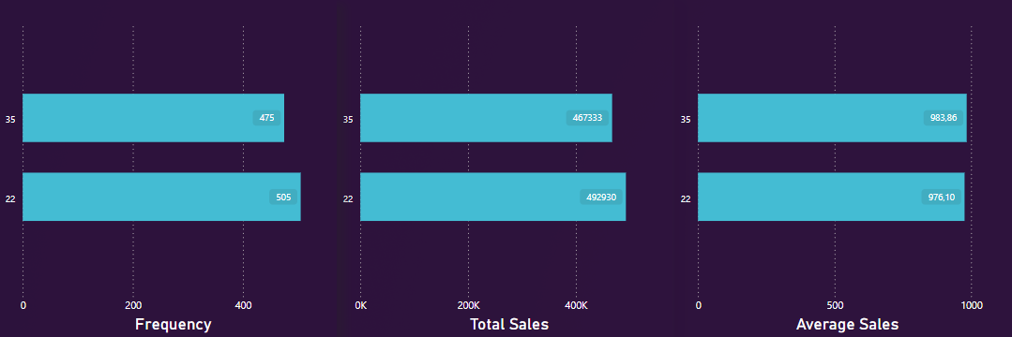
CUSTOMER AGE
Sales METRICS BY CUSTOMER AGE
22-years-olds GOT MOST SALES
35-years-olds SLIGHTLY BIGGER AVERAGE
9
TECHPRO ACADEMY – DATA SCIENCE 2024

Slide 10
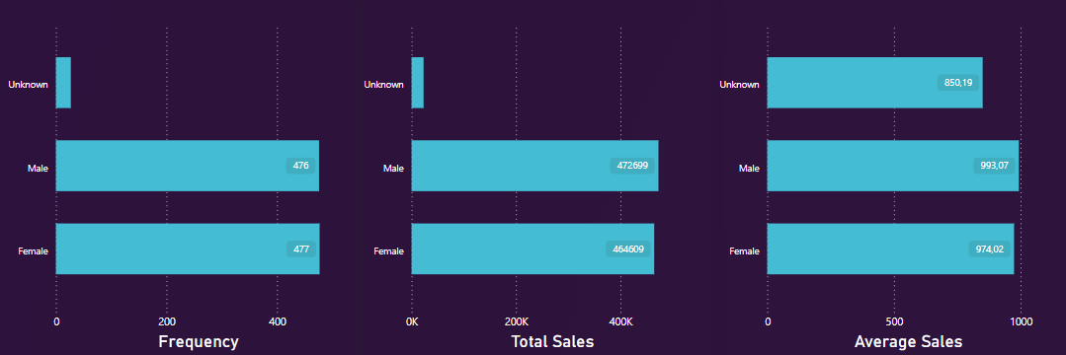
CUSTOMER GENDER
Sales METRICS BY CUSTOMER GENDER
MALES MORE SALES
UNKNOWN GENDER LOWER AVERAGE
10
TECHPRO ACADEMY – DATA SCIENCE 2024

Slide 11
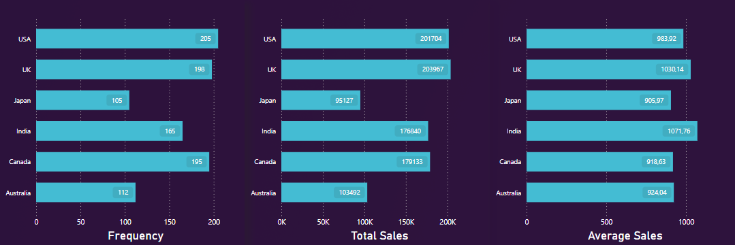
CUSTOMER LOCATIONS
Sales METRICS BY CUSTOMER locations
UK, USA BIGGEST MARKETS
AUSTRALIA , JAPAN SMALLEST MARKETS
INDIA HIGHER AVERAGE SALES AMOUNT
11
TECHPRO ACADEMY – DATA SCIENCE 2024

Slide 12
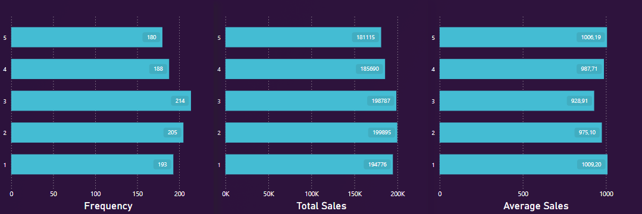
Product ratings
Sales METRICS BY product ratings
RATING 2 AND 3 HAVE THE MOST ORDERS AND MOST SALES
12
TECHPRO ACADEMY – DATA SCIENCE 2024

Slide 13
HYPOTHESIS TESTING
ONE WAY ANOVA RESULTS
ONLY CUSTOMER LOCATION ANOVA SHOWS SIGNIFICANTLY DIFFERENCE IN SALES MEANS (P VALUE <0.5)
OTHER FEATURES DIFFERENCIAL LIKELY DUE TO RANDOMNESS
SAME RESULT FOR CUSTOMER AGE TWO SAMPLE T-TEST (Τ-statistic: -0.225 , P:0.821)
FEATURE | DEGREES OF FREEDOM | CRITICAL_F | F-STATISTIC | P- VALUE
Product Category | 977 | 3.005 | 0.007 | 0.993
Customer Gender | 977 | 3.005 | 0.955 | 0.385
Customer Location | 974 | 2.223 | 2.469 | 0.031
Product Ratings | 975 | 2.381 | 0.744 | 0.562
ONE WAY ANOVA CHECKS IF MEANS OF GROUPS ARE SIGNIFICANTLY DIFFERENT FROM EACH OTHER
13
TECHPRO ACADEMY – DATA SCIENCE 2024

Slide 14
HYPOTHESIS TESTING
TWO WAY ANOVA RESULTS
Combination of features | P-Value
Customer Age – Product Category | 0.406
Customer Age – Customer Gender | 0.742
Customer Age – Product Ratings | 0.099
Customer Age – Customer Location | 0.302
Product Category – Customer Gender | 0.189
Product Category – Product Ratings | 0.132
Product Category – Customer Location | 0.077
Customer Gender – Product Ratings | 0.591
Customer Gender – Customer Location | 0.576
Product Ratings – Customer Location | 0.086
ALL COMBINATIONS SCORES POORLY,
NO COMBINATION JOINTLY AFFECTS SIGNIFICANT THE SALES
FURTHER STATISTICAL EXAMINATION OF PRODUCT CATEGORY – CUSTOMER LOCATION COMBINATION
A TWO-WAY ANOVA EXAMINES HOW TWO INDEPENDENT VARIABLES AFFECTS A DEPENDENT VARIABLE
14
TECHPRO ACADEMY – DATA SCIENCE 2024

Slide 15
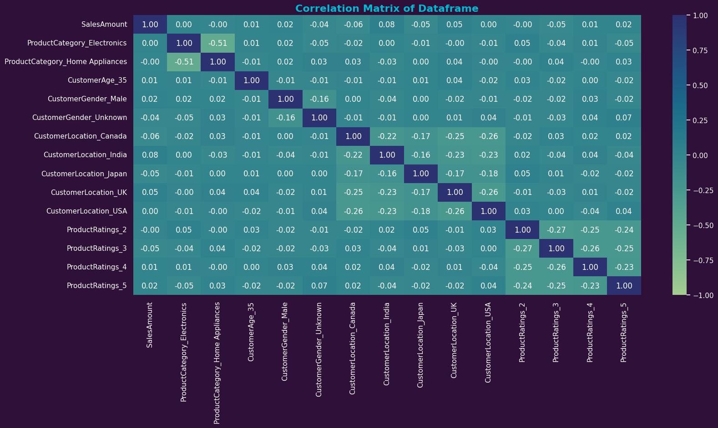
Predictive modeling linear regression
LOW SCORES ON CORRELATION , ALL BELOW 0.08 , MOST BELOW 0.05
TECHPRO ACADEMY – DATA SCIENCE 2024

Slide 16
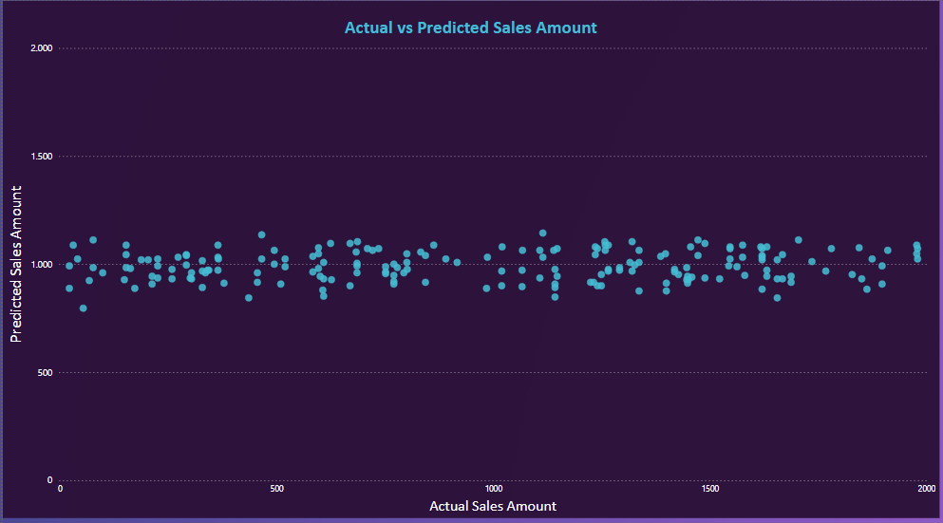
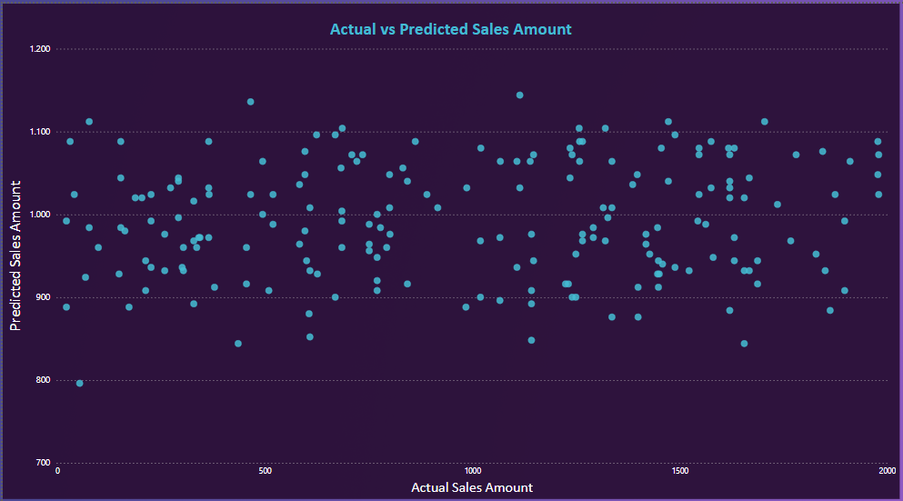
Predictive modeling linear regression
LINEAR REGRESSION EVALUATION SCORES
 | R^2 | Interception | Mean Average Error | Mean Squared Error | Root Mean Square Error
Min | -0.027 | 905.162 | 467,333 | 291,043.857 | 539.309
Max | -0.012 | 1,006.06 | 470,789 | 295,189.720 | 543.167
Average | -0.0197 | 952.890 | 469,99 | 293150.048 | 541.274
NO SUITABLE FEATURES TO BUILD A LINEAR PREDICTIVE MODEL
ALL COMBINATIOS SCORE POURLY IN ALL METRICS
R SQUARED IN THE NEGATIVES
NO LINEAR RELATIONSHIPS DRIVES MODEL TO HOVER AROUND MEAN SALES
TECHPRO ACADEMY – DATA SCIENCE 2024

Slide 17
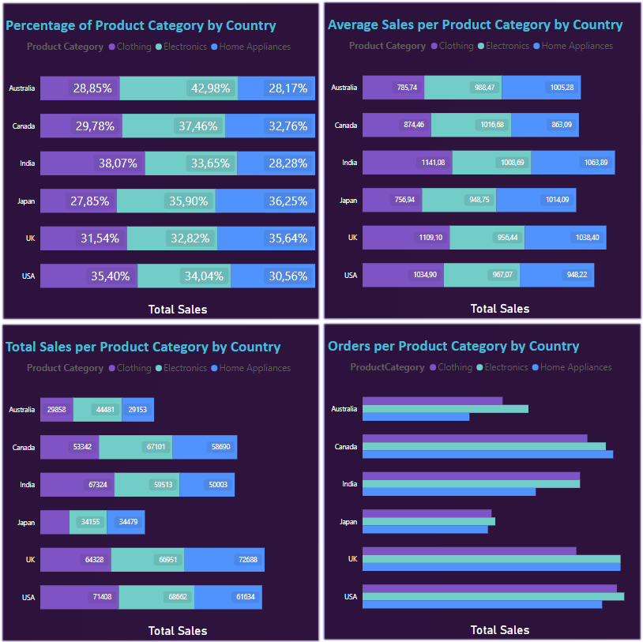






Multivariable statistical analysis
DOMINATION OF ELECTRONICS ON TOTAL SALES
MORE ORDERS ON HOME APPLIANCES
MORE SALES ON ELECTRONICS
CLOTHING PREFERENCE
ALL AVARAGES OVER 1000$
EQUAL DISTRIBUTED ORDERS
LOW SALES ON CLOTHING
COUNTRY WITH MOST SALES
CLOTHING HIGHER AVERAGE ON LOWER SALES
COUNTRY WITH MOST ORDERS
CLOTHING MORE SALES
TECHPRO ACADEMY – DATA SCIENCE 2024

Slide 18
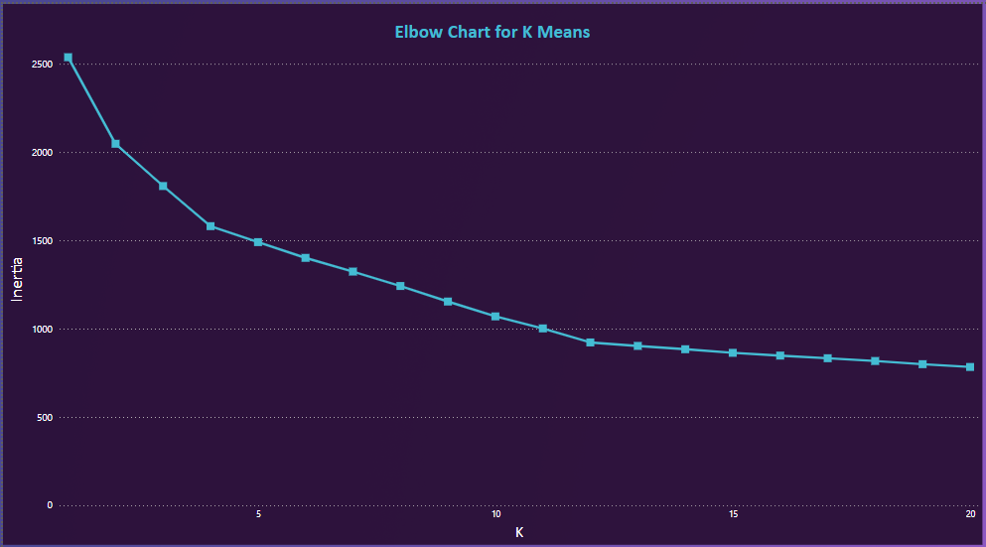
CLUSTERING – K MEANS
INERTIA DROPS SLOWER AFTER K=4
HUGE INERTIA AND LOW SILHOUETTE SCORES
MODEL CANNOT FIND WELL-DIFINED CLUSTERS
K | 1 | 2 | 3 | 4 | 5 | 6 | 7 | 8 | 9 | 10
INERTIA | 2,537 | 2,047 | 1,808 | 1,580 | 1,492 | 1,402 | 1,316 | 1,233 | 1,153 | 1,074
SILHOUETTE |  | 0.19 | 0.17 | 0.22 | 0.20 | 0.20 | 0.22 | 0.22 | 0.25 | 0.27
DROP |  | 490 | 239 | 228 | 88 | 90 | 86 | 83 | 80 | 79
DROP % PERCENTAGE |  | 19.31 | 11.69 | 12.57 | 5.59 | 6 | 6.14 | 6.35 | 6.43 | 6.87
K | 11 | 12 | 13 | 14 | 15 | 16 | 17 | 18 | 19 | 20
INERTIA | 1000 | 922 | 903 | 887 | 866 | 851 | 833 | 814 | 794 | 773
SILHOUETTE | 0.29 | 0.32 | 031 | 0.30 | .029 | 0.28 | 0.27 | 0.28 | 0.29 | 0.28
DROP | 74 | 78 | 19 | 16 | 21 | 15 | 18 | 19 | 20 | 21
DROP % PERCENTAGE | 6.94 | 7.77 | 2.09 | 1.73 | 2.42 | 1.71 | 2.15 | 2.29 | 2.42 | 2.62
18
TECHPRO ACADEMY – DATA SCIENCE 2024

Slide 19
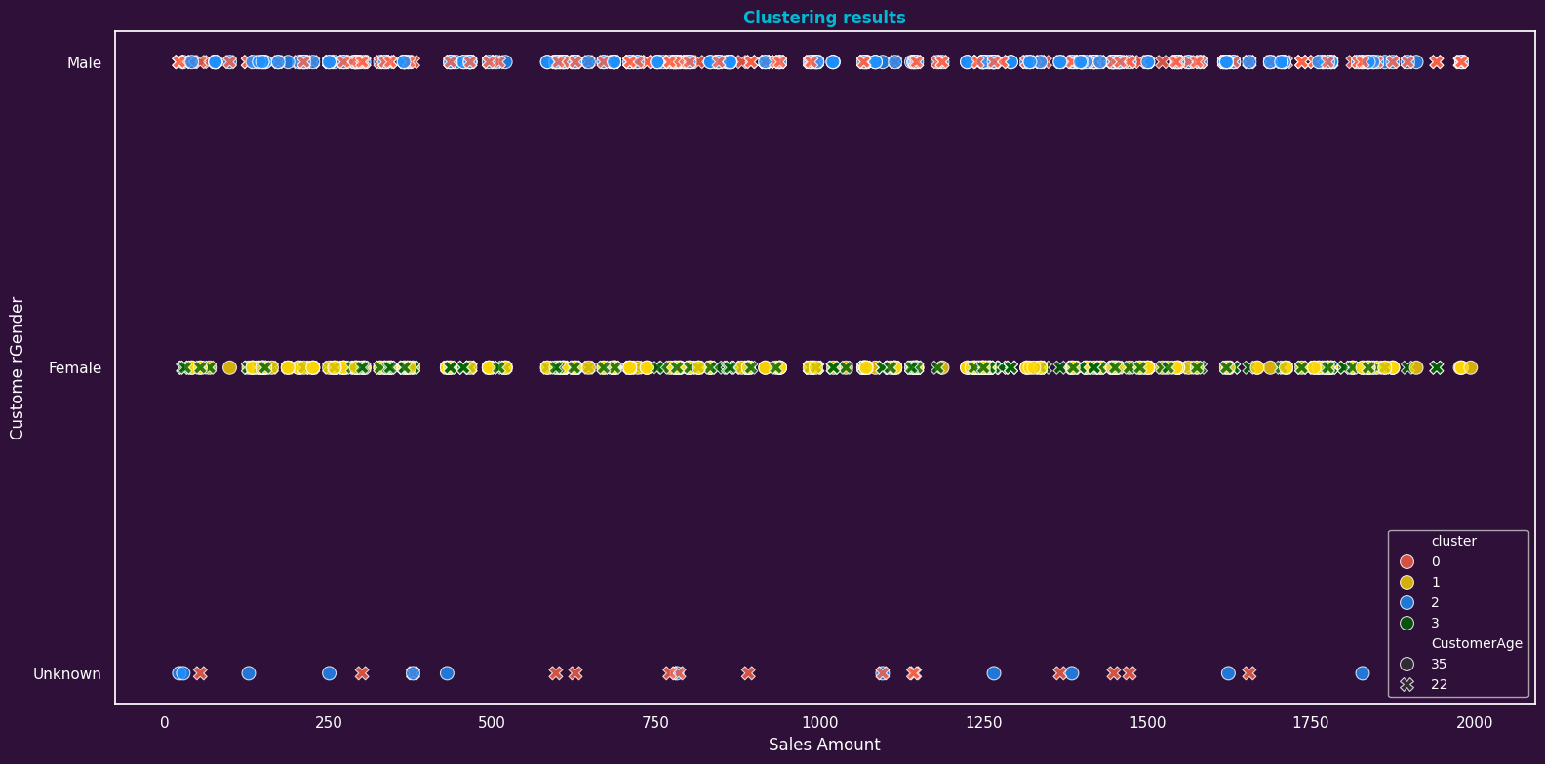
CLUSTERING – K MEANS
FOUR CLUSTERS , COMBINATION OF AGE AND GENDER
UNKNOWN GENDER MERGED INTO MALE
HUGE OVERLAPPING OVER CLUSTERS
19
TECHPRO ACADEMY – DATA SCIENCE 2024

Slide 20

Final conclusion
All our findings and results suggests that our data have much variation.
All categories behave in a way that makes it difficult to predict purchase behavior based solely on customer demographics or product category.
We were unable to successfully categorize customers based on their purchase characteristics.
TECHPRO ACADEMY – DATA SCIENCE 2024

Slide 21
THANK YOU
Martinos Nianios
macnianios@gmail.com

