Slide 1
3D Mezzanine Model
Standard-Work Line Simulation
Mac O'Keefe
Continuous Improvement · 07/2026

Slide 2
What it is
A 3D model of the mezzanine floor, built from the CAD layout.
All three lines run live (Meritage, Sola, Canyon Crew) using the real times from our SWIs.
Shows cycle, pace, capacity, and the bottleneck for each line, and updates the moment you change anything.
Runs in any browser. No install.

Slide 3
Products mapped so far
Meritage: 3-Seater, 2-Seater, Chair, Swivel Chair
Sola Lounge: no arms, 1 arm, both arms, middle leg
Canyon Crew: Canyon Chair
Each product carries its own real steps or a measured time factor, so labor and pace change when you switch products.

Slide 4
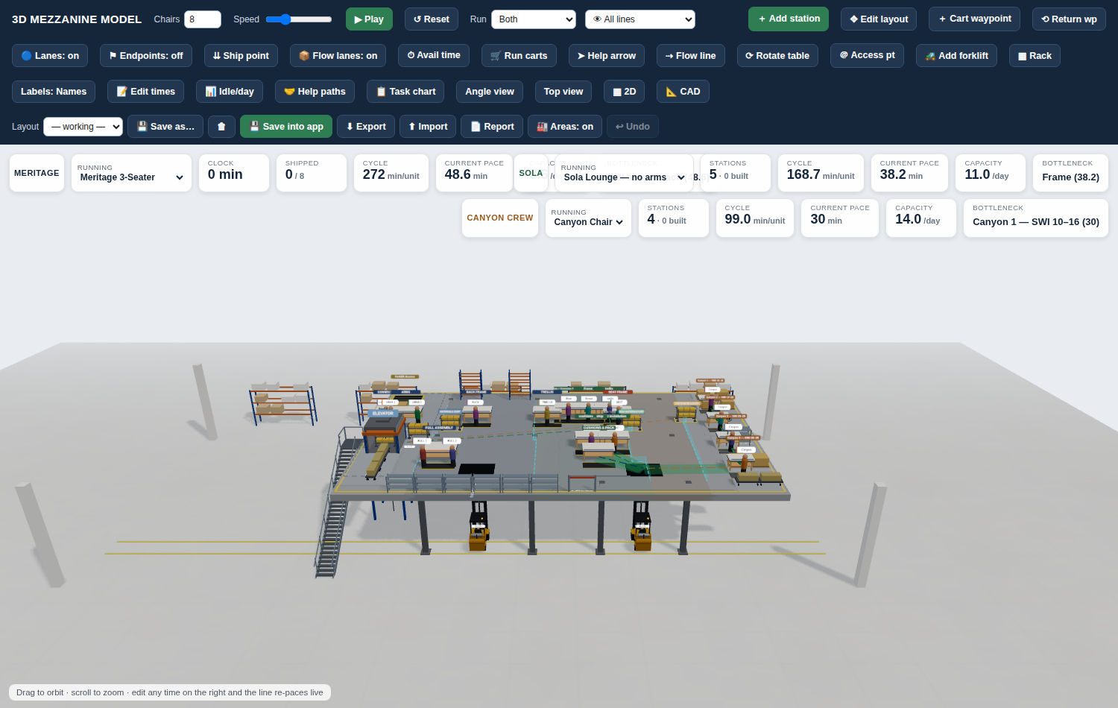
Live look

Slide 5
Where we want to take it
Turn it into a daily planning tool, split into two roles:
Admin page: owns the back end and the workflow design, station setup, product step times, line rules.
Floor manager page: each day, enter the products lined up to build and the people available.
The tool then shows the best way to run the lines that day, staffing, help, and balance, to optimize output.

