Slide 1
Meritage 3-Seater Sofa
Engineering Improvement Plan
Douglas O'Keefe
06/18/2026

Slide 2
Agenda — Meritage 3-Seater (Engineering)
Improvement plan (4 engineering fixes)
Deep dive 1 — Connector BOM & CAD gap (3 real types)
Deep dive 2 — Eliminate connector screw swaps & reorientation
Deep dive 3 — Pre-drill connector holes (seat-frame bottleneck)
Deep dive 4 — Receive leg pieces pre-assembled

Slide 3
Why is this so important?
Operator 1 spends most of her time on this product doing nothing but removing and replacing screws. A simple BOM fix from engineering pays back that time on every single unit built from that point forward.
All Meritage product lines share the same connector system, this is not isolated to the 3-Seater Sofa.
A single BOM correction and supply chain adjustment in Vietnam translates to reduced assembly time across a significant portion of Tuuci's total furniture output.
These are not one-time fixes; they are systemic improvements with compounding impact as volume grows.

Slide 4
Improvements: Meritage
Assign different connector types part numbers. Currently, the 3 different types of Meritage connectors arrive the same way (only one design is being sent to Vietnam), and two types have the same part number in the BOM.
Eliminate connector screw swaps & reorientation: recovers ~11:40 of labor per unit to redeploy elsewhere. Connectors are arriving with the incorrect screws and costing operators a ton of time on the floor to correct them.
Pre-drill connector holes for screw entry (for leg piece insertion): saves at least 6 min per frame assembly (seat-frame assembly is a top bottleneck).
Receive leg pieces pre-assembled from manufacturing: There are two types of leg pieces. One of them being used 90% of the time. That one should be outsourced. The only potential issue is paint.

Slide 5
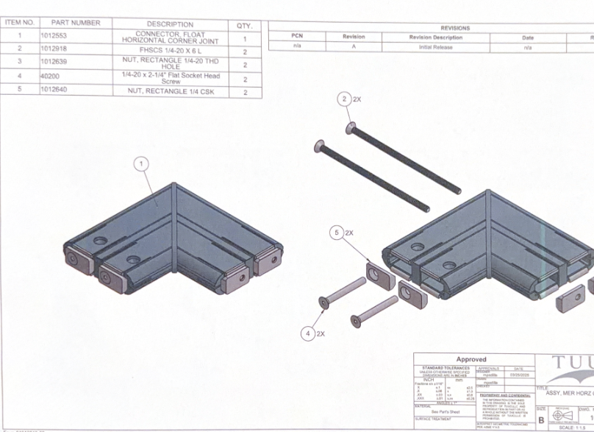
Meritage Flat connectors (Classic type #1)
These are the CAD drawings of the flat Meritage connectors used for the seat frame.
The CAD drawing states the part # is 1012553 but in reality it is 1015301 (how it appears in the BOM and the floor)
The operator on the floor currently removes the 40200 screw (shown in the drawing) from every single one of these connectors that arrives from Vietnam and replaces it with the 1012919 screw. There is no reason it should be arriving with the wrong screw.

Slide 6
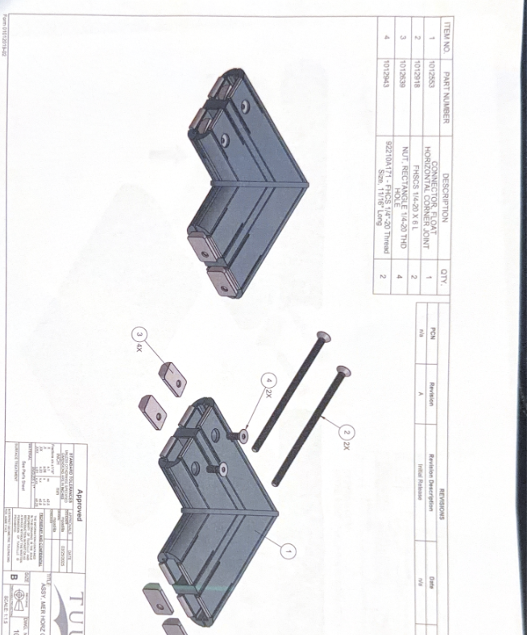
Meritage Flat connectors (Type #2 which is split between left and right)
The CAD drawing states the part # is 1012553 but in reality it is 1015302
This connector arrives with the 1012934 screw, and the operator currently removes that screw and replaces it with 40204
Half of these also need to have their orientation (which side the screw enters through) flipped which could be avoided by giving each side its own part # and design in the BOM.

Slide 7
Fix #1: First Step to Pre-Assembly: Fix the Connector BOM
The first step to getting connectors pre-assembled in Vietnam: give each connector its own part number in the BOM.
Today all three connectors arrive from Vietnam as one generic type, then get swapped and reconfigured by hand on the line.
The BOM lists 2 connector types — but there are really 3: front ×2 (1015301), back-left (1015302), back-right (1016592).
⚠ CAD drawing lists part number 1012553. The actual part number on the floor and in the BOM is 1015301.
The work is already done — this is a BOM + file-handoff fix, not new engineering.
The seat frame sub-assembly drawings (e.g. TU_523) are the only place where each connector is correctly identified with its own design and part number. Engineering does not need to create anything new — the work is already done in SolidWorks. The fix is updating the BOM and sending Vietnam the correct design file for each of the 3 connector types separately.

Slide 8
Fix # 1: Eliminate Connector Screw Swaps & Reorientation
Problem: every connector arrives from Vietnam as one generic type, so Operator 1 hand-reworks each one before use.
Type #1 (front, x2): operator removes the 40200 screw and replaces it with 1012919 on every connector.
Type #2 (back, left/right): arrives with 1012934; operator removes it and replaces with 40204.
Half of Type #2 also need their orientation flipped by hand, very avoidable.
Impact: this rework burns ~11 min 40 sec of labor per unit that adds zero value.
Fix: order each connector under its own part number and design, so Vietnam ships it already configured: front / back-left / back-right.
Result: ~11:40 of labor per unit recovered to redeploy onto the bottleneck stations.

Slide 9
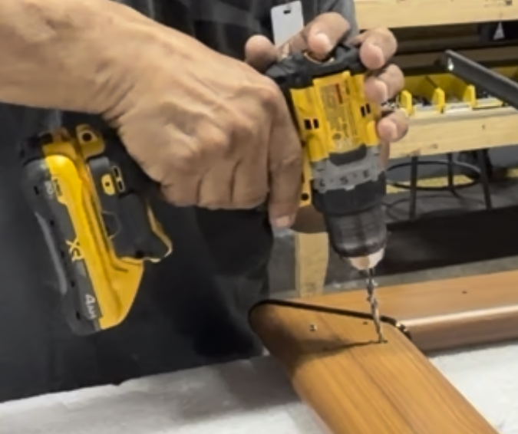
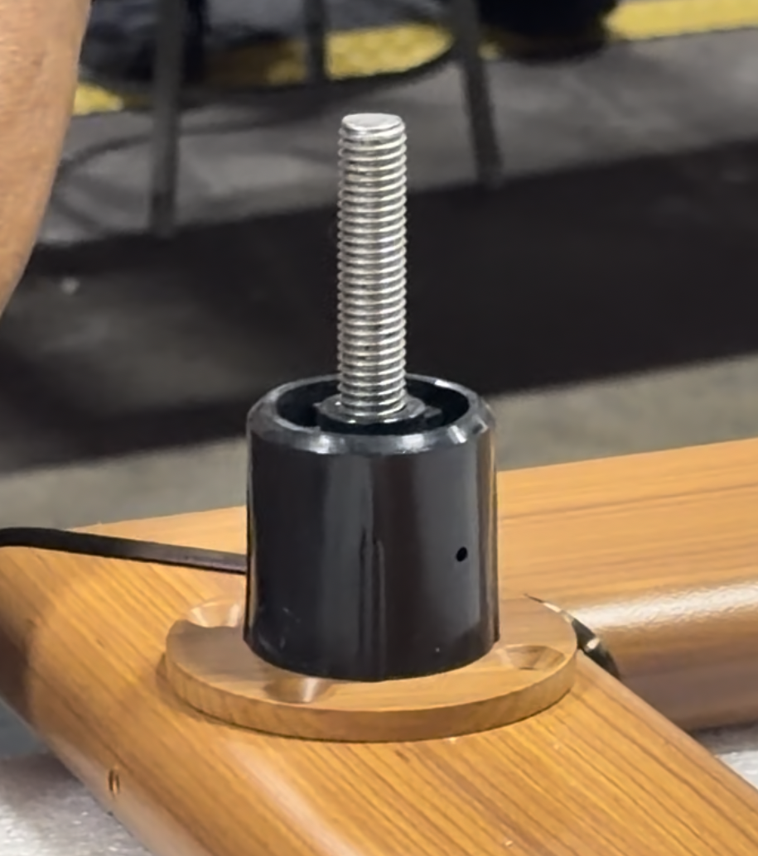
Fix #2: Pre-Drill Connector Holes for Leg Insertion
Problem: connector holes are not pre-drilled for screw entry, so operators must manually drill 4 holes into the flat Meritage connectors for leg-piece insertion during seat-frame assembly.
Seat-frame assembly is a top bottleneck, anything that slows it slows the whole line.
Fix: Have connectors arrive from Vietnam with holes already drilled out for leg insertion.
Impact: saves at least 5 min per frame assembly, taken directly off the bottleneck.
Because it hits the bottleneck, every minute saved here raises line throughput, not just labor.

Slide 10
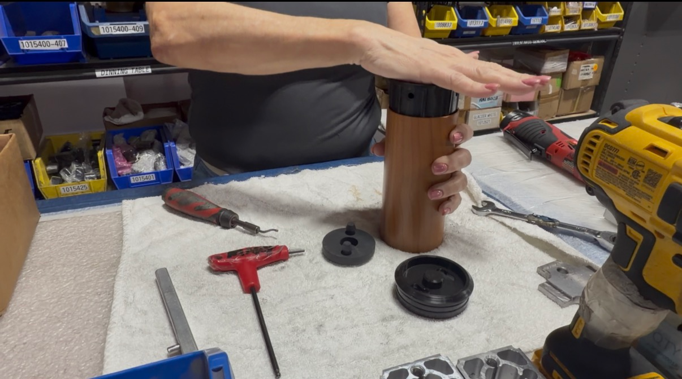
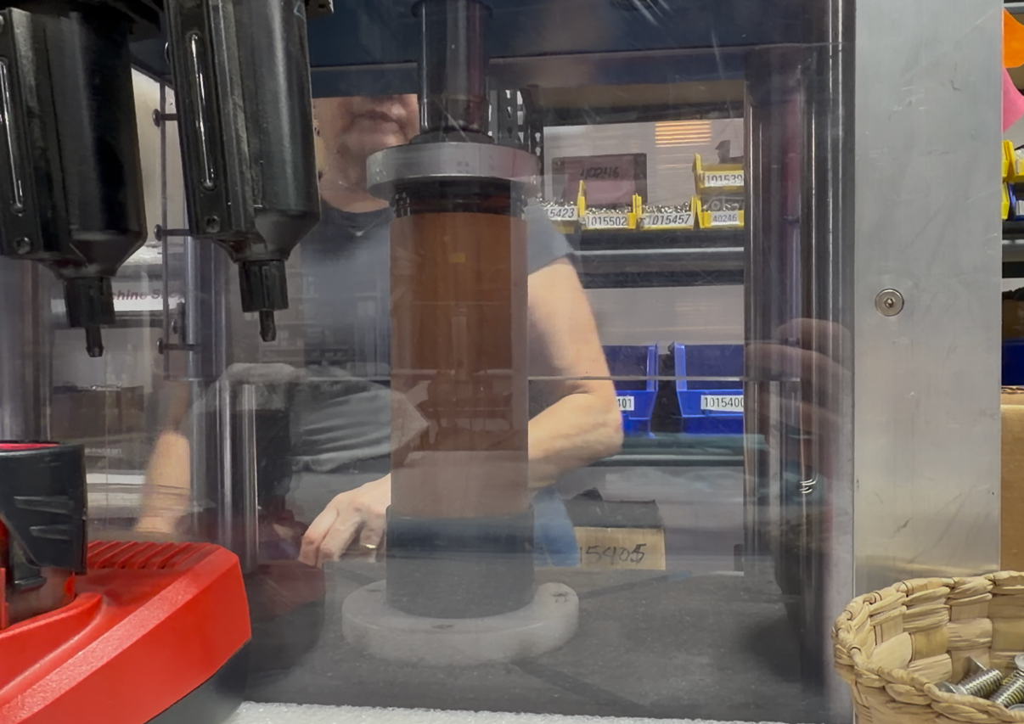
Fix #3: Receive Leg Pieces Pre-Assembled
Currently, the connector operator spends approximately 8 minutes per unit assembling the leg piece in-house.
There are two types of leg piece; one is used ~90% of the time. The other one has wheels and is used 10% of the time
Fix: outsource the high-volume (90%) leg piece to arrive from Vietnam pre-assembled.
Labor in Vietnam is much cheaper than assembling it here, it removes work from the bottleneck and frees up time at manufacturing and paint as well.
Question for engineering: Is the leg piece finish paintable to our spec through the Vietnam supply chain?
Action: confirm paint spec / supplier finish capability, then transition the basic leg piece to arrive pre-assembled

Slide 11
Labor-Savings Roll-Up & Roadmap
Per-unit labor recovered (measured / estimated):
Connector screw swaps + reorientation: ~11 min 40 sec
Pre-drill connector holes (seat-frame): >= 5 min
Pre-assembled legs: 8 minutes, removes steps from the line and from other departments
Combined: ~24+ min/unit recovered, concentrated on the bottleneck -> directly lifts throughput.
Roadmap:
1) Fix the connector BOM: give all 3 types their own part numbers (enables everything downstream)
2) Move connector configuration + the 90% leg piece to pre-assembled supply from Vietnam
3) Pre-drill connector holes
4) Re-balance the cell to takt with the recovered labor

Slide 12
Disclaimer: The replacement screws listed (1012919 and 40204) reflect what operators are currently using on the line and are confirmed to work. They are provided as a reference baseline for what currently works, but engineering should still validate whether these are the optimal spec before formalizing in the BOM.

Slide 13
Thank you for your time
Any Questions?

