Slide 1
Organic Product Analysis
Macon Barker
BAN 6025 – Project 3
November 21, 2023

Slide 2
Contents
Business Problem
Exploratory Analysis
Noticeable Differences for Organics Customers
Is loyalty status a factor?
Model Summary and Findings
Organic Customer Profile
Recommendations

Slide 3
Business Problem
What are the characteristics of customers who purchase organic products?
Notes:
Our data analytics team was hired to analyze historical data of customers who purchased from their chain. The main variable of interest is the ‘TargetBuy’, which is 1 if the customer purchased an organic product during his/her visit and 0 if the customer did not purchase an organic product. We will be using these data to build a classification model to help us identify important characteristics of customers who purchase organic items and ultimately use it to predict whether new customers will purchase organic products. This will allow us to recommend different marketing strategies that may persuade customers to purchase the new organic product line and appropriately stock organic items to maximize profits.

Slide 4
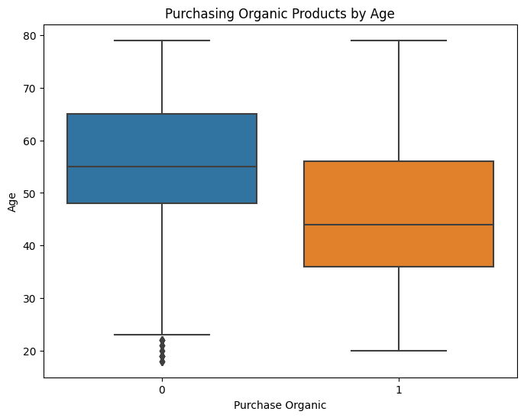
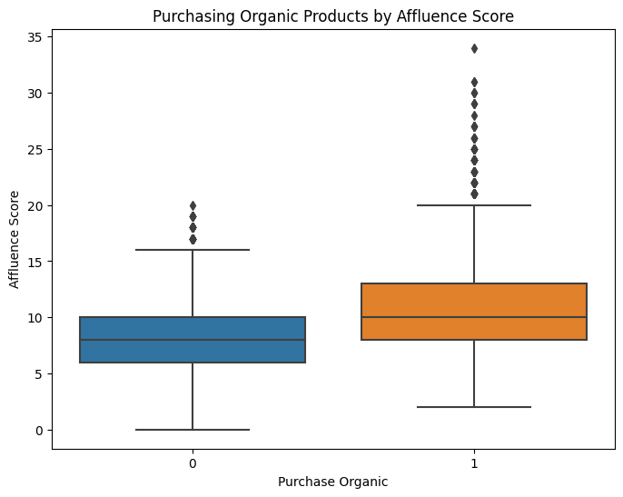
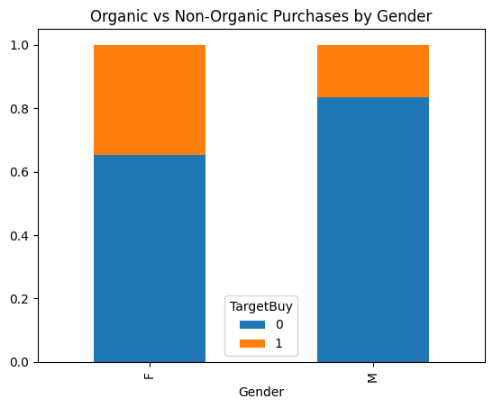
Exploratory Analysis
Are there noticeable differences in customers who purchase organic products?
Notes:
Age: We can see that customers who purchase organic products tend to be younger than those not purchasing organic products.
Affluence Score: We looked at the affluence score and found that customers with a higher score are more likely to purchase organic products. (i.e., Customers with higher household income.)
Gender: We found that female customers tend to purchase more organic products than male customers.

Slide 5
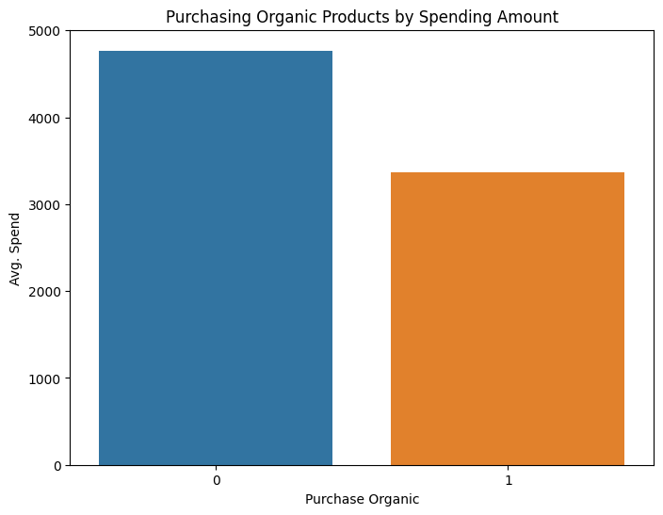
Exploratory Analysis
Do customers who purchase organic products spend more (or less) on average than other customers?
Notes:
Looking at the average yearly spend by customers who purchased organic vs. those who did not, we can see that non-organic customers spend around $1,500 more.

Slide 6
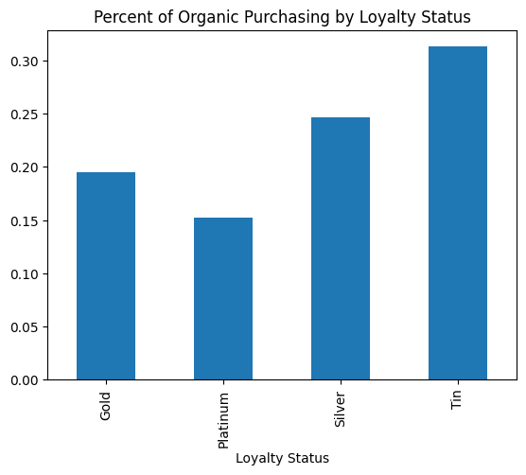
Exploratory Analysis
Which loyalty status makes the most organic purchases?
Notes:
The loyalty status of a customer seems to have a negative influence on the number of organic purchases made. The graph shows us that members in the ‘Tin’ status had the highest percentage of organic purchases made, followed by ‘Silver’, ‘Gold’, and finally ‘Platinum’.

Slide 7
Model Comparison
Model | Accuracy (Train) | Precision (Train) | Recall (Train) | AUC (Train) | Accuracy (Test) | Precision (Test) | Recall (Test) | AUC (Test)
Stepwise | 0.8064 | 0.6951 | 0.3893 | 0.8019 | 0.8158 | 0.7227 | 0.4165 | 0.8107
L1, C=0.1 | 0.8076 | 0.7028 | 0.3867 | 0.8020 | 0.8152 | 0.7215 | 0.4140 | 0.8105
L1, C=0.01 | 0.8058 | 0.7144 | 0.3597 | 0.7979 | 0.8178 | 0.7509 | 0.3959 | 0.8057
L2 | 0.8068 | 0.7127 | 0.3683 | 0.7996 | 0.8163 | 0.7354 | 0.4038 | 0.8063
Decision Tree | 0.8156 | 0.6868 | 0.4695 | 0.8311 | 0.8140 | 0.6801 | 0.4709 | 0.8187
Notes:
This table shows some statistics for each of the classification models we built. In the top row, there are 4 different categories: Accuracy, Precision, Recall, and AUC, which are divided into two parts: train and test. A training-test split is a common practice used in model building, which involves splitting up the data set (in our case 70 to train, 30 to test) so that the model does not only perform well on with the data it was built off. The training data is used to build the model itself and the test data is used to assess the performance on other data.
When assessing a model’s performance, we want to focus on how it performs on the test data as we will ultimately be using this model to predict if new customers will buy organic products. For each statistic, the closer it is to 1, the better. The accuracy tells us the percentage of correct predictions our model made. As we can see, all 5 models have nearly identical accuracies, so let’s look at a statistic that may give us more insight on predicting customers who will purchase organic products. Recall tells us of the customers who purchased organic products, the percentage correctly predicted as ‘purchase organic’ by the model. Our goal is to correctly identify the customers who will actually purchase organic items, therefore the model we selected to move forward with was the Decision Tree.

Slide 8
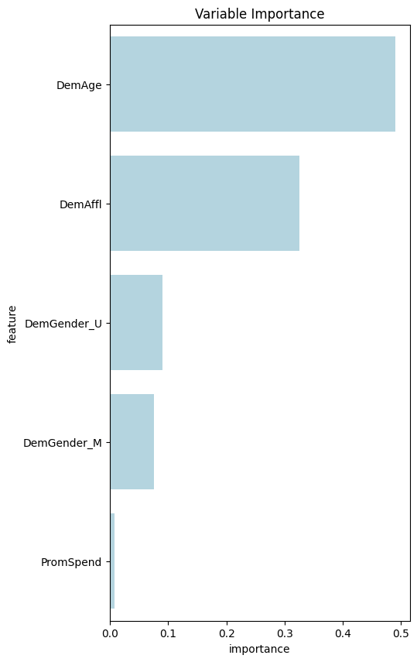
Organic Customer Profile
Age 44 or younger
Above average household income
Females more likely than males
Notes:
The graph on the right comes from our Decision Tree Model. It shows the top five most influential variables in the model.
Age has the most influence. We saw earlier in the exploratory analysis that the customers who purchase organic products tend to be on the younger side. From our model, we found that customers aged 44 or younger had a higher percentage of organic products purchased.
Affluence was another important feature to consider. As organic products tend to be more expensive, this makes sense that customers with more household income would be more likely to purchase. Customers under the age of 44, with an above-average affluence score (>15) were the most likely group to purchase organic products (92% of the time).
Gender plays a role as well with females purchasing more organics than males.

Slide 9
Recommendations
Promote new line to younger, affluent customers
Shift organic offerings in affluent locations
Organic coupons to Platinum tier
Offer organic coupons based on money spent to Tin tier
Advertise to Females aged 45-55; partner with fitness studio
Notes:
Customers who did not purchase organic products tend to spend more on average per year. Therefore, we want to be more strategic with our stocking and marketing strategies to ensure we do not incur unnecessary costs from carrying or promoting the new product line.
Our top customers are those under the age of 45 with an above-average affluent score. We want to make sure that the word about the new product line gets out to this group as they are most likely going to be interested. We can target them with web or in-store coupons. If there is some way to offer a coupon for the new line when a customer rings up an organic product, we recommend doing that.
Customers with an above-average household income are more likely to purchase organic products. We suggest stocking more organic products in stores located in affluent areas/neighborhoods.
The Platinum tier spends the most money but has the lowest percentage of customers purchasing organic items. It could be beneficial to offer customers in this tier some coupons for organic products to try and increase that percentage.
Tin tier members purchase the highest percentage of organic products but spend the least amount of money. We could try to increase the spending amount by offering more organic coupons or larger discounts based on how much they spend per visit.
Females aged between 45-55 seem to be split (about 50/50) over purchasing organic items. Perhaps advertising the new organic line at fitness/yoga classes (or partnering with a coupon deal) could help get the word out and sway that demographic to purchase more organics.

