Slide 1
Outer and inner shadows
blur 4 dist 3 dir 45
blur 0 dist 6 dir 45
blur 12 dist 8 dir 90
blur 20 dist 0 (halo)
dir 225 red
perspective sx/sy/kx
innerShdw
inner + outer

Slide 2
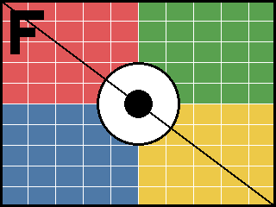
Glow and soft edges
glow 4pt
glow 10pt
glow 18pt
softEdge 2.5pt
softEdge 10pt
softEdge 25pt

Slide 3
Reflections
tight
half, 4pt away
full, blurred

Slide 4

Effects on text and pictures
Shadowed heading
Glowing heading

Slide 5
3D: bevels, extrusion, cameras, materials
bevel circle
relaxedInset + softRound
extrusion iso
perspective + contour

Slide 6
Default theme effect styles via effectRef 0-3
effectRef idx=0
effectRef idx=1
effectRef idx=2
effectRef idx=3
fillRef 3 (gradient) / lnRef 1; effectRef 3 adds the theme's scene3d + bevel

