Slide 1
Pattern fills 1-27
pct5
pct10
pct20
pct25
pct30
pct40
pct50
pct60
pct70
pct75
pct80
pct90
horz
vert
ltHorz
ltVert
dkHorz
dkVert
narHorz
narVert
dashHorz
dashVert
cross
dnDiag
upDiag
ltDnDiag
ltUpDiag

Slide 2
Pattern fills 28-54
dkDnDiag
dkUpDiag
wdDnDiag
wdUpDiag
dashDnDiag
dashUpDiag
diagCross
smCheck
lgCheck
smGrid
lgGrid
dotGrid
smConfetti
lgConfetti
horzBrick
diagBrick
solidDmnd
openDmnd
dotDmnd
plaid
sphere
weave
divot
shingle
wave
trellis
zigZag

Slide 3
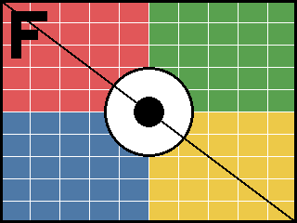

Picture fills
stretch
stretch + srcRect
tile 100%
tile 50% flip xy
Text on picture fill
ellipse stretch
star5 stretch
heart tile offset
text over picture

Slide 4
noFill outlines and group fill (grpFill)
children use <a:grpFill/> (group gradient spans all)

