Slide 1
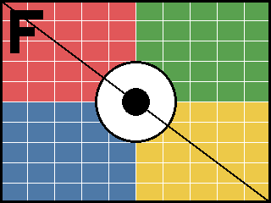
Cropping with srcRect
none
l=25%
t=10% b=10%
all 20%
top-left quadrant
negative l/r -20%
negative all -10%
r=60% b=-30%

Slide 2
Rotation, flips, outlines, shadows, geometry
rot 30
flipH
flipV
rot 200 flipH
6pt border
dbl border + shadow
ellipse geometry
roundRect geometry

Slide 3

Blip effects
alphaModFix 50%
grayscl
biLevel 50%
lum bright +30 contrast +40
duotone navy/gold
clrChange sky->transparent
hsl sat -100 (desaturate)
tint 50% + lum -20

