Slide 1



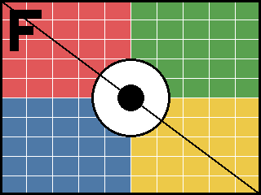
Raster formats
PNG with alpha
JPEG
GIF (transparent index)
BMP 24-bit
TIFF (LZW)
PNG RGB

Slide 2
Scaling: stretched, tiny, large

