Slide 1
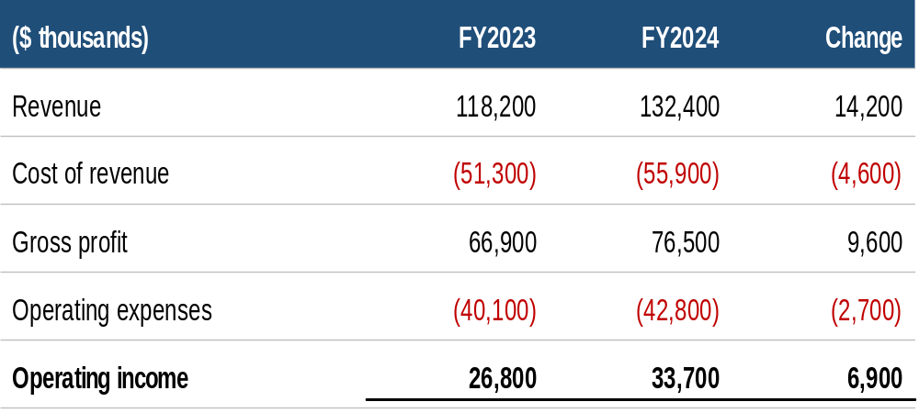
Embedded worksheet shown as content (EMF preview)
Double-click target in PowerPoint; renderers draw the EMF preview

Slide 2
Embedded worksheet shown as an icon

