Slide 1
A4 portrait report page
Portrait slides are common for one-page financial summaries.
Revenue up 12%
Margin 25%
Cash $310M

Slide 2
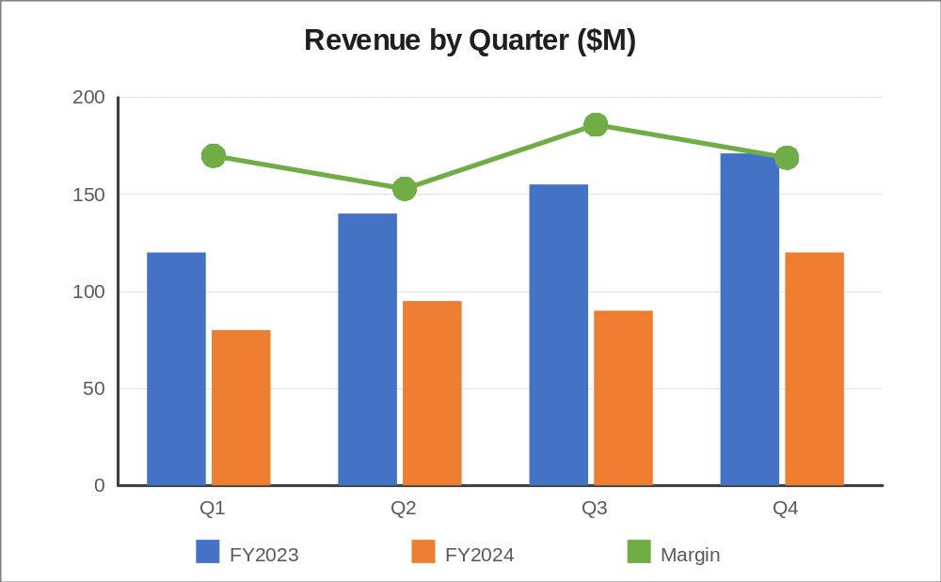
Summary table and chart area
Metric | 2023 | 2024
Revenue | 118.2 | 132.4
EBITDA | 30.0 | 33.4
Net income | 19.2 | 25.9
Footer note box at the bottom of an A4 page

