Slide 1
EMF and WMF
EMF: chart-like (text, gridlines, bars)
EMF: gradients, beziers, paths, transforms, DIB
same EMF, non-uniform scale
WMF (placeable): pie, polygons, text

Slide 2
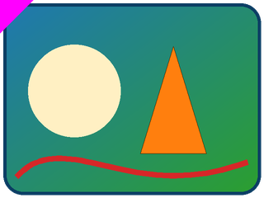
SVG with PNG fallback (asvg:svgBlip)
PNG fallback alone (no svgBlip)

