Slide 1
DNN example
11/27, 2017
Jinhyun Kim

Slide 2
Thesis
A Deep-Learning Based Ultrasound Text Classifier for Predicting Benign and Malignant Thyroid Nodules.
Dehua chen, Jinxuan niu, Qian Pan, Mei Wang
School of Computer Science and Technology
Donghua University. Shanghai, China

Slide 3
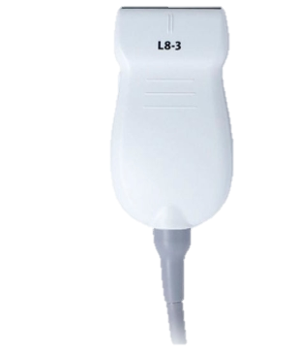
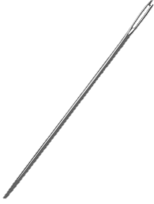
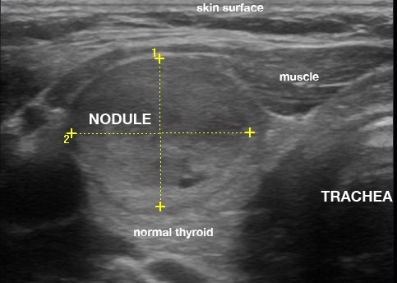
Benign vs malignant
Thyroid nodule (갑상선 혹)

Slide 4
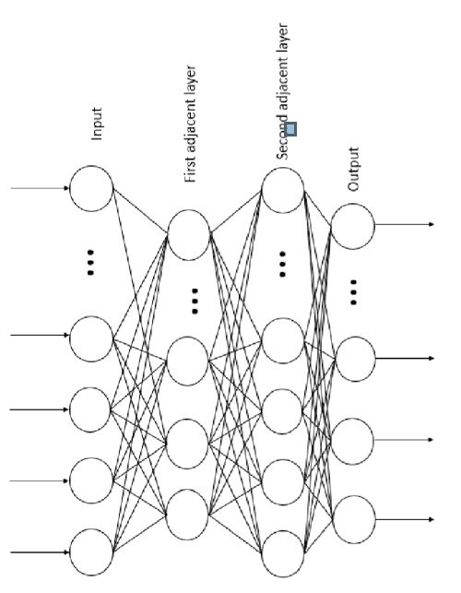
traning
Ultrasonic
Indexed data provided by hospital
Blood pattern, blood supply, echo distribution, envelope contact area, blood supply of thyroid parenchyma, tubercle boundary
By text!
information
DNN
Fully connected
Syntax, sentence segmentation,
Parse key values
By neural network
malignant
Information 추출 과정
benign
Reducing distortion,
And overlapping information
By PCA
(Principle component analysis)

Slide 5
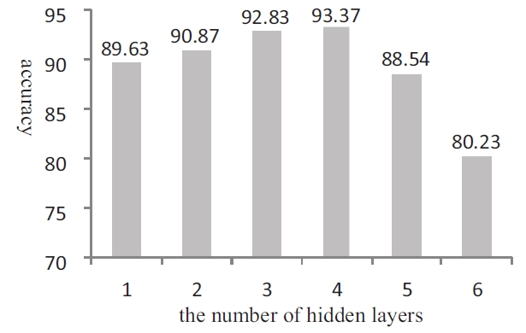
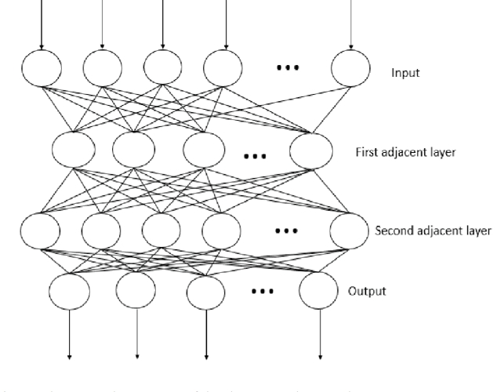
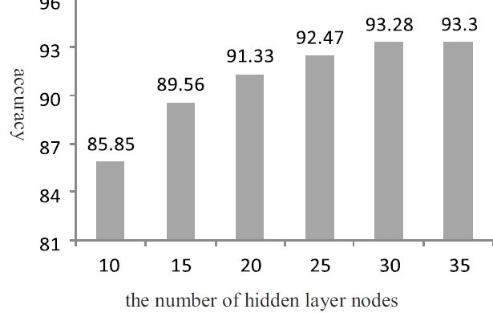
Hidden layer
Best performance on
Hidden layer number : 4
The number of hidden layer nodes : 30

Slide 6
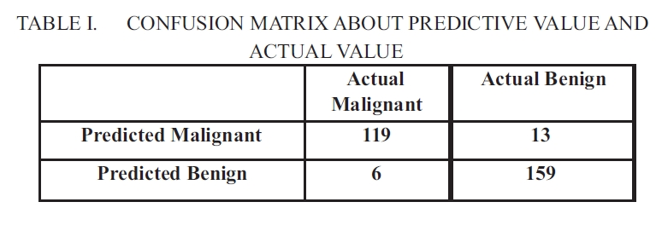
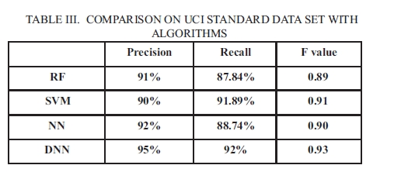
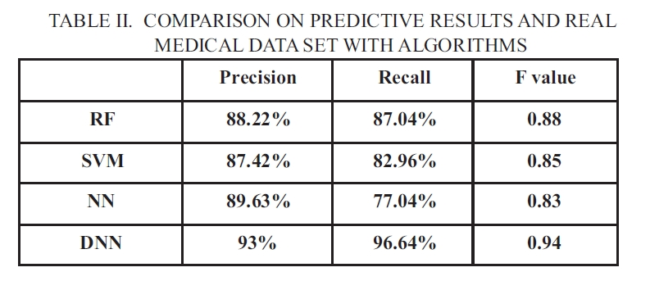
Result

Slide 7
Thank you for your attention
\

