Slide 1
Text generation
12/11, 2017
Jinhyun Kim
20기

Slide 2
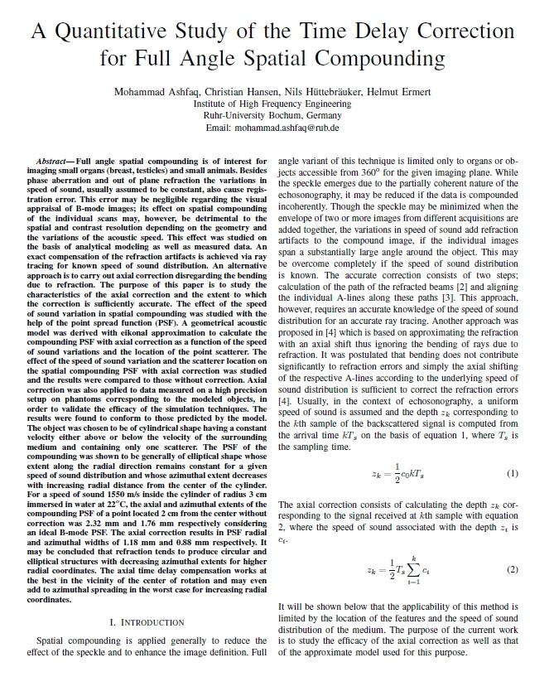
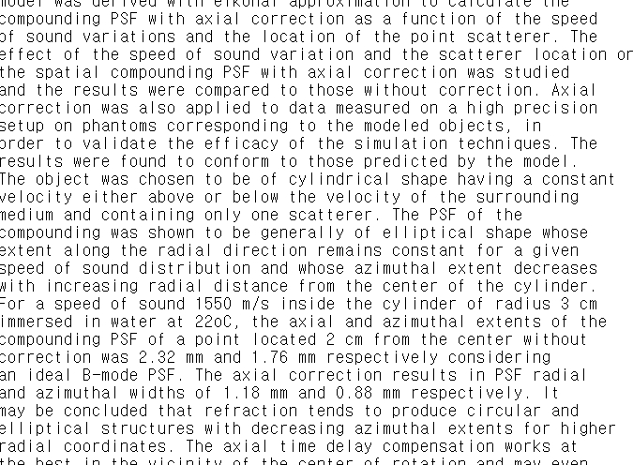
Text generation
Total characters : 7918
Tocal vocab : 52
Total Patterns : 7818

Slide 3
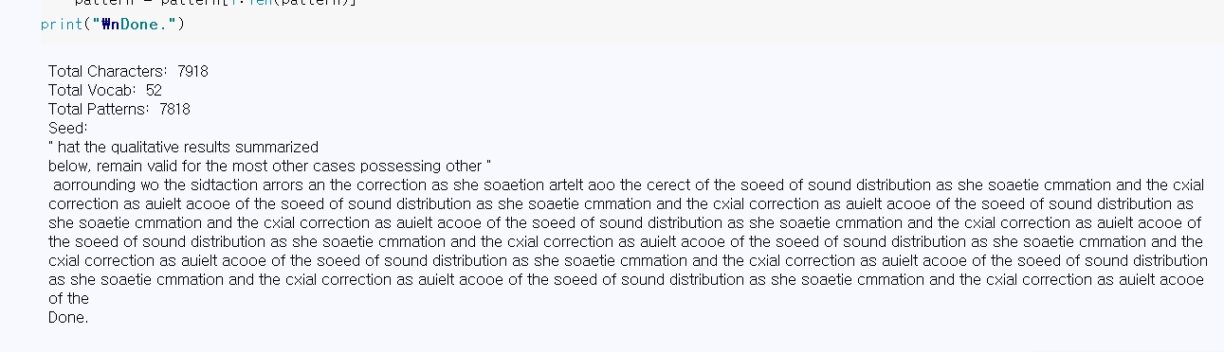
Text generation
Epoch : 30
Loss : 1.7248

Slide 4
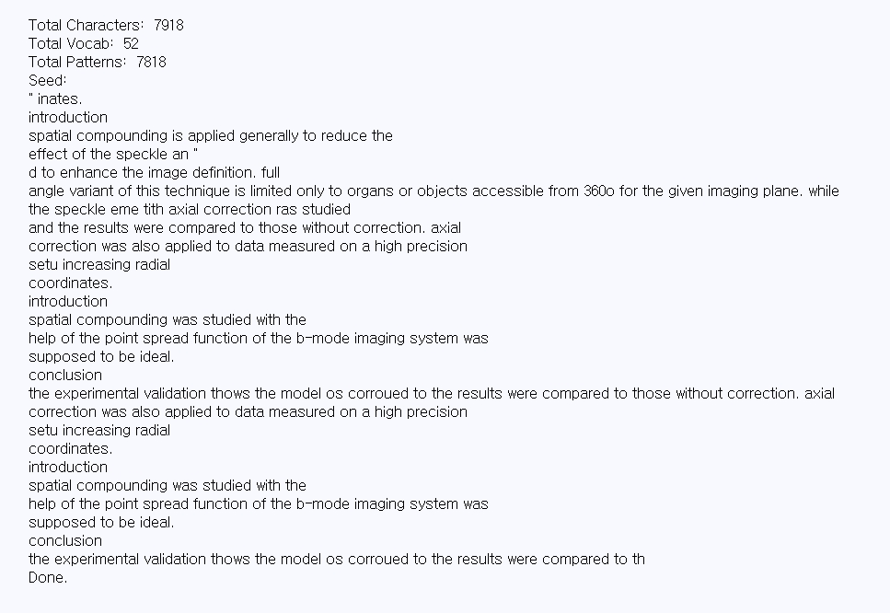
Text generation
Epoch : 50
Loss : 0.3069

Slide 5
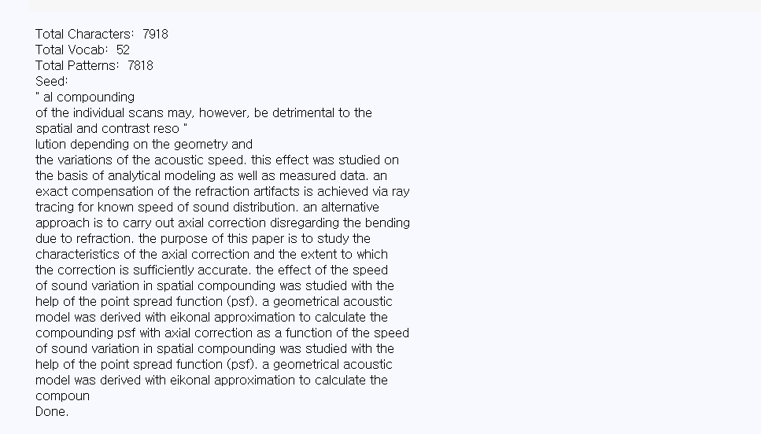
Text generation
Epoch : 100
Loss : 0.0838

Slide 6
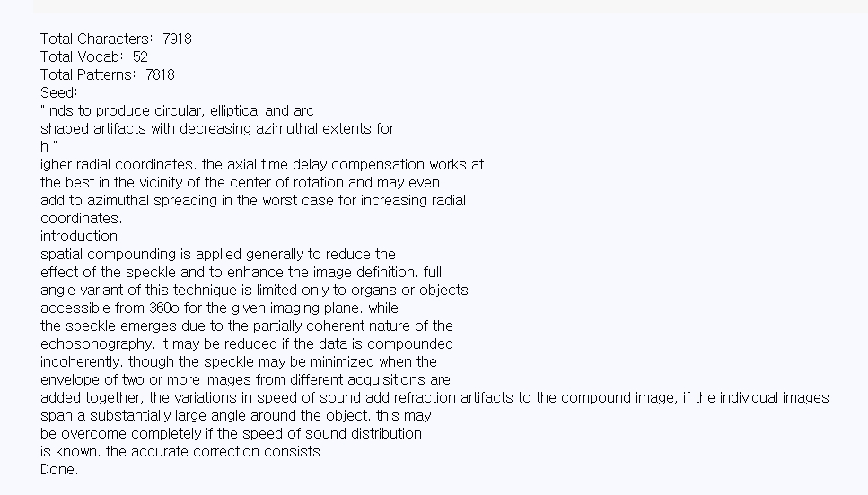
Text generation
Epoch : 150
Loss : 0.0229

Slide 7
Thank you for your attention
\

