Slide 1
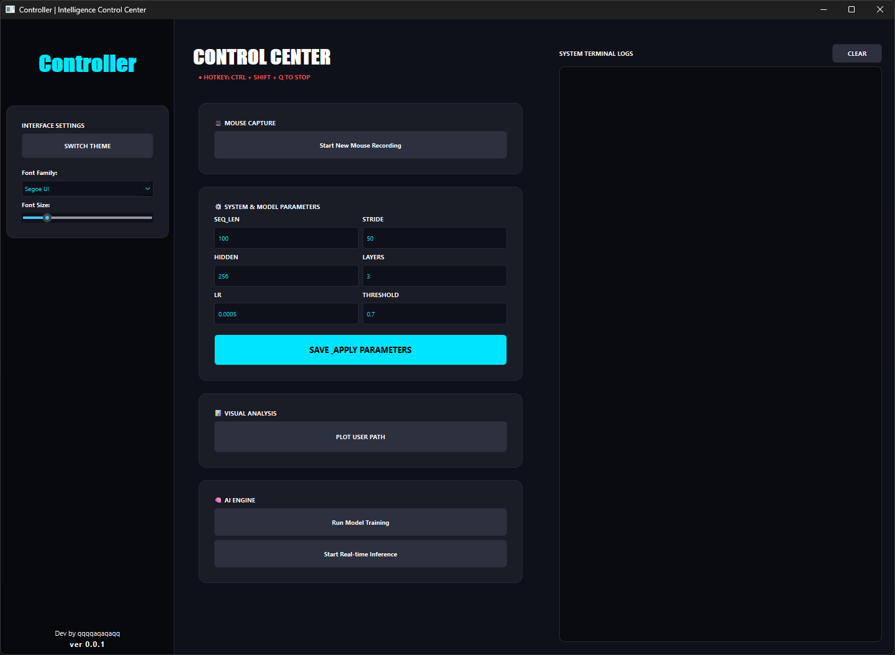
UI
STOP KEY
(Recording / Train / Inference)
Log Panel
Dark Mode/White Mode
Font
Env Setting
Visible User Record Path
Train
Inference

Slide 2
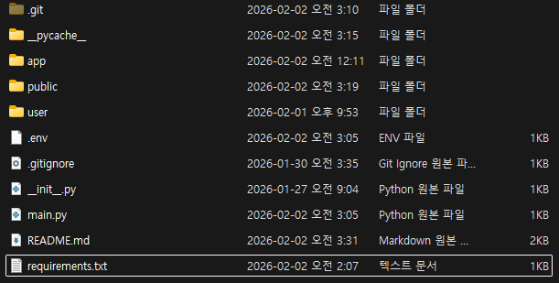
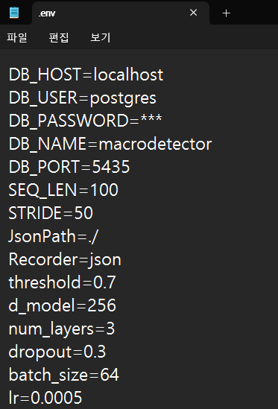
Setting
1. git clone https://github.com/qqqqaqaqaqq/mouseMacroDetector.git
2. create .env file
# Recorder
# use postgres => postgres
# use json => json
Recorder=json
# use postgres
DB_HOST=localhost
DB_USER=your_name
DB_PASSWORD=your_db_password
DB_NAME=your_db_name
DB_PORT=db_host
# Requirements
SEQ_LEN=100
STRIDE=50
JsonPath=./
threshold=0.7
d_model=256
num_layers=3
dropout=0.3
batch_size=64
lr=0.0005

Slide 3
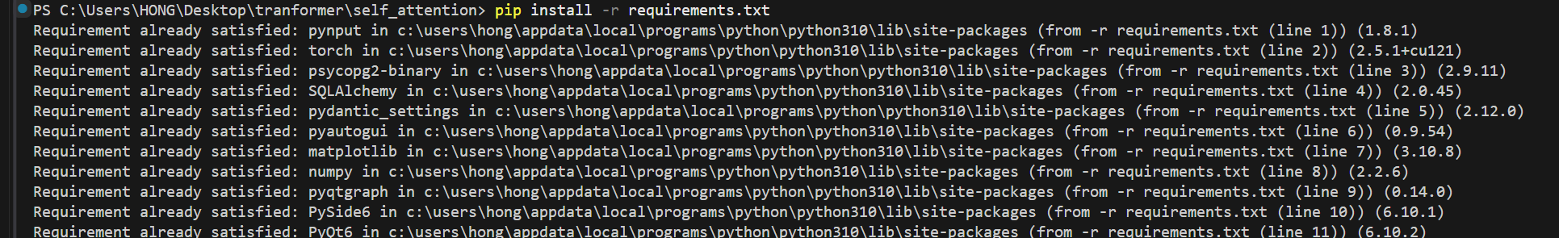
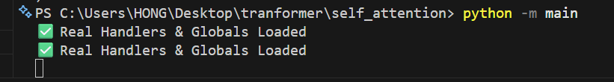

Setting
3. Install dependencies from requirements.txt
- Python version 3.10.9 or higher is required.
4. Run : Success message: "Real Handlers & Globals Loaded"
When you first start Postgres, it will look like the image below

Slide 4
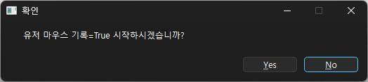
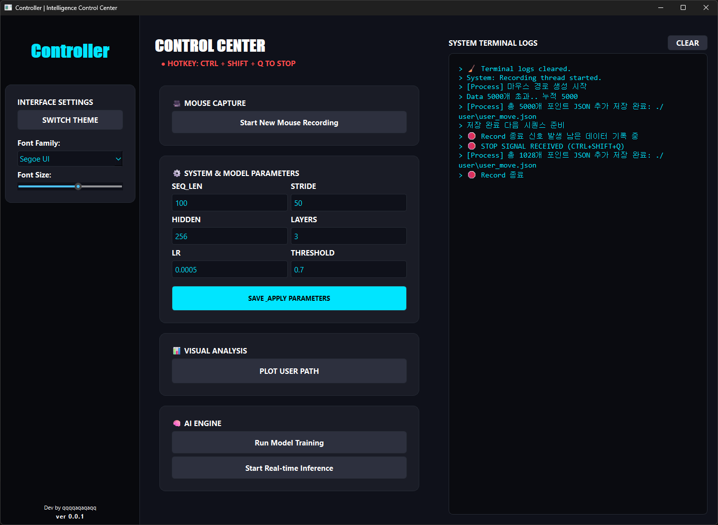
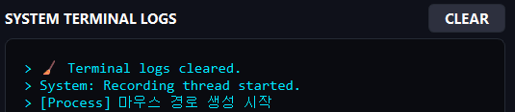

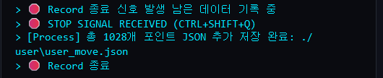
Record
1. Click Start New Mouse Recording => Yes
2. Records only on movement
3. Ctrl + shift + q => quit

Slide 5
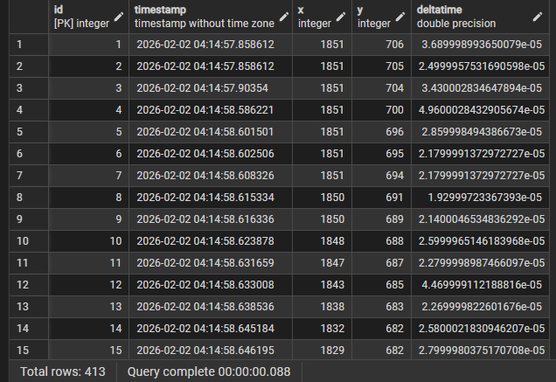
Record - Dataset
json
Postgres (pgadmin)
[
{
"timestamp": "2026-02-01T21:50:21.317201",
"x": 2679,
"y": 357,
"deltatime": 6.330001633614302e-05
},
{
"timestamp": "2026-02-01T21:50:21.318696",
"x": 2680,
"y": 357,
"deltatime": 2.0799983758479357e-05
},
{
"timestamp": "2026-02-01T21:50:21.325893",
"x": 2682,
"y": 356,
"deltatime": 2.559996210038662e-05
}
....
]

Slide 6
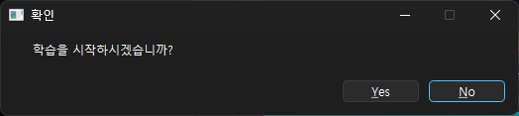
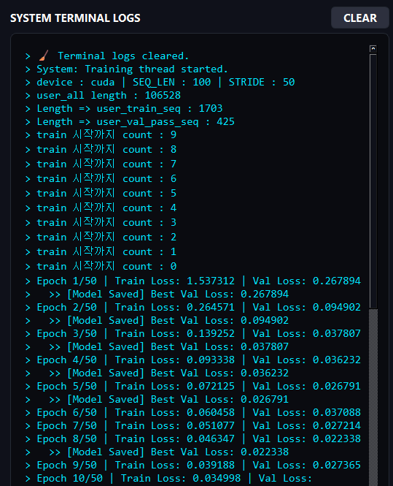
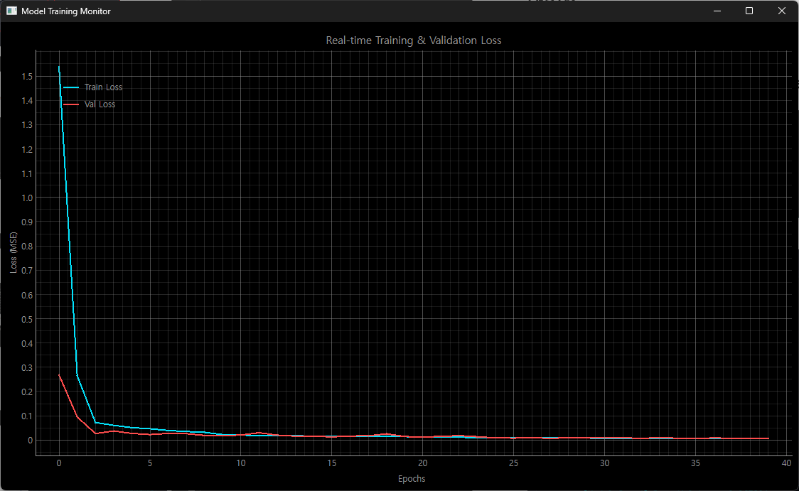
Train
1. Click Run Model Training => Yes
3. Log
2. Show Real time Training Chart
4. Finally
Notice: Min Data Length ≥ Global.SEQ_LEN * 1000
- Continuous collection is not required (DeltaTime is calculated independently).
- The more accumulated data, the better.

Slide 7
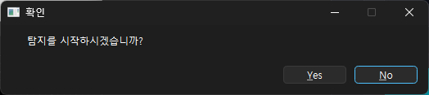
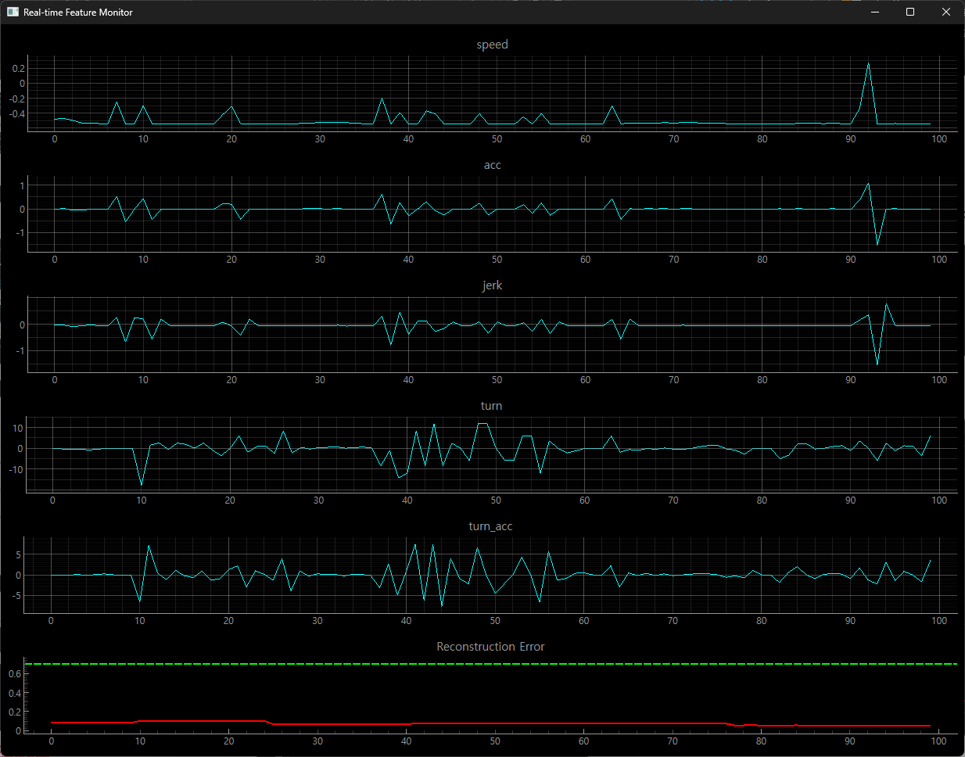
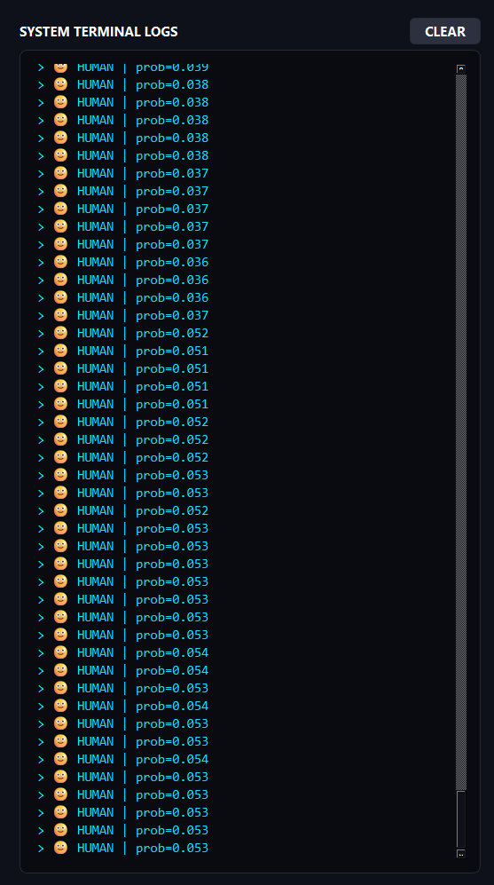
Inference
1. Click Start Real time Inference => Yes
2. Show Real time Feacture / Threshold Chart => Human

Slide 8
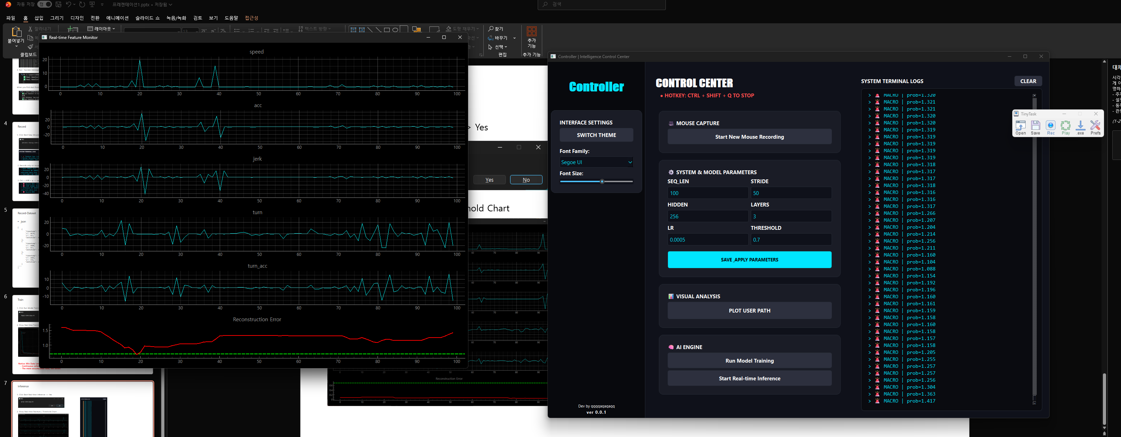
Inference
3. Show Real time Feacture / Threshold Chart => Macro
4. Set the threshold appropriately.

