Slide 1
Graph Theory

Slide 2
What's graph theory?
How are graphs represented?
Directed and Undirected graphs.
Applications of graph theory.
Shortest path discovering problems.
Dijkstras algorithm in a nutshell.
Agenda
Bellman Ford's algorithm in a nutshell.
References we opted.

Slide 3
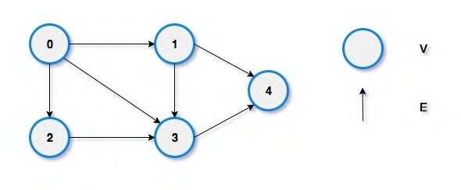
What's Graph Theory
The study of graphs, which are mathematical structures used to model pairwise relations between objects.
Graph's theoretically a territory which's composed of two subsets, each containing vertices and edges
Vertices are addressed as nodes, their motive in this concept is to store data and function as access points
Edges are referred to as pointers, they define and maintain the relationship between two nodes thus embarking the essence of functionalities of graphs.

Slide 4
Directed And Undirected Graphs
Undirected Graphs
The undirected graph is also referred to as the bidirectional. It is a set of objects (also called vertices or nodes), which are connected together. Here the edges will be bidirectional. The two nodes are connected with a line, and this line is known as an edge.
Directed Graphs
Is also known as the digraph, which is a collection of set of vertices edges. Here the edges will be directed edges, and each edge will be connected with order pair of vertices.

Slide 5
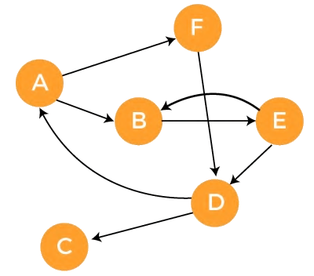
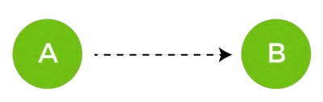
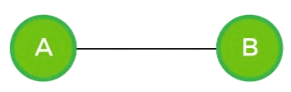
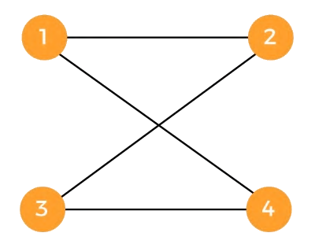

Slide 6
How are graph's represented?
An Adjacency matrix allows representing a graph with
a V × V matrix M = [f(i, j)] where each element f(i, j)
contains the attributes of the edge (i, j).
If the edges do not have an attribute, the graph
can be represented by a boolean matrix
to save memory space
An adjacency list represents
a graph as an array of linked lists. The index of the array represents a vertex and each element in its linked list represents the other vertices that form an edge with the vertex.

Slide 7
Graph
Adjacency List
{“1” : [[2, 1], [3, 1]],
“2” : [[3, 3]],
“3” : [[4, 4]],
“4” : [[1, 5]]}
1
5
1
4
2
1
Adjacency Matrix
4
3
3
[[0, 1, 1, 0],
[0, 0, 3, 0],
[0, 0, 0, 4],
[5, 0, 0, 0]]

Slide 8


Applications of Graph Theory
Social Media - Friends' suggestion.
Gmaps - connecting two nodes through a medium of nodes and finding optimized path from source to destination.
Networking Topologies.
X – Rays.
Circuit Designs.
To model relationships between objects.

Slide 9
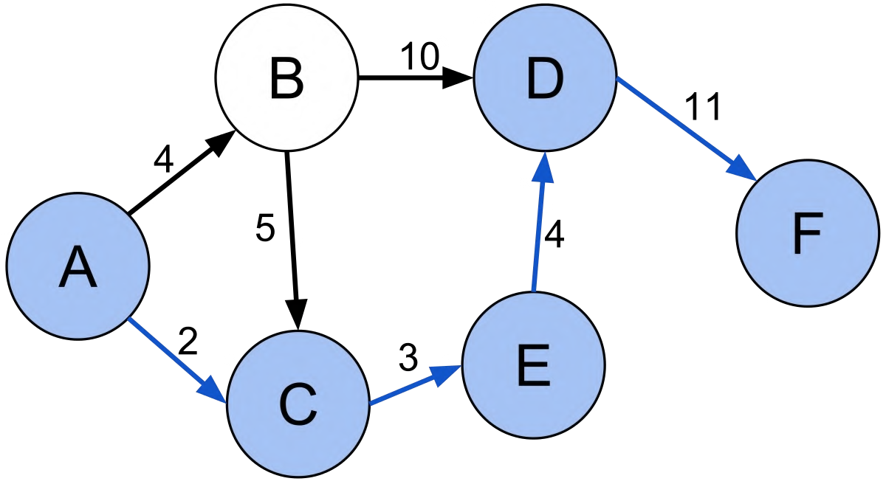
Shortest Path Discovering Problems
The shortest path problem involves
finding the shortest path between two vertices (or nodes) in a graph.
Algorithms Generally deployed to figure these out are
Dijkstras Algorithm
Bellman Ford Algorithm
A* Search
Floyd Warshall Algorithm

Slide 10
Dijkstras Algorithm
This is an algo which is implemented on a graph to find shortest distance between two vertices or more…
Using the greedy algorithm approach this technique was discovered by computer scientist Edsger W. Dijkstra
Pros
Easily implemented using loops
flexibility to use heaps for storing vertices of source nodes to discover
Adjacency list implementation has an impeccable time-complexity of [O(VlogV + E) → V is tally of vertices | E is tally of edges]
Cons
Adjacency matrix implementation has a terrible time-complexity of [O(V^2)]
Can't detect negative weighted or valued edges
Seems a tough cookie at start to learn but process gets better as time elapses

Slide 11
Concept Behind Dijkstra's Algorithm
inf
inf
0
5
15
B
D
A
Here, the motive is to find shortest path from source vertex A to all vertices
inf
8
4
3
inf
7
C
9
H
9
inf
1
11
5
6
13
F
inf
inf
4
G
E
20

Slide 12
Solution
Fix initial point, then make its min distance 0.
Explore the nodes connected to it.
Then initialize the distance from source node to them as their min-dist-value, and set the origin node as its predecessor.
Initialize the priority queue and push in the nodes connected to source node.
Pop the queue to get node nearest to source and mark it as visited.
Continue to check distance between src node to the target nodes, if distance is less than its current min value, then assign the new one and make src nde as target node's predecessor.
Repeat the whole process until there's nothing in priority queue.
Atlast, track path using predecessors to display the output.

Slide 13
Solution Graph
5
17
0
5
15
B
D
A
14
4
3
Green Arrows
represent shortest path from source vertex to target vertices
8
8
7
C
9
H
9
13
1
11
5
6
13
Numerals in Green
resemble shortest distance of each target vertex from source vertex
F
25
9
4
G
E
20

Slide 14
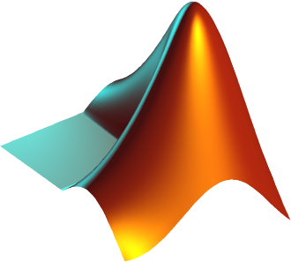
function distance = dijkstras_algo(map, startingpoint)
%map of distances among N nodes
%N = No. of nodes
N = length(map);
%initialize the distance to all points as infinity
%its Inf as Nodes aren't explored yet
distance(1:N) = Inf;
%note all nodes as unvisited
visited(1:N) = 0;
%initialize the distance to the first point as zero.
%cuz... distance from the node to itself is Nothing a.k.a 0
distance(startingpoint) = 0;
while sum(visited)<N
%find unvisited nodes
%anything that's visited is Inf else it stands with real weight
candidates(1:N) = Inf;
for index = 1:N
if visited(index) == 0
candidates(index) = distance(index);
end
end
%find the one with smallest distance value
[currentdistance, currentnode] = min(candidates);
%given the distance to the current point, update the distances
%to all its neighbours if the new distance will be smaller
for index = 1:N
newdistance = currentdistance + map(currentnode, index);
if newdistance < distance(index)
distance(index) = newdistance;
end
end
%mark the current node as visited
visited(currentnode) = 1;
%loop it through untill all nodes are *visited*
end
end

Slide 15

Adjacency List implementation
import heapq
class Node:
def __init__(self, name):
self.name = name
self.predecessor = None
self.min_value = float('inf')
self.adjacency_list = list() # gotta add edges here
self.visited = False
def __lt__(self, other_node):
return self.min_value < other_node.min_value
class Edge:
def __init__(self, weight, origin_vertex, target_vertex) -> None:
self.origin_vertex = origin_vertex
self.target_vertex = target_vertex
origin_vertex.adjacency_list.append(self)
self.weight = weight
class DijkstrasAlgorithm:
def __init__(self) -> None:
self.heap = list()
def calculate(self, start_vertex):
start_vertex.min_value = 0
heapq.heappush(self.heap, start_vertex)
while self.heap:
actual_node = heapq.heappop(self.heap)
if actual_node.visited:
continue
for edge in actual_node.adjacency_list:
org = edge.origin_vertex
dest = edge.target_vertex
heapq.heappush(self.heap, dest)
if org.min_value + edge.weight < dest.min_value:
dest.min_value = org.min_value + edge.weight
dest.predecessor = org
actual_node.visited = True
def min_path(self, vertex):
print("the shortest distance from source vertex to given vertex is {} ".format(vertex.min_value))
actual = vertex
while actual:
print(F"{actual.name}", end= ' -> ' if actual.predecessor else '')
actual = actual.predecessor

Slide 16
Adjacency Matrix implementation
import sys
class DijkstraAlgorithm:
def __init__(self, adjacency_matrix, start_vertex):
#if 0 then no connection
self.adjacency_matrix = adjacency_matrix
self.start_vertex = start_vertex
self.v = len(adjacency_matrix)#no. of vertices
self.visited = [False for _ in range(len(adjacency_matrix))]
self.distances = [float('inf') for _ in range(len(adjacency_matrix))]
self.distances[start_vertex] = 0
def get_min_vertex(self):
#find the vertex with lowest distance value
min_vertex_value = sys.maxsize
min_vertex_index = 0
#linear serach in O(N) time cmplxty
for index in range(self.v):
if not self.visited[index] and self.distances[index] < min_vertex_value:
min_vertex_value = self.distances[index]
min_vertex_index = index
return min_vertex_index
def calculate(self):
#we consider all the items in O(V) time complexity
for vertex in range(self.v):
actual_vertex = self.get_min_vertex()
print(F"considering vertex {actual_vertex}")
self.visited[actual_vertex] = True
for other_vertex in range(self.v):
#if there is a connection between two nodes
if self.adjacency_matrix[actual_vertex][other_vertex]>0:
#is there a shorter path to the other_vertex from actual_vertex ?
if self.distances[actual_vertex] +self.adjacency_matrix[actual_vertex][other_vertex] < self.distances[other_vertex]:
self.distances[other_vertex] = self.distances[actual_vertex] + self.adjacency_matrix[actual_vertex][other_vertex]
def print_distances(self):
print(self.distances)

Slide 17
Bell-Man Ford’s Algorithm
Bellman Ford algorithm helps us find the shortest path from a vertex to all other vertices of a weighted graph.
It is similar to Dijkstra’s Algorithm but it can work with graphs in which edges can have negative weights.
Computer scientists Richard Bellman and Lester Ford published papers on it in the year 1958 and 1956
Edward Moore joined the party by publishing a new optimized variation of Bell-Man Fords Algorithm thus paving the way to call this algorithm “Bell-Man Ford Moore algorithm”
With a not so impressive time complexity of O(V*E) [ V – no. of vertices | E – no. of edges] this programs continues to strive for its negative edge detecting feature

Slide 18
Concept Behind Bell-Man Ford’s Algorithm
inf
inf
0
5
15
B
D
A
Here, the motive is to find shortest path from source vertex A to all vertices
inf
8
4
3
inf
7
C
9
H
9
inf
1
11
5
6
13
F
inf
inf
4
G
E
20

Slide 19
Solution
Fix initial point, then make its min distance 0.
Explore the nodes connected to it.
Then initialize the distance from source node to them as their min-dist-value, and set the origin node as its predecessor.
Continue to check distance between src node to the target nodes, if distance is less than its current min value, then assign the new one and make src nde as target node's predecessor.
The same process has to be repeated N-1 time where N is the no. of nodes or vertices
Its affirmative that shortest paths have been discovered after N-1 iterations
But we have to profess one last iteration to validate whether it has negative edges or not
In the last iteration if any node’s min_distance value seems to fluctuate then it has a negative edge
If it has one then we have to print an exception else reflect the path to shortest distance

Slide 20
Solution Graph
5
17
0
5
15
B
D
A
14
4
3
Green Arrows
represent shortest path from source vertex to target vertices
8
8
7
C
9
H
9
13
1
11
5
6
13
Numerals in Green
resemble shortest distance of each target vertex from source vertex
F
25
9
4
G
E
20

Slide 21
class Edge:
def __init__(self, weight, start_vertex, target_vertex):
self.weight = weight
self.start_vertex = start_vertex
self.target_vertex = target_vertex
self.start_vertex.adjacency_list.append(self)
class Node:
def __init__(self,name):
self.name = name
#list gotta store edges connected to it
self.adjacency_list = list()
self.predecessor = None
self.min_distance = float('inf')
class BellmanFordAlgorith:
def __init__(self, vertex_list, edge_list, start_vertex):
self.vertex_list = vertex_list
self.edge_list = edge_list
self.start_vertex = start_vertex
self.has_cycle = False #has negative cycle or not by default its False
def find_shortest_path(self):
self.start_vertex.min_distance = 0
#iterate through (V-1) Times as per algo
for _ in range(len(self.vertex_list)-1):
# in every iteration we consider all the edges
#final running time O(V*E)
for edge in self.edge_list:
#we have to calculate wheter are there shorter paths
u = edge.start_vertex
v = edge.target_vertex
distance = u.min_distance + edge.weight
if distance < v.min_distance:
v.predecessor = u
v.min_distance = distance
#after we make V-1 iterations we have to check negative cycles
for edge in self.edge_list:
if self.check_cycle(edge):
print("Negative cycle detected....")
return
def check_cycle(self, edge):
# if the total cost (min_distance) of a given vertex decreases after V-1 iterations
# it means there is a negative cycle
if edge.start_vertex.min_distance + edge.weight < edge.target_vertex.min_distance:
self.has_cycle = True
return True
else:
return False
def get_shortest_path(self, vertex):
if not self.has_cycle:
print("shortest path exists with value : {}". format(vertex.min_distance))
node = vertex
while node is not None:
print(node.name)
node = node.predecessor
else:
print('there is a negative cycle in the G(V,E) graph...')

Slide 22






References Opted

Slide 23
An awesome presentation
Group III – AIE Sem1
Siddhaarth
Rasha Sharma
Amrit Subramanian
Abhiram

