Slide 1
HDD benchmark problem: a powerful tool for learning and designing controllers
2011-09-20
Xu Chen

Slide 2
The benchmark problem is…
A MATLAB oriented tool set that implement HDD track seeking and following algorithms
A combination of matlab script and simulink models, to completely construct and simulate the control system (including the disturbance generation)
A great tool to learn HDD control

Slide 3
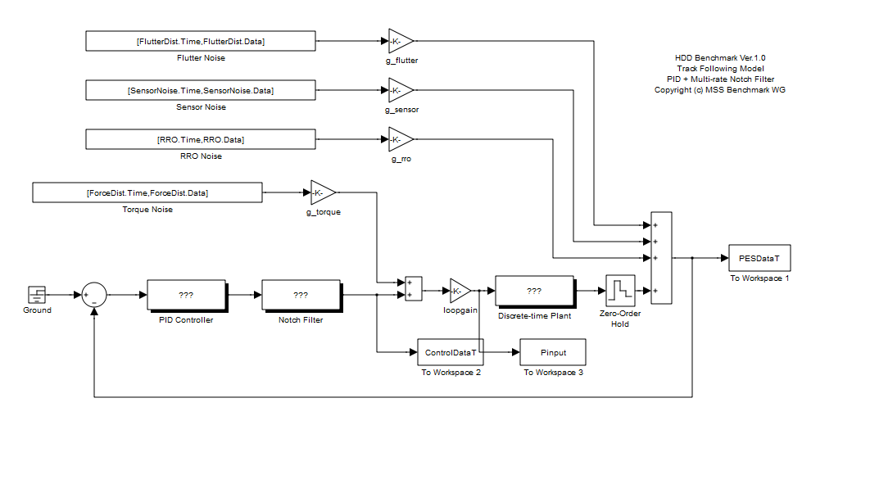
Benchmark: how and why
For the above basic feedback control system, the benchmark tool can generate in detail EVERY elements in the block diagram!

Slide 4
To get a little more details:
Make_plant.m:
  Wn = 2*pi*Fn;
  ap = [ 0 1;-Wn(1)^2, -2*Zeta(1)*Wn(1) ];
  bp = [ 0; Gain(1) ];
  cp = [ 1, 0 ];
  sys_p(1,1,1) = ss(ap,bp,cp,0);
  sys_plant = sys_p(1);

Slide 5
Essential main functions:
HDDBench.m
Seekdemo.m
Followdemo.m
SimTrackFollowing.mdl
…

