Slide 1
HDD Benchmark Problem -disturbance profile
Xu Chen
2008-2013

Slide 2
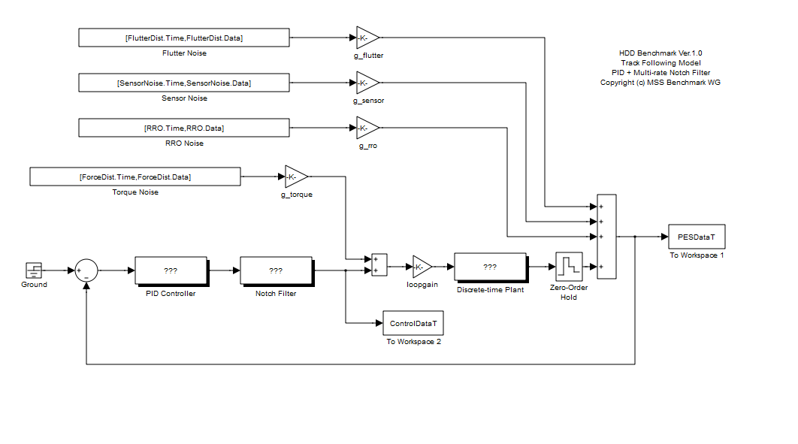
Force dist.: white noise obeying normal distribution; standard deviation: 1e-4
Sensor noise: white noise obeying normal distribution; standard deviation: 1.5e-2
RRO: sinusoidal signals
Flutter dist.: colored noise; generated by filtering white noise through a series of second order systems;

Slide 3
Force dist. is white

Slide 4
i.e., force dist.
filtered by
the plant model

Slide 5
FlutterFreq = [ 750, 780, 900, 1020, 1080, 1230, 1800, 3000, 5000];
FlutterFreqZeta = [ 0.01, 0.01, 0.01, 0.01,0.005, 0.01,0.005,0.002,0.002];
AmpFlutterDist = [ 0.09, 0.17, 0.20, 0.17, 0.06, 0.09, 0.06, 0.06, 0.12]*scl; (scl will be cancelled in whitenoise.m)
Flutter dist.: colored noise;
generated by filtering white noise through a series of second order systems;

Slide 11
Numerical values of disturbance profile: hdd_distparam_v2.m
Run HDDBench.m to check the above

Slide 12
Appendix: the plant

