Slide 1
Chapter 9 – Automatic Update
JSON
with open
File Times
Cron Job in Windows
hashlib & hmac
pickle & marshal

Slide 2
os.path.getmtime( ) P.9-2
Has a file been modified?
Is filesize the same?
Is its last modified time the same?
Not precise, because modTime can be changed by the user. See Slide 15.
Is checksum the same?
See Slide 26
On P.9-3, only fileSize and fileMTime are considered.
They are stored in a dictionary as a tuple associated with its fileName as the key:
{ … fileName: (fileSize, fileMTime), … }
Two tuples (lists) can be compared or sorted directly.

Slide 3
Save dict in a File
A dict is stored in the main memory, so you certainly want to store it in a secondary memory in case of power failure or system restart.
str or bytes can be read()/write() directly. int, float, bool can be converted to bytes with struct.pack() (See P.3-9).
How should we handle tuple, list, or dict?
JSON can be utilized to handle these in-memory objects.

Slide 4
JSON
JavaScript Object Notation – a lightweight data interchange format.
It was originally designed for communication between the web server and client in a REST API, but is also useful for other inter-application communication needs.
Python | JSON
dict | object
list, tuple | array
str | string
int, float | number
True | true
False | false
None | null
https://docs.python.org/3.7/library/json.html#json.JSONEncoder

Slide 5
json.dumps() and loads()
{'a': 'A', 'b': (2, 4), 'c': 3.0}
{'a': 'A', 'b': (2, 4), 'c': 3.0}
import json
json.dumps([123, "four hundred", 3.14])
'[123, "four hundred", 3.14]'
s = '[123, "four hundred", 3.14]'
json.loads('[123, "four hundred", 3.14]')
[123, 'four hundred', 3.14]
d = {'c': 3.0, 'a': 'A', 'b': (2, 4)}
json.dumps(d)
'{"c": 3.0, "a": "A", "b": [2, 4]}'

Slide 6
Note: Some Differences P.9-8
Strings in JSON are quoted only in double quotes.
In Python, strings are quoted in single quotes or double quotes.
Most functions, such as repr() or pprint.pprint() prefer single quotes.
There is no “tuple” in JSON, so if you convert a tuple to JSON and then convert it back, it becomes a list.
A dict in Python is called an “object” in JSON. However, its key can only be str. (int key will also be converted to str)
s = json.dumps({1: "one"})
d = json.loads(s)
{'1': 'one'}

Slide 7
Output the keys of a dict in sorted order
s1 = json.dumps( {'a':'A', 'b':(2,4), 'c':3.0 } )
s2 = json.dumps( {'c': 3.0, 'a': 'A', 'b': (2, 4)} )
s1 == s2
False
s1 = json.dumps( {'a':'A', 'b':(2,4), 'c':3.0 }, sort_keys=True )
s2 = json.dumps( {'c': 3.0, 'a': 'A', 'b': (2, 4)}, sort_keys=True )
s1 == s2
True
Notes:
Actually, you can compare two dictionaries and you will get “True”.

Slide 8
indent and separators
The default is (', ', ': ')
d = {'a':'A', 'b':(2,4), 'c':3.0 }
print(d)
{'a': 'A', 'b': (2, 4), 'c': 3.0}
print( json.dumps(d, indent=2) )
{
"a": "A",
"b": [
2,
4
],
"c": 3.0
}
json.dumps(d, separators=(',',':'))
'{"a":"A","b":[2,4],"c":3.0}'
A more compact output.
Nice for nested data structures.
The output format is similar to that of pprint.
The default is (', ', ': ').

Slide 9
with open() P.9-11
fp = open("a.txt", "w")
for i in range(1, 7):
print(i, file=fp)
fp.close()
with open("a.txt", "w") as fp:
for i in range(1,7):
print(i, file=fp)
# The opened file automatically closed
when it exits the block..

Slide 10
json.dump() and load()
import json
with open("a.json", "w") as fp:
d = {"a":"A","b":[2,4],"c":3.0}
s = json.dumps(d)
print(s, file=fp)
import json
with open("a.json", "r") as fp:
s = fp.read()
d = json.loads(s)
print(d)
import json
with open("a.json", "w") as fp:
d = {"a":"A","b":[2,4],"c":3.0}
s = json.dump(d, fp)
import json
with open("a.json", "r") as fp:
d = json.load(fp)
print(d)

Slide 11
Exercise: List Updated Files
Utilizing scan_dir() developed in Chapter 7.
Write a program which lists all updated files since the last time you run this program.
Try to modify some files and run the program again. See whether it correctly list those updated files.
Inspect the log file (e.g., you may name it as “update.log”) to see whether it correctly records the size and modified time of each file.

Slide 12
Epoch Time
{"./json_sort_keys.py": [230, 1581950078.8192046], "./update.log": [144, 1581950061.1542056]}
What does this magic number means?
This is the number of seconds since the epoch.
The epoch is January 1, 1970, 00:00:00 (UTC).
To find out what the epoch is on a given platform, look at time.gmtime(0).
time.gmtime(seconds) - Convert seconds since the Epoch to a time tuple expressing UTC (a.k.a. GMT).
time.localtime(seconds) – Convert to local time (CST=GMT+8)
When 'seconds' is not passed in, convert the current time instead.
Conversely, you may convert a time tuple in local time to seconds since the Epoch.
time.mktime( time.localtime() )
1582028742.0
Universal Time Coordinated
Greenwich Mean Time
Notes:
[ˋɛpək] 值得紀念的日子
time.localtime(1582028742.0)
time.struct_time(tm_year=2020, tm_mon=2, tm_mday=18, tm_hour=20, tm_min=25, tm_sec=42, tm_wday=1, tm_yday=49, tm_isdst=0)

Slide 13
Human-Readable Form: strftime( )
localtime()
strftime()
seconds
time tuple
str
mktime()
time.strftime("%a, %Y-%m-%d %H:%M:%S", time.localtime(1581950061.0))
'Mon, 2020-02-17 22:34:21'
time.strftime("%a, %Y-%m-%d %H:%M:%S")
'Tue, 2020-02-18 23:54:02'
Current time

Slide 14
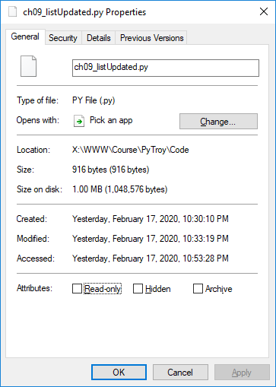
File Times
Created Time
Modified Time
Accessed Time
Not all file systems can record creation and last access times, and not all file systems record them in the same manner.
The NTFS file system delays updates to the last access time for a file by up to 1 hour after the last access.
In Unix,
ls -l – show the last modified time
ls -lu – show the last accessed time
ls -lc – show the last “status changed” time
https://docs.microsoft.com/en-us/windows/win32/sysinfo/file-times

Slide 15
os.utime( )
These metadata are stored in filesystems, so users can modify them.
os.utime(filename, times)
times = None
current time
times = (atime, mtime)
last access time & last modified time
t = datetime.datetime(year=2020, month=2, day=14, hour=19, minute=7, second=26)
atime = mtime = time.mktime(t.timetuple())
os.utime(“a.txt", (atime, mtime))
time.localtime(os.path.getmtime("a.txt"))
time.struct_time(tm_year=2020, tm_mon=2, tm_mday=14, tm_hour=19, tm_min=7, tm_sec=26, tm_wday=4, tm_yday=45, tm_isdst=0)
https://nitratine.net/blog/post/change-file-modification-time-in-python/

Slide 16
Exercise: Last Modified Time
When you backup files on remote servers, you want the last modified time to be the same, so that you can know whether one file is newer than the other.
Modify save_file() in Chapter 5 so that after a file is saved on the remote server, changed its last modified time to be the same as the modified time on the client.

Slide 17
JSON at Command Line
If you download a JSON file,
[{"a": "A", "c": 3.0, "b": [2, 4]}]
The json.tool module implements a command line program for reformatting JSON data to be easier to read.
python3 -m json.tool --sort-keys example.json
[
{
"a": "A",
"b": [
2,
4
],
"c": 3.0
}
]

Slide 18
User-Defined Objects in JSON
Q: How to convert a custom types to JSON
A: Convert it to a dict, then dict can be a valid value for JSON.
myObj.py
class Rational:
def __init__(self, numerator=0, denominator=1):
self.numerator = numerator
self.denominator = denominator
def __repr__(self):
return '<Rational({}, {})>'.format(self.numerator, \
self.denominator)

Slide 19
obj_to_dict( )
First observe that a class has a built-in attribute __dict__
from myObj import Rational
a = Rational(1, 3)
a.__dict__
{'numerator': 1, 'denominator': 3}
This is the “contents” of the object. We need to add the “class name” and the “module name” (in which the class is defined).
def obj_to_dict(obj):
d = {
'__class__': obj.__class__.__name__,
'__module__': obj.__module__,
}
d.update(obj.__dict__) # merge two dicts
return d

Slide 20
dict_to_obj( )
def dict_to_obj(d):
if '__class__' in d:
class_name = d.pop('__class__') # get the value corresponding to key
module_name = d.pop('__module__') # and delete this key/value pair from d
module = __import__(module_name) # 平時見到的 "import module_name" 為
# statement, 不能作為 expression.
# 且 module_name 無法是變數
class_ = getattr(module, class_name) # getattr() 和 __import__() 有類似功效
kwargs = {
key : value # brace內可自由換行
for key, value in d.items()
}
inst = class_(**kwargs) # call the constructor with kwargs
else:
inst = d
return inst

Slide 21
object_hook
Now you can instruct JSON how to handle those non-built-in data types.
from myObj import Rational, obj_to_dict, dict_to_obj
a = Rational(1, 3)
json.dumps(a)
TypeError: Object of type 'Rational' is not JSON serializable
s = json.dumps(obj, default=obj_to_dict)
b = json.loads(s, object_hook=dict_to_obj)

Slide 22
XMLRPC
Does XMLRPC provide an easier way to handle user-defined class?

Slide 23
Cron Jobs on Unix
crontab -e # edit
0-55/5 * * * * /usr/local/bin/python3.7 /home/solomon/Waste/a.py
crontab -l # list
crontab -r # remove

Slide 24
Cron Jobs in Windows
Start – “Scheduled Tasks” – Create Task
Don’t choose “Create Basic Task”, which is too basic for cron jobs.
Check “Run when user is logged in or not”.
Do not store password.
Check “Run with highest privileges”.
Trigger – New
Daily
Repeat task every: 5 minutes, for a duration of 1 day.
Enabled
Action – New
Program: C:\WinApp\Anaconda3\python.exe
Add arguments: D:\Waste\a.py
Start in: D:\Waste
Now you can see the task in the list of “Active Tasks”
https://moreabout.tech/creating-cron-jobs-in-windows-10-and-windows-server-2016/
Notes:
If you click the "Task Scheduler Library", you can inspect the "Next Run Time", "Last Run Time", "Last Run Result" of tasks.
You should not try to access network disk (either in your code, or the starting directory), otherwise the run result will be an error message "The directory name is invalid."

Slide 25
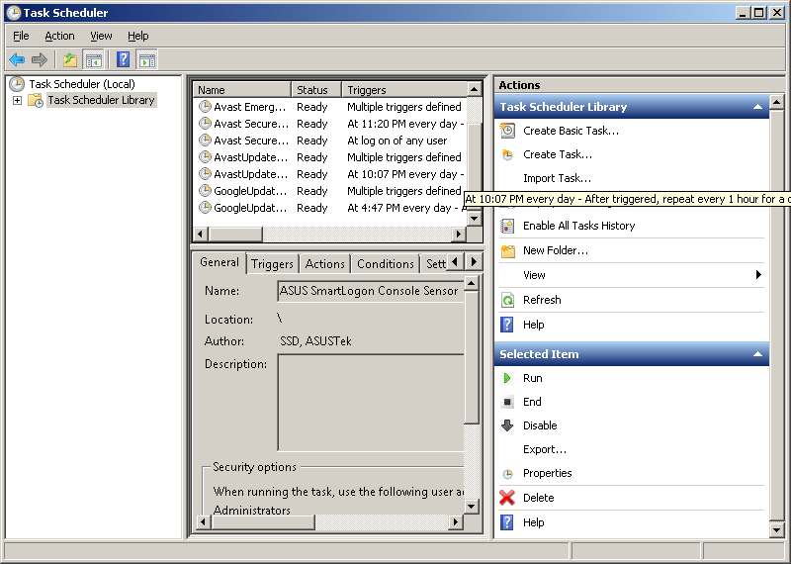
Hands-On: Windows Task Scheduler
Create a task which repeats every 5 minutes.
How do you verify that it successfully runs 12 times in an hour?

Slide 26
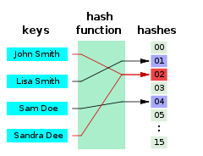
Hash Functions
A hash function is a mathematical algorithm that maps data of arbitrary size (often called the "message") to a bit string of a fixed size (the "hash value", "hash", "checksum", or "message digest").
It is a one-way function, that is, a function which is practically infeasible to invert.
If you design an authentication system, in your database, you should not store users’ passwords in plaintext.
You should store the hashed values.
Ideally, the only way to find a message that produces a given hash is to attempt a brute-force search of possible inputs to see if they produce a match, or use a rainbow table of matched hashes.

Slide 27
hashlib
hashlib is based on the support of OpenSSL, so all the algorithms supported by that library are available, including
md5
sha1
sha224
sha256
sha384
sha512
hashlib.algorithms_available
A set of hash algorithms that are available in the running Python interpreter.
hashlib.algorithms_guaranteed
A set of hash algorithms guaranteed to be supported by this module on all platforms.
This is a subset of the above one.

Slide 28
MD5 and SHA1 Are Insecure
2005 - MD5's designer Ron Rivest wrote that "md5 and sha1 are both clearly broken (in terms of collision-resistance)“.
2008 - Bruce Schneier wrote of the attack that "we already knew that MD5 is a broken hash function" and that "no one should be using MD5 anymore“.
With the computing power of modern desktop PCs and servers, I recommend you to adopt SHA256 whenever you can.
If your code is running on a low-power embedded system, that might be another story. However, you still need to justify why you don’t want to consider SHA256.
We shall adopt sha256 in the following examples.
Because the syntax is the same, you may easily substitute with md5 or sha1 if you want to try.
Q: Isn’t SHA512 more secure? (It has larger digest size.)
A: Yes.But my 7-ZIP only support SHA1 and SHA256 now.

Slide 29
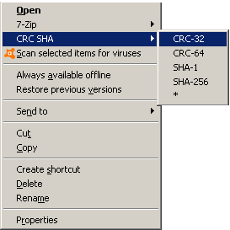
Generating SHA256 Checksums
On Windows,
Install 7-Zip
If you know any command-line utility like Microsoft File Checksum Integrity Verifier, please do tell me.
On FreeBSD,
echo -n "MESSAGE" > msg.txt
sha256 msg.txt
echo -n "MESSAGE" | sha256
sha256 -s "MESSAGE“
On Linux,
sha256sum msg.txt
echo -n MESSAGE | sha256sum
With Python,
Note: -n cannot be omitted.
python -c "import hashlib; print( hashlib.sha256(b'MESSAGE').hexdigest())"

Slide 30
import hashlib
Step-by-step
import hashlib
msg = "MESSAGE"
h = hashlib.sha256( msg.encode('UTF-8') )
print( h.hexdigest() )
More condensed:
hashlib.sha256( b"MESSAGE" ).hexdigest()
h.digest_size
h.block_size
h.name

Slide 31
Incremental Updates
If the message size which you want to hash is very large (e.g., a 4GB ISO file), it is inefficient to load the whole message into the memory.
The design of hashlib (actually, the hash algorithm) allows you to handle one block at a time incrementally, and the result will be the same.
import hashlib
msg = "May the force be with you"
result1 = hashlib.sha256( msg.encode('UTF-8') ).hexdigest()
BLOCK_SIZE=5
h2 = hashlib.sha256()
for i in range( len(msg)//BLOCK_SIZE ):
h2.update( msg[i*BLOCK_SIZE : (i+1)*BLOCK_SIZE].encode('UTF-8') )
result2 = h2.hexdigest()
print(result1, result2, result1 == result2, sep='\n')

Slide 32
MD5 Collision Vulnerability
Q: I understand that MD5 is theoretically vulnerable, but is there a real case with hash collision?
A: https://en.wikipedia.org/wiki/MD5#Collision_vulnerabilities
Message 1:
d131dd02c5e6eec4 693d9a0698aff95c 2fcab58712467eab 4004583eb8fb7f89
55ad340609f4b302 83e488832571415a 085125e8f7cdc99f d91dbdf280373c5b
d8823e3156348f5b ae6dacd436c919c6 dd53e2b487da03fd 02396306d248cda0
e99f33420f577ee8 ce54b67080a80d1e c69821bcb6a88393 96f9652b6ff72a70
Message 2:
d131dd02c5e6eec4 693d9a0698aff95c 2fcab50712467eab 4004583eb8fb7f89
55ad340609f4b302 83e4888325f1415a 085125e8f7cdc99f d91dbd7280373c5b
d8823e3156348f5b ae6dacd436c919c6 dd53e23487da03fd 02396306d248cda0
e99f33420f577ee8 ce54b67080280d1e c69821bcb6a88393 96f965ab6ff72a70

Slide 33
Exercise: MD5 Collisions
Write a Python program to calculate the MD5 hash of the above two messages, and verify that they are identical.
The output of your program should be:
3f96ad062ec7f28765584259be27208b0cb1921a9b306ccbfc5ea925ca7dd72e
3f96ad062ec7f28765584259be27208b0cb1921a9b306ccbfc5ea925ca7dd72e
True

Slide 34
bytes.fromhex( )
bytes.fromhex( string )
Returns a bytes object, decoding the given string object.
The string must contain two hexadecimal digits per byte, with ASCII whitespace being ignored.
bytes.fromhex("4142 43 44")
b'ABCD‘
bytes.hex( )
Return a string object containing two hexadecimal digits for each byte in the instance.
bytes.hex( b'ABCD' ) or b'ABCD'.hex()
'41424344'

Slide 35
ch09_md5Collision.py
import hashlib
msg = "May the force be with you"
result1 = hashlib.sha256( msg.encode('UTF-8') ).hexdigest()
BLOCK_SIZE=5
h2 = hashlib.sha256()
for i in range( len(msg)//BLOCK_SIZE ):
h2.update( msg[i*BLOCK_SIZE : (i+1)*BLOCK_SIZE].encode('UTF-8') )
result2 = h2.hexdigest()
print(result1, result2, result1 == result2, sep='\n')

Slide 36
MD4 Algorithm?
Q:
I am reading an old cryptography textbook (or an old document such as RFC 1320) and want to try some examples of MD4.
I saw “MD4” is listed in hashlib.
But hashlib.md4() shows an error message
module 'hashlib' has no attribute 'md4‘
How should I use this hash function?
A:
Only guaranteed algorithms have been assigned a constructor name.
blake2b, blake2s, md5, sha1, sha224, sha256, sha384, sha3_224, sha3_256, sha3_384, sha3_512, sha512, shake_128, shake_256
For those available but not guaranteed algorithms, you should create the hash function by name.

Slide 37
Create a Hash by Name
import hashlib
import sys
msg = input()
hash_name = sys.argv[1]
if hash_name in hashlib.algorithms_available:
# hashlib.new(hash_name, b"MESSAGE").hexdigest()
h = hashlib.new(hash_name) # hashlib.new('sha256')
h.update( msg.encode('UTF-8') )
result = h.hexdigest()
print( result )
else:
print( "The hash algorithm '{}' is not supported.".format( hash_name ) )
echo -n MESSAGE | python ch09_hashName.py sha256
echo -n MESSAGE | python ch09_hashName.py md5
echo -n MESSAGE | python ch09_hashName.py md4
# Note: Not every platform implements MD4.
Notes:
In Unix bash, “echo –n” to suppress the newline.
In Windows command-line, ECHO | SET /P dummy="MESSAGE" | python ch09_hashName.py sha256

Slide 38
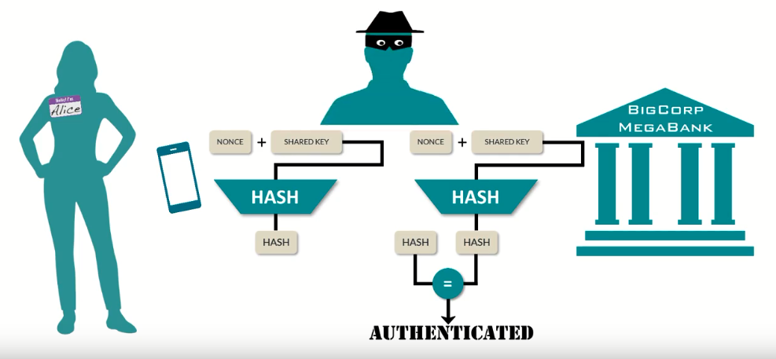
Shared Key Authentication
https://www.youtube.com/watch?v=Dd7KqKuXgfM

Slide 39
Exercise: Shared Key Authentication
Write a program which prompts the user to input
key
filename
and generate the hash value of “key+filename”. Save the result as filename+”.sig”
By default, use the “SHA256” hash algorithm.
The program may run as follows:
$ python3 ch09_auth.py
Key? python
Filename? a.txt
The hash value is stored at a.txt.sig
If the key is “python”, and the contents of “a.txt” is “msg” (3 bytes, no newline), the contents of “a.txt.sig” will be
01accbe10339b3033a32d6a49ce149a8927a71f4adff231039331126a8982c6d
Notes:
ch09_auth.py

Slide 40

HMAC
Hash Message Authentication Code – defined in RFC 2104 to provide a simple and fast approach to check the integrity of information transmitted over or stored in an unreliable medium.

Slide 41
import hmac
You can specify the digestmod.
hmac.new(b'key', b'msg').hexdigest()
'18e3548c59ad40dd03907b7aeee71d67'
hmac.new(b'key', b'msg', 'md5').hexdigest()
hmac.new(b'key', b'msg', 'MD5').hexdigest()
hmac.new(b'key', b'msg', hashlib.md5).hexdigest()
hmac.new(b'key', b'msg', hashlib.sha256).hexdigest()
h = hmac.new(b'key', digestmod=hashlib.sha256)
h.update(b'msg')
h.hexdigest() # str (64-character)
Show for human-readable
h.digest() # bytes (32-byte)
Sent in network communication

Slide 42
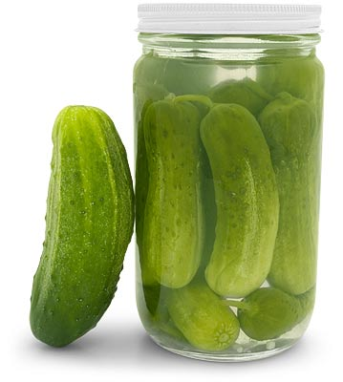
pickle (P.9-10)
“Pickling” is the process to convert a Python object into a series of bytes.
This process is also called “serializing” the object.
import pickle
obj1 = [{'c': 3.0, 'a': 'A', 'b': 2 }]
data = pickle.dumps(obj1) # data is actually bytes, not str
obj2 = pickle.loads(data)
print( obj1 is obj2 )
print( obj1 == obj2 )
False
True
The newly constructed object is equal to, but not the same object as, the original.

Slide 43
Pickle to a File
import pickle
obj1 = [{'c': 3.0, 'a': 'A', 'b': 2 }]
with open("a.dat", "wb") as outfile:
pickle.dump(obj1, outfile)
with open("a.dat", "rb") as infile:
obj3 = pickle.load(infile)
print( obj1 == obj3 )
json.dump() outputs texts, so it opens a text file.

Slide 44
User-Defined Objects in pickle
It’s much easier than JSON.
from myObj import Rational
import pickle
a = Rational(1, 3)
data = pickle.dumps(a)
print(data)
You don’t need to write your own “default handler” or “object hook”.
import pickle
with open("a.dat", "rb") as fp:
data = pickle.load(fp)
print(data)
you don’t need to explicitly import the module. It will be automatically imported when unpickling.
Notes:
Only the data for the instance is pickled, not the class definition.
When pickling, the class name is used to find the constructor to create a new object.
Therefore, the class being pickled must appear in the namespace of the process reading the pickle.
The module name is also stored in the pickled data, so as long as the module is under the current working directory, you don’t need to explicitly import the module. It will be automatically imported when unpickling.

Slide 45
JSON vs. pickle
JSON is a text serialization format, while pickle is a binary serialization format.
JSON is human-readable, while pickle is not.
JSON is interoperable and widely used outside of the Python ecosystem, while pickle is Python-specific.
JSON, by default, can only represent a subset of the Python built-in types, and no custom classes; pickle can represent an extremely large number of Python types.
If you have complex object hierarchies that need to be serialized, pickle is the solution which makes your life easier.
If you only need to handle simple built-in data types, JSON is faster.
https://konstantin.blog/2010/pickle-vs-json-which-is-faster/
Notes:
WWW/Lang/Python/nato_alphabet.py

Slide 46
marshal
If you are quite sure that your code will only handle built-in data types, you may consider the module marshal, which is a more primitive serialization module.
It is faster, and the output is smaller (in most cases).
Marshalling is alternatively known as “serialization”, “Pickling”, or “flattening”.
The API is exactly the same as pickle:
dumps(), loads(), dump(), load()
You can even insert this line into your code:
import marshal as pickle
The program will run faster.
But the serialized data will be different from the one generated by pickle, as you may expect.
Notes:
The example in https://pymotw.com/3/pickle/index.html#circular-references actually tries to explain that pickle can handle recursive objects, but marshal can not.

Slide 47
Exercise: Size Comparison
Create 10 arbitrary data objects in Python.
Serialize them with JSON, pickle, and marshal, respectively.
Observe the size of the byte series.
The output may look like
Comparing the size ...
JSON Pickle Marshal
390 208 505
102 110 102
373 537 271
Notes:
Lang/Python/nato_alphabet.py

