Slide 1
EcoView
Exploring the Link between the Political Leaning & Sustainability of Each State In U.S.
Anmin Yang, Hantao Xiao, Violet Huang

Slide 2
Motivation & Interest

Slide 3
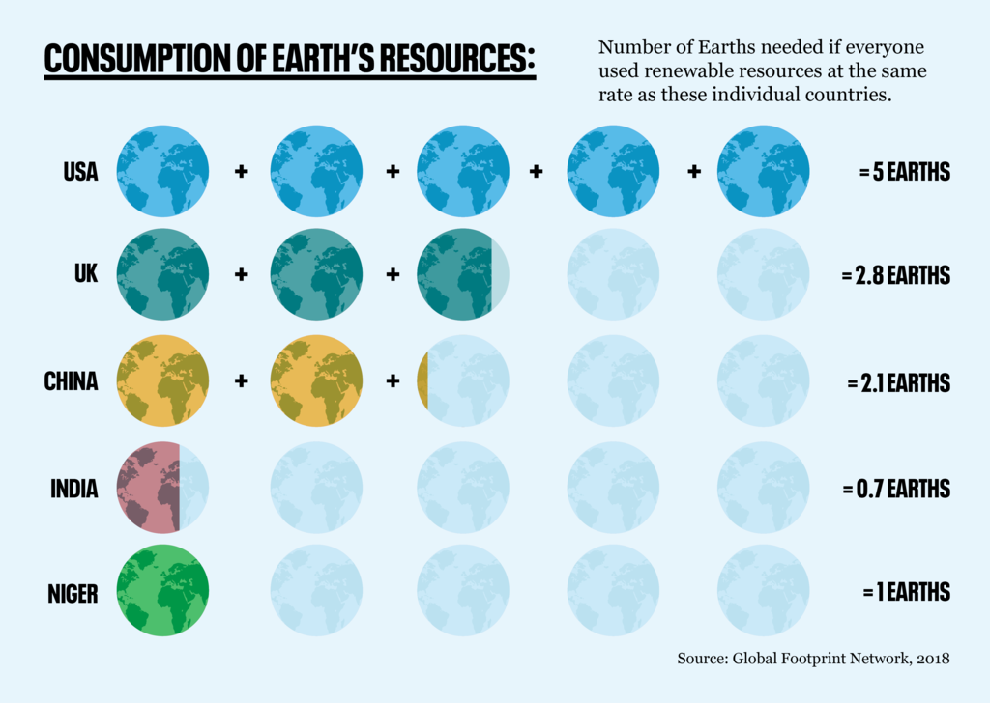
Notes:
interpret graph;
less text
By 2050 xxx

Slide 4
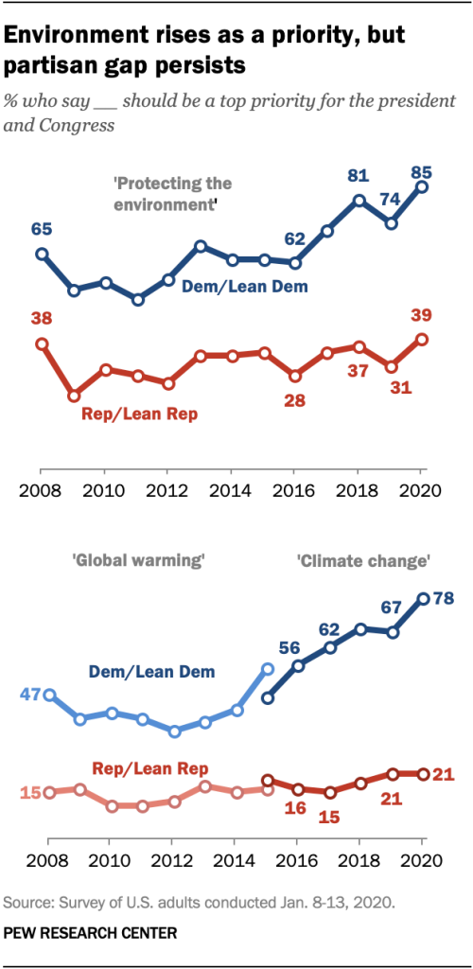
Environment rises as a priority, but the partisan gap persists
% who says ____ should be a top priority for the president and Congress

Slide 5
Content
Results
&
Implications
Data Collection
&
Analysis Methods
Project Description
&
Objectives

Slide 6
Project Description & Objectives
01

Slide 7
Project Description
Hypothesis
Concept-ualization
Interest
What is the relationship between sustainability and political leaning at the state level?
States with more sustainability efforts are more democratic.
Sustainability: The efforts and effects of a state in conserving environment and using renewable resources
Political Leaning: The extent of a state being Democratic or Republican

Slide 8

Conceptualizing Sustainability
Legislative Efforts
Measures the extent of a state proposing and installing environmental protection and energy conservation laws and policies at the state and federal level
Clean Energy Jobs
Measures the amount of people working in the clean energy sector
. . . . . .
. . . . . .
Environmental Quality
Measures the amount of pollutants a state emits and the cleanliness of environment
Clean Energy Share
Measures the proportion of energy generated using clean energy source
. . . . . .
. . . . . .

Slide 9
Project Significance
Other Projects
Our Project
Unit of Analysis
Individual
State
Perception
Action
Variable 1
Political Leaning
Political Leaning
Variable 2

Slide 10
Data Collection & Analysis
02

Slide 11
Data Collection
Concept | variable | Description | Resource
Clean Energy Jobs | EMPLOYMENT | Amount of labor working in the clean Energy industry | E2
Clean Energy Jobs | SHARE | Ratio of workforce working in the clean Energy industry | E2
Clean Energy Jobs | GROWTH | Percentage change in employment compared to the previous year. | E2
Environmental Quality | GOOD DAY RATIO | The proportion of days with good air quality in a year | EPA
Environmental Quality | EMISSION PER CAPITA | Emission of harmful particles per capita | EPA
Clean Energy Share | GREEN RATIO | The proportion of green source in electricity generation | EIA
Legislative Efforts | POLICY_SCORE | The score indicates the implementation level energy efficiency policies in a state | ACEEE
Legislative Efforts | NUMBER_BILL | The number of environmental protection bills proposed in a year | GovTrack
Political leaning | SCORE | State's ideological position | Politics
Range: (-47, 68)
Notes:
bullet points for five sources, make it big; open one link during presentation; keep sources and variables separate

Slide 12
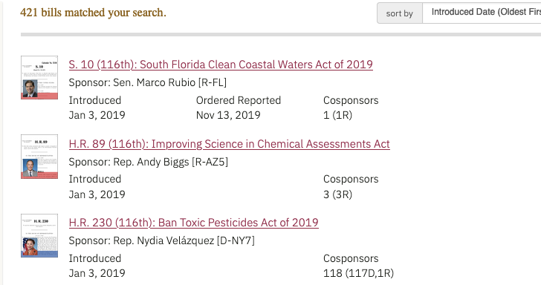
Collecting Number of Bills in GovTrack
Title
Time
Name
Political Party
State

Slide 13
Data Preview
Title | Title Link | state | party | Year | Time
H.R. 5973 (117th): Great Lakes Fish and Wildlife Restoration Reauthorization Act of 2022 | https://www.govtrack.us/congress/bills/117/hr5973 | MI | D | 2021 | 15-Nov-21
H.R. 5715 (117th): To reauthorize the Morris K. Udall and Stewart L. Udall Trust Fund, and for other purposes. | https://www.govtrack.us/congress/bills/117/hr5715 | AZ | D | 2021 | 25-Oct-21
H.R. 3756 (117th): Department of Homeland Security Climate Change Research Act | https://www.govtrack.us/congress/bills/117/hr3756 | NY | D | 2021 | 8-Jun-21
H.R. 2021 (117th): Environmental Justice For All Act | https://www.govtrack.us/congress/bills/117/hr2021 | AZ | D | 2021 | 18-Mar-21
H.R. 2021 (117th): Environmental Justice For All Act | https://www.govtrack.us/congress/bills/117/hr2021 | AZ | D | 2021 | 18-Mar-21
S. 66 (117th): South Florida Clean Coastal Waters Act of 2021 | https://www.govtrack.us/congress/bills/117/s66 | FL | R | 2021 | 27-Jan-21
S. 66 (117th): South Florida Clean Coastal Waters Act of 2021 | https://www.govtrack.us/congress/bills/117/s66 | FL | R | 2021 | 27-Jan-21
S. 2372 (117th): Recovering America’s Wildlife Act of 2022 | https://www.govtrack.us/congress/bills/117/s2372 | NM | D | 2021 | 15-Jul-21
H.R. 4677 (117th): New York-New Jersey Watershed Protection Act | https://www.govtrack.us/congress/bills/117/hr4677 | NY | D | 2021 | 22-Jul-21
H.R. 1546 (117th): Combating Online Wildlife Trafficking Act of 2021 | https://www.govtrack.us/congress/bills/117/hr1546 | GA | R | 2021 | 3-Mar-21

Slide 14
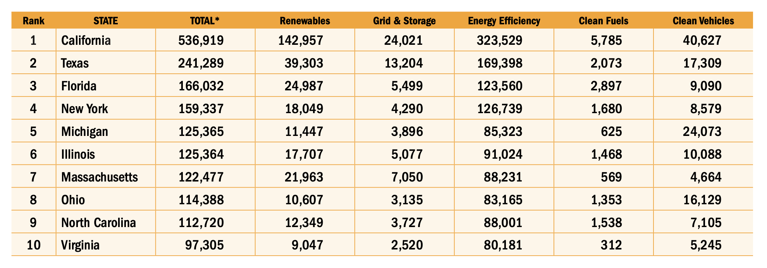
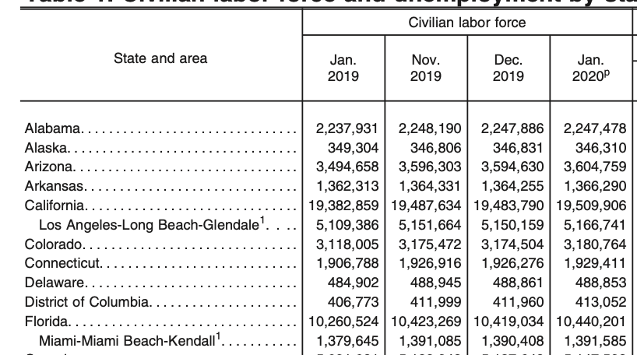
Collecting Clean Energy Employment in E2 and BLS
Employment in Clean Energy Sector from E2
Share of Clean Energy Employment :
$\frac{The number of employment in clean energy industry }{The number of employment in all industries}$
Employment in all sectors from BLS

Slide 15
Data Augmentation
Treating Missing Value
Normalization
Data Integration
Using linear regression to approximate missing clean energy employment data before 2019 from 2019 to 2021 data
Pseudo data in 2019 and 2021 political leaning, averaged from nearby years
Calculating share of clean energy employment by using two data sources
Calculating growth of clean energy employment from previous year's data
Normalizing variables affected by population (emission, employment)
Normalizing all variables from 0 to 1 for each year

Slide 16
Data Preview
204 rows x 11 columns
State | year | Share | Growth | Good Day Ratio | GREEN RATIO | SCORE | Number_bill | Population | Emission | Political_leaning
Iowa | 2018 | 0.019 | -0.025 | 0.770 | 0.375 | 17.000 | 0.000 | 0.010 | 44.695 | -6.000
Iowa | 2019 | 0.018 | -0.002 | 0.836 | 0.397 | 18.500 | 0.000 | 0.010 | 40.137 | -7.500
Iowa | 2020 | 0.020 | -0.097 | 0.856 | 0.424 | 12.500 | 0.000 | 0.010 | 33.220 | -9.000
Iowa | 2021 | 0.020 | 0.050 | 0.783 | 0.389 | 8.000 | 3.000 | 0.010 | 35.939 | -9.306
... | ... | ... | ... | ... | ... | ... | ... | ... | ... | ...
Michigan | 2018 | 0.026 | -0.021 | 0.843 | 0.448 | 28.500 | 20.000 | 0.030 | 8.433 | 1.000
Michigan | 2019 | 0.025 | -0.006 | 0.883 | 0.458 | 28.500 | 26.000 | 0.030 | 7.836 | 3.500
Michigan | 2020 | 0.028 | -0.095 | 0.879 | 0.469 | 28.500 | 10.000 | 0.030 | 6.162 | 6.000
Michigan | 2021 | 0.028 | 0.056 | 0.798 | 0.454 | 26.000 | 13.000 | 0.030 | 6.944 | 2.412

Slide 17
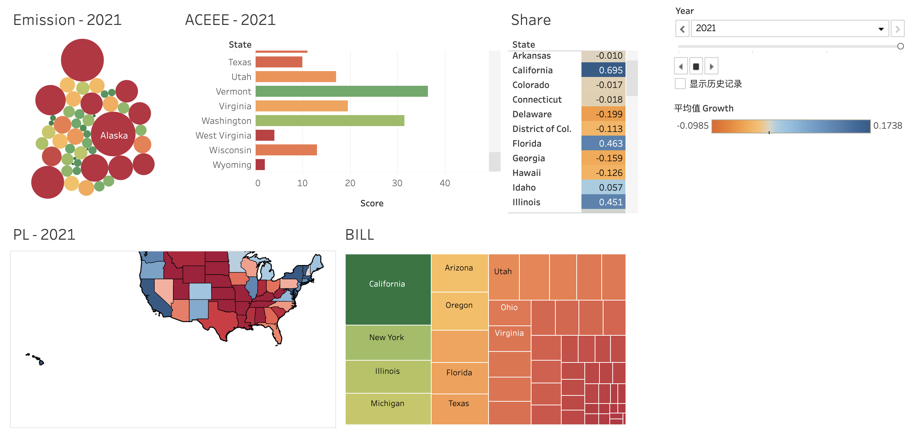
Features Overview: Interactive Interface
Notes:
variation of xx by state over time, explain the measure again, and put the numbers in context, put title of graph larger, put legend and scale on visualization; 2 variables

Slide 18
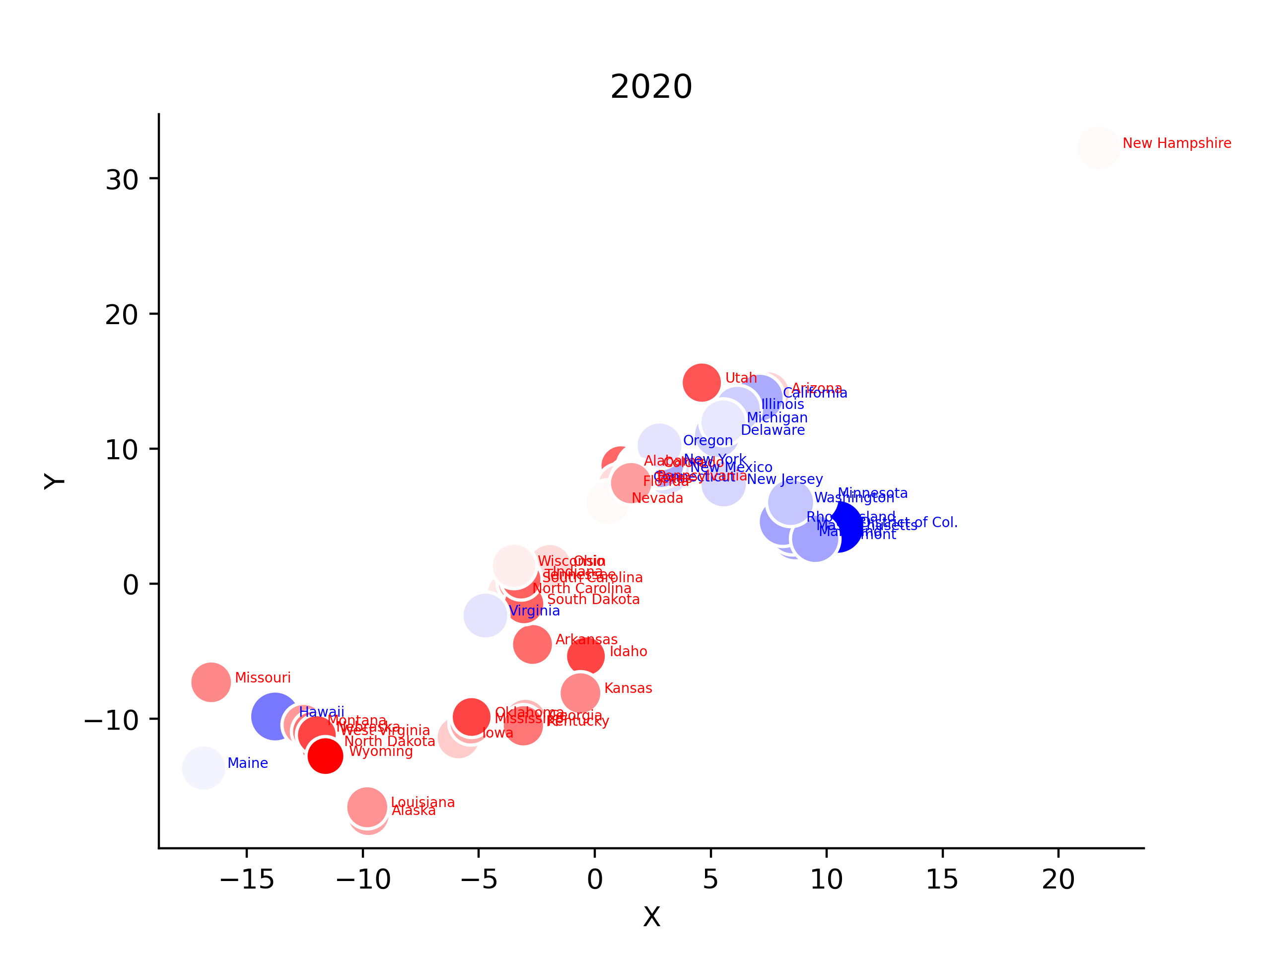
Features Overview: Dimension Reduction with t-SNE
Notes:
New Hampshire is so different from other states for all its attributes are similar to the average except small population

Slide 19
Exploring Correlation (averaged feature)
 | Share | Grouth | Good Day Ratio | Green Ratio | Score | Emmision per Capita | Number of Bills
Political Leaning | 0.4 | 0.23 | 0.012 | 0.24 | 0.87 | -0.34 | 0.37

Slide 20
Data Advantage and Limitation
Advantage | Limitation
Temporal data incorporating pre-covid and post-covid | Missing value in 2018 employment data (only top 10 included), simulated with linear regression using the latter years
Multiple aspects: Job Market, Energy Market, Legislation Effort, Environmental Status | Pseudo data in 2019 and 2021 political leaning, averaged from nearby years
Political Leaning quantified as continuous variable | Over simplification of bill count (different party representatives)

Slide 21
Results & Implications
03

Slide 22
OLS REGRESSION : Y = ‘Political_leaning’
2018: 0.470
2019: 0.502
2020: 0.646
2021: 0.600
Strong significant impact: POLICY_SCORE
Unexpected significant impact: GROW
2020: -0.188

Slide 23
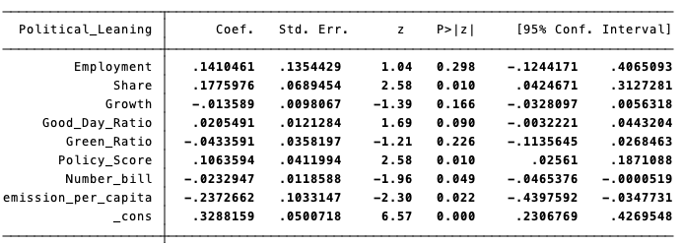
Panel regression 2018-2019: Y = ‘Political_leaning’
Share | Policy_Score | Emission_Per_Capita
Significant | Significant | Significant
0.177 | 0.106 | -0.237

Slide 24
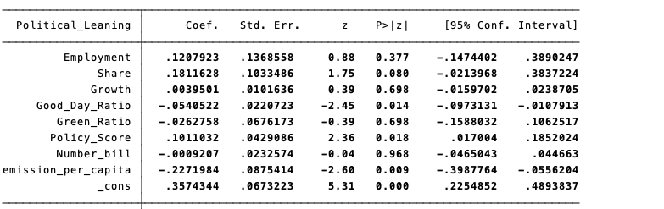
Panel regression 2020-2021: Y = ‘Political_leaning’
Good_Day_Ratio | Policy_Score | Emission_Per_Capita
Significant | Significant | Significant
-0.054 | 0.101 | -0.227

Slide 25
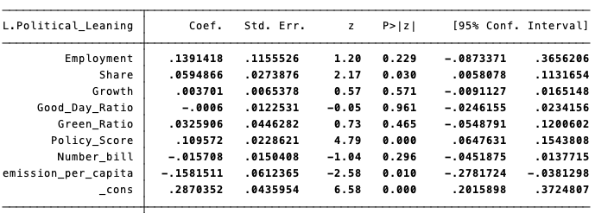
Panel Data Analysis (Lag 1-period): Y = ‘Political_leaning’
Share | Policy_Score | Emission_Per_Capita
Significant | Significant | Significant
0.059 | 0.109 | -0.158
Notes:
say that this result coincides with the previous ols regression; explain what panel data analysis is. eg. to confirm our ols regression, we did xxx, define what lag 1 period is. share does not have a long term effect

Slide 26
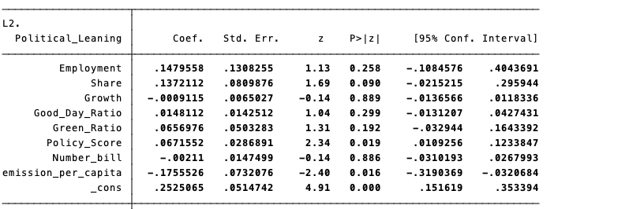
Panel Data Analysis (Lag 2-period): Y = ‘Political_leaning’
Policy_Score | Emission_Per_Capita
Significant | Significant
0.067 | -0.175

Slide 27
Take-Home Points

Slide 28


Take home point (substantial)
states with more sustainable efforts (in terms of clean energy jobs, clean energy share, legislative efforts, environmental quality) are more democratic?
In cross-sectional analysis, sustainable policy score is the only steady indicator of political leaning. The higher the sustainable policy score, the bluer the states.
In 2020, states became redder as clean energy employment growth rate increases. Since 2020 is marked by the Pandemic and clean energy sector took a major blow, we could infer that bluer states faced a more severe setback in the clean energy sector
The use of emission per capita as a time-lagged indicator of political leaning is an intriguing phenomenon that warrants further investigation.

Slide 29
Take home point (substantial)
Do states with more sustainable efforts (in terms of clean energy jobs, clean energy share, legislative efforts, environmental quality) are more democratic?
Pre-Covid | a moderately positive correlation between the political leaning and the “SHARE” ratio of employees working in the clean energy industry.
After-Covid | connection disappears
Emission_per_capital | Negative in (lag-1, lag-2)
Policy_Score | Positive in (lag-1, lag-2)
Share | Positive in (lag-1)
In lag analysis

Slide 30
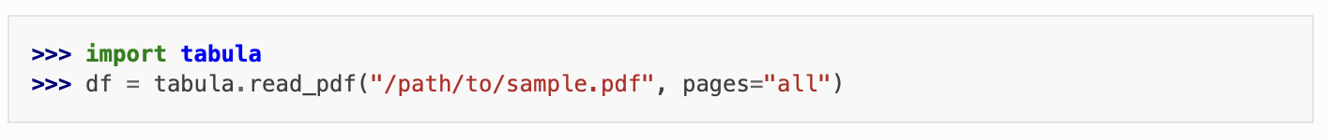
Take-home point from the experience
Using the package Tabula to scrape tabular data stored in PDF files
An efficient data resource of U.S. government: Data.gov
A website that collaborates all data from the U.S. government.
Regression for data with time series: Panel Data
Panel data is a two-dimensional concept, where the same individuum's are observed repeatedly over different periods in time.

Slide 31
Q&A

