Slide 1
MACS 30200
The study of covid19's impacts on unemployment rate in China on provinces' level in 2020 by using regression and time series model.
Jingwen Ni

Slide 2
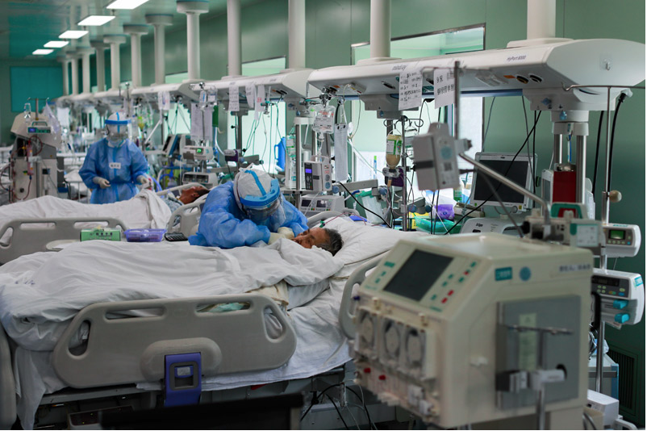
Background/Literature Review: Why covid?
by the end of November in 2021, there were more than 63 million reported cases and 1.4 million deaths over the world.
Notes:
Firstly , let me introduce covid19. Covid19, later renamed as Coronavirus, gripped China since the beginning of 2020。 Wuhan in Hubei province was the first city where was found covid19 cases in China
Why we need to study covid?
by the end of November in 2021, there were more than 63 million reported cases and 1.4 million deaths over the world. Because Covid19 is a respiratory infectious disease, countries published several policies about social distance, quarantine to reduce covid19 infections. This contagious disease changed the world from economics and politics throughout the history.

Slide 3
Background/Literature Review
In China, government took enforce measures that locking down the cities which has covid cases. (eg: From BBC news, From January 23rd, Wuhan was locked down for 72 days )
The control measures to prevent the covid19 leaded 2.7% loss of China’s annual gross domestic product.
Notes:
In China, government took enforce measures that locking down the cities which has covid cases. For example From BBC news, From January 23rd, Wuhan was locked down for 72 days
To the nationwide, China also took actions: for instance, The risk classification for each country is based on the principle of formulating guidelines for classification and implementing the strategy of "internal prevention of spread and external prevention of import" to reduce the possible impact of imported cases on China. Establish a joint prevention and control mechanism at ports of entry, organize the Civil Aviation Administration, public security, health, foreign affairs, border control, airports, and other departments to coordinate the information. The control measures to prevent the covid19 leaded 2.7% loss of China’s annual gross domestic product
Due to covid19, both exports and imports were limited because of the much higher cost of transportation which leaded many businesses got into trouble. They had to cut the number of employees to reduce operations expenses.
Hence in this case, the unemployment rate could increase.

Slide 4
Background/Literature Review: Why Unemployment?
Unemployment was a significant factor which would lead to poverty and income disparity in China (Xue, Zhong, 2003) .
Unemployment would also cause psychological and health problems. (Gali, Smets, Wouters 2022)
Notes:
China, a socialist country, which labor markets reformed and transformed into a market-driven system. After the reformation, people were not limited by “Hukou”, a certification of their birthplace and they were not allowed to work in outside of the birthplace before the reformation, so that there were a lot of migrant-workers those affected by Covid19, the quarantine and lock-down policies. Unemployment was a historical problem and become more serious with time in China because China is a populous country. From United Nations, the world population was 7.6 billion and the population of Mainland was 1.39 billion which was 18.3% of the world while China only has 7.059% land area share of the world. From January 1996 to September 2002, the unemployment of urban residents increased from 6.1% to 11.1%. In economics, unemployment was a significant factor which would lead to poverty and income disparity in China. In 1999, urban unemployment was a major cause of urban poverty, and the growing urban poverty became a significant factor which worsen the urban inequality. This inequality in China has increasing influence on migrant households
In addition to economic perspective, unemployment would also cause psychological and health problems. The unemployed group could have greater symptoms like depression and anxiety than employed group. Moreover, as central of policy debate and aggregate resource utilization, unemployment was also an important indicator
Furthermore, unemployed group was more likely to visit a physician than employed group

Slide 5
Research Question
How covid19 impacts unemployment rate on Provinces’ level in China in 2020?
Hypothesis:
Covid19 will promote unemployment rate in China in 2020 on Provinces’ level
Notes:
The research question is How covid19 impacts unemployment rate on Provinces’ level in China in 2020?
The hypothesis is Covid19 will promote unemployment rate in China in 2020 on Provinces’ level
To answer the research question and test hypothesis, I used time series model and regression model.
Time series model is used to make prediction of unemployment rate in 2020 if covid 19 never exists based on the trend line from 2008 to 2019. Then I make a comparison between the true unemployment rate of each province in 2020 and the predicted unemployment rate of the time series model. From the time series model, we can also see whether the covid 19 has positive or negative impact on unemployment rate on province level by checking the coefficient of covid related variables on 31 provinces
After making the prediction, there exists a gap between the predicted unemployment rate and true unemployment rate of each province. To check whether covid19 is a significant factor of the gap between predicted and true value. I analyze the causal effects between covid19 and unemployment rate by checking the p of variables in OLS regression. If covid is statically significant, The gap can be treated as the impacts from covid19 on unemployment rate.
After analyzing the province level, I explore a little more about the covid effects of unemployment rate on nationwide by running a linear regression and check the feature coefficient.

Slide 6
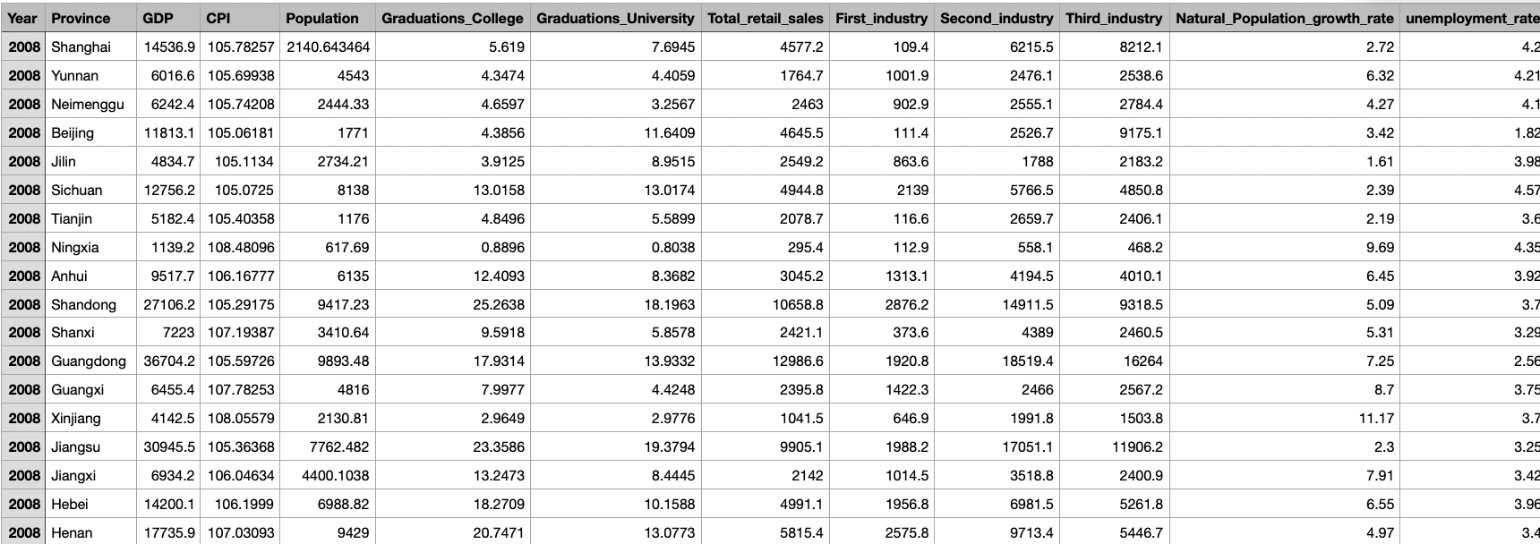
Data: China’s National Bureau of Statistics (NBS)
Harvard
Notes:
Scrape from china’s NBS
1. Products’ price level: CPI (Consumer price index)
2. Education level: the number of graduations from university and from college
3. population: the total population of each province,
4. province’s development level: GDP
5. Economic condition: total retail sales, first industry increased income, second industry increased income, third industry increased income
Download from Harvard
6. Covid: number of confirmed, deaths, recovery from January 15th 2020 to January 15th 2021. Recorded daily on province level.

Slide 7
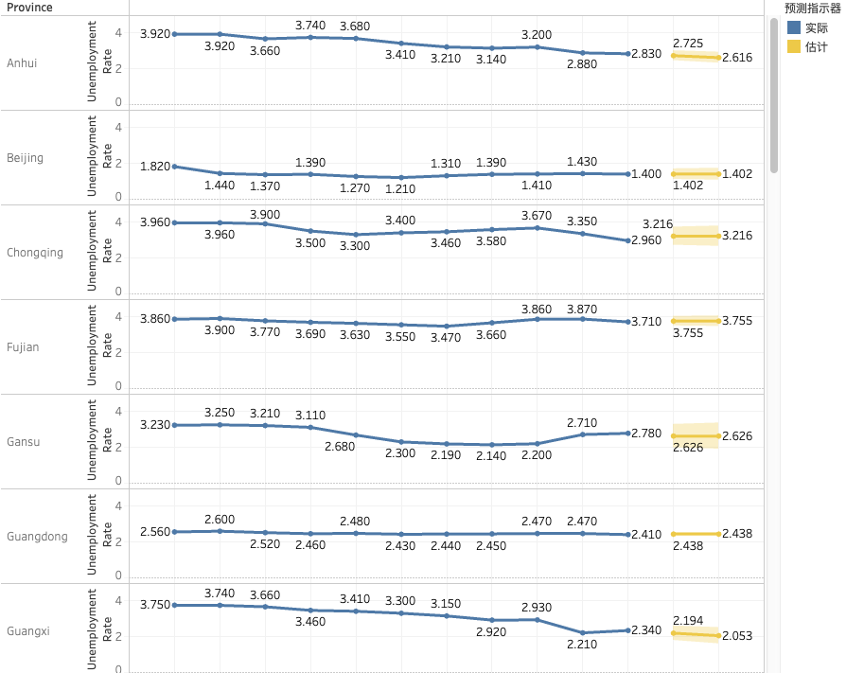
Time Series: Trend line prediction
Notes:
The hypothesis of the research is: covid19 promote the unemployment rate in China. To test the hypothesis, I divided the test into nationwide part and provinces’ part. On the provinces level, from the coefficient of time series model. There are 31 provinces which have different outcomes. The dependent variable is unemployment rate, and covid cases are as independent variables with other control variables. There are 22 provinces have the positive coefficient that means there are 22 out of 31 provinces have increasing unemployment rate and 9 provinces have decreasing unemployment. On provinces’ level, the hypothesis was partially rejected。 Then I calculate the gap value between the predicted unemploymemt rate and true unemployment rate in 2020 to see whether the gap is caused by covid19 by using OLS regression

Slide 8
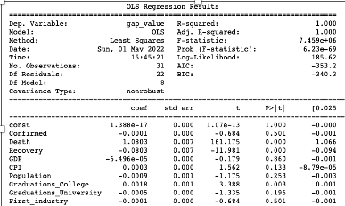
OLS regression: Finding:
Death and Recovery are statistically significant

Slide 9
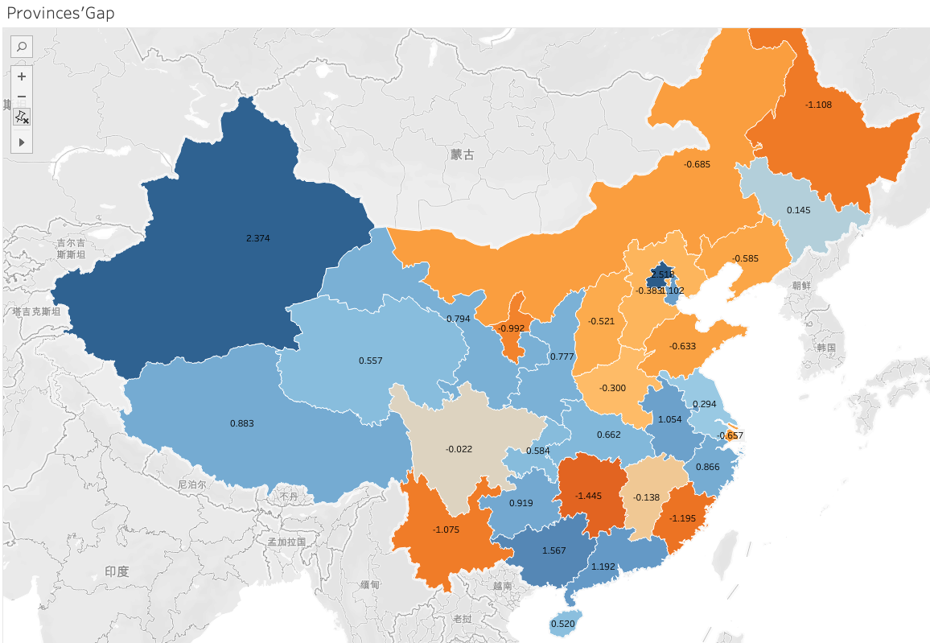
Findings
larger gap concentrate in the southwest part of China and the northeast part has comparative smaller gap between predicted and true unemployment rate
Notes:
larger gap concentrate in the southwest part of China and the northeast part has comparative smaller gap between predicted and true unemployment rate
The reason that the impacts were various geographically is temperature and humidity. Based on previous study, there exists a homogeneity regarding the effect of temperature and humidity on the seasonal viability and transmissibility of covid19. The cold and dry condition make covid19 be more likely to spread than warm and wet weather
In southeast part of China, the temperature and humidity are higher than northwest part. From the previous graph, it is obvious that, the gap value between predicted unemployment rate and true unemployment in northwest part is much larger than that in southeast part which is consistent with the virus characteristics.
Because of the difference of weather condition in northwest and southeast parts. The virus spread much faster and broad in northwest part of China. The China government started the lock down policy in these provinces to keep social distance. Accordingly, the covid19 has better effects on economic and society in northwest part. More companies in southeast part were shut down or reducing employees to relief economic pressure. Hence, unemployment rate in northwest are increase significantly which is consistent with that the gap value between predicted unemployment rate if covid19 never exists and true unemployment rate with covid19 impacts is larger in northwest provinces.

Slide 10
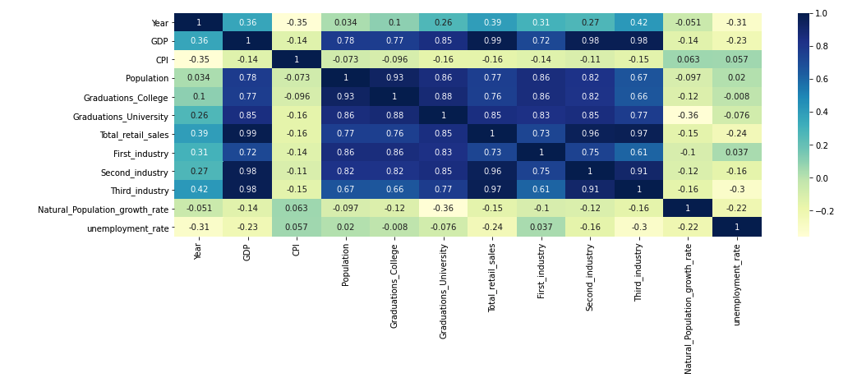
Linear Regression:
Notes:
The linear regression is used to further explore the research to see covid19 impacts on unemployment rate in nationwide
To satisfy the assumption that the variables should be mutually independent, so I calculate the correlations and draw the Heatmap (figure1) to make it more visualized. The correlation over 0.9 are removed or added together.
From the heatmap, the second and third industry income increase in 2020 were high corelated with GDP, which is 0.98. The correlation between total retail sales and second industry is 0.96 and third industry is 0.97. The correlation between second industry and third industry is 0.99. So, for those correlation, which is larger than 0.9, I only choose GDP, which is more representative than second, third industry income, and total retail sales of each province as control variable instead of using all these variables.

Slide 11
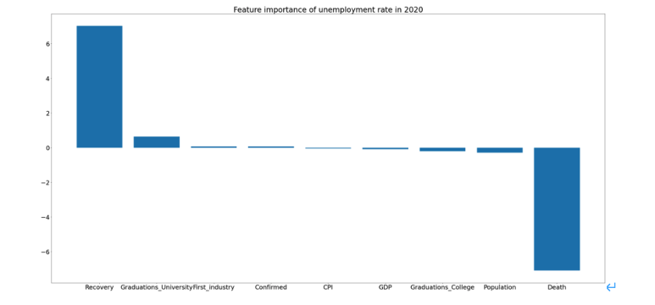
Feature coefficient
Notes:
The recovery, graduations from university, first industry income, confirmed has positive relation with unemployment rate. And the CPI, GDP, Graduations of college, population and deaths has negative relationship with unemployment. The coefficient of recovery is 7.025, of confirmed is 0.066, of death is -7.098. One unit of recovery increasing will lead to 7.025 unit increase in unemployment rate. One unit of confirmed increasing will lead to 0.066 unit increase in unemployment rate. One unit of death increasing will lead to 7.098 unit decrease in unemployment. From the covid dataset, the covid confirmed is the sum of recovery and deaths. Hence, the number of covid confirmed can be representative to show the covid cases condition. Because of the coefficient of confirmed is 0.66, which prove that covid will promote unemployment rate of nationwide in China.

Slide 12
Discussion/Conclusion
There exists a causal effect between covid 19 and unemployment rate
Some provinces supported and some rejected the hypothesis that covid19 promotes the unemployment rate in China.
Covid19’ impact has regional differences in China

Slide 13
Limitations
Chinese government could hide the real data which may cause the models perform not ideally. Dataset of covid was recorded in provinces instead of communities
the time series makes prediction by trends over time so it cannot consider the special cases in the model like policy impact
For the time series model, the R squares for each province are different. Most provinces have high R square which is over 0.85 but few of them are only around 0.25.

Slide 14
Future Research:
Conduct survey for exploring real data and estimation and record the data in community level
Utilize more comprehensive control variables to improve the model performance
Notes:
For future study, we should put more detailed information. The dataset of covid19 cases should be recorded daily in community level. The age, gender, recovery time should also be considered in studying the covid19 impacts. The unemployment rate is still too broad if we want to focus on. Different groups will also have different effects from covid19. What kind of group is more vulnerable? Does elder people are more likely to lose their job? Does first year graduated students cannot find a job? After we decompose the covid19 impacts in detail, it can help government improve the condition fast and efficient.

Slide 15
Reference:
Fang Cai & Kam Wing Chan (2009) The Global Economic Crisis and Unemployment in China, Eurasian Geography and Economics, 50:5, 513-531, DOI: 10.2747/1539-7216.50.5.513
Xue, Jinjun, and Wei Zhong. “Unemployment, Poverty and Income Disparity in Urban China.” Asian Economic Journal, vol. 17, no. 4, 2003, pp. 383–405., https://doi.org/10.1111/j.1467-8381.2003.00192.x.
M W Linn, R Sandifer, and S Stein, 1985:Effects of unemployment on mental and physical health.American Journal of Public Health 75, 502_506, https://doi.org/10.2105/AJPH.75.5.502
Niraj Poudyal, Aris Spanos Model Validation and DSGE Modeling, Econometrics 10, no.22 (Apr 2022): 17.
Ceylan, R.F., Ozkan, B. & Mulazimogullari, E. Historical evidence for economic effects of COVID-19. Eur J Health Econ 21, 817–823 (2020). https://doi.org/10.1007/s10198-020-01206-8

