Slide 1
MACS 30200
Jingwen Ni

Slide 2
Topic
The study of covid19's impacts on unemployment rate in China on provinces' level in 2020 by using regression and time series model.

Slide 3

Background/Literature Review: Why covid?
Covid19, later renamed as Coronavirus, gripped China since the beginning of 2020(Qiu et al.2020).
Wuhan in Hubei province was the first city where was found covid19 cases in China
Notes:
by the end of November in 2021, there were more than 63 million reported cases and 1.4 million deaths over the world (Brodeur, Gray, Islam, Bhuiyan 2021)

Slide 4
Background/Literature Review
In China, government took enforce measures that locking down the cities which has covid cases. (eg: From BBC news, From January 23rd, Wuhan was locked down for 72 days )
The control measures to prevent the covid19 leaded 2.7% loss of China’s annual gross domestic product.

Slide 5
Background/Literature Review: Why Unemployment?
Unemployment was a significant factor which would lead to poverty and income disparity in China.
Unemployment would also cause psychological and health problems.
Notes:
China, a socialist country, which labor markets reformed and transformed into a market-driven market system. After the reformation, people were not limited by “Hukou”, a certification of their birthplace and they were not allowed to work in outside of the birthplace before the reformation, so that there were a lot of migrant-workers those affected by Covid19, the quarantine and lock-down policies. Unemployment was a historical problem and become more serious with time in China because China is a populous country. From United Nations, the world population was 7.6 billion and the population of Mainland was 1.39 billion which was 18.3% of the world while China only has 7.059% land area share of the world. From January 1996 to September 2002, the unemployment of urban residents increased from 6.1% to 11.1% (Giles, Park, Zhang, 2004).

Slide 6
Research Question
How covid19 impacts unemployment rate on Provinces’ level in China in 2020?

Slide 7
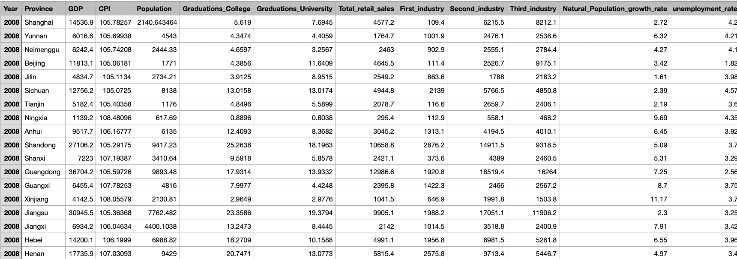
Data: China’s National Bureau of Statistics (NBS)
Notes:
1. Products’ price level: CPI (Consumer price index)
2. Education level: the number of graduations from university and from college
3. population: the total population of each province,
4. province’s development level: GDP
5. Covid: number of confirmed, deaths, recovery

Slide 8
Hypothesis:
Covid19 will promote unemployment rate in China in 2020 on Provinces’ level

Slide 9
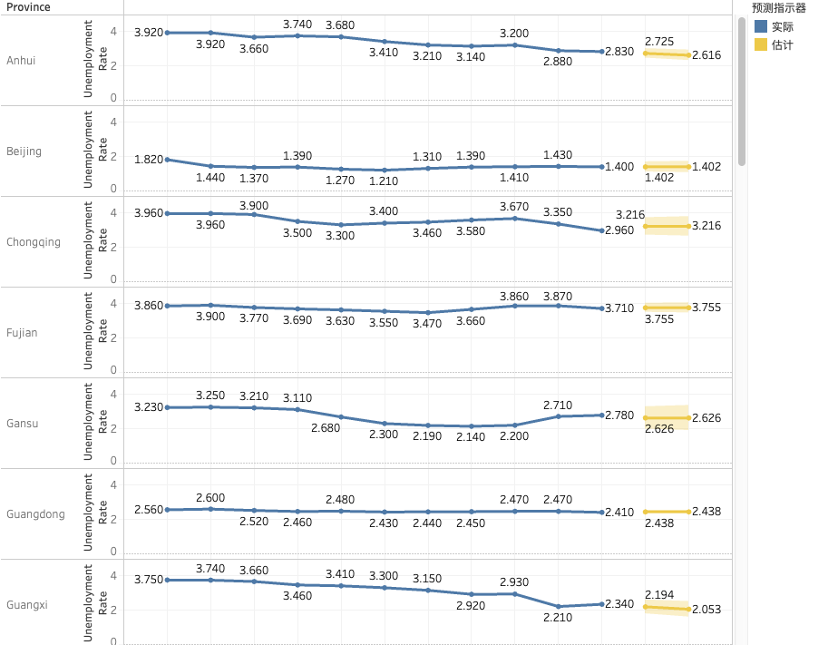
Time Series: Trend line prediction

Slide 10
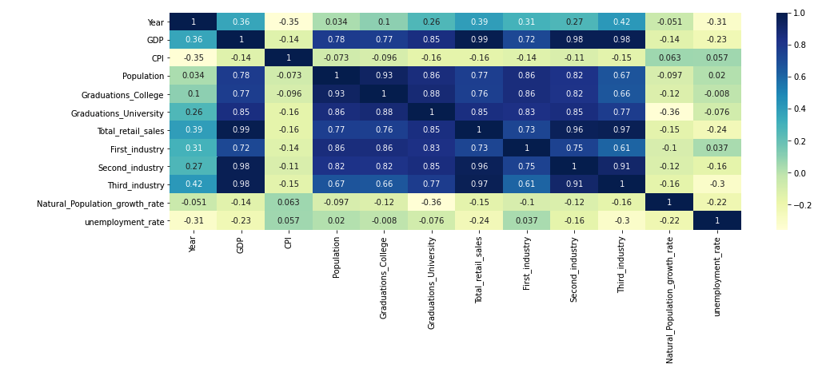
Regression:
X: independent Variables
Y: Gap_value

Slide 11
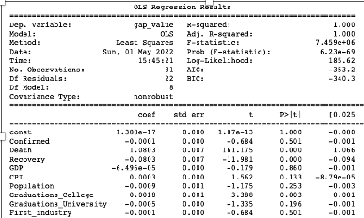
Finding:
Death and Recovery are statistically significant

Slide 12
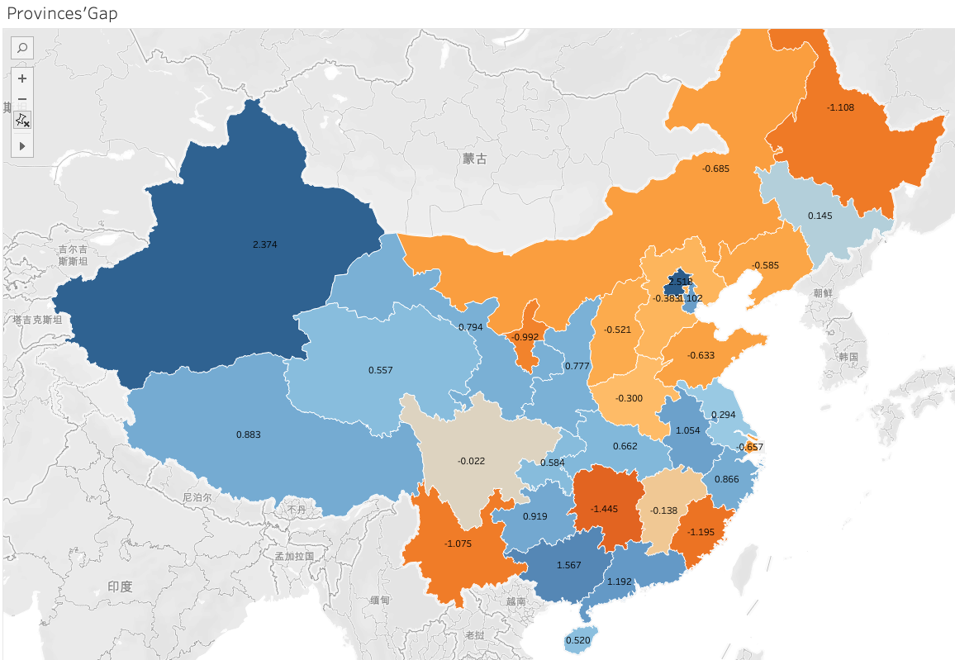
Findings
larger gap concentrate in the southern part of China and the northern part has comparative smaller gap between predicted and true unemployment rate

Slide 13
Discussion/Conclusion
There exists a causal effect between covid 19 and unemployment rate
Some provinces supported and some rejected the hypothesis that covid19 promotes the unemployment rate in China.
Covid19’ impact has regional differences in China

Slide 14
Limitations
Chinese government could hide the real data which may cause the models perform not ideally.
the time series makes prediction by trends over time so it cannot consider the special cases in the model like policy impact
Future Research:
Conduct survey for exploring real data and estimation
Utilize more comprehensive control variables

Slide 15
Reference:
Fang Cai & Kam Wing Chan (2009) The Global Economic Crisis and Unemployment in China, Eurasian Geography and Economics, 50:5, 513-531, DOI: 10.2747/1539-7216.50.5.513
Xue, Jinjun, and Wei Zhong. “Unemployment, Poverty and Income Disparity in Urban China.” Asian Economic Journal, vol. 17, no. 4, 2003, pp. 383–405., https://doi.org/10.1111/j.1467-8381.2003.00192.x.
M W Linn, R Sandifer, and S Stein, 1985:Effects of unemployment on mental and physical health.American Journal of Public Health 75, 502_506, https://doi.org/10.2105/AJPH.75.5.502
Niraj Poudyal, Aris Spanos Model Validation and DSGE Modeling, Econometrics 10, no.22 (Apr 2022): 17.
Ceylan, R.F., Ozkan, B. & Mulazimogullari, E. Historical evidence for economic effects of COVID-19. Eur J Health Econ 21, 817–823 (2020). https://doi.org/10.1007/s10198-020-01206-8

