Slide 1

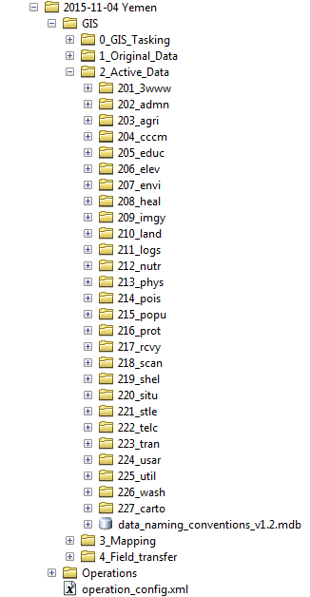

Slide 2

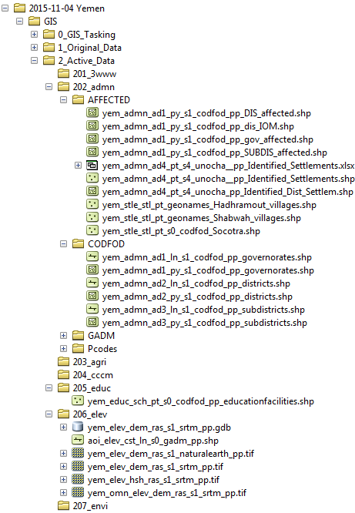

Slide 3
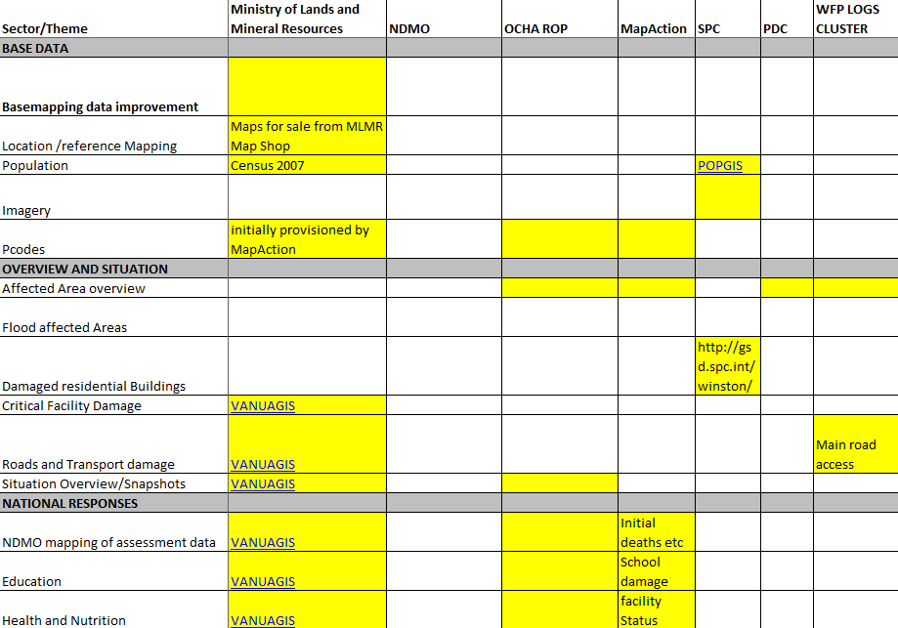

Slide 4
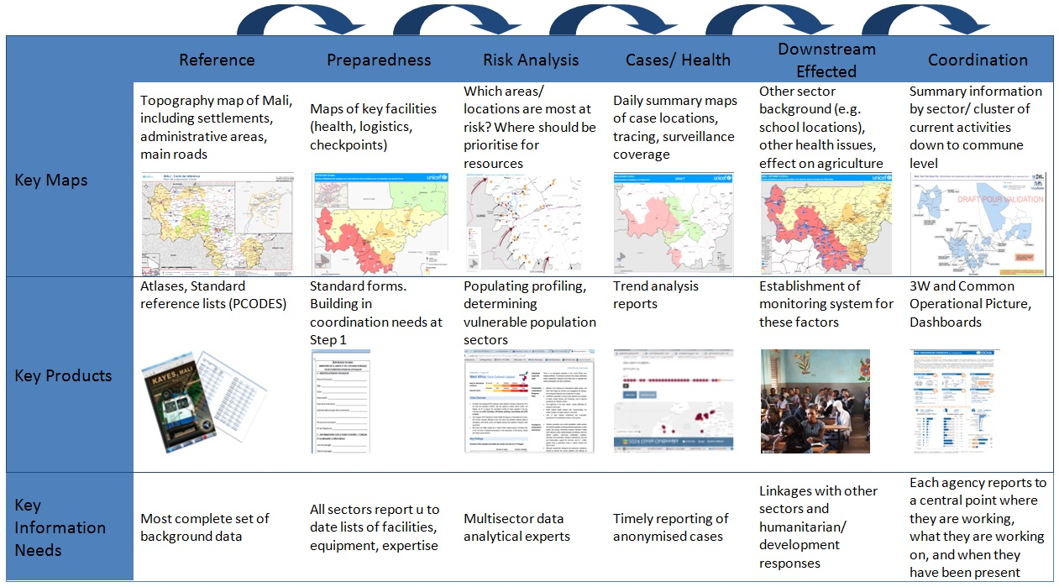

Slide 5
Data Preparedness
t
Trigger Event
I
Post Mission Archiving
¨
Data Scramble
{
Mission Cycle
y

Slide 6
¥
ě
+
Ĕ
5
©
¨
CUSTARD
CUSTARD
p
Ù
Ø
;
"
§
&
.
'
¦
*

Slide 7
Data Scramble
Requirements Definition
Dataset Discovery
Preparedness
Response
Recce
Mission Archives
Global Datasets
Country Specific
Disaster Specific
Initial Situational
Data Acquisition
Data Preparation
Resolving License Issues
Renaming
Checking Projection
Repeat
&
revise
Cutoff and review
Notes:
Talk through each component

Slide 8
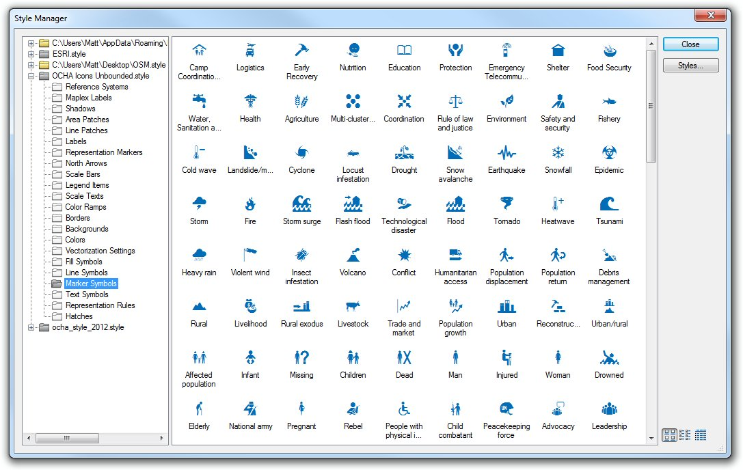

Slide 9
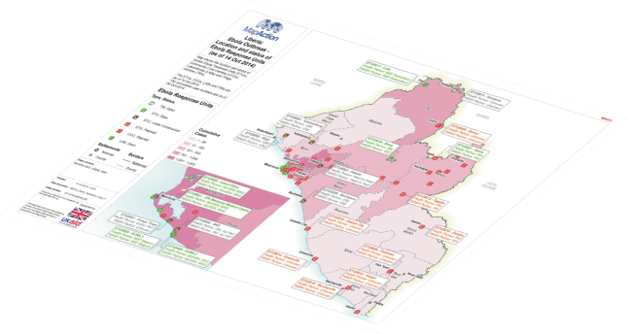
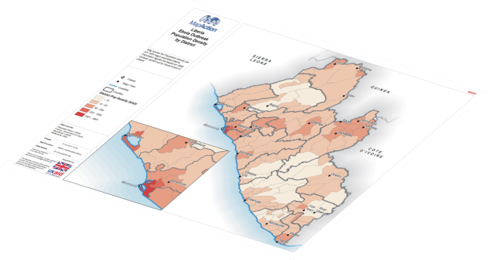
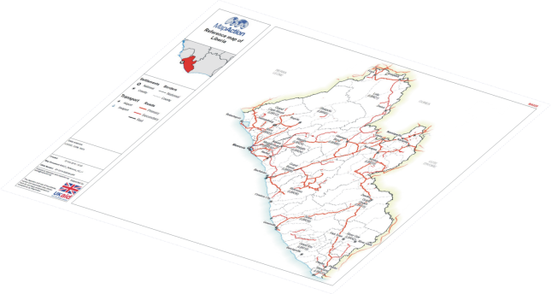
Situational
Baseline
Base Map

