Slide 1
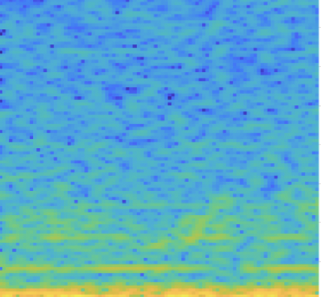
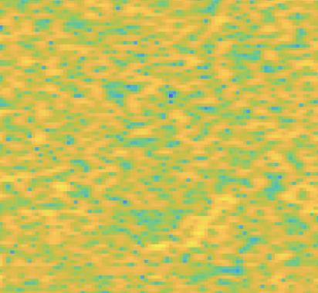
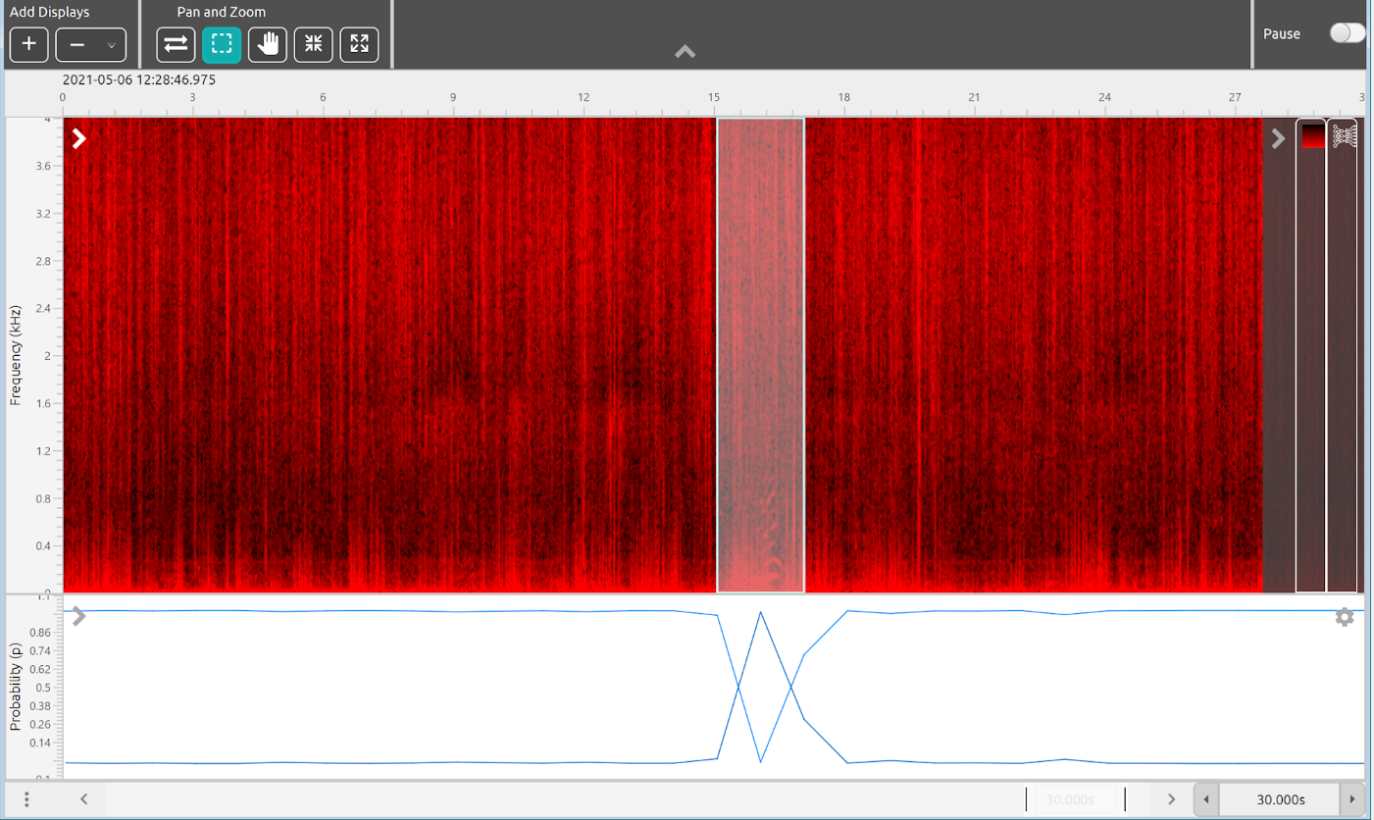
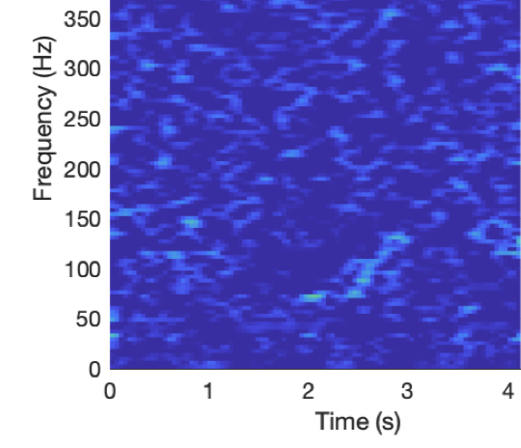
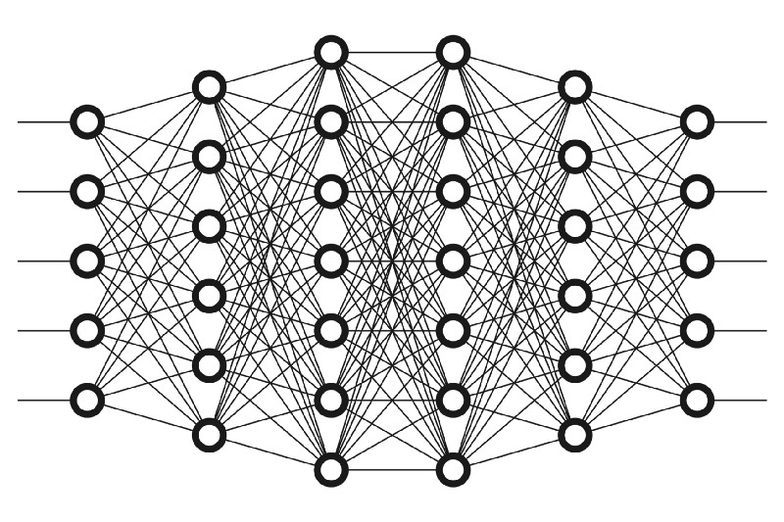
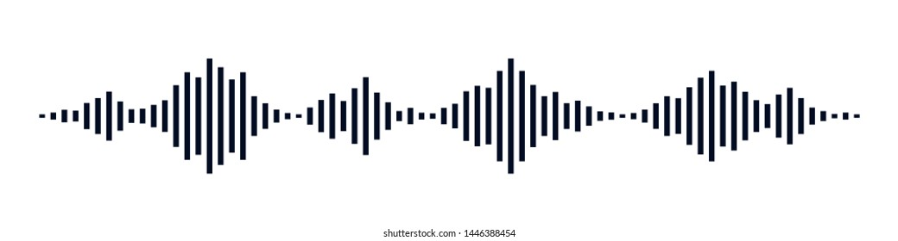
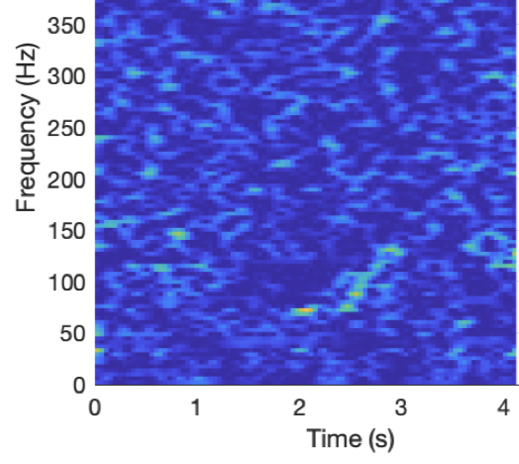
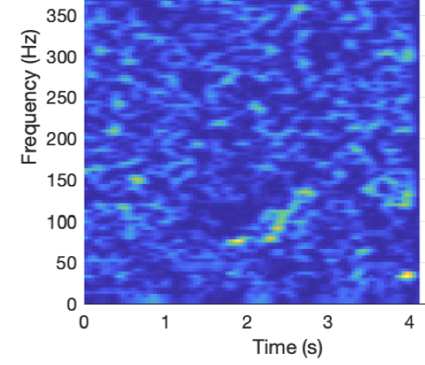
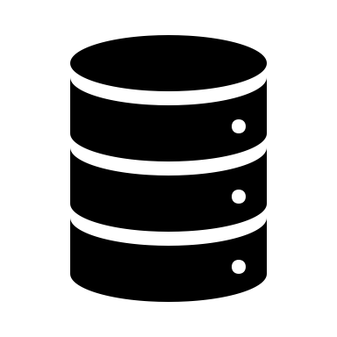
Segment Waveform Data
Apply Transforms to each segment
e.g. filters, spectrograms, normalization, noise reduction
Send transformed data to deep learning model
Results are saved and can be exported and/or viewed in PAMGuard
AnimalSpot and Ketos models automatically set up transforms
Raw continuous data or any detector which save raw data (e.g. clicks, clips)
View in real time or post processing
Right whale upsweep
Database/ PAM files

