Slide 1
Newport Algorithm 1
Pair Points
Version 0.1.0
2021/4/28

Slide 2
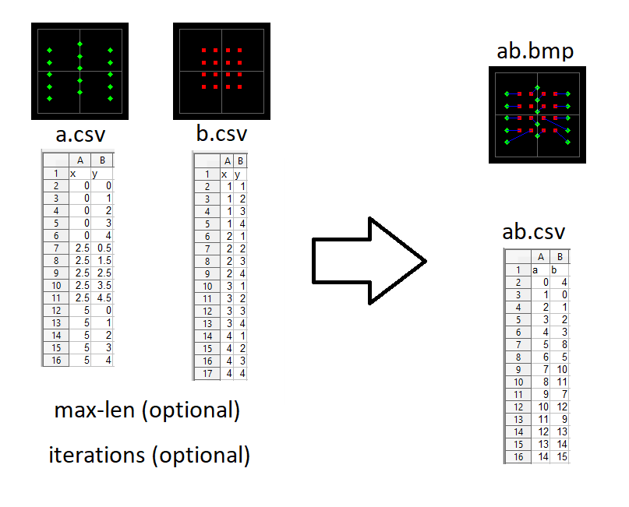
Input & Output

Slide 3
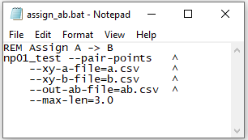
Command Options
--pair-points
  for point pairing algorithm
--xy-a-file, --xy-b-file
  input (x,y) csv files
--out-ab-file
  output (A index, B index) file
--max-len
  attempted maximum point-to-point length
--iterations
  optimization iteration count

Slide 4
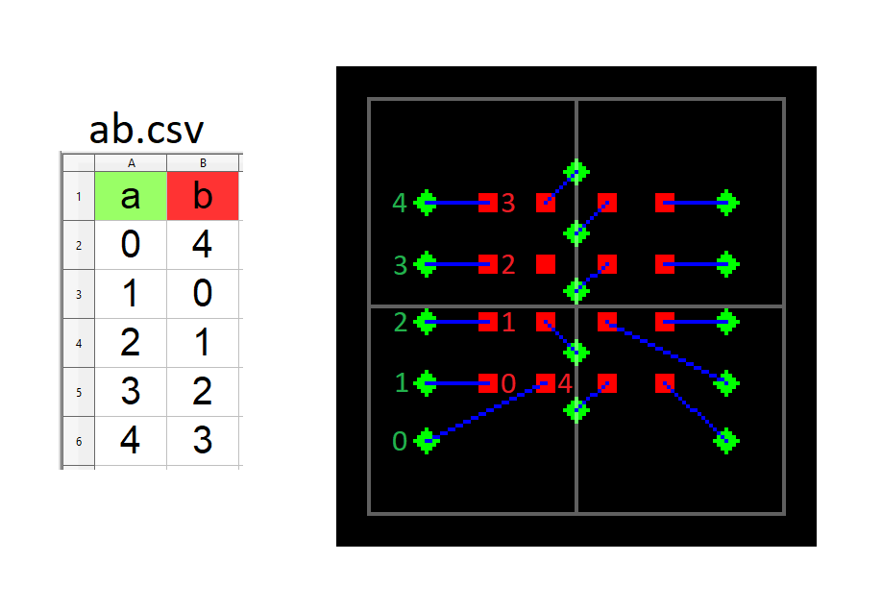
Output Assignment File

