Slide 1
Genetic Algorithm Framework

Slide 2
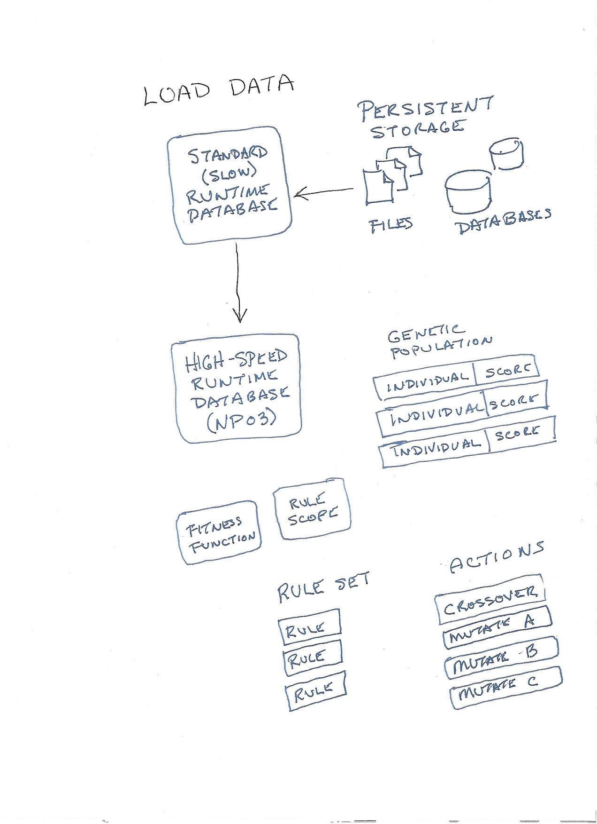
1. Load data from persistent storage.
  Standard (slow) Runtime Database
  High-speed runtime database (NP03)
    Memory pool → rapid object allocation and de-allocation
    Locator grid → efficient shape queries, rapid DRC

Slide 3
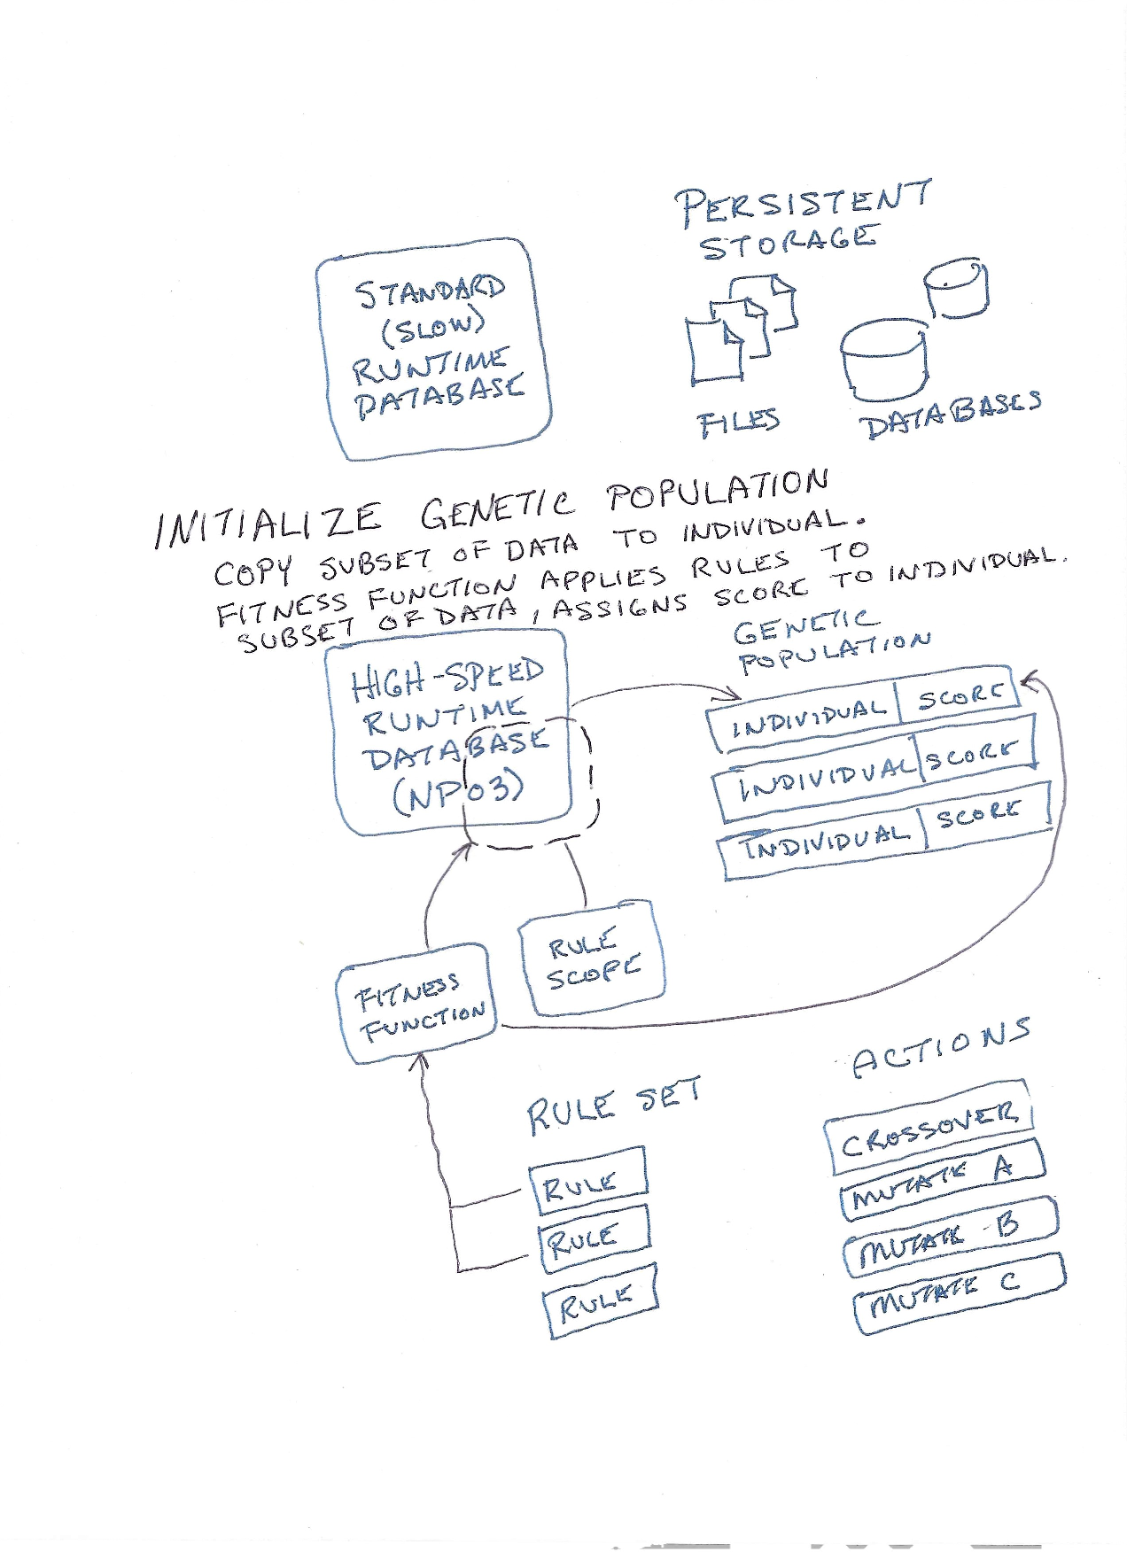
2. Initialize genetic population.
  Create single individual.
    Genetic Individual = compact representation of variation of design data.
  Run fitness function to assign score to individual.
    Requires alignment of Genetic Individual with high-speed runtime database
    DRC is run
      Selection of rules based on current phase of design
    Score is value [0.0,1.0]
      0.0 → optimum, no error
      0.5 → barely passing
      1.0 → worst error

Slide 4
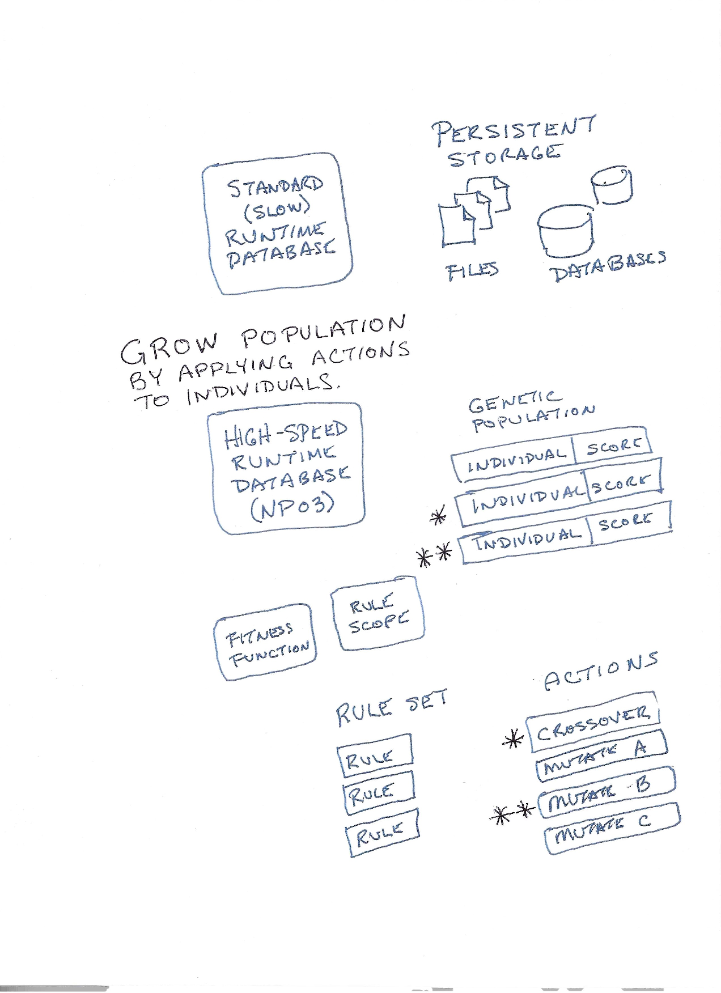
3. Grow population by running actions.
  Mutation
    Swap pin assignments
    Modify trace shape
    Swap layer assignment
    Etc.
  Crossover
    Combine portions of design from two or more individuals
  Selection of available actions depends on phase of design.

Slide 5
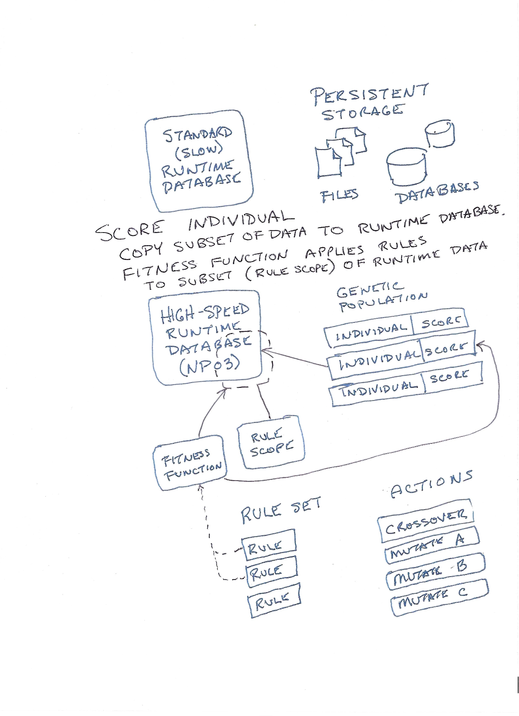
4. Assign score to each individual.

Slide 6
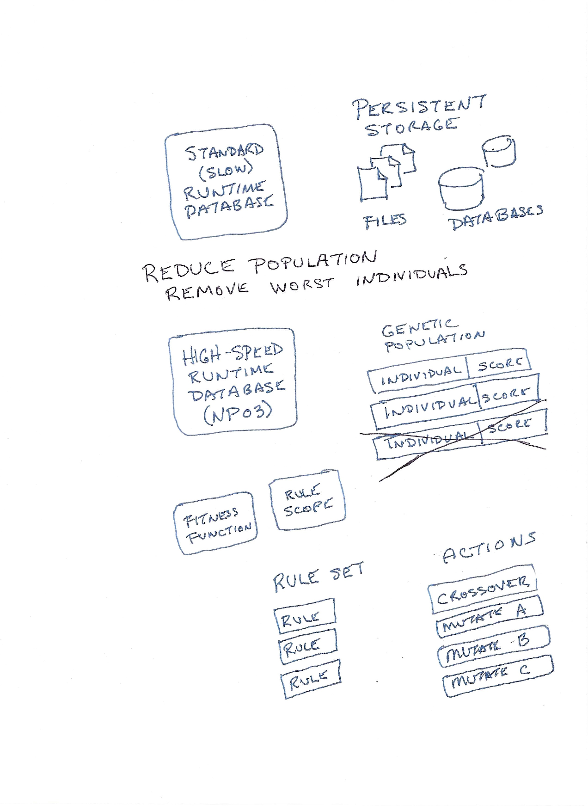
5. Reduce population.
  Remove individuals with highest error score.

Slide 7
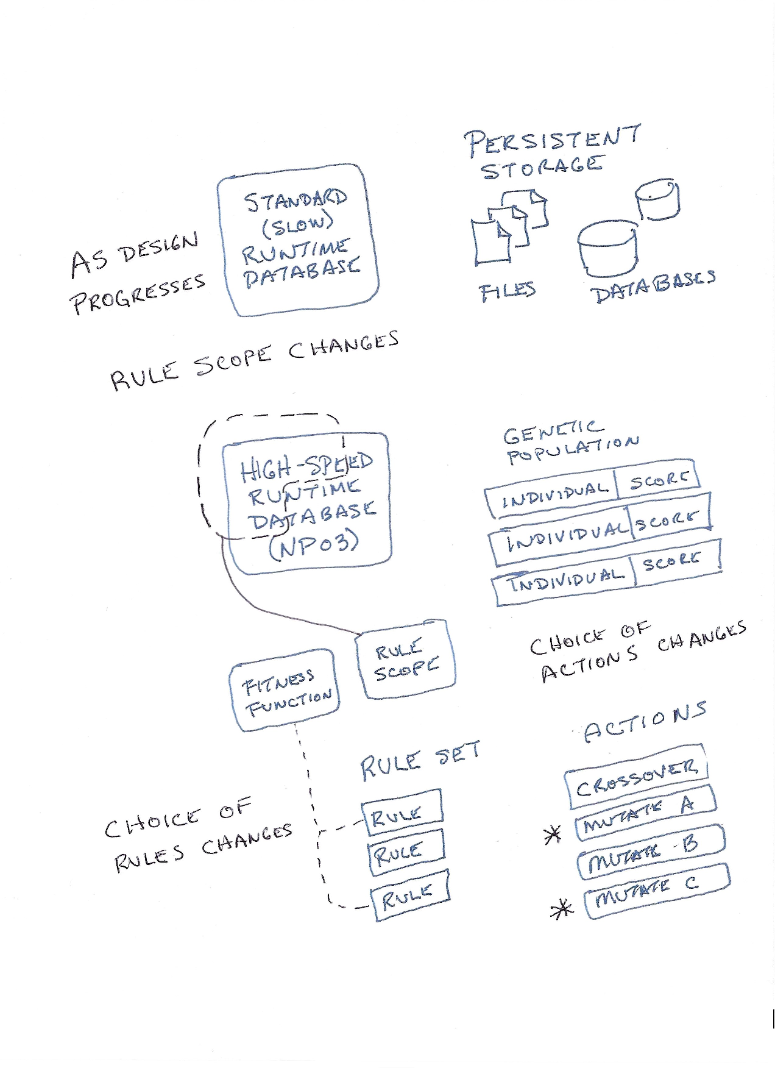
Steps 3-5 are repeated on a given scope.
Then, the process is repeated on a different scope.
As design progresses
  Scope changes.
  Selection of rules changes.
  Selection of actions changes.

Slide 8
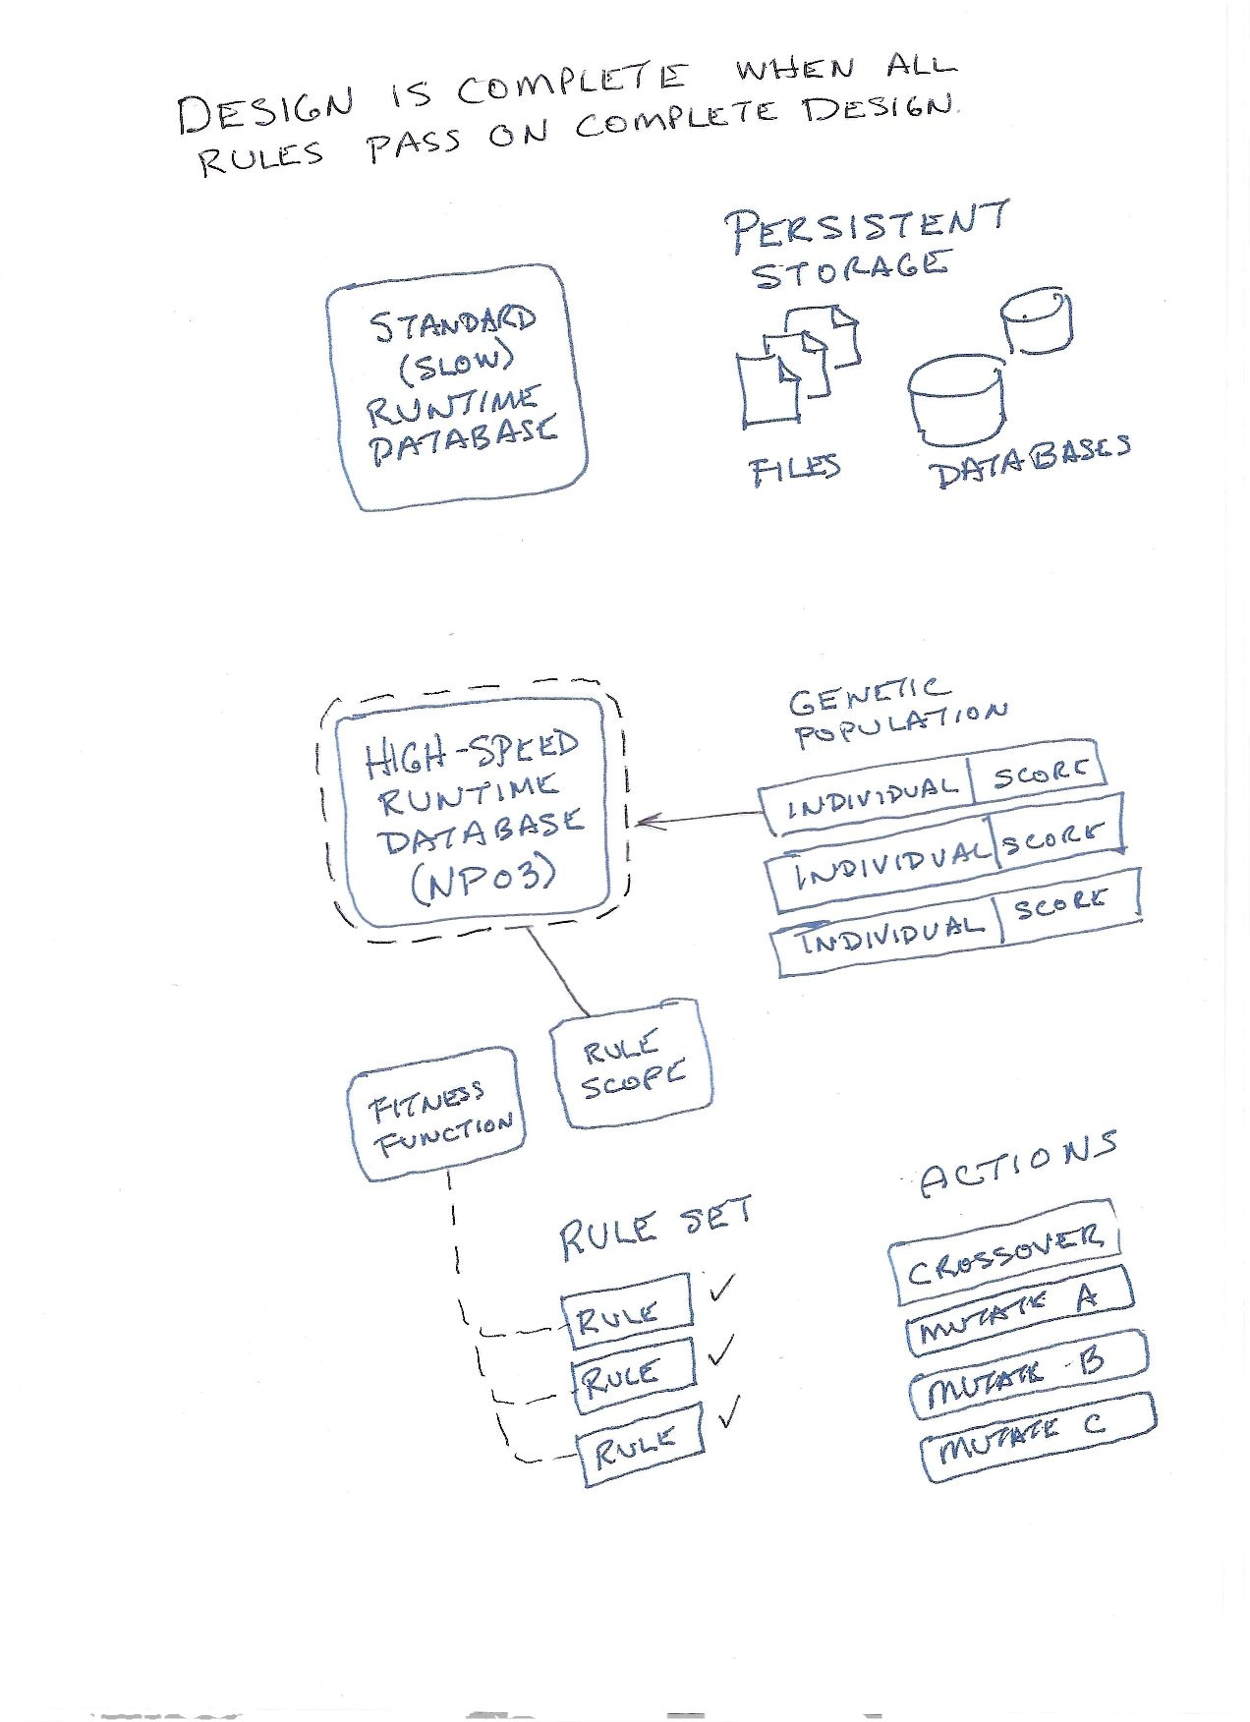
6. Design is complete when all rules pass.

Slide 9
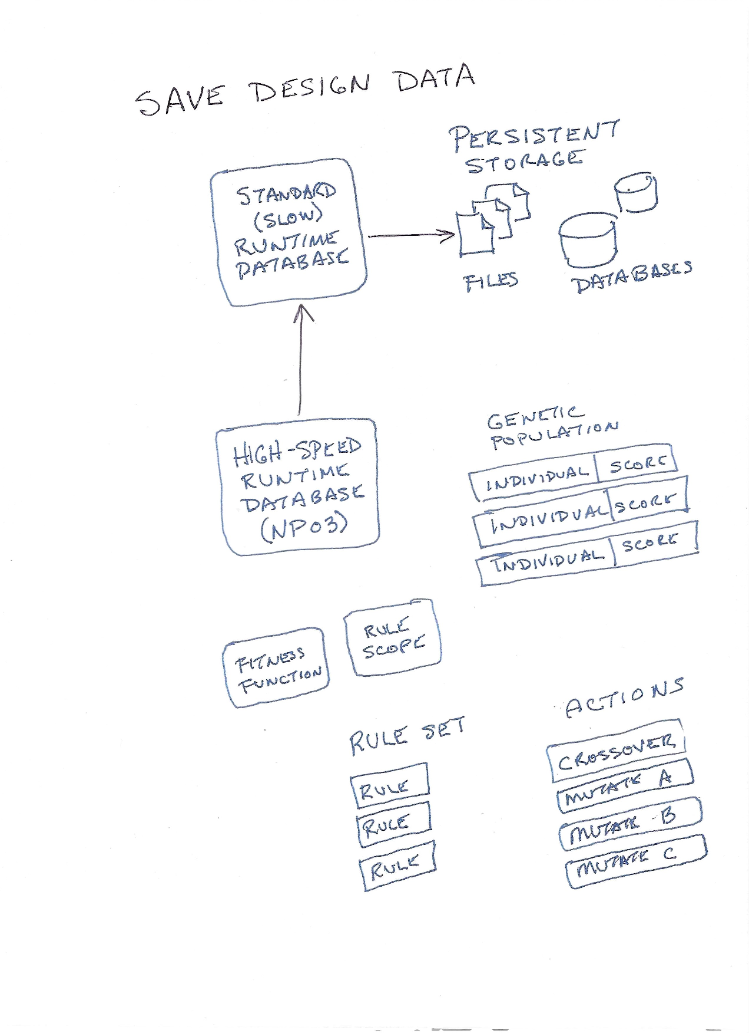
7. Modified design is saved to persistent storage.

Slide 10
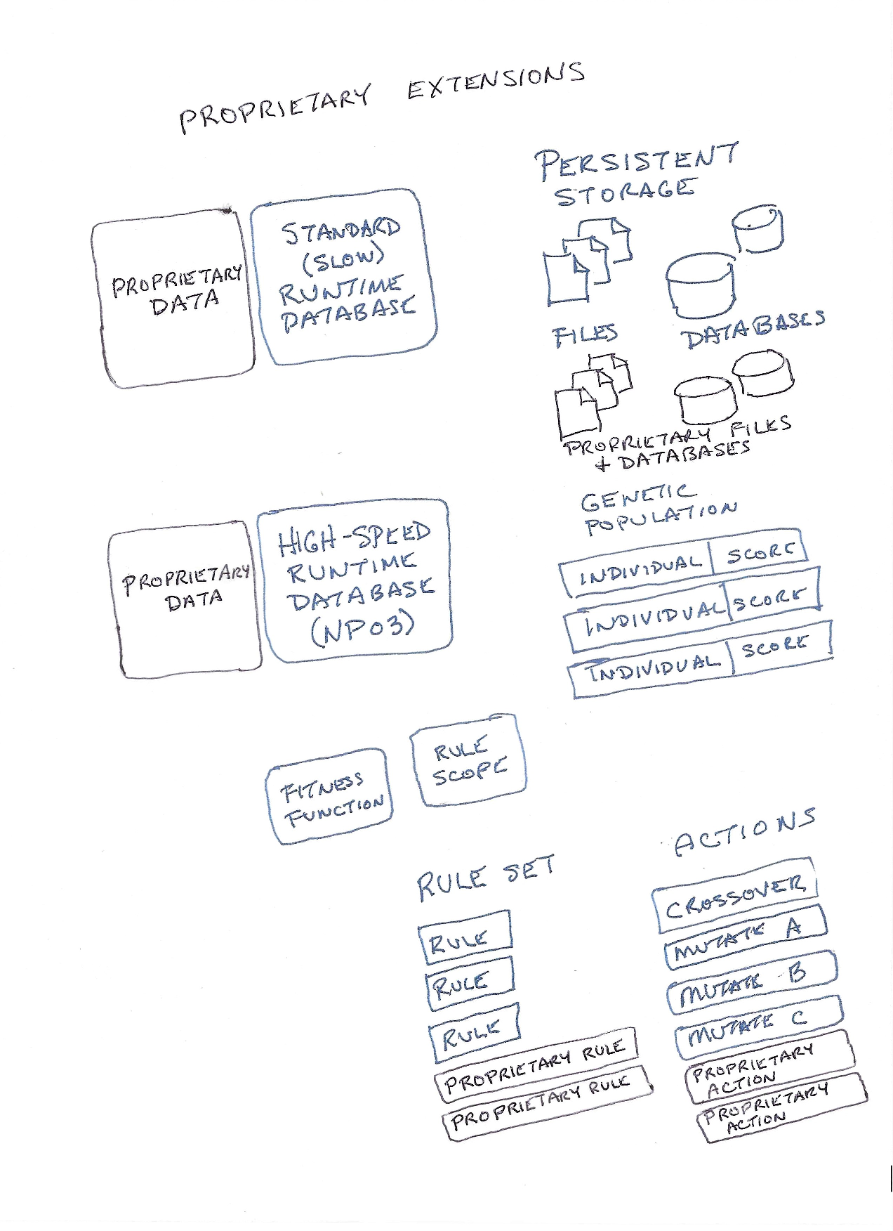
Proprietary extensions are possible
  Data
  Rules
  Actions

Slide 11
Rules

Slide 12
Rules
Score
  Violation Cost
    missing required net assignments made (missing pin-pairs)
    incorrectly shorted pins
    mismatched diff-pair assignments
    pad-pad overlap & clearance
    pad-to-trace overlap & clearance
    trace-to-trace overlap & clearance
    total sq length for violating pin-pair length
    total sq length for violating trace length
  Optimization Score
    pin-pair (flyline) crossover cost
    total pin-pair length

Slide 13
Actions

Slide 14
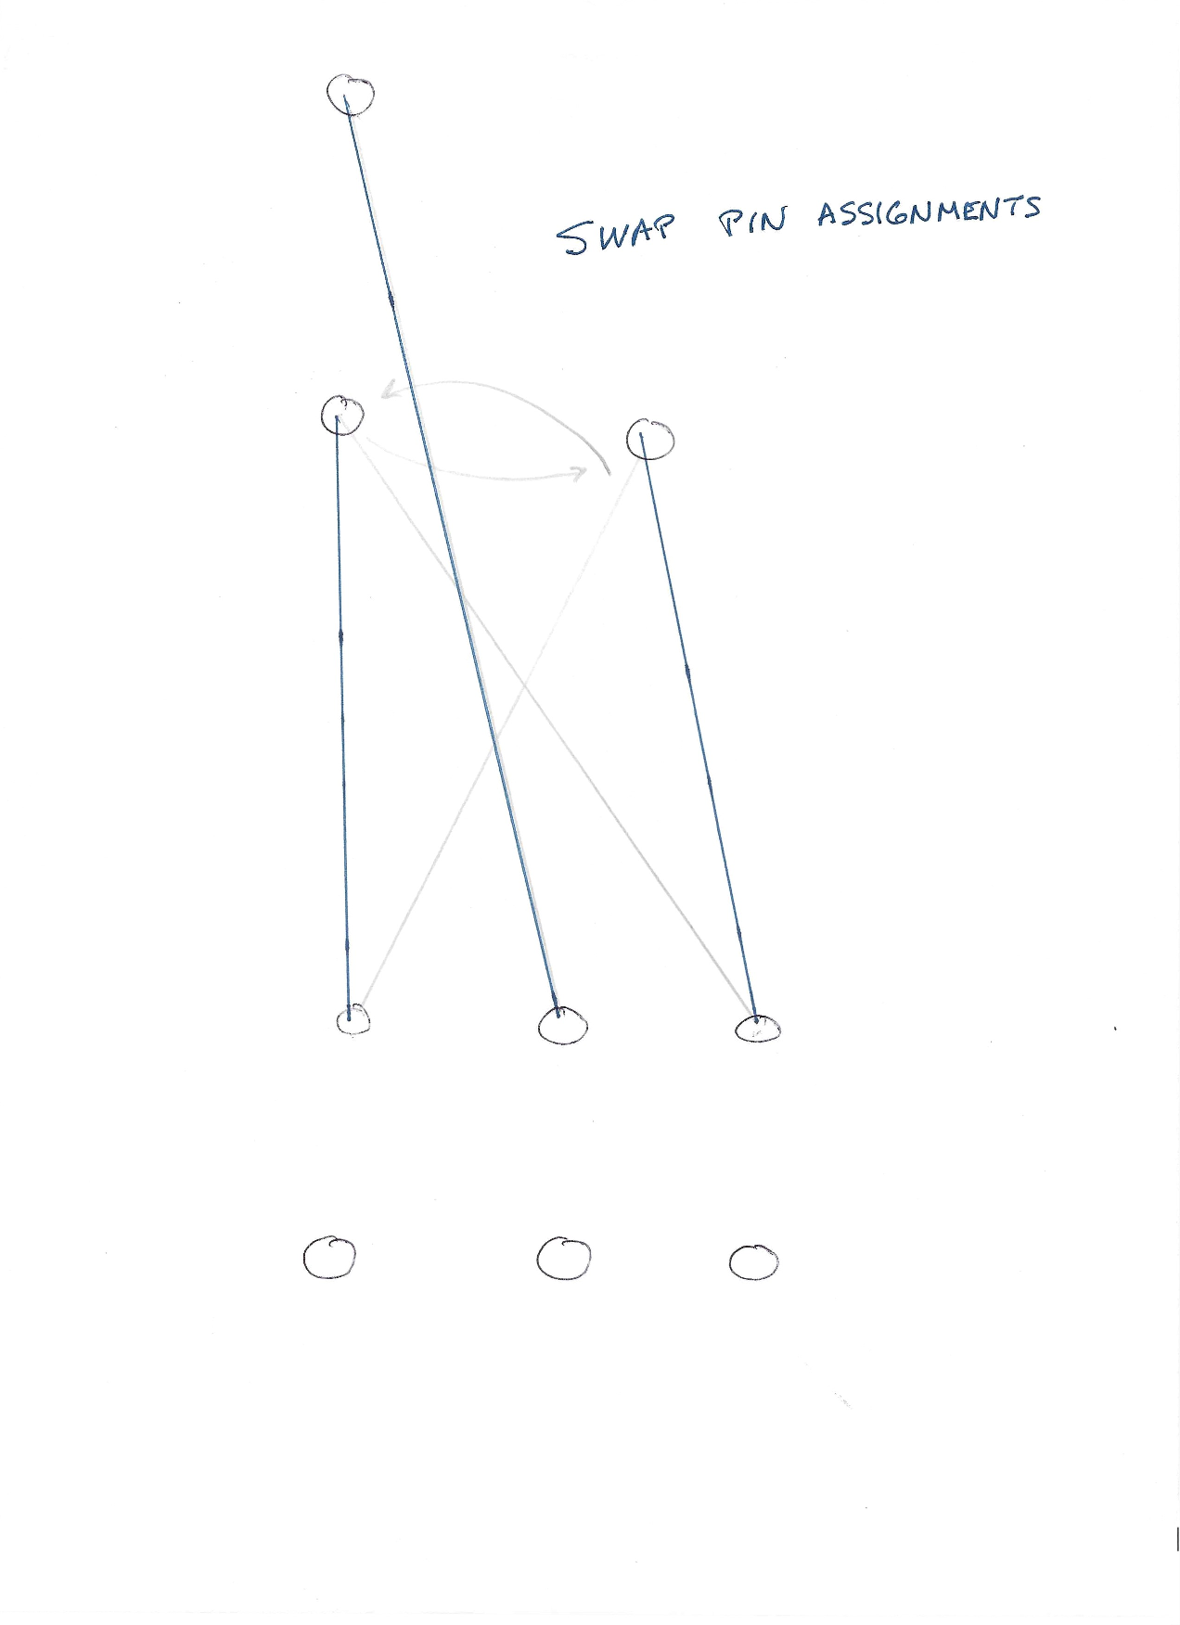
Actions
Swap Pin Assignments

Slide 15
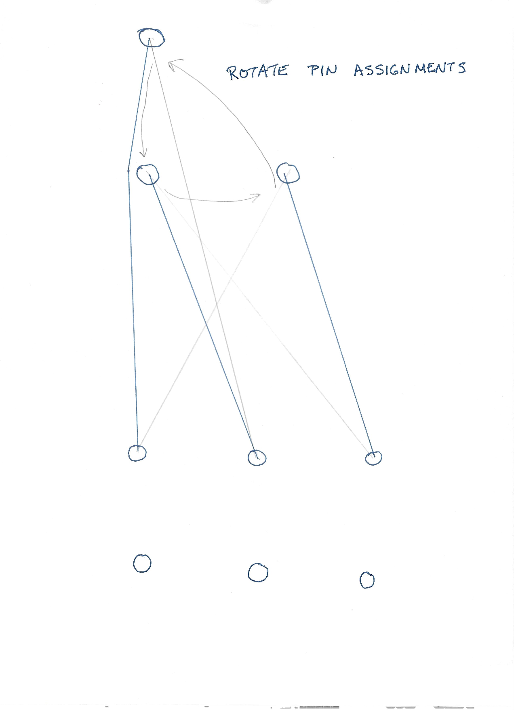
Actions
Rotate Pin Assignments

Slide 16
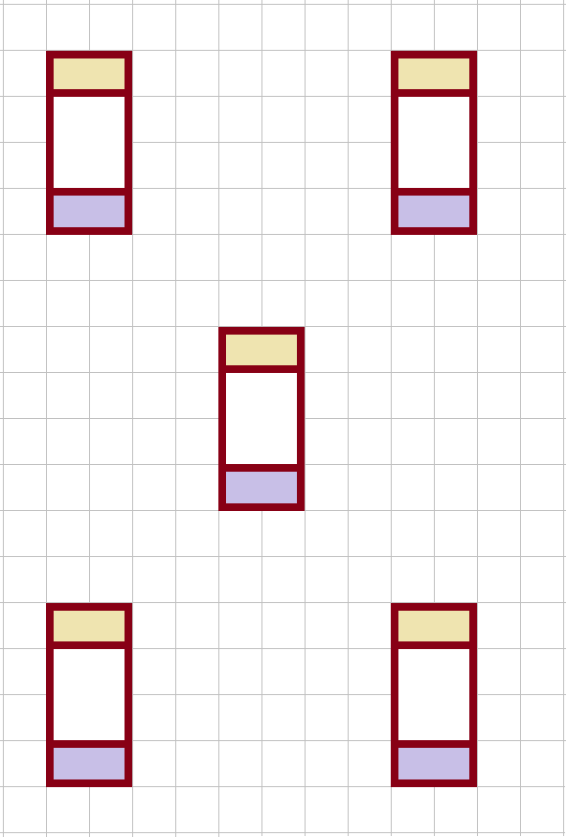
Actions

Slide 17
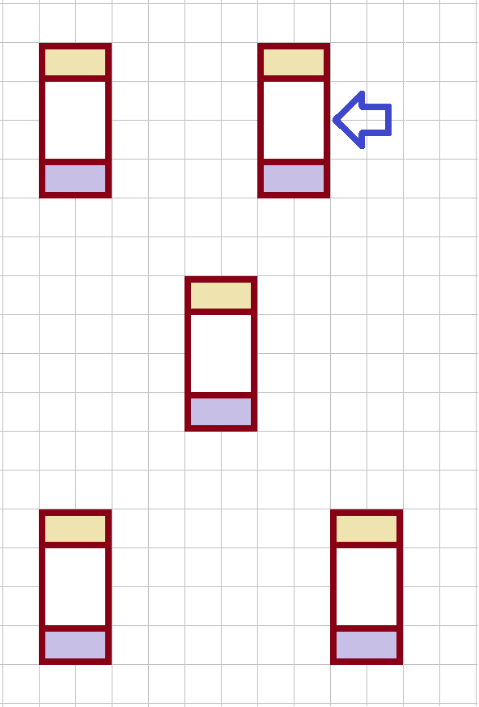
Actions
Move component
  On grid
  Off grid

Slide 18
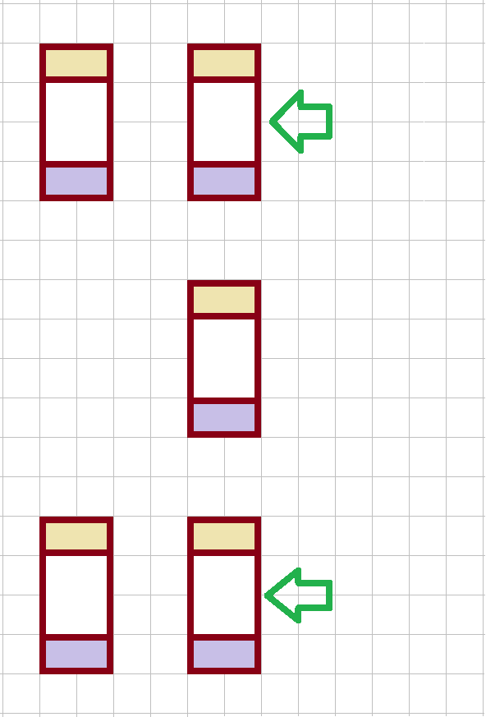
Actions
Move group of components

Slide 19
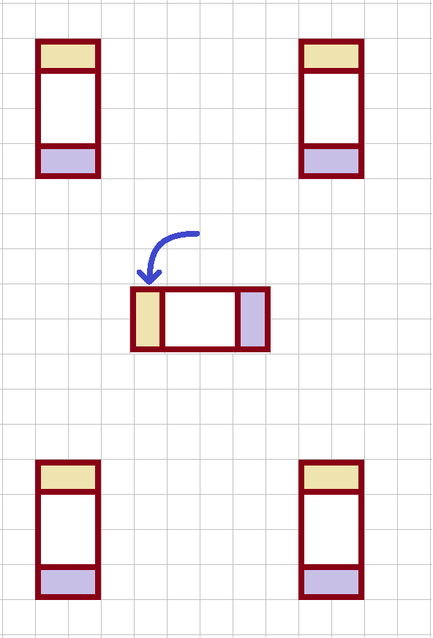
Actions
Rotate
  component
  group of objects

Slide 20
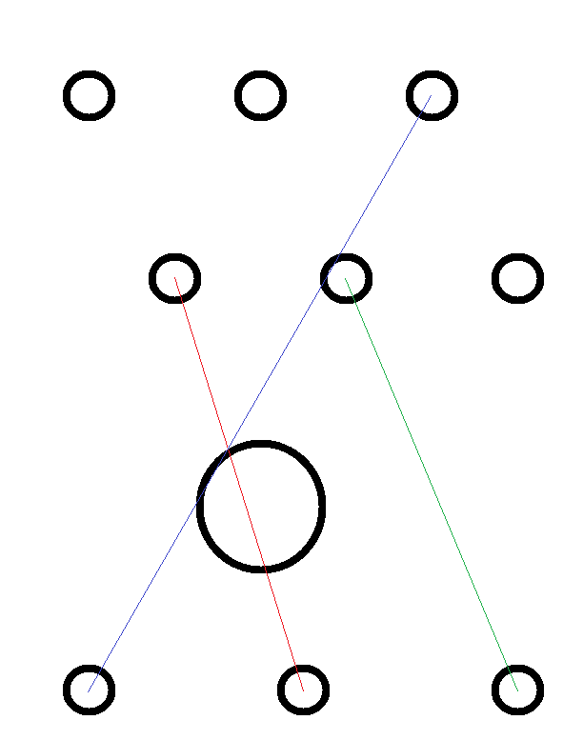
Actions

Slide 21
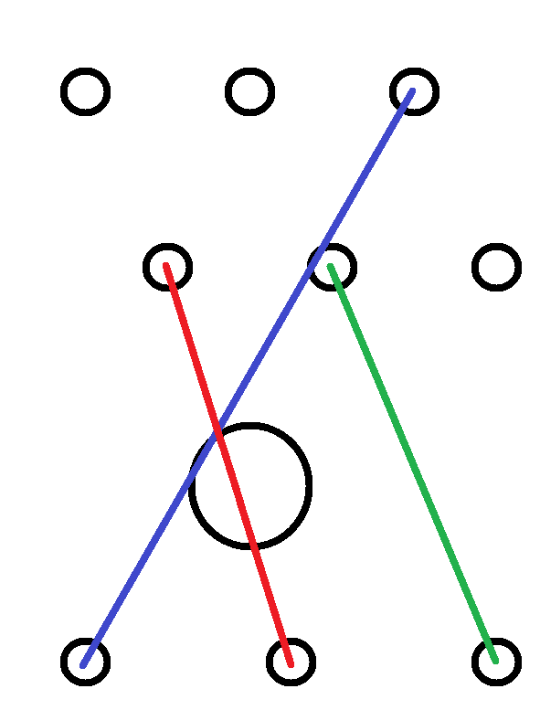
Actions
Create trace on layer
Move trace to other layer

Slide 22

Actions
Add vertex
Remove vertex

Slide 23
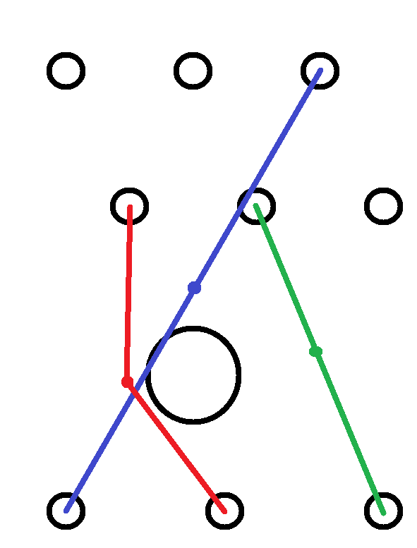
Actions
Move vertex

Slide 24
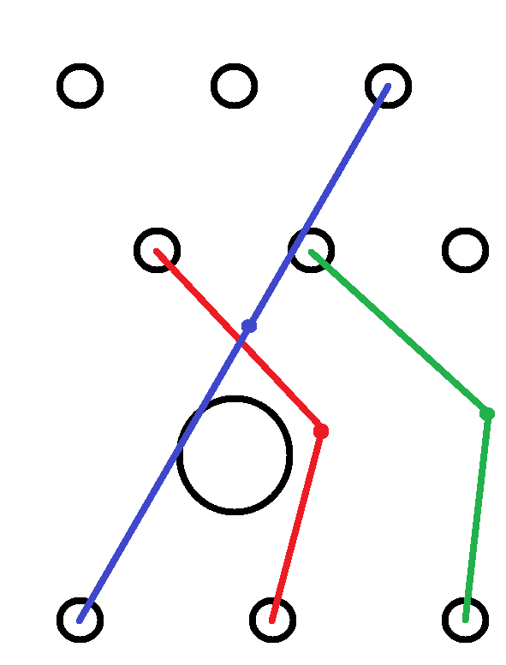
Actions
Move group of traces in common direction

Slide 25
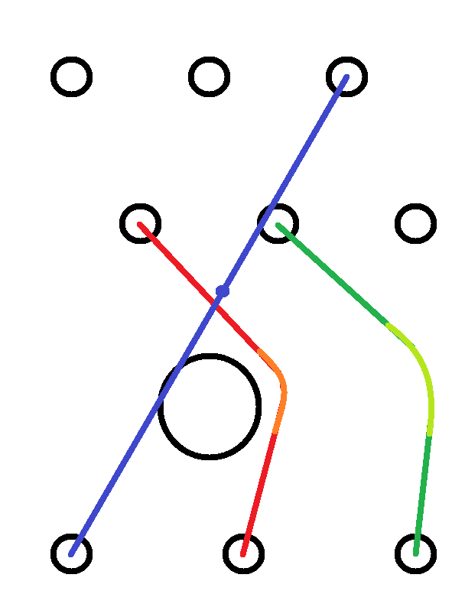
Actions
Replace vertex with arc

Slide 26
References

Slide 27
References
Blackboard Pattern
https://en.wikipedia.org/wiki/Blackboard_(design_pattern)

Slide 28
References
Blackboard Pattern
  https://en.wikipedia.org/wiki/Blackboard_(design_pattern)

Slide 29
References
Genetic Algorithm
  PCB Layout Design Using a Genetic Algorithm, by Sakait Jain and Hae Chang Gea
    https://asmedigitalcollection.asme.org/electronicpackaging/article-abstract/118/1/11/404553/PCB-Layout-Design-Using-a-Genetic-Algorithm
    https://doi.org/10.1115/1.2792119
  Effective PCB Decoupling Optimization by Combining an Iterative Genetic Algorithm and Machine Learning, by Riccardo Cecchetti et al.
    https://www.mdpi.com/2079-9292/9/8/1243
    https://doi.org/10.3390/electronics9081243

Slide 30
References
Genetic Algorithm
  Optimization of electronics component placement design on PCB using self organizing genetic algorithm (SOGA), by Fatimah Sham Ismail et al.
    https://link.springer.com/article/10.1007/s10845-010-0444-x
    https://doi.org/10.1007/s10845-010-0444-x
  Optimization of printed circuit board component placement using an efficient hybrid genetic algorithm, by Hsueh-Yi Lin et al.
    https://link.springer.com/article/10.1007/s10489-016-0775-1
    https://doi.org/10.1007/s10489-016-0775-1

Slide 31
References
Genetic Algorithm
  Reduction of crosstalk on printed circuit board using genetic algorithm in switching power supply, by M. H. Pong et al.
    https://ieeexplore.ieee.org/abstract/document/904584
    https://doi.org/10.1109/41.904584
  A Delay Line Circuit Design for Crosstalk Minimization Using Genetic Algorithm, by C. Chung et al.
    https://ieeexplore.ieee.org/document/4454008

Slide 32
References
Genetic Algorithm
  Multiobjective placement of electronic components using evolutionary algorithms, by K. Deb et al.
    https://ieeexplore.ieee.org/abstract/document/1331543
  Optimization of electonics component placement design on PCB using genetic algorithm, by L.I. Zinnatova and I.V. Suzdalcev
    https://cyberleninka.ru/article/n/optimization-of-electonics-component-placement-design-on-pcb-using-genetic-algorithm

