Slide 1
Shape Offset Algorithm
NP02 Library

Slide 2
Input
  Region = series of input boundary loops
  Input boundary loop
    Circle
    Sequence of arcs & line segments
    Boolean indicating which side is in region
Output
  Offset region

Slide 3
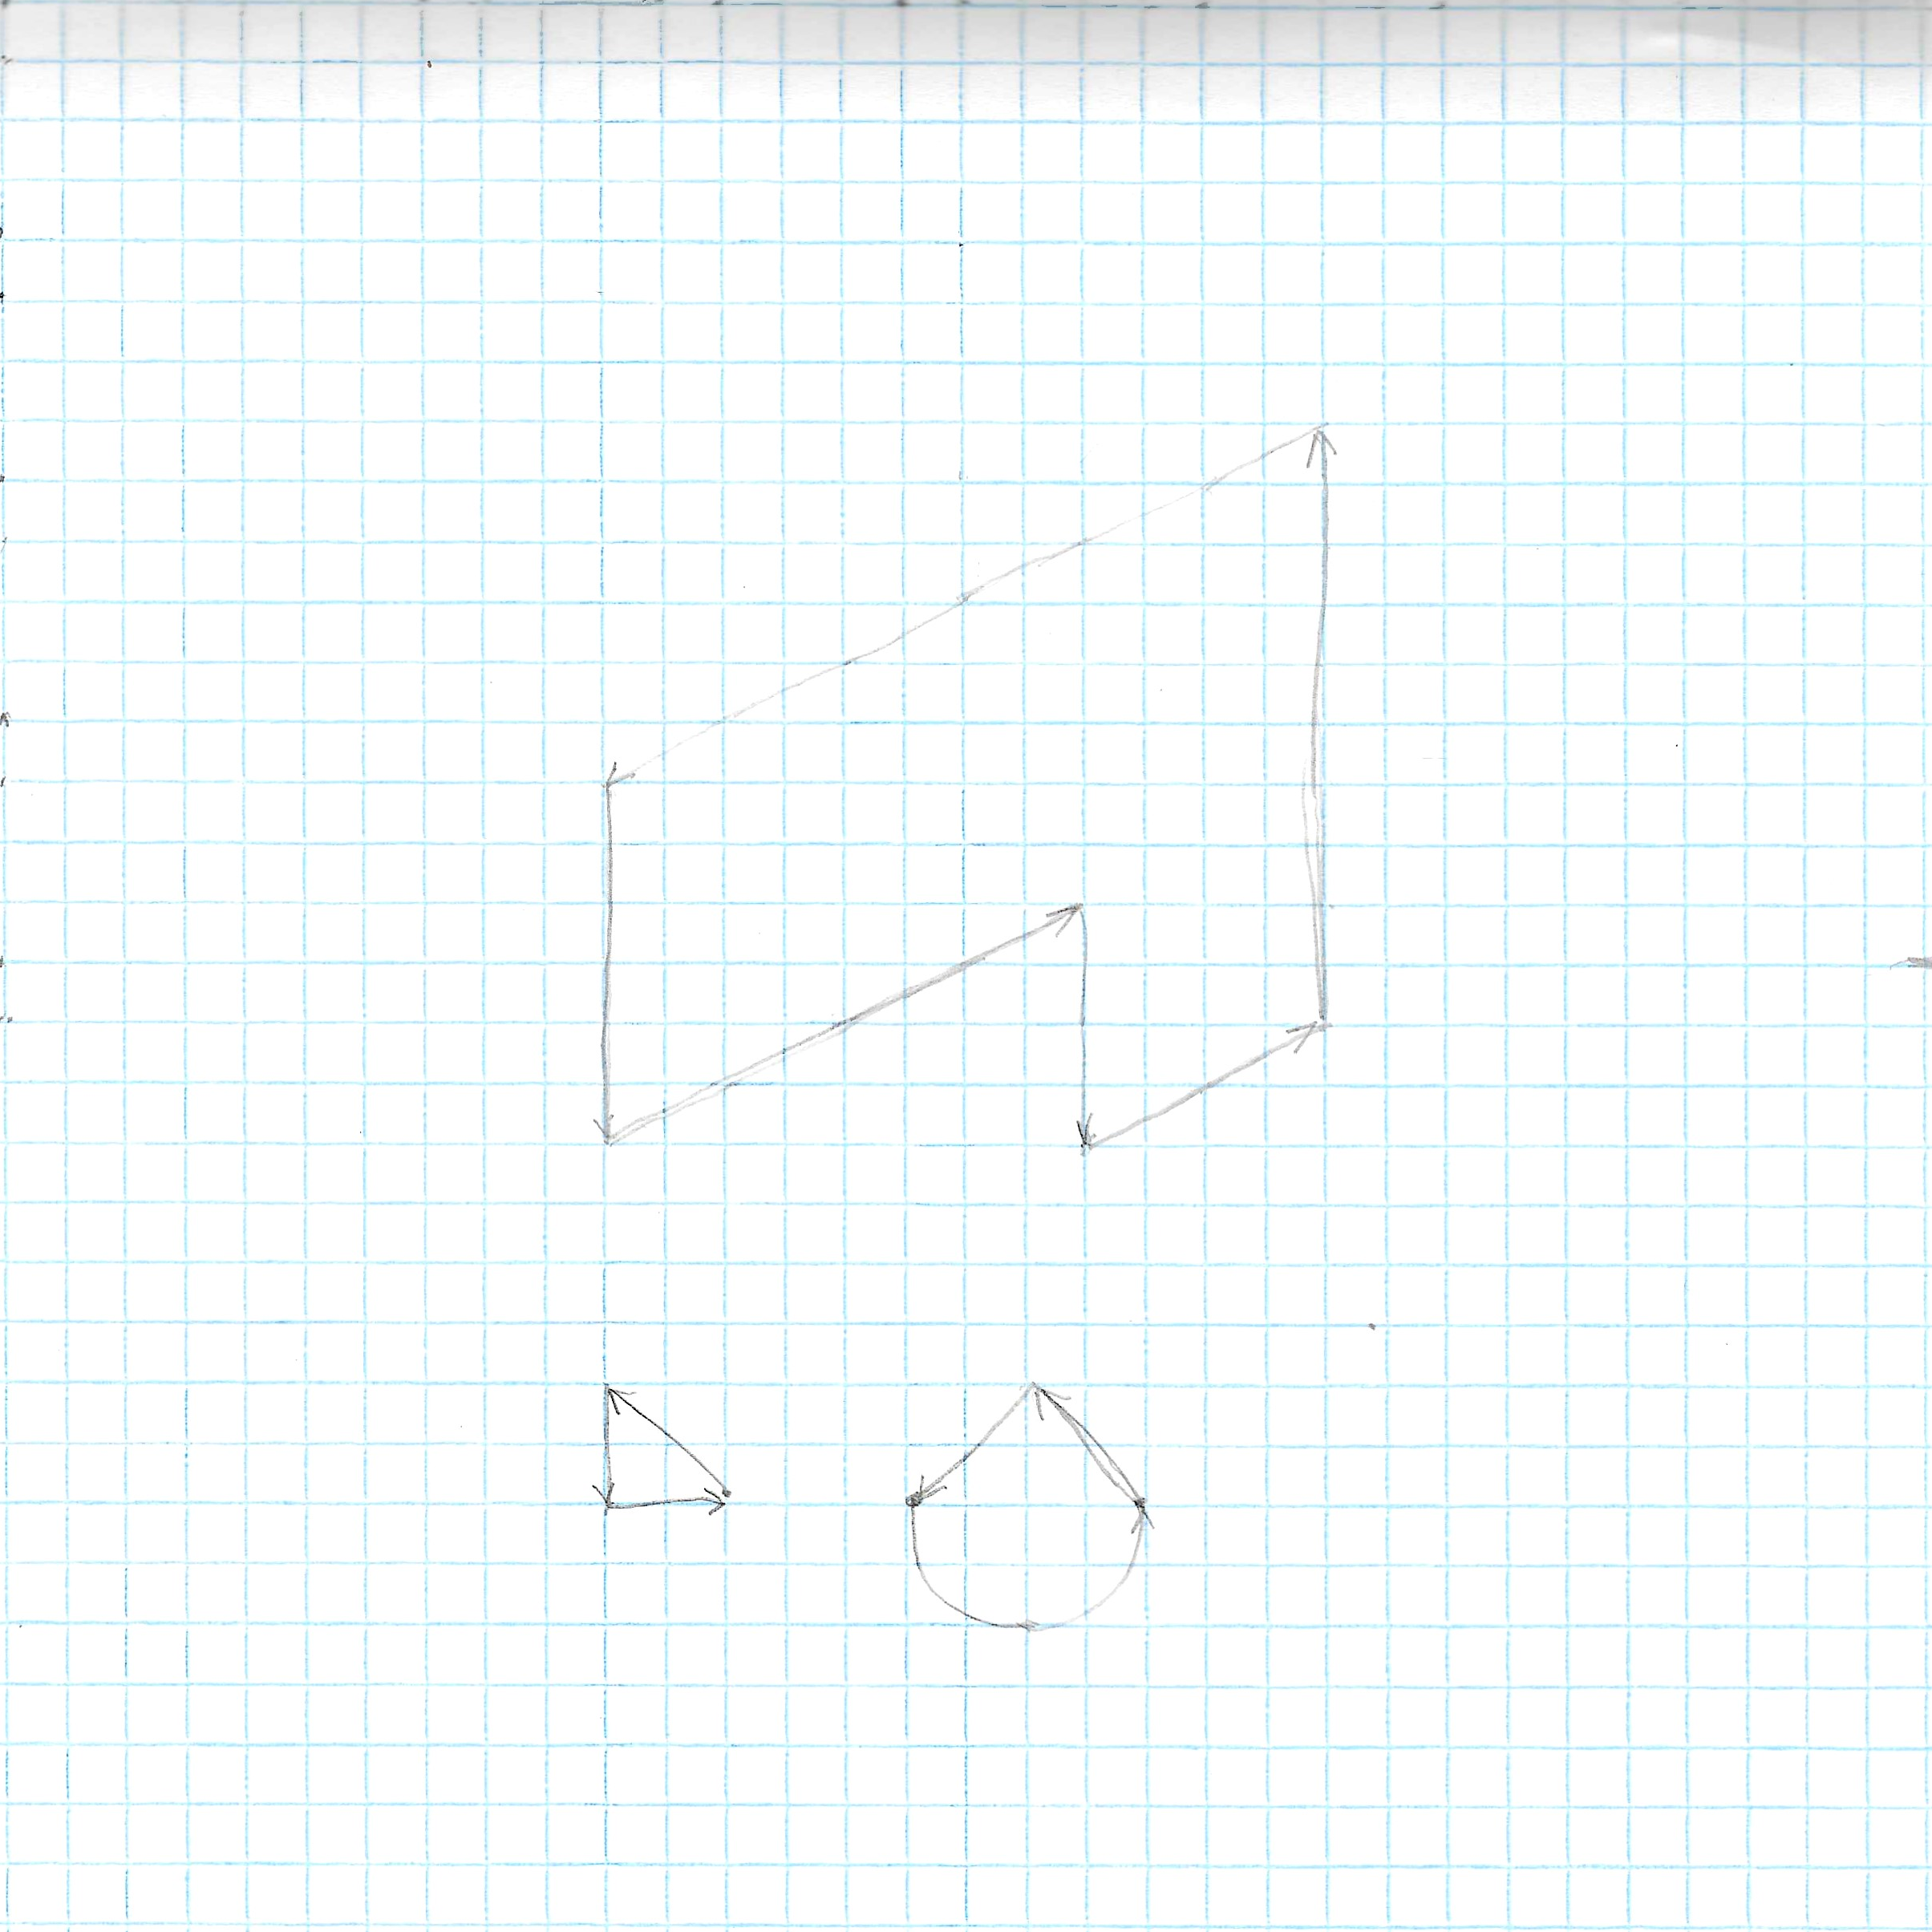

Slide 4
1. Create candidate boundary segments
2. Quad Tree
3. Quad Tree Boundary Segments
4. Quad Tree Boundary Loops
5. Associate Quad Tree Boundary points to points on candidate boundary segments.
6. Find boundary shape transitions
7. Boundary Loops

Slide 5
1. Create candidate boundary segments
Arc, Line Segment, or Circle
Offset from input boundary segments

Slide 6
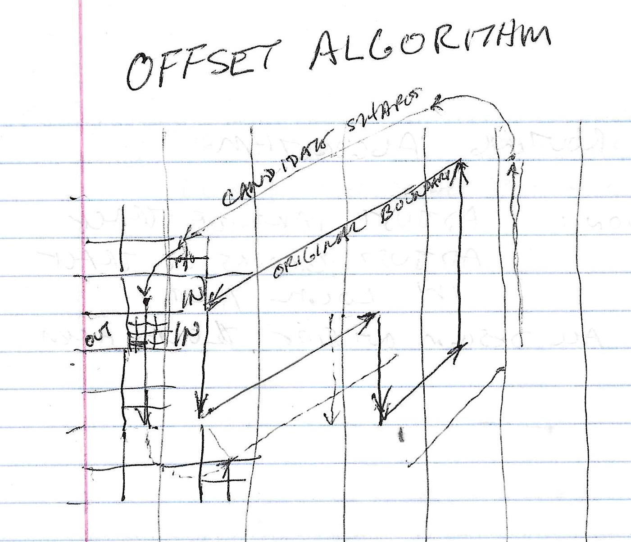

Slide 7
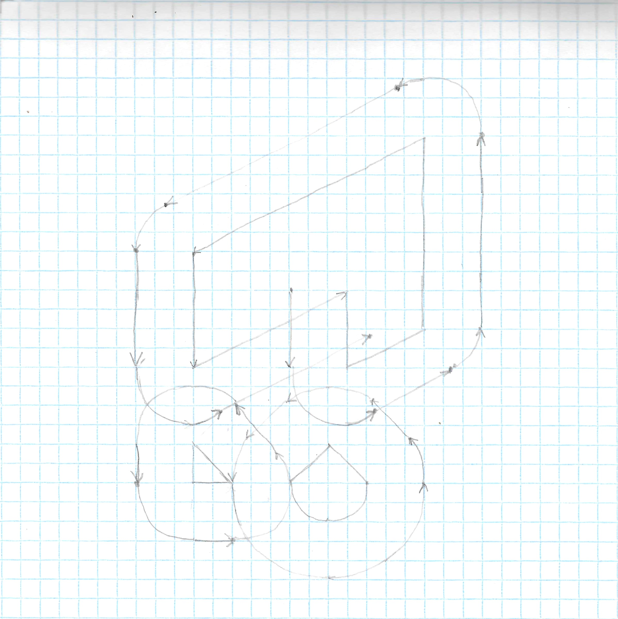

Slide 8
2. Quad Tree
Each square has status
  IN
    Near Boundary
    Deep Inside
  OUT
    Near Boundary
    Deep Inside
  IN/OUT

Slide 9
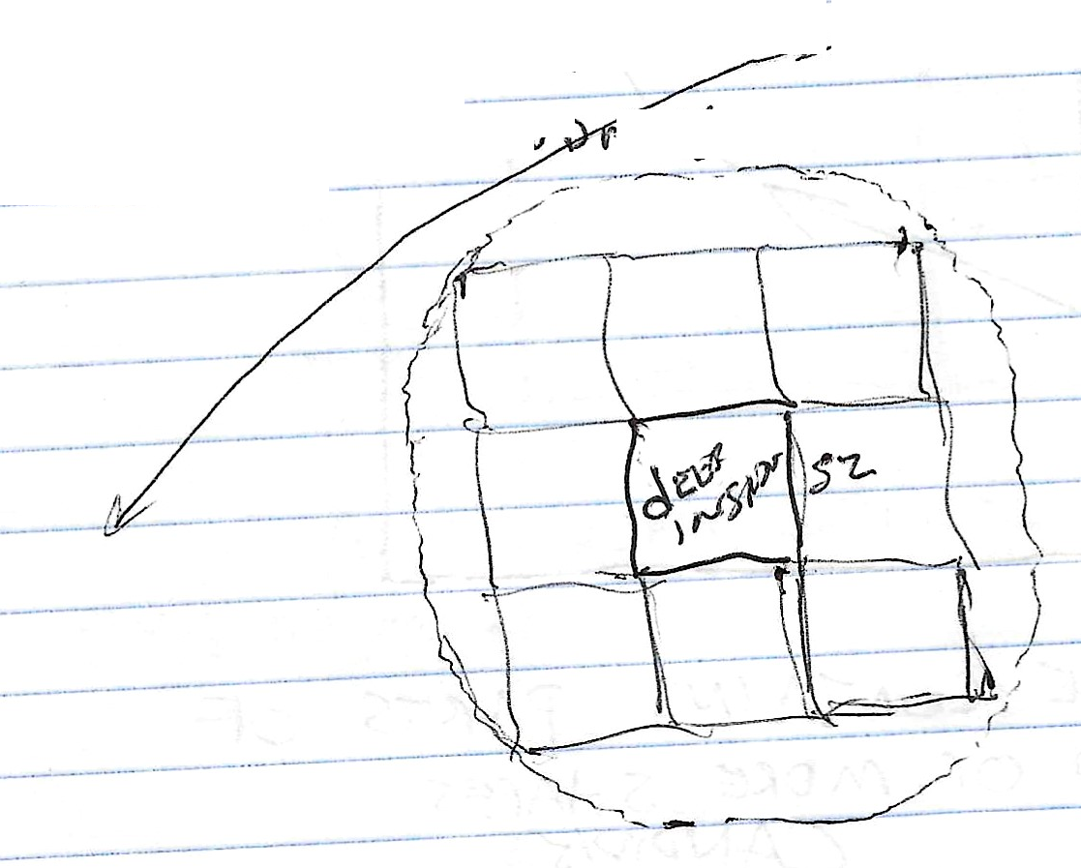
2. Quad Tree
Square is Deep Inside (Deep Outside)
  Distance from square to boundary > sqrt(2)*sq_sz
  All eight adjacent and diagonally adjacent squares are entirely inside(outside) boundary.
A deep inside (outside) square could still contain or be near a candidate boundary shape

Slide 10
2. Quad Tree
Criteria to Subdivide Square
Subdivide if
  not deep, AND
  sq_sz > (1/4)min_allowable_region_size, AND
  distance(square center to nearest candidate boundary shape) < (1/16+sqrt(0.5))*sq_sz

Slide 11
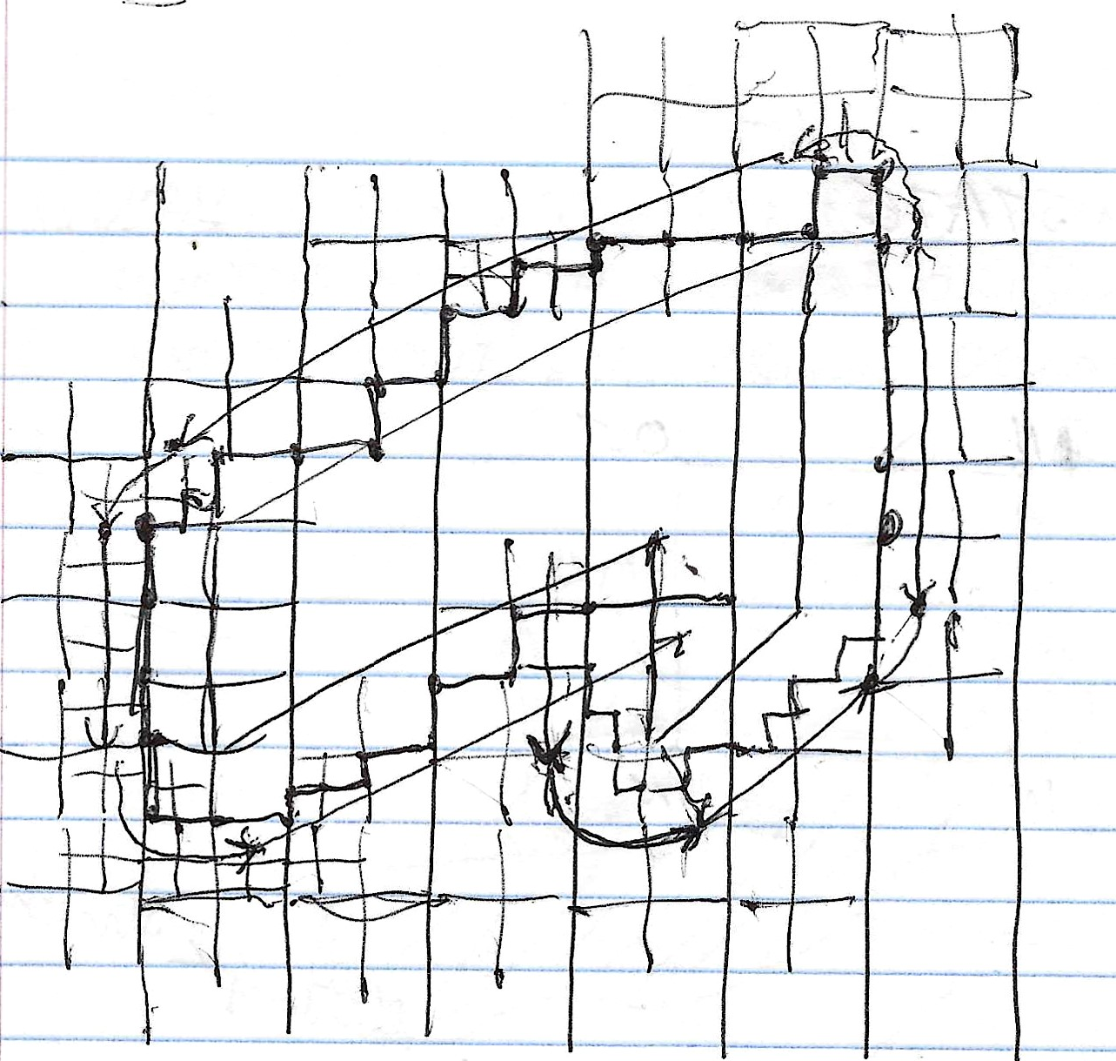

Slide 12
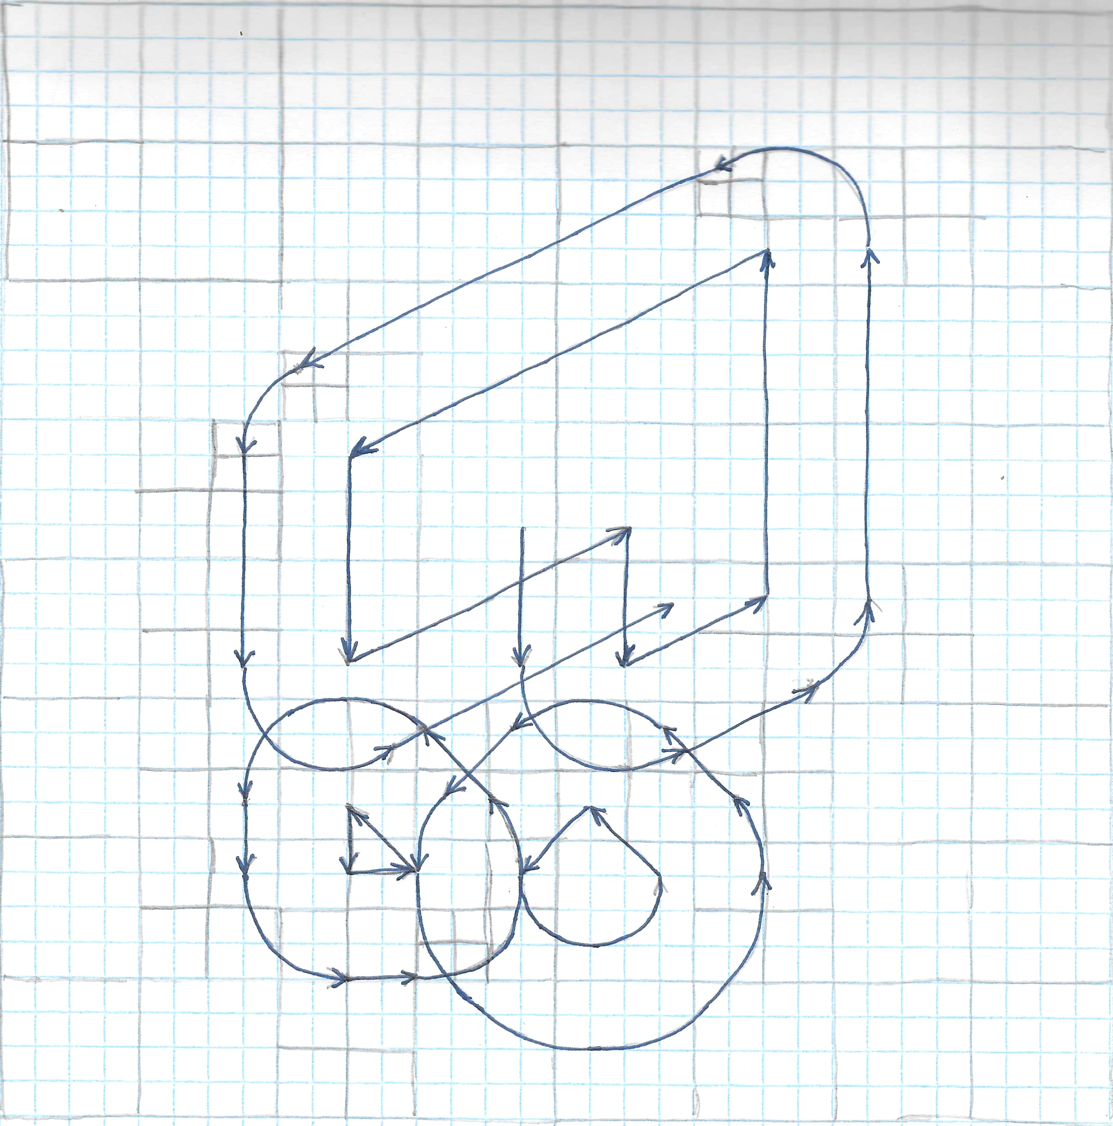

Slide 13
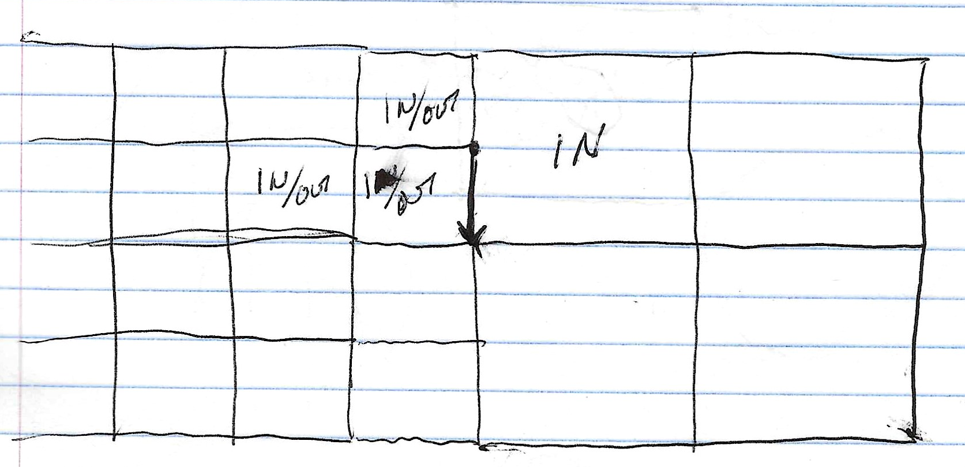
3. Quad Tree Boundary Segments
Fore each leaf node (square)
  If type=IN/OUT
    For each side
      If adjacent square type == IN
        Create quad tree boundary segment
          Line segment

Slide 14
4. Quad Tree Boundary Loops
While there remain unprocessed quad tree boundary segments
  Get next unprocessed q.t.b.s.
  Find nearest q.t.b.s to fwd point Pa
  Join two segments as adjacent segments of quad tree boundary loop

Slide 15
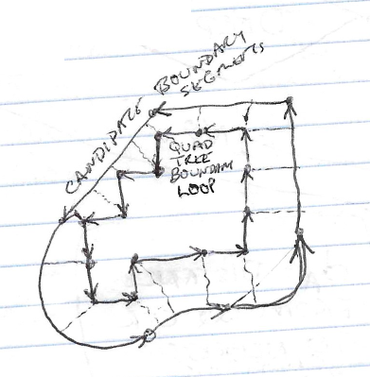
5. Associate Quad Tree Boundary points to points on candidate boundary segments.

Slide 16
5.
Initial Assignment
  For each quad tree boundary loop
    For each quad tree boundary segment
      Find nearest candidate boundary segment
Try to make each candidate boundary segment connect to at least two quad tree boundary segments
  While not done
    For each quad tree boundary loop
      For each quad tree boundary segment
        If (prev q.t.b.s has different candidate b.s) AND (next q.t.b.s has different candidate b.s )
          Subdivide q.t.b.s and next q.t.b.s
            Find nearest candidate boundary segment for each new q.t.b.s

Slide 17
6. Boundary Shape Transitions
For each quad-tree boundary loop
  For each quad tree boundary segment
    If next q.t.b.s. Is associated with different candidate boundary shape
      Move association point to intersection of respective candidate boundary shapes

Slide 18
7. Boundary Loops
For each quad-tree boundary loop
  Proceed around loop, taking each sequence of adjacent q.t.b.s. that are associated with same candidate shape.
  Find start and end associated points on candidate boundary shapes.
  Create finalized boundary shape
    Subset of candidate boundary shape
      Prev intersect point to next intersect point

