Slide 1
Newport Router Algorithm
NP03 Library

Slide 2
Basic Concepts
A*
  https://en.wikipedia.org/wiki/A*_search_algorithm
  https://docs.pgrouting.org/3.1/en/bdAstar-family.html
SURF (Santa Cruz ULSI Routing Framework)
  https://citeseerx.ist.psu.edu/document?repid=rep1&type=pdf&doi=91ce7726d0b103db47ab5db433ed75b538e6e7f8
  Cut Graph
  Route Search formulated as finding a sequence of regions

Slide 3
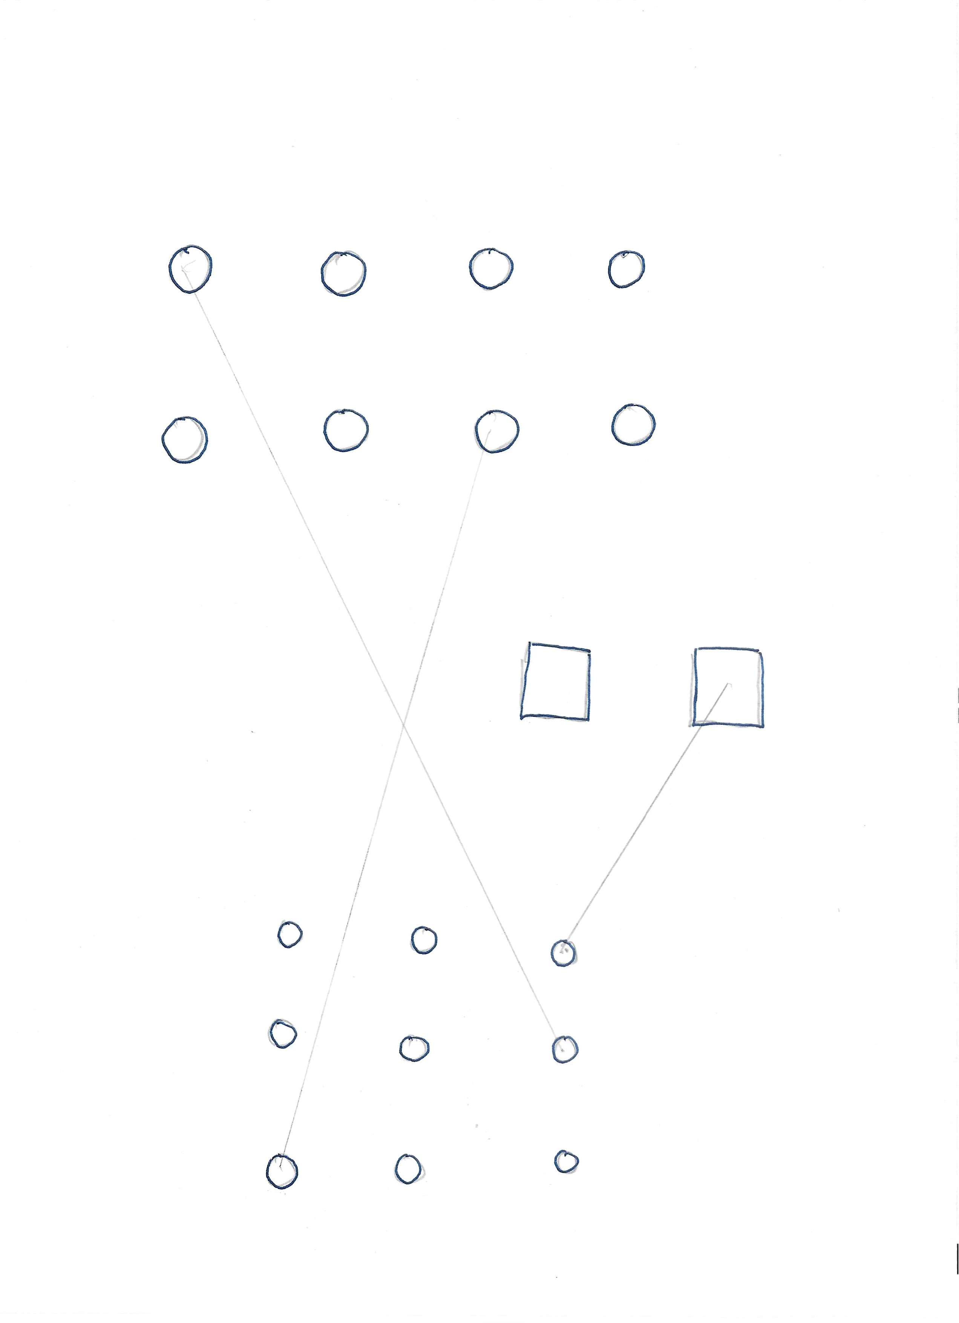
Input
  Layers
  Pads
  Nets
  Pin-pairs
  Rules

Slide 4
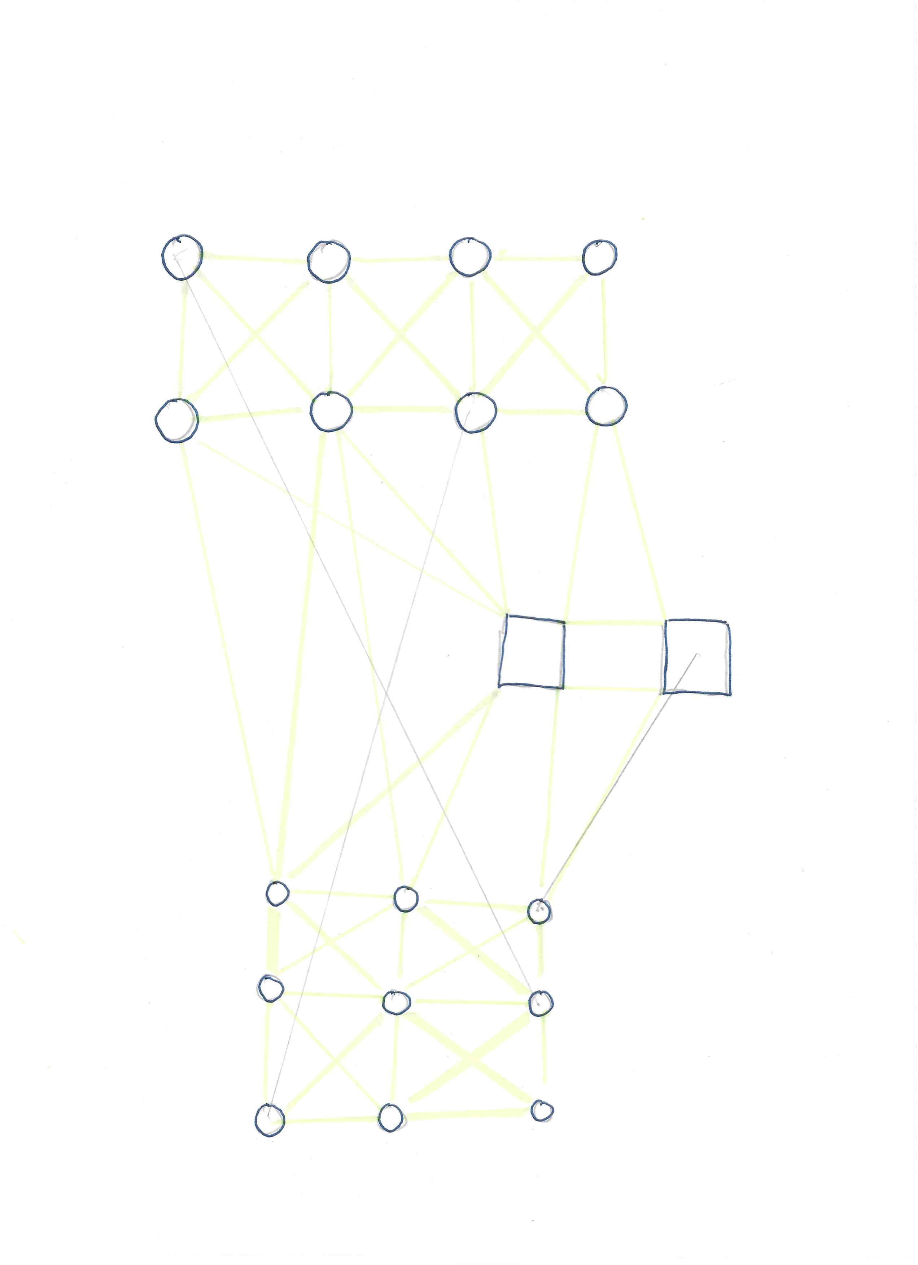
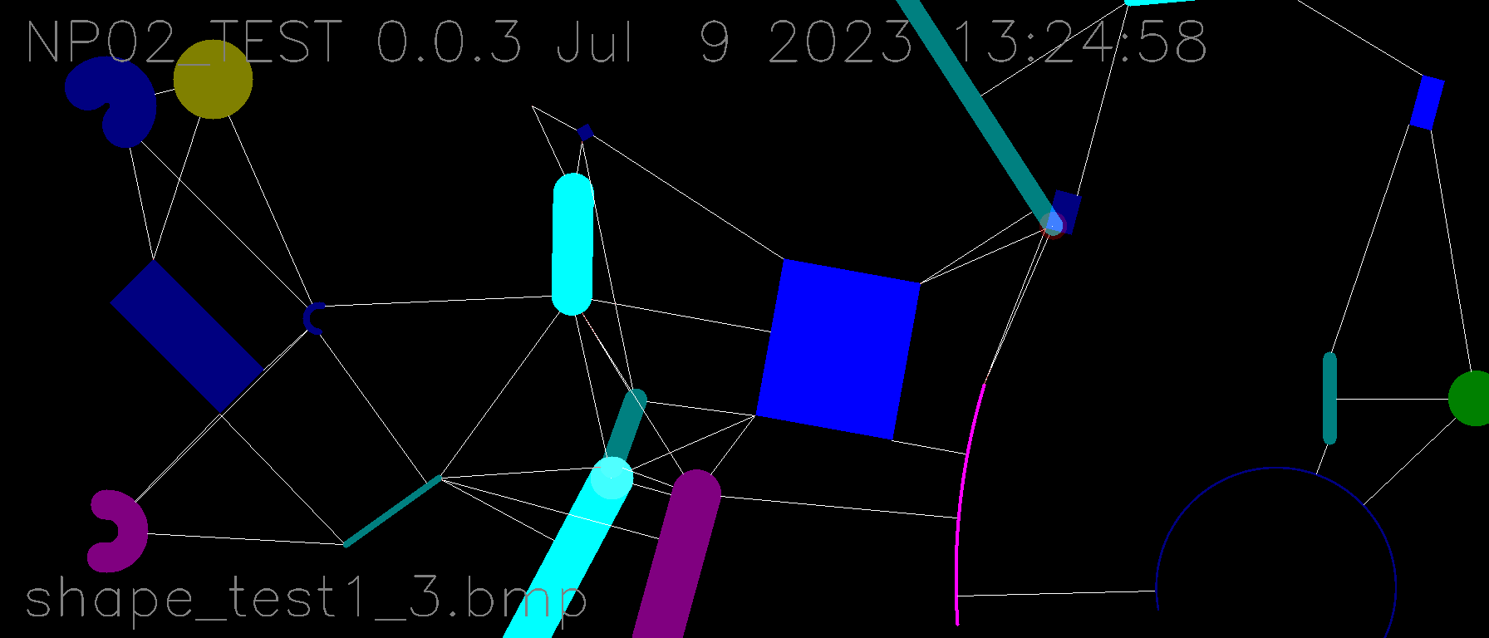
Generate Cut Graph

Slide 5
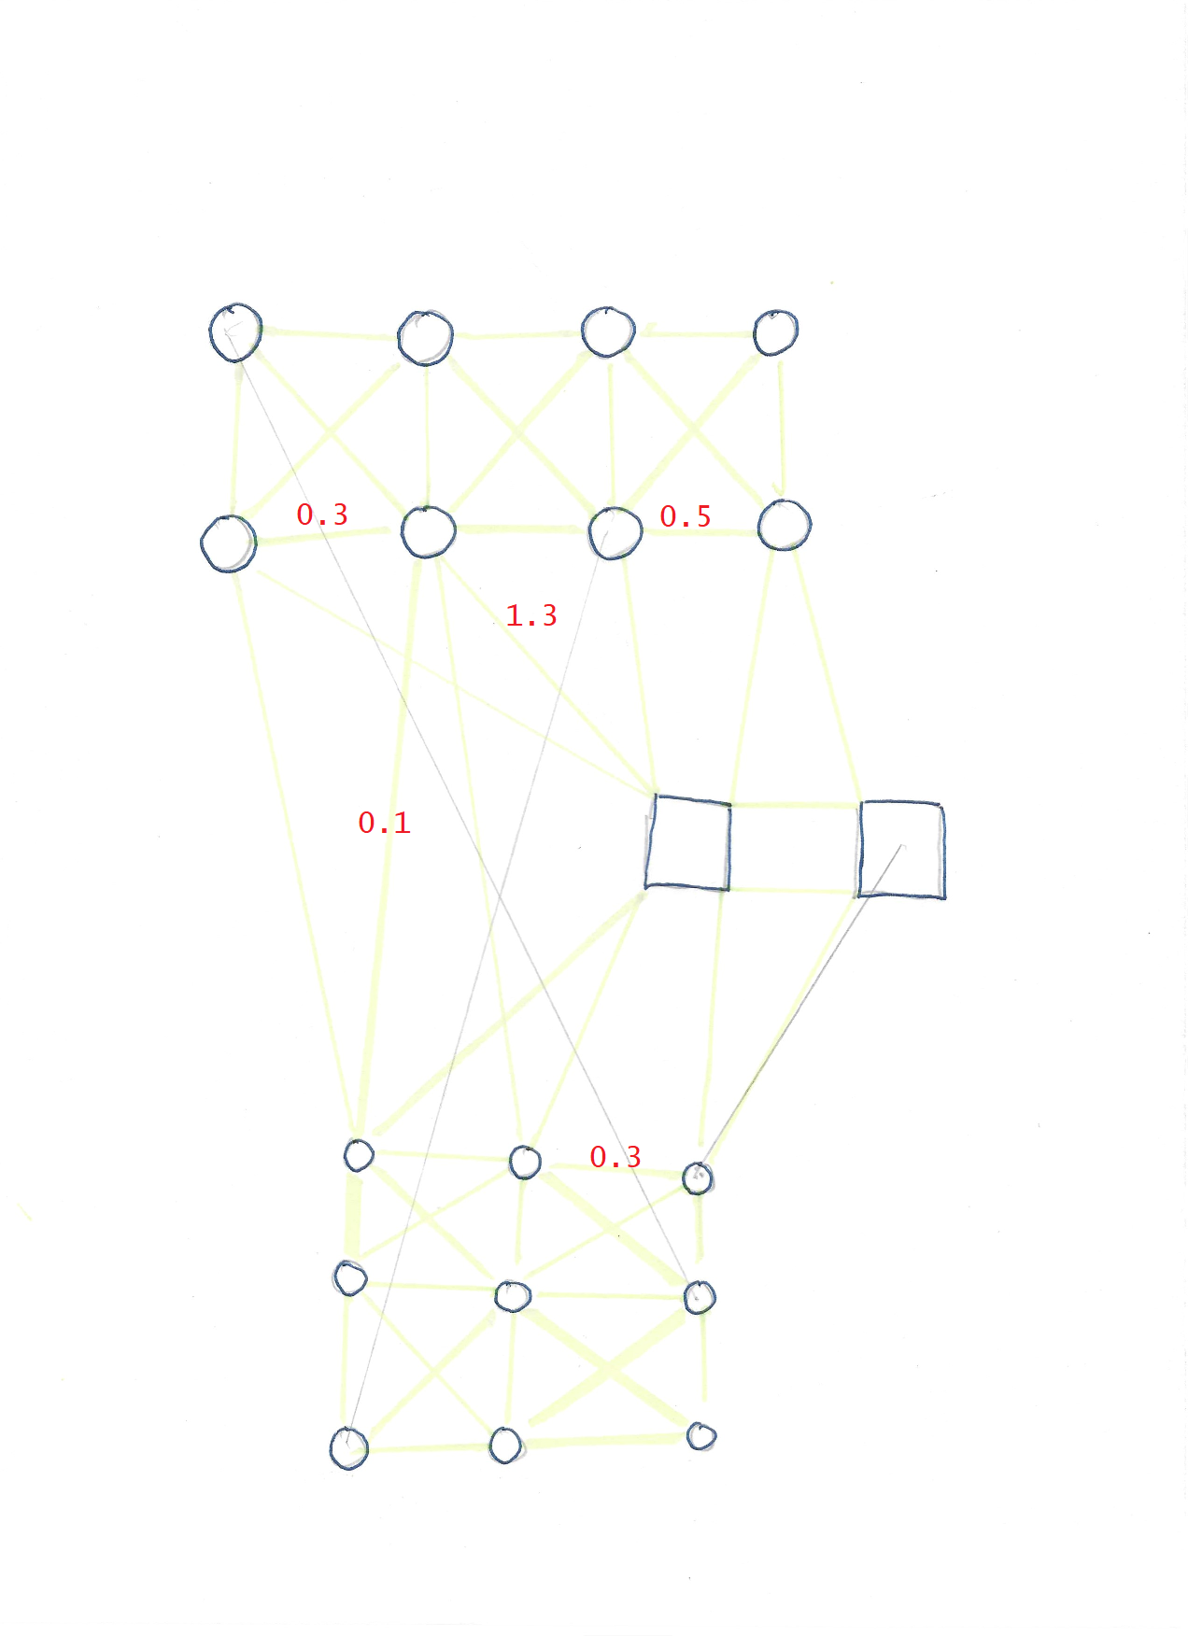
Pre-route
  Generate cost weight structure.
  Assign additional cost to various cuts, per net.
  Decide route sequence (net_a, net_b, net_c...)
  Cost structure and route sequence can be modified genetically for subsequent route attempts.

Slide 6
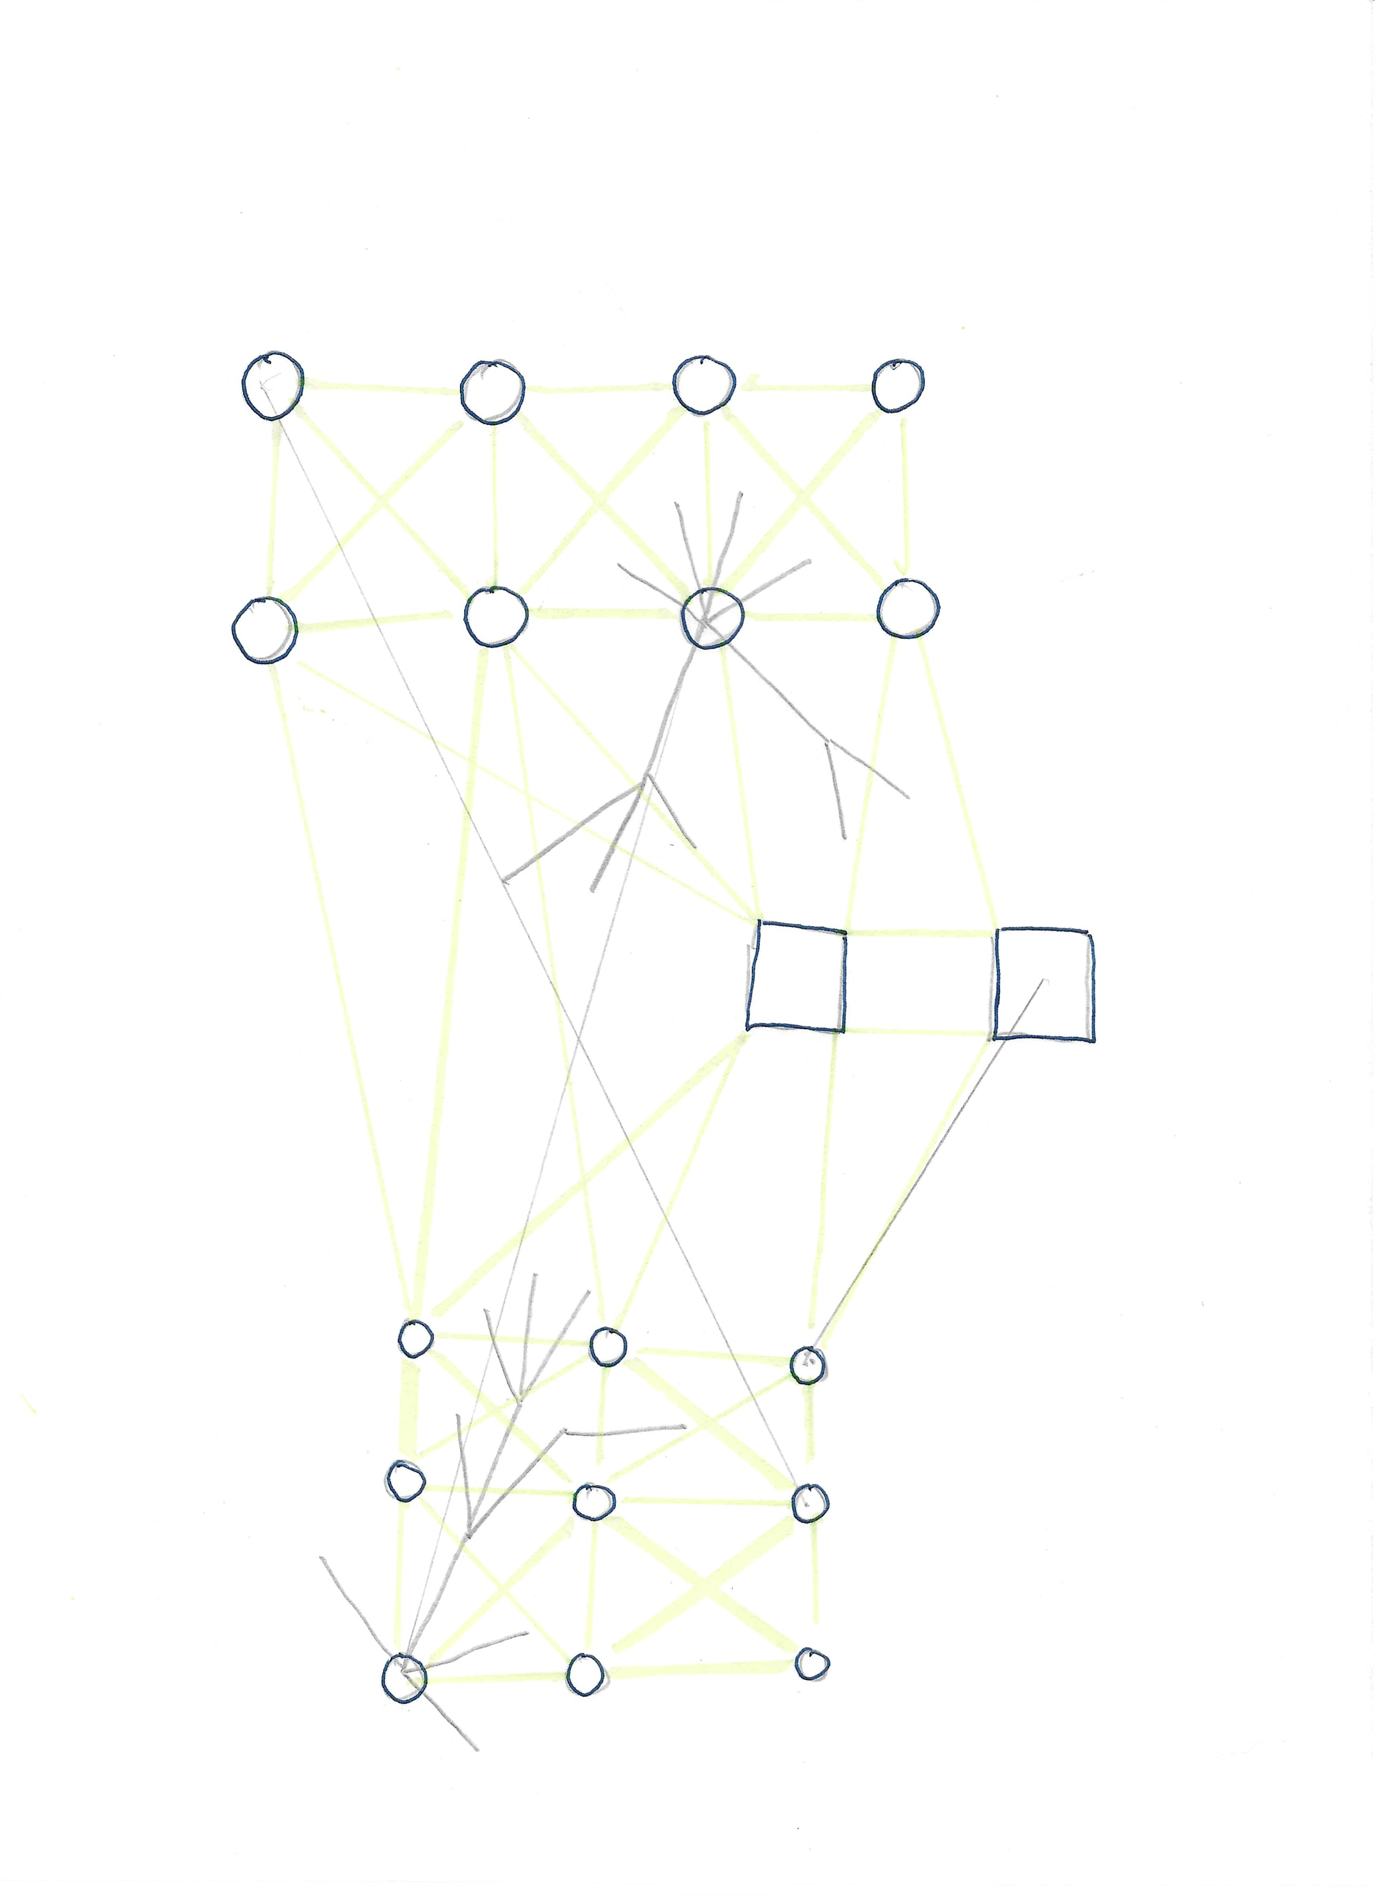
Double-ended A* search
  Unconstrained any-angle local search segments
    extension of the SURF concept of path as a sequence of regions.
  Capacity check at each cut where crossed.

Slide 7
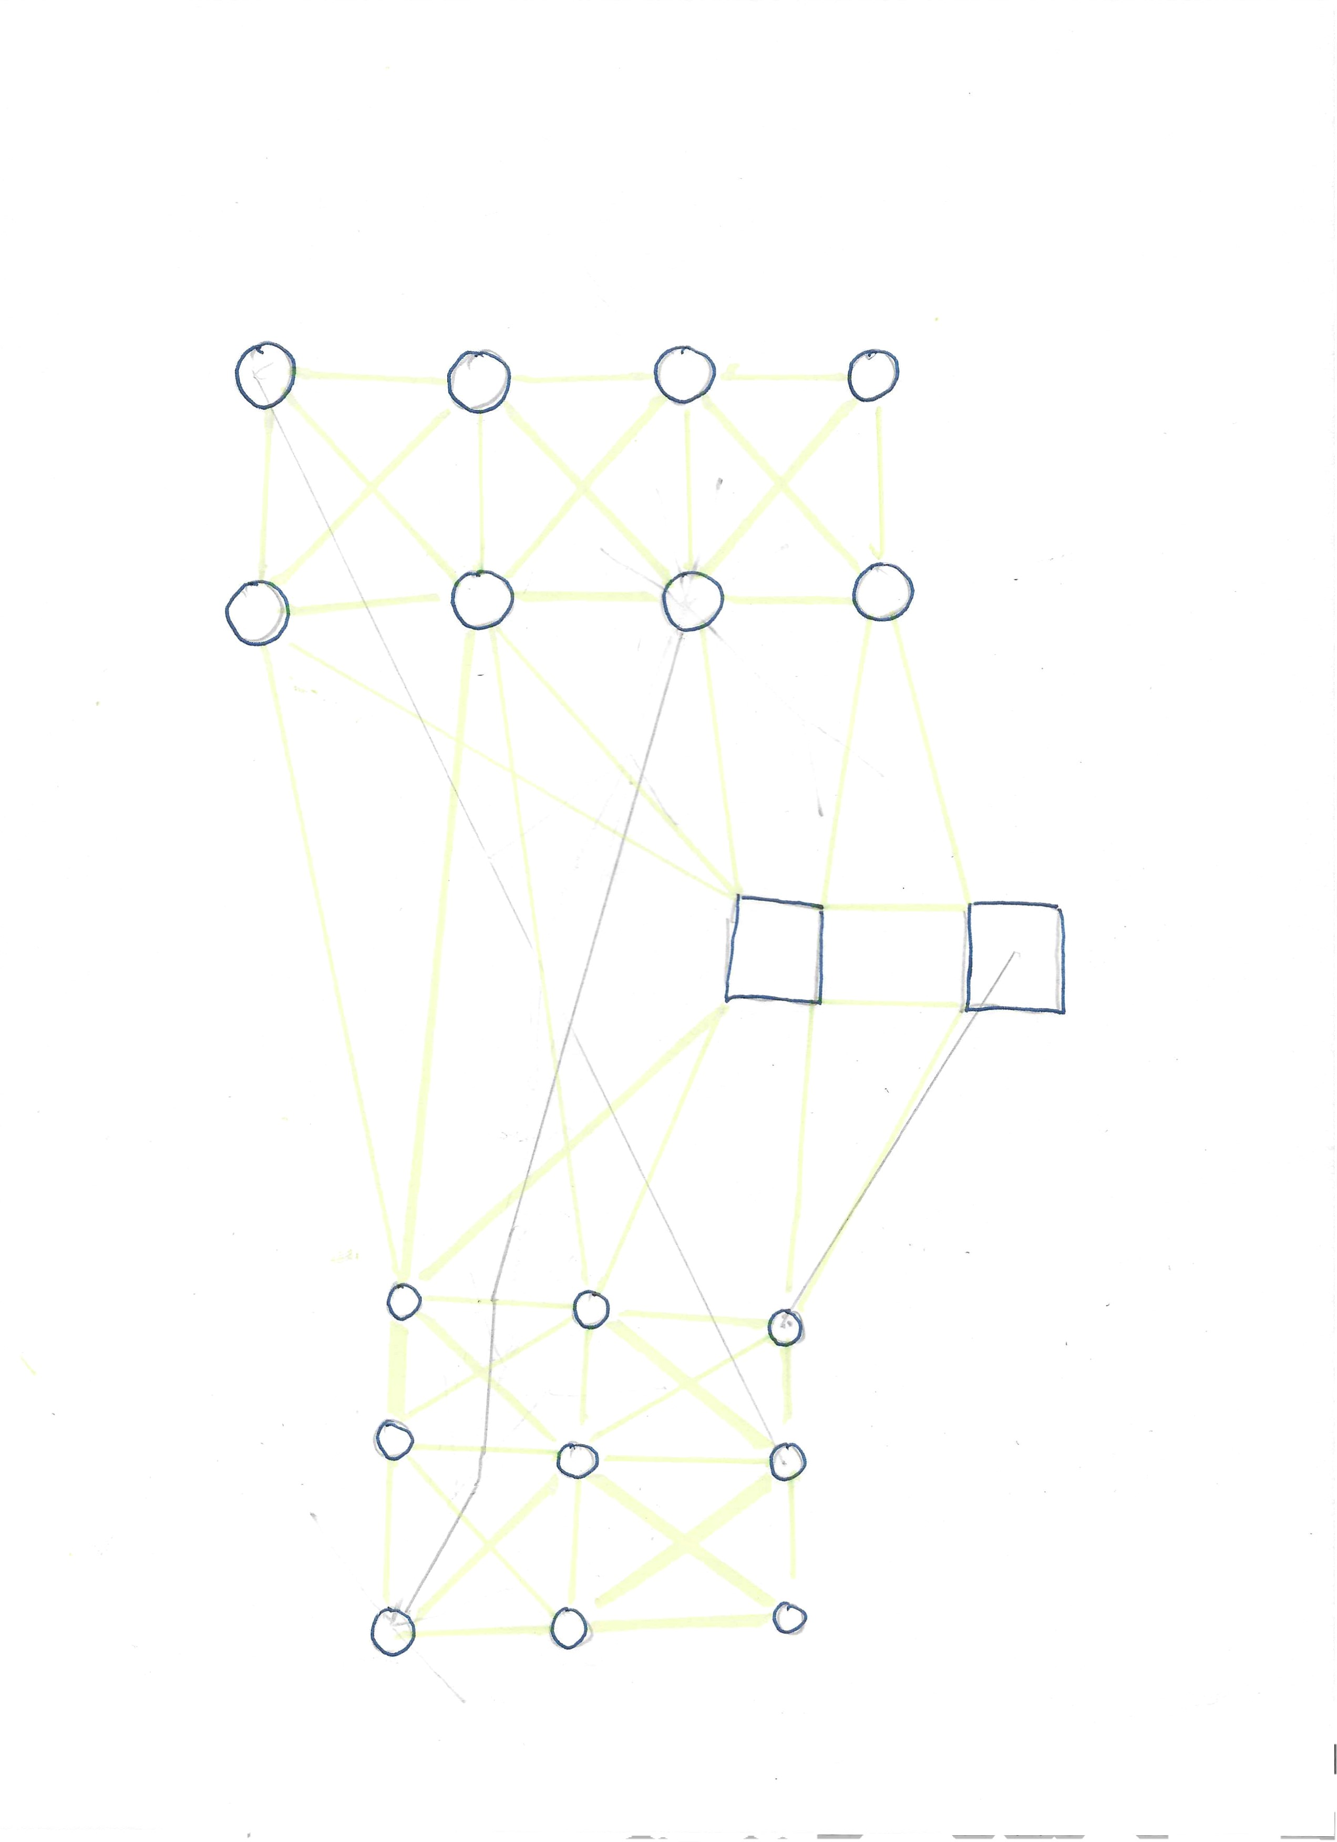
Post-route smoothing using Genetic Autorouter

Slide 8
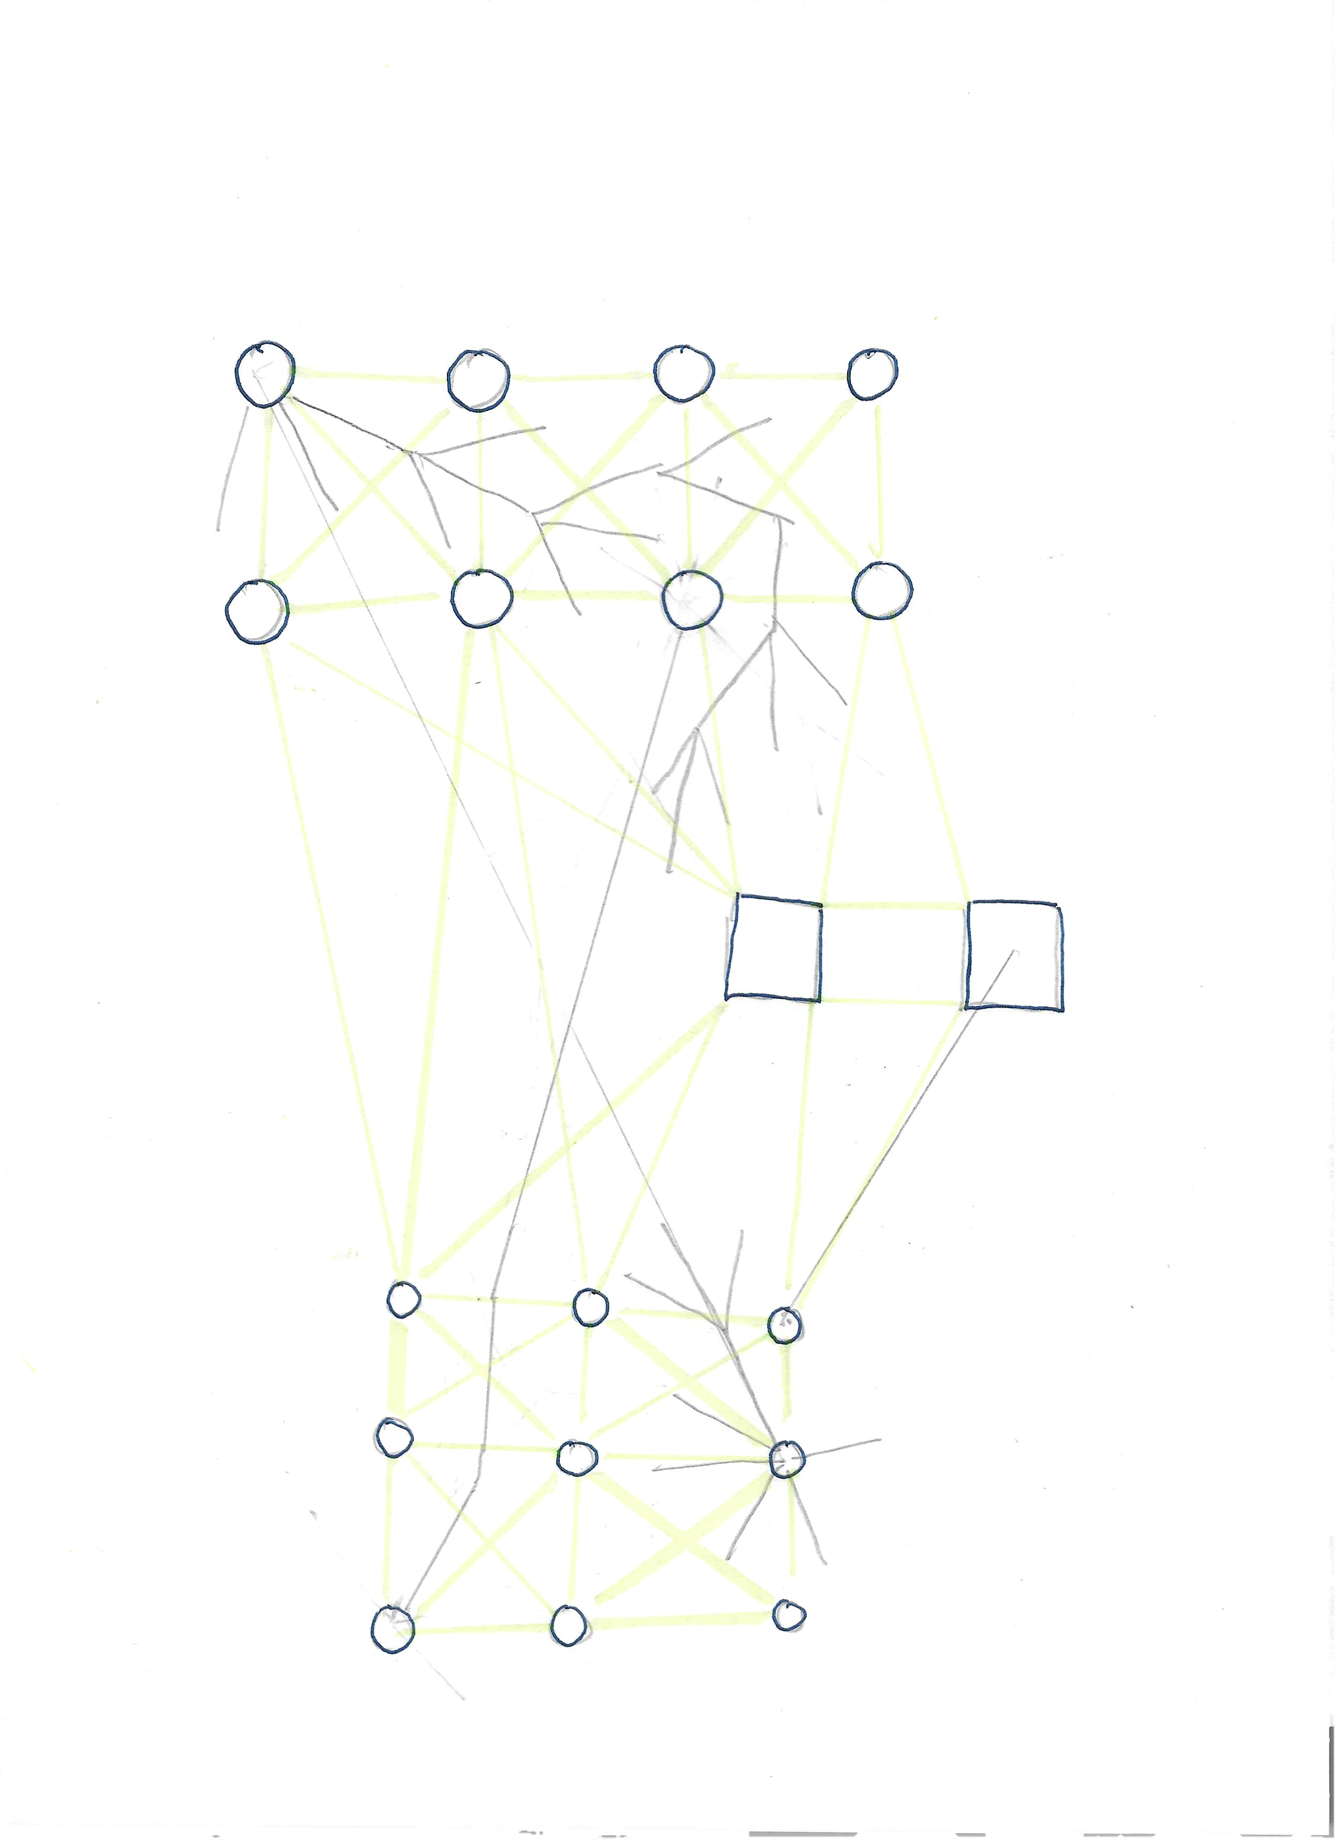
Congested cuts, especially those causing route failures, inform future cost weight structures

