Slide 1

Developing Software for the PS3/Cell Platform
Mike Acton
macton@insomniacgames.com

Slide 2
The Cell Processor
A quick introduction to the hardware

Slide 3
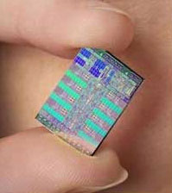

Slide 4
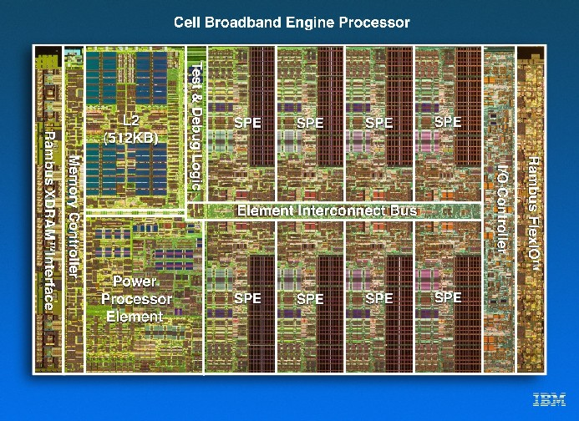

Slide 5
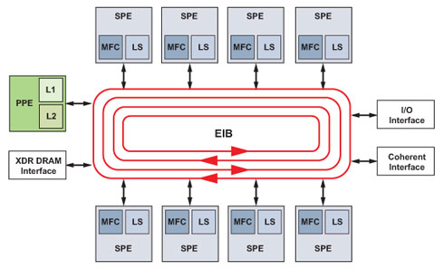

Slide 6
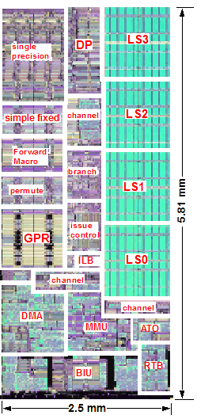

Slide 7
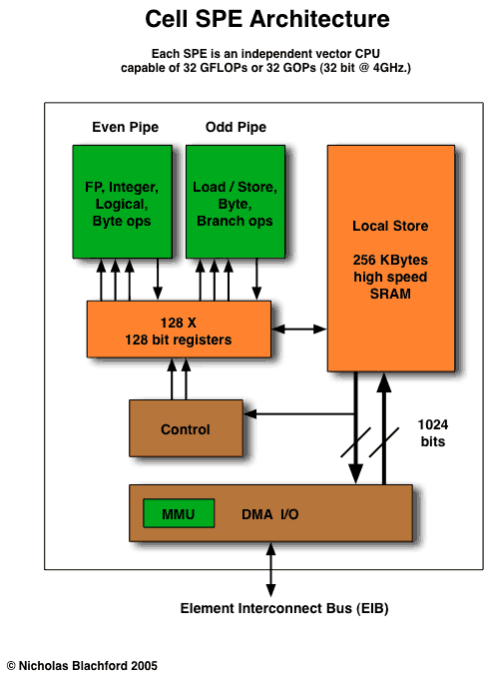

Slide 8
The Cell is...
  ... not a magic bullet.
  ... not a radical change in high-performance design.
  ... fun to program for!

Slide 9
Programming for Games
Quick background of game development

Slide 10
Performance
Mostly "soft" real-time
(60Hz or 30Hz)

Slide 11
Languages and Compilers

Slide 12
Other Processers and I/O
GPU, Blu-ray, HDD, Peripherals, Network

Slide 13
Many Assets
Art, Animation, Audio

Slide 14
"Game" vs. "Engine" code
Divisions of development

Slide 15
Our Approach to the Cell for games
What does it change?

Slide 16
“Manual Solution” “Very optimized codes but at cost of programmability."
WARNING!
Marc Gonzales, IBM

Slide 17
Good solutions for the Cell will be good solutions on other platforms.

Slide 18
High-performance code is easy to port to the Cell.

Slide 19
Poorly performing code from any platform is hard to port.

Slide 20
Data and code optimization are merely important on conventional architectures
... On the Cell, they're critical.

Slide 21
Common Complaints

Slide 22
#1 "But, it's too hard!"

Slide 23
Multi-processing is not new
  Trouble with the SPUs usually is just trouble with multi-core.
  You can't wish multi-core programming away.
  It's part of the job.

Slide 24
"Cache and DMA data design too complex"
Enforced simplicity

Slide 25
Not that different from calling memcpy

Slide 26
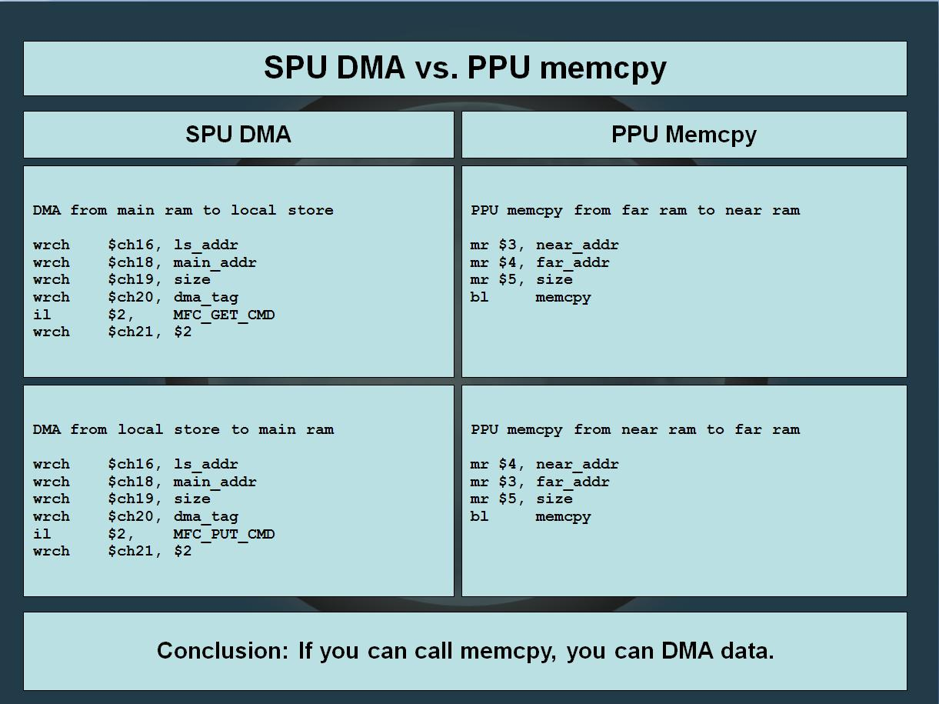

Slide 27
But you get extra control

Slide 28
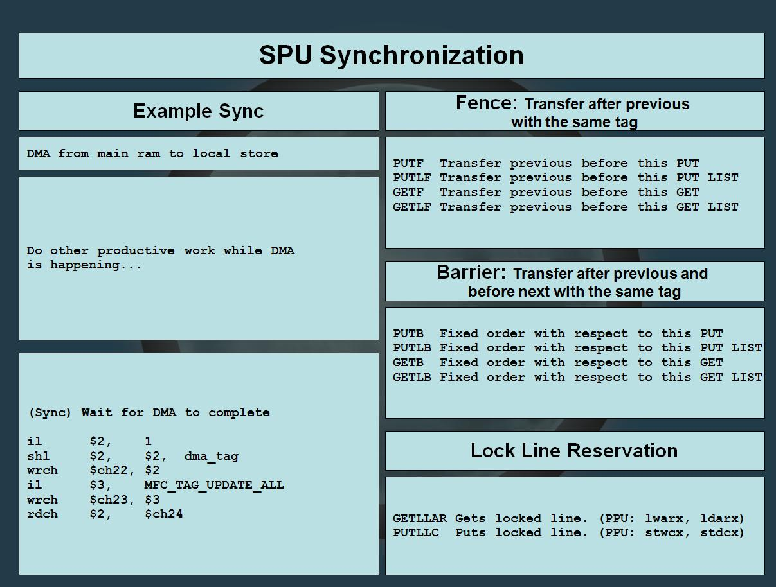

Slide 29
"My code can't be made parallel."
Yes. It can.

Slide 30
"C/C++ is no good for parallel programming"
The solution is to understand the issues --
not to hide them.

Slide 31
"But I'm just doing this one little thing... it doesn't make any difference."
Is it really just you?
Is it really just this one thing?

Slide 32
It's all about the SPUs
Designing code for concurrency

Slide 33
“What's the easiest way to split programs into
SPU modules?”

Slide 34
Let someone else do it.

Slide 35
But if that someone is you...
Rules and guidelines

Slide 36
Rule #1
DATA IS MORE IMPORTANT
THAN CODE

Slide 37
  Good code follows good data.
  Fast code follows good data.
  Small code follows good data.
Guess what follows bad data.

Slide 38
Rule #2
WHERE THERE IS ONE,
THERE IS MORE THAN ONE

Slide 39
The "domain-model design" Lie.

Slide 40
Rule #3
SOFTWARE IS NOT A PLATFORM

Slide 41
Unless you are a
CS Professor.

Slide 42
The real difficulty is in the unlearning.

Slide 43
The ultimate goal:
Get everything on the SPUs.

Slide 44
Complex systems can go on the SPUs
  Not just streaming systems
  Used for any kind of task
  But you do need to consider some things...

