Slide 1
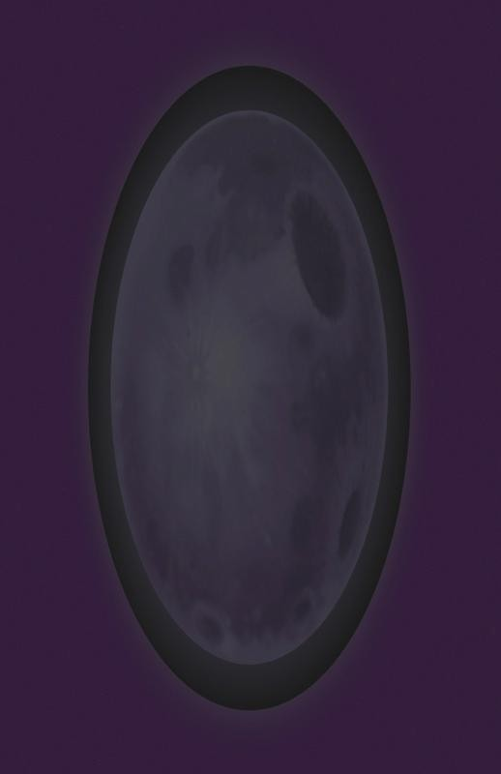
Pre-lighting
in Resistance
2
Mark Lee
mlee@insomniacgames.com

Slide 2
The
problem
for each dynamic light
for each mesh light intersects
render mesh with lighting
•
•
•
•
O(M*L)
Too much redundant texture lookups. Hard to optimize, we were often vertex
bound.
Each object we render needs to track lights
which illuminate it.

Slide 3
One
solution
for each mesh
render mesh
for each light
render light
•
•
O(M+L)
Lighting is decoupled from geometry
complexity.

Slide 4
G-Buffer
Caches inputs to lighting pass to multiple
buffers (G-buffer).
•
•
•
All lighting is performed
Nicely separates scene
lighting, once geometry
in screen space.
geometry from
is written into G-
Buffer, it is shadowed and lit automatically.
G-buffer also available for post processing.
•

Slide 5
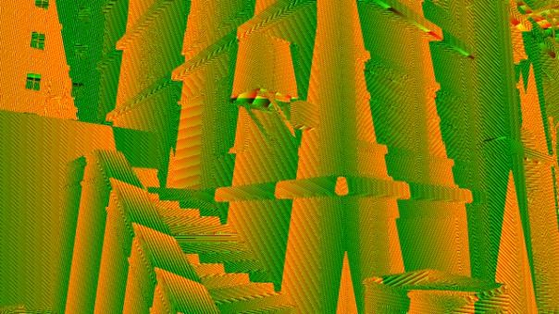
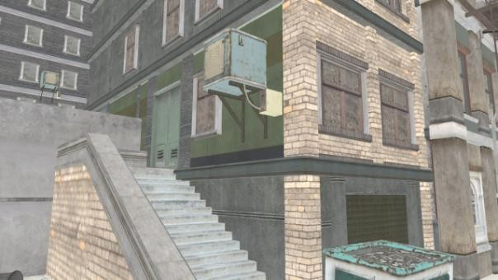
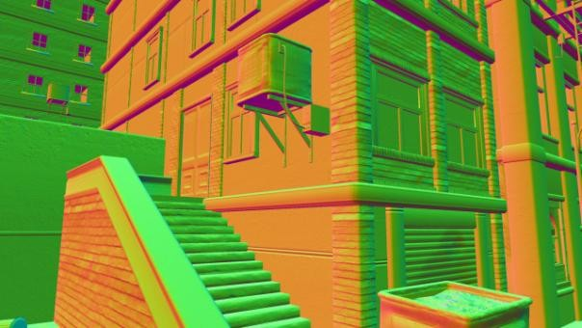
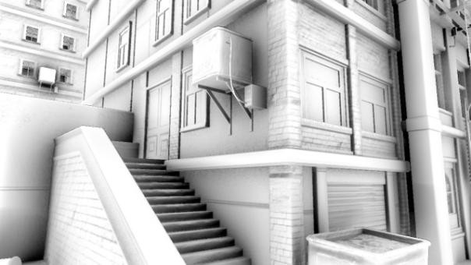
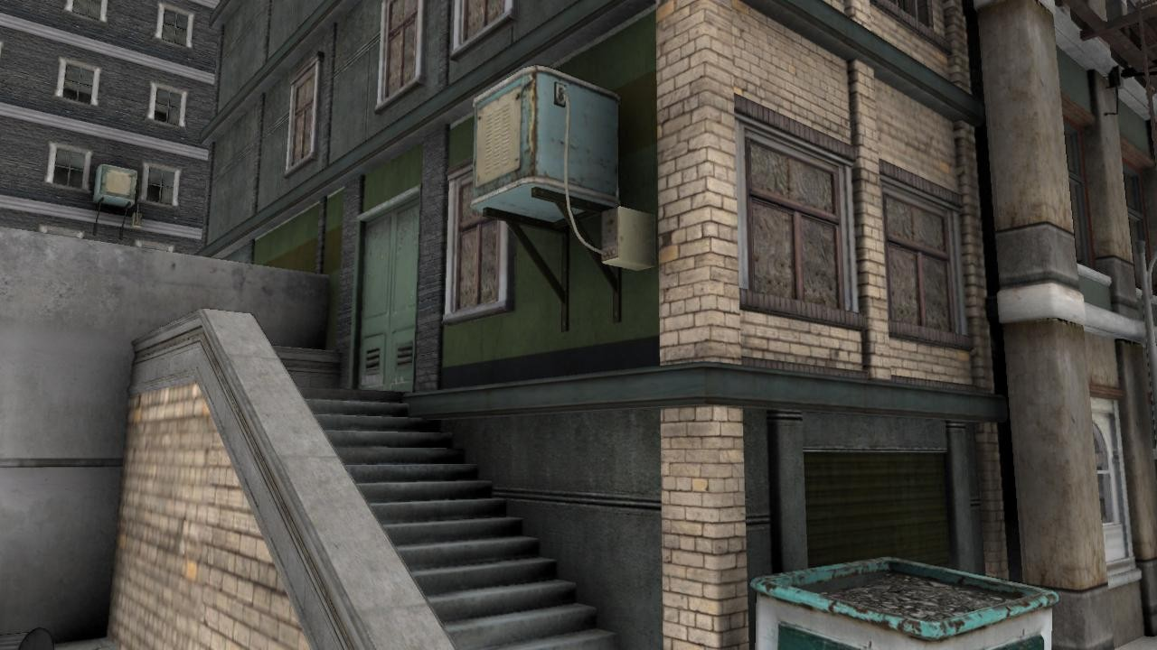
do lighting

Slide 6
G-Buffer issues
•
Prohibitive memory footprint.
– 1280*720 MSAA buffer is 7.3mb,
is 38mb
multiplied by 5
•
•
Unproven technology on the PS3.
A pretty drastic change to implement.

Slide 7
Pre-lighting / Light pre-pass
Like the G-Buffer approach except
•
It only caches normals and minimal material
properties in an initial geometry pass.
A screen space pre-lighting pass is done
before the main geometry pass.
All the other material properties are supplied a second geometry pass.
•
•
in

Slide 8
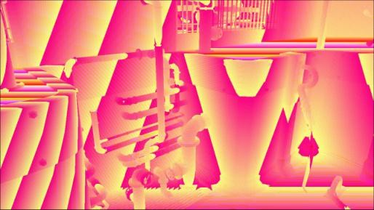
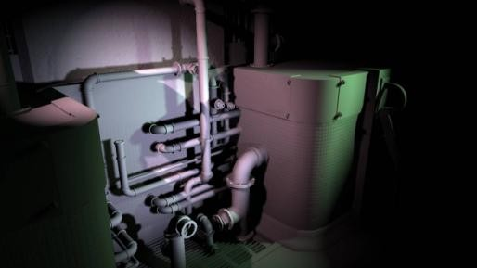
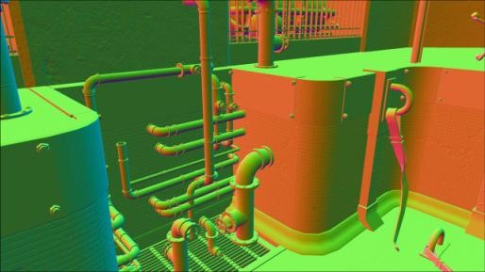
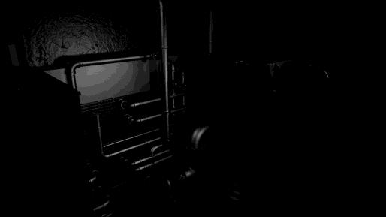
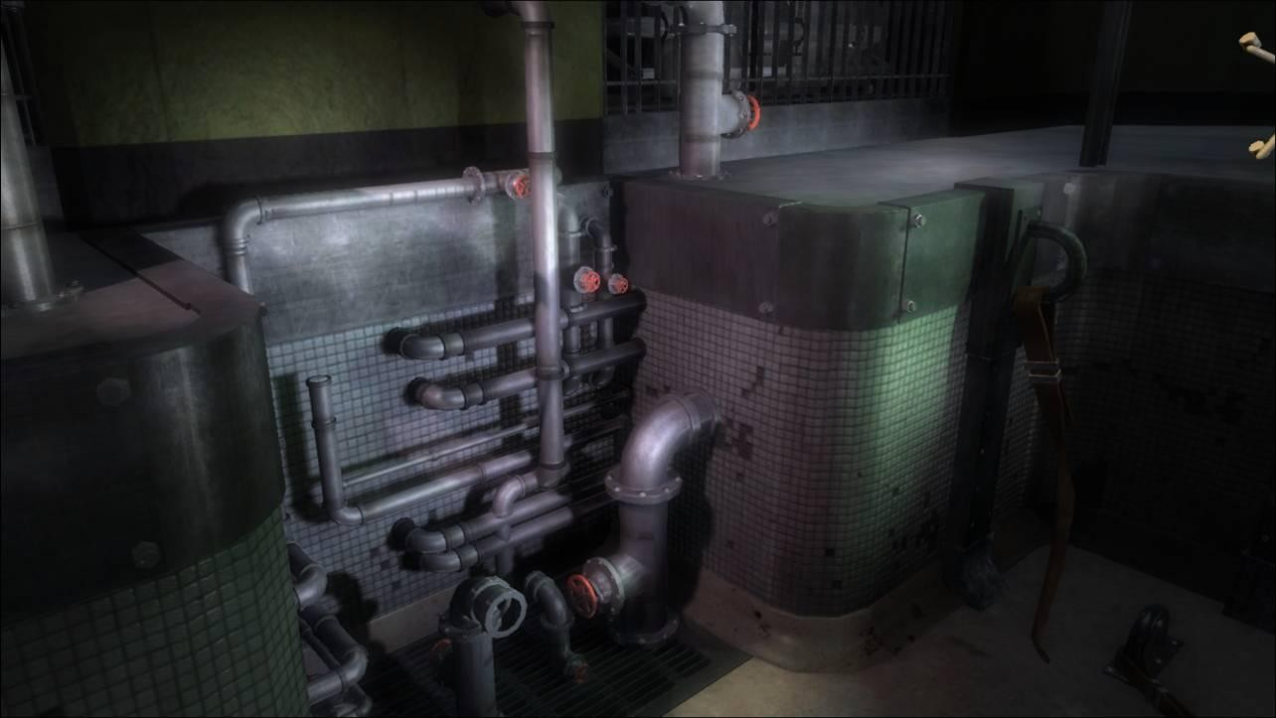
pre-lighting
render
scene

Slide 9
Step
1
–
Depth
&
normals
(and some other stuff)

Slide 10
Writing depth and normals
R2 used 2x MSAA.
Write out normals when you are rendering your early depth pass.
Use primary render buffer to store normals.
Write specular power into alpha channel of normal buffer.
– Use discard in fragment programs to achieve alpha
testing.
Normals are stored in viewspace as 3 8-bit components for simplicity.
•
•
•
•
•

Slide 11
The viewspace normal myth
Store viewspace x and y, and reconstruct z…
– i.e. z = sqrt(1 – x*x – y*y)
Widespread misconception that this is valid.
Z can go negative due to perspective projection.
When z goes negative, errors are subtle and
continuous so easy to overlook.
We store the full xyz components for simplicity.
•
•
•
•
•

Slide 12
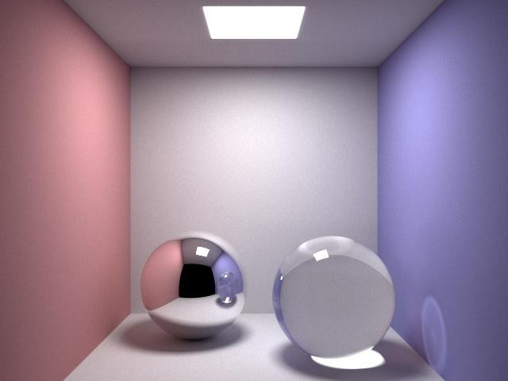

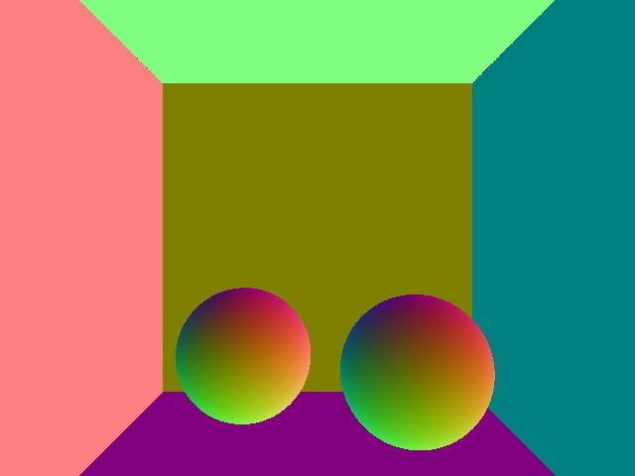
The
viewspace normal
myth
Fig.
Fig.
A
B
normal = (1,
0,
0)
normal = (-1, 0, 0)

Slide 13
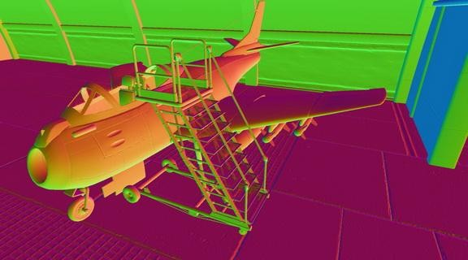

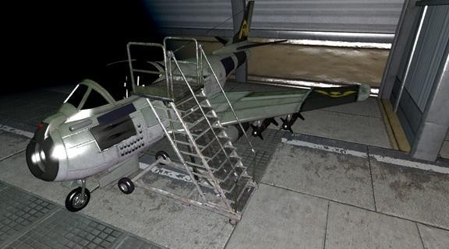
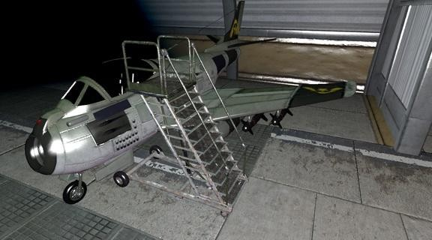
Viewspace
normal
error
correct
incorrect

Slide 14
Step
2
–
Depth
resolve

Slide 15
Depth resolve
Convert MSAA to non-MSAA resolution.
Our lighting and shadow buffers are non-MSAA,
this allows us to use stencil optimizations.
No extra work, we’re just moving it earlier.
The same final depth buffer is used for all non- MSAA rendering post color resolve.
But what if my geometry is heavily vertex bound?
•
•
•
•
•

Slide 16
Step 3 – Accumulate sun
shadows

Slide 17
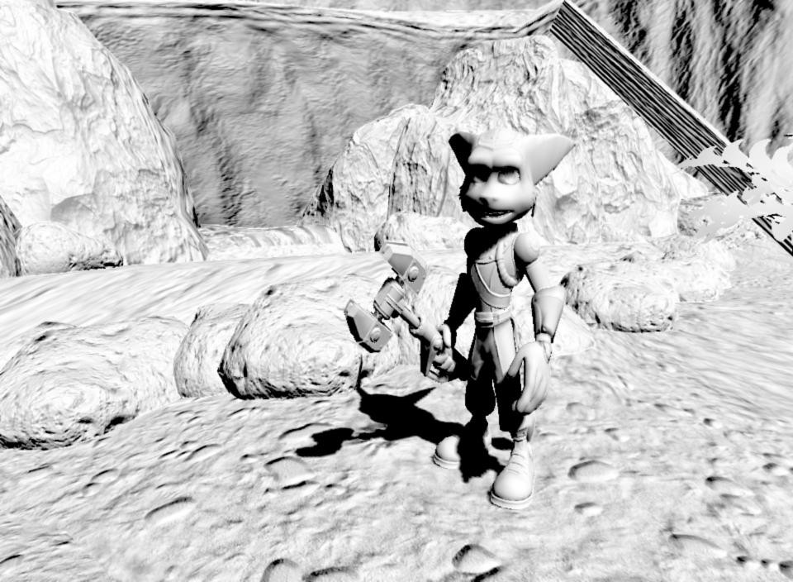
Sun shadows

Slide 18
Sun shadows
All done in screen space.
All sun shadows from static geometry are lightmaps.
We just want to accumulate sun shadows casters.
•
•
precomputed in
•
from dynamic
for each dynamic caster
compute OBB // use collision rays
merge OBBs where possible
for each OBB
render sun shadow map
for each sun shadow map
render OBB to stencil buffer
render shadow map to sun shadow buffer

Slide 19
Sun shadows
•
•
•
Full screen backface darkening
Min blend used to accumulate.
pass.
Use lighting buffer as temporary memory,
copy to an 8-bit texture afterwards.

Slide 20
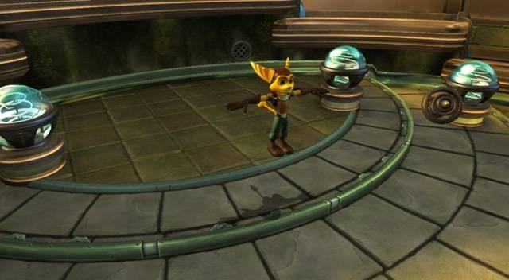
Which pixels to shadow?

Slide 21
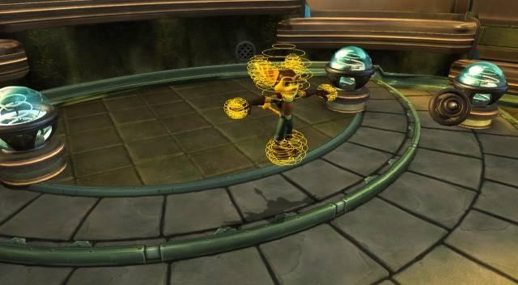
Which pixels to shadow?

Slide 22
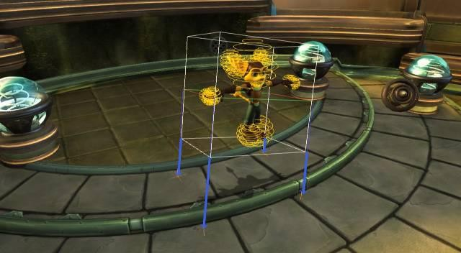
Which pixels to shadow?

Slide 23
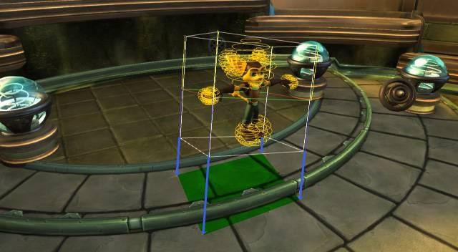
Which pixels to shadow?

Slide 24
Step
4
–
Accumulate
lights
dynamic

Slide 25
Accumulating
Render all spotlight shadow
linear depth.
For each light:
– Lay down stencil volumes.
light
maps
•
using D16
•
– Rendered screen space projected quad covering
light.
Stenciling vs. Tiling.
Single buffer vs. MRT, LDR vs. HDR.
•
•

Slide 26
Accumulating light
•
MSAA vs. non-MSAA
– Diffuse, shadowing, projected, etc.
all done at non-MSAA resolution.
– Specular is 2x super sampled.
These buffers are available to all subsequent rendering passes for rest of the frame.
are
•
the

Slide 27

Dynamic
lights
where:
•
•
l is our set of lights
gp is the limited set of geometric/material properties we choose to store for each pixel
mp is the full set of material properties for each pixel
P is the function evaluated in the pre-lighting pass for each
light (step 4)
C is our combination function which evaluates the final
result (step 5)
•
•
•

Slide 28
Lambertian
lighting
example
•
•
•
•
gp = normal
P = function inside
mp = albedo
C = mp * P
of sigma

Slide 29

Specular
lighting
example
•
•
•
•
gp = specular power
P = function inside of
mp = gloss
C = mp * P
sigma

Slide 30
Limitations
Very limited range of materials can be factored in
this way.
•
–
–
Extra storage for extra material properties.
Conditionally execute different fragment shader code paths depending on material.
Resistance 2, more complex material types
•
In
were done with forward rendering.

Slide 31
Step
5
–
Render
scene

Slide 32
Rendering the scene
Scene is rendered identically to before with the addition of the lighting and sun shadow buffer lookups.
Smart shadow compositing function used:
•
•
–
–
–
“in shadow” global ambient level defined
input light level determined from baked lighting
geometry is only shadowed if baked light level is
above this threshold

Slide 33
Implementation
tips

Slide 34
Reconstructing position
•
•
•
Don't store it in your G-buffer.
Don’t do a full matrix transform per pixel.
Instead interpolate vectors from camera such
that view z = 1.
Technique not confined to viewspace.
•

Slide 35




Reconstructing position
Scene
zbuffer z = 1

Slide 36
Reconstructing depth
•
W-buffering isn’t supported on the PS3.
– Linear shadow map tricks don’t work.
Z-buffer review (D3D conventions):
•
–
–
–
–
The z value is 0 at near clip and far at the
far clip.
The w value is 0 at viewer and far at the far clip.
z/w is in the range 0 to 1.
This is scaled by 2^16 or 2^24 depending on our
depth buffer bit depth.

Slide 37
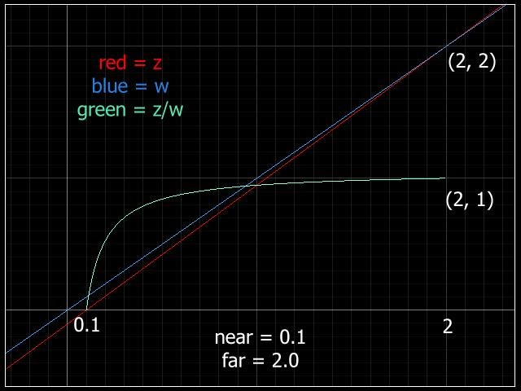
Reconstructing
depth
z = f(vz - n) / (f - n)
w = vz
zw = z / w
zb = zw*(pow(2, d)-1)
where:
f = far clip
n = near clip vz = view z
zb = what is stored in the z-buffer
d = bit depth of the z buffer

Slide 38
Recovering hyperbolic
depth
•
Alias an argb8 texture to the depth
buffer.
00
ff
ff
ff
•
Using a 24-bit integer
maps to near clip and
to far clip.
In C we would do
depth buffer, 0
0x00ffffff maps
A
R
G
B
•
float(r<<16 + g<<8 + b) / range
•
When dealing with floats it becomes
(r * 65536.f + g * 256.f + b) / range

Slide 39
Recovering hyperbolic depth
But….
Texture inputs come in at a (0, 1) range
The texture integer to float conversion isn’t operating
float precision
– We are magnifying error in the red and green channels significantly
•
•
•
at
full
•
Solution: round each component back to 0-255 integer
boundaries
float3 rgb = f3tex2D(g_depth_map, uv).rgb;
rgb = round(rgb * 255.0);
float zw = dot(rgb, float3( 65536.0, 256.0, 1.0 ));
zw *= 1.0 / 16777215.0;

Slide 40
Recovering
linear
depth
•
Recall that:
z = f(vz - n) / (f - n)
w = vz
zw = (f(vz - n) / (f - n)) / vz
•
Solving for vz,
we get:
vz = 1.0 / (zw * a + b)
where:
a = (f - n) / -fn b = 1.0 / n
•
Reconstructed linear depth
precision will be
very
skewed – but it’s skewed to where we want it.

Slide 41
Stenciling
algorithm
clear stencil buffer
if( front facing and depth test passes )
increment stencil
if( back facing and depth test passes )
decrement stencil
render light only to pixels which have non-zero stencil
•
•
Stencil shadow hardware does this.
Set culling and depth write to false when volume.
Same issues as stencil shadows
– Make sure light volumes are closed.
rendering
•
– This only works if camera is outside light volumes.

Slide 42
Object is inside light volume

Slide 43
Object is near side of light volume

Slide 44
Object is far side of light volume

Slide 45
If
the
camera
goes
inside
light
volume
clear stencil buffer
if( front facing and depth test fails )
wrap increment stencil
if( back facing and depth test fails )
wrap decrement stencil
render light only to pixels which have
non-zero stencil
•
•
Switch to depth fail stencil test.
Only do this when we have to, this disables optimizations.
– Typically we’ll need some fudge factor here.
Stenciling is skipped for smaller lights.
z-cull
•

Slide 46
If the camera goes inside light volume

Slide 47
Pros
and cons
Pre-lighting / Light pre-pass
G-Buffer
•
Requires only a single
geometry pass. Good for
vertex bound games.
More complex materials can be implemented.
Not all buffers need to be updated with matching data, e.g. decal tricks.
•
Easier to retrofit into
"traditional" rendering pipelines. Can keep all your current shaders.
Lower memory and
bandwidth usage.
Can reuse your primary shaders for forward rendering of alpha.
•
•
•
•

Slide 48
Problems common to both approaches
•
Alpha blending is problematic.
– MSAA and alpha to coverage can help.
Encoding different material types is not
elegant.
– Coherent fragment program dynamic branching
can help.
•

Slide 49
See also
Deferred Rendering in Killzone 2 - Guerrilla Games
http://www.guerrilla-games.com/publications/dr_kz2_rsx_dev07.pdf
•
•
The Light Pre-Pass Renderer – Wolfgang Engel
http://www.wolfgang-engel.info/RendererDesign.zip

Slide 50
Questions?
mlee@insomniacgames.com

