Slide 1
Developing
Software
for
the
PS3/Cell
Platform
Mike Acton
macton@insomniacgames.com

Slide 2

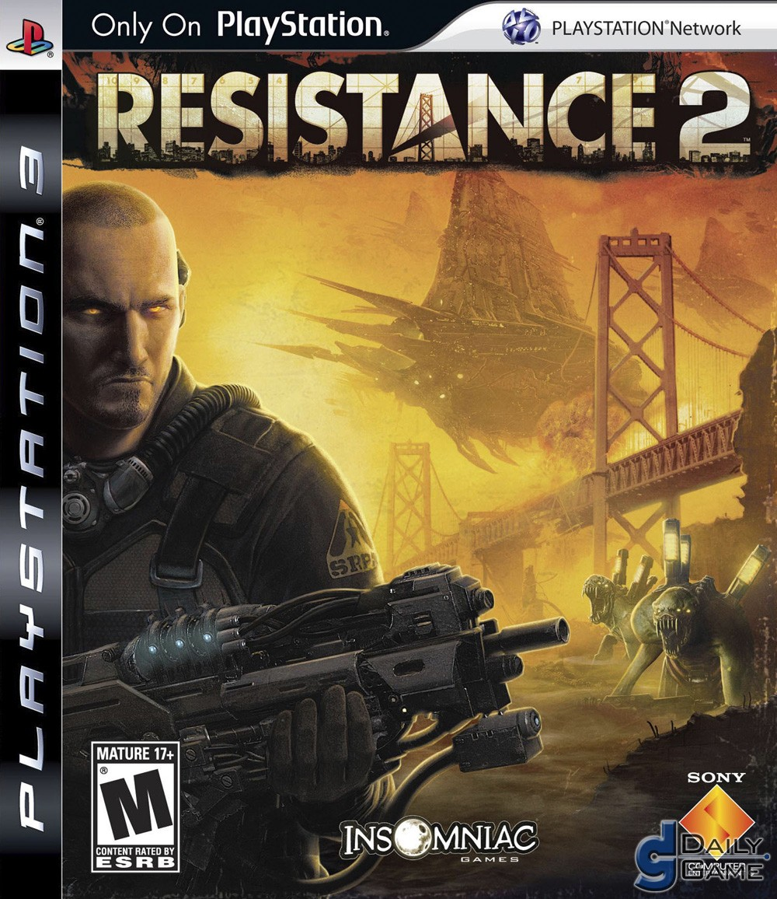


Slide 3
The
Cell
Processor
A quick introduction to the hardware

Slide 4
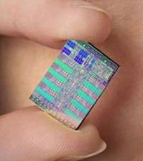

Slide 5
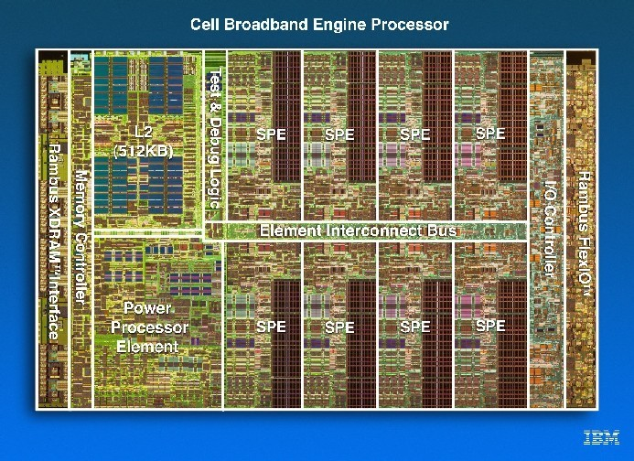

Slide 6
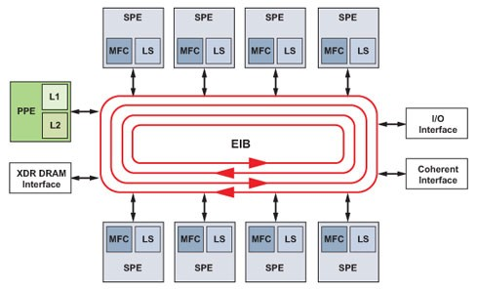

Slide 7
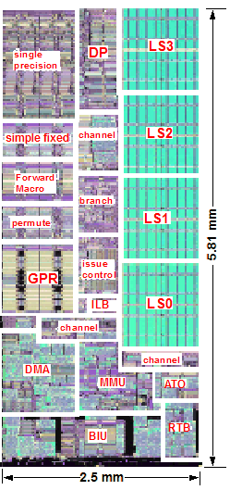

Slide 8
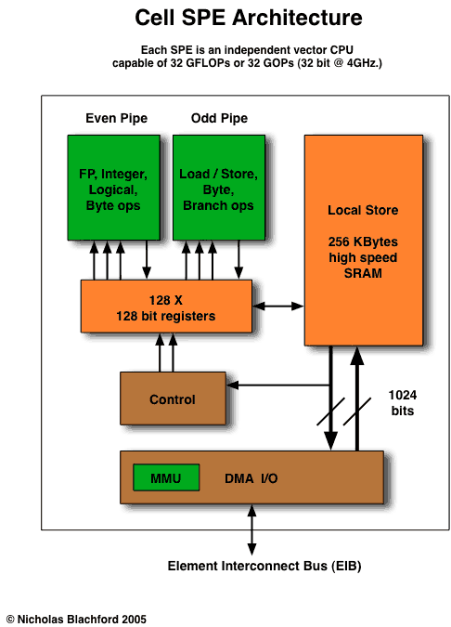

Slide 9
The Cell is...
...
...
...
not
not fun
a magic bullet.
a radical change to program for!
in high-performance design.

Slide 10
Programming
for Games
Quick background of game
development

Slide 11
Performance
Mostly "soft" real-time
(60Hz or 30Hz)

Slide 12
Languages
and
Compilers

Slide 13
Other
Processers
and
I/O
GPU, Blu-ray, HDD, Peripherals,
Network

Slide 14
Many
Assets
Art, Animation, Audio

Slide 15
"Game"
vs.
"Engine"
code
Divisions of development

Slide 16
Our
Approach
to
the
Cell
for
games
What does it change?

Slide 17
WARNING!
“Manual
Solution”
“Very
optimized
codes
but
at
cost
of
programmability."
Marc Gonzales, IBM

Slide 18
Good
solutions
for
the
Cell
will
be
good
solutions
on
other
platforms.

Slide 19
High-performance
code
is
easy
to
port
to
the
Cell.

Slide 20
Poorly
performing
any
code
from
platform
is
hard
to
port.

Slide 21
Data
and
code
optimization
are
merely
important
on
conventional architectures
... On the Cell, they're critical.

Slide 22
Common
Complaints

Slide 23
#1
"But,
it's
too
hard!"

Slide 24
Multi-processing is not new
Trouble with the SPUs usually is just trouble with multi-core.
You can't wish multi-core programming away. It's part of the job.

Slide 25
"Cache
and
too
DMA
data
design
complex"
Enforced simplicity

Slide 26
Not
that
different
from
calling
memcpy

Slide 27
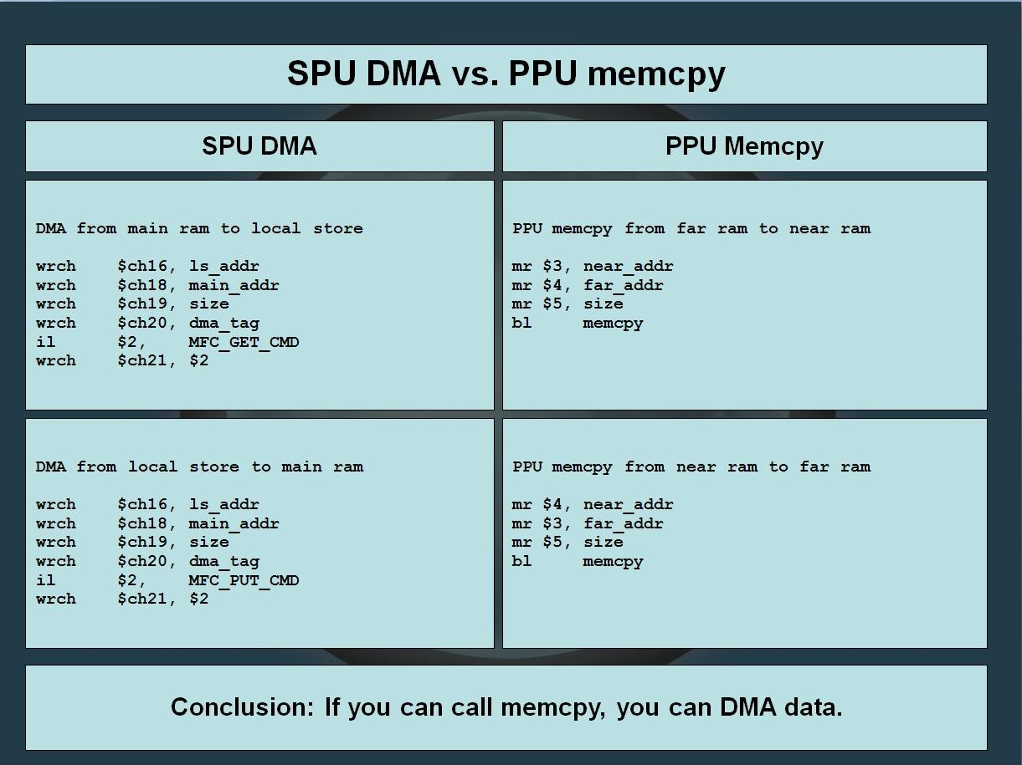

Slide 28
But
you
get
extra
control

Slide 29
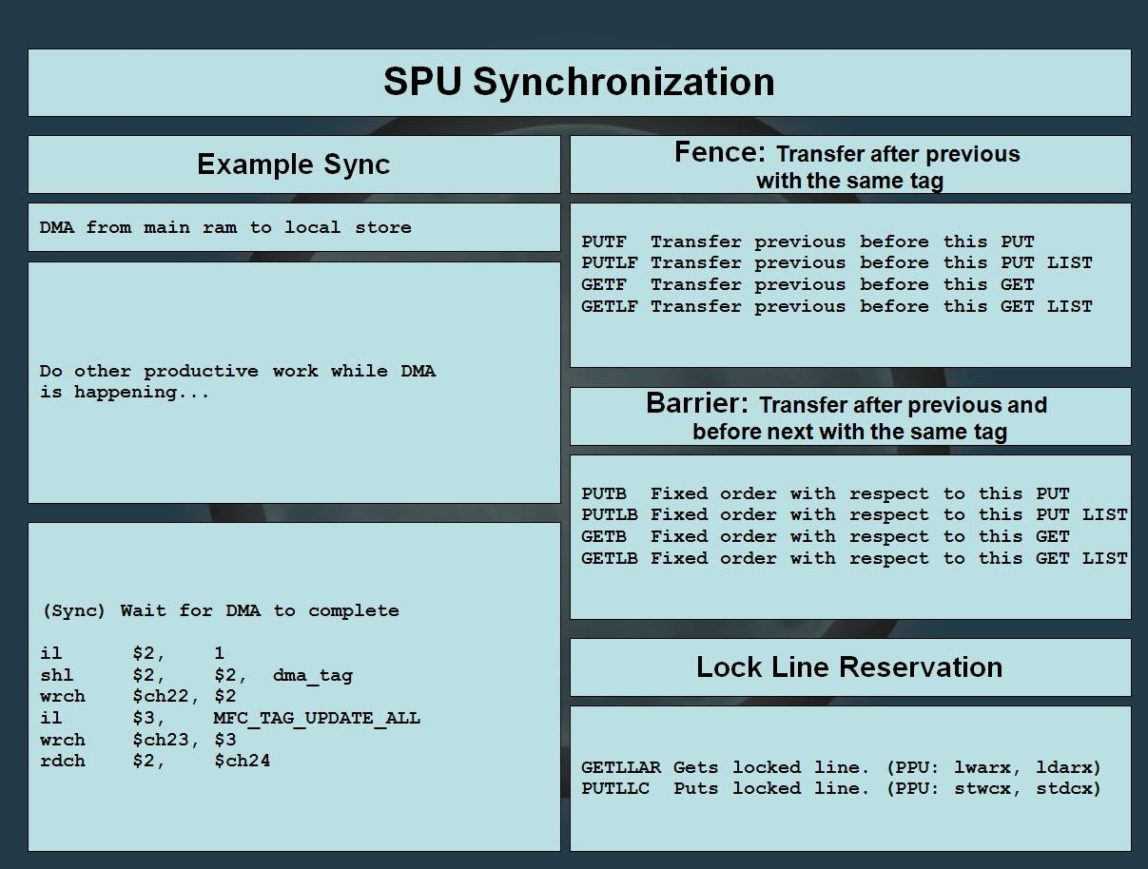

Slide 30
"My
code
can't
be
made
parallel."
Yes. It can.

Slide 31
"C/C++
is
no
good
for
parallel
programming"
The solution is to understand
not to hide them.
the issues --

Slide 32
"But
little
I'm
just
doing
this
one
thing...
it
doesn't
make
any
difference."
Is it really just you?
Is it really just this one thing?

Slide 33
It's
all
about
the
SPUs
Designing code for concurrency

Slide 34
“What's the
easiest
way
to
split
programs
into
SPU
modules?”

Slide 35
Let
someone
else
do
it.

Slide 36
But
if
that
someone
is
you...
Rules and guidelines

Slide 37
Rule #1
DATA
IS
MORE
IMPORTANT
THAN
CODE

Slide 38
Good code follows good data.
Fast code follows good data.
Small
code
follows
good
data.
Guess what
follows bad
data.

Slide 39
Rule
#2
WHERE
THERE
IS
ONE,
THERE
IS
MORE
THAN
ONE

Slide 40
The
"domain-model
Lie.
design"

Slide 41
Rule #3
SOFTWARE
IS
NOT
A
PLATFORM

Slide 42
Unless
you
are
a
CS
Professor.

Slide 43
The real difficulty is in
the unlearning.

Slide 44
The
ultimate
goal:
Get everything on the SPUs.

Slide 45
Complex systems can go on the SPUs
Not just streaming systems
Used for any kind of task
But you do need to consider some things...

Slide 46
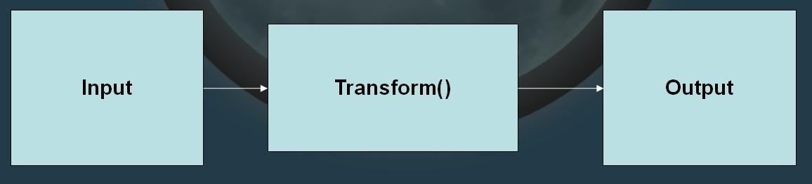
Data comes first.
Goal is minimum energy for transformation. What is energy usage?
CPU time.
Memory read/write time. Stall time.

Slide 47
Design the transformation pipeline
back to front.
Start
with
your
destination
data
and
work
backward.
Changes are
inevitable -- Pay less
for them.

Slide 48
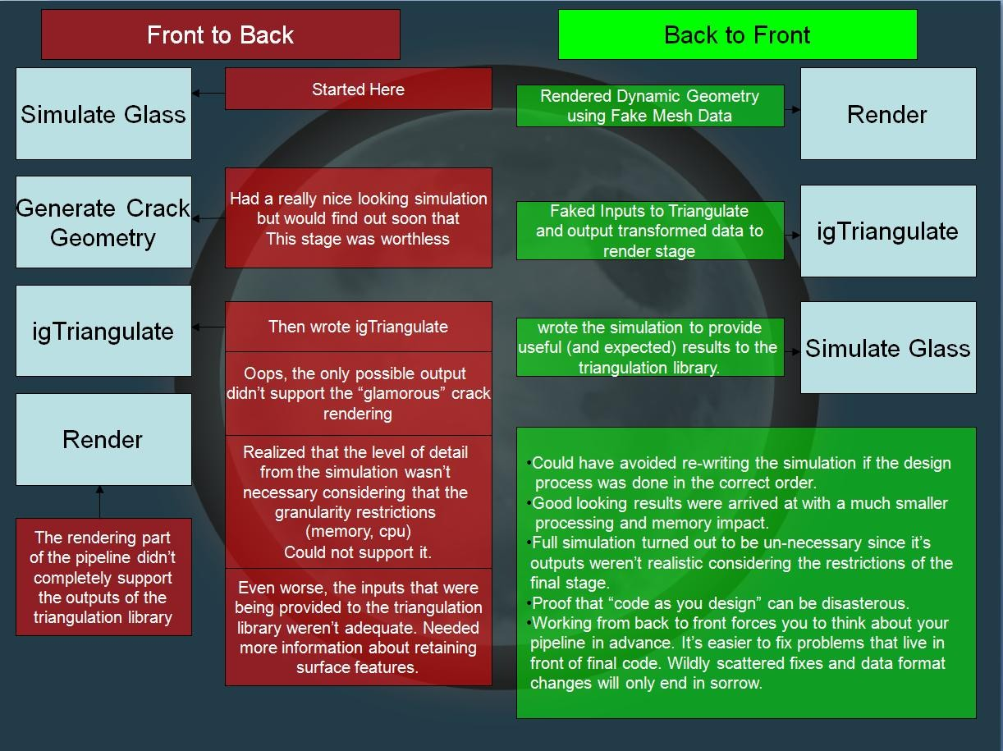

Slide 49
SPUs use
the
canonical
data.
Best format for the most expensive
case.

Slide 50
Minimize
synchronization
Start with the smallest
synchronization method possible.

Slide 51
Often is
lock-free
single
reader,
single
writer
queue.

Slide 52
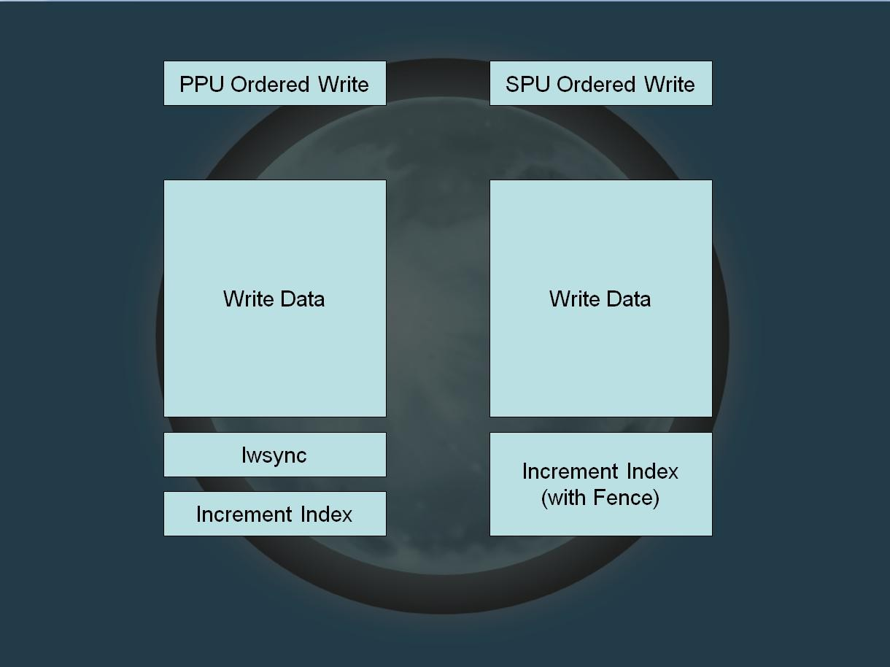

Slide 53
Load
balancing
Data centric design will give coarser
divisions.

Slide 54
Start with simplest task
queues
For constant time transforms:
Divide into multiple queues
For other transforms:
Use heuristic to decide times and a single entry distribute to multiple queues.
queue to

Slide 55
Then work your way up.
Is there a pre-existing sync point that will work? (e.g. vsync)
Can you split your data into need-to-sync and don't-care?

Slide 56
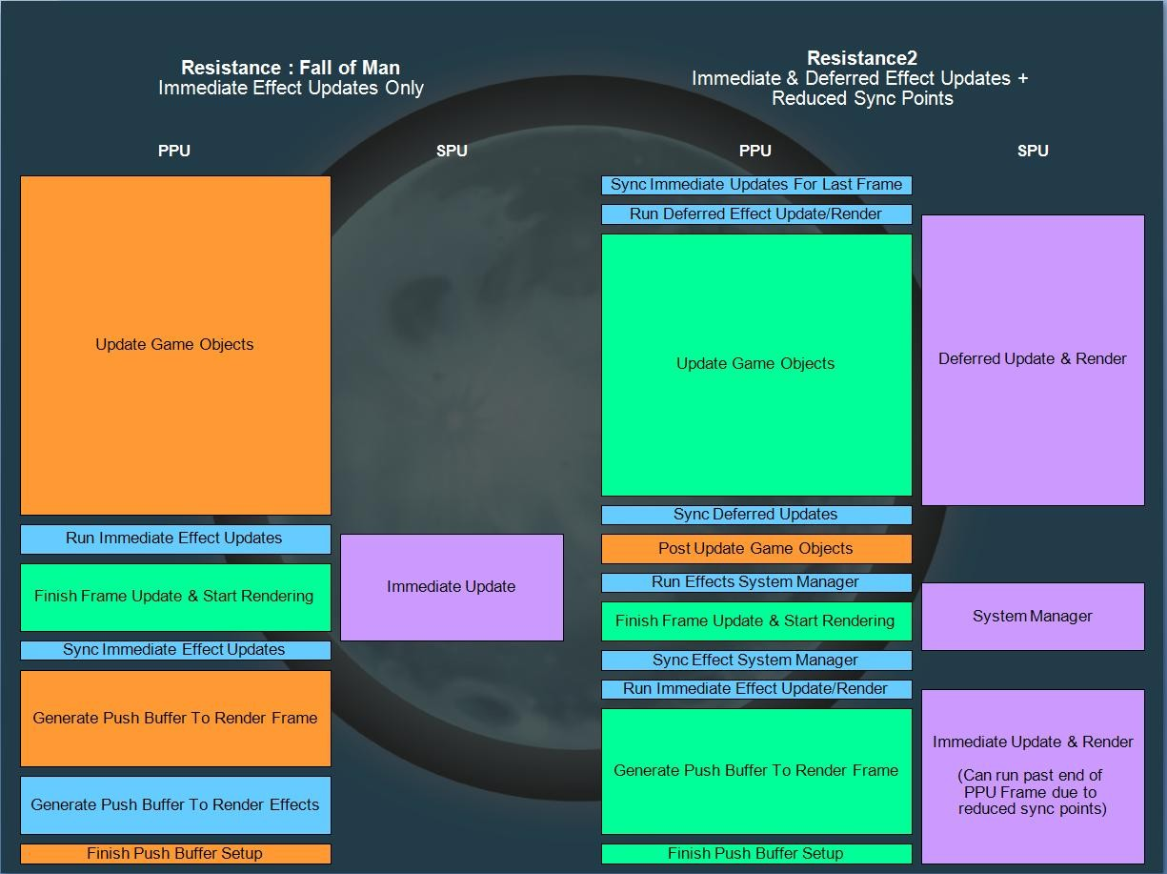

Slide 57
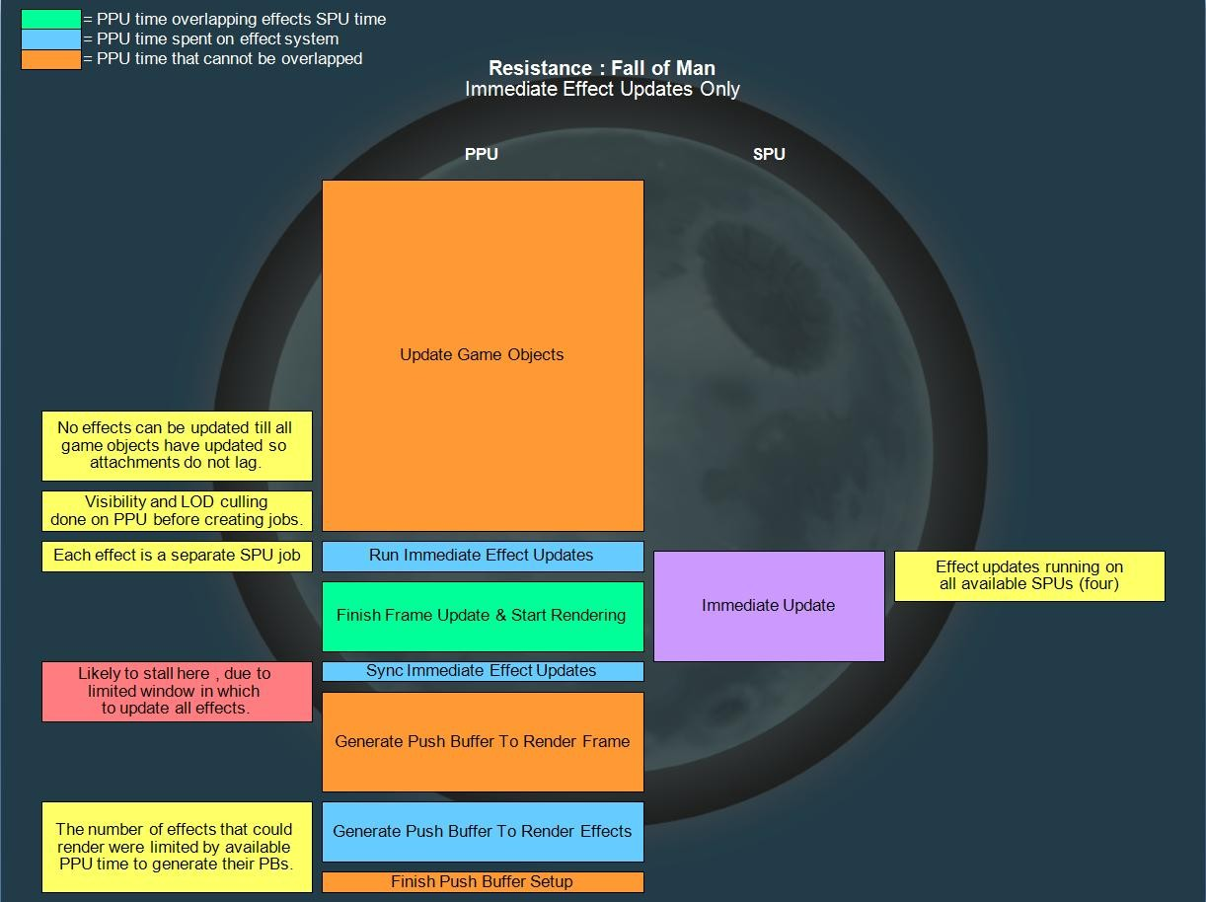

Slide 58
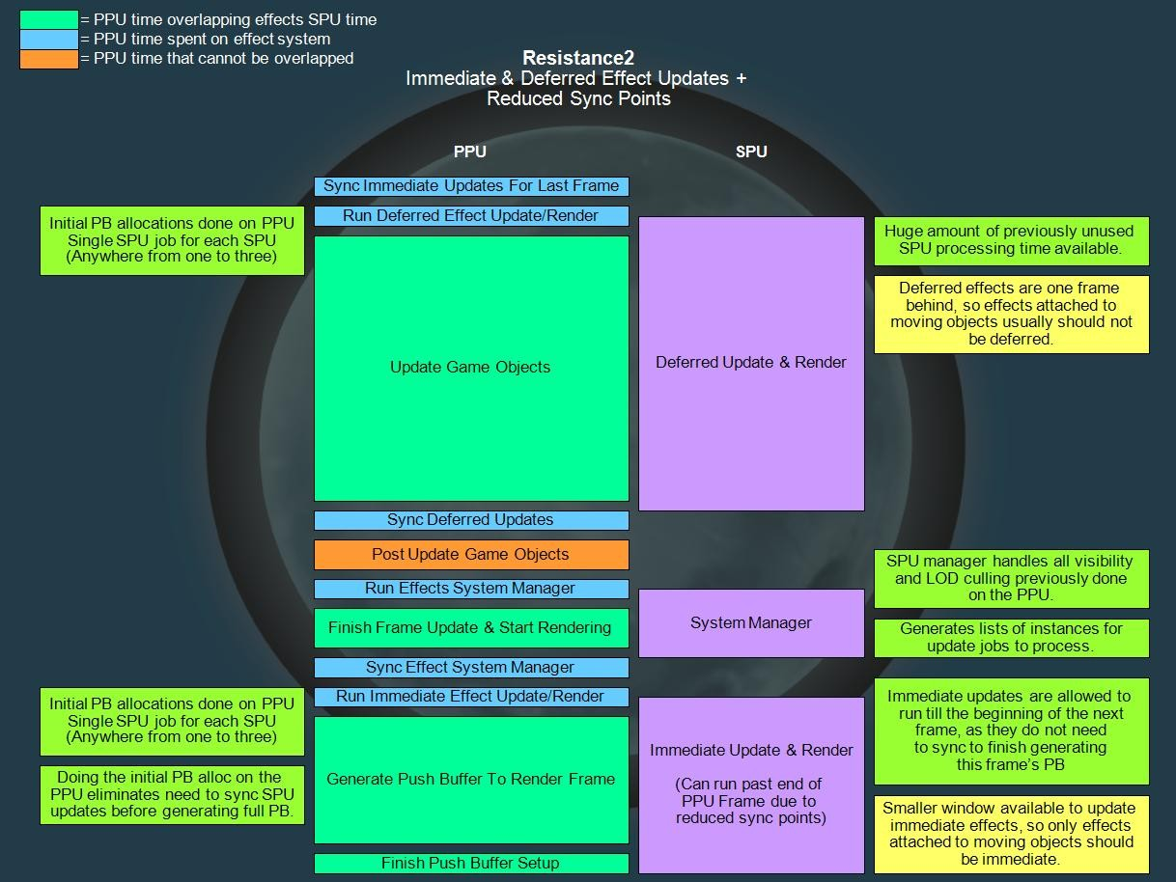

Slide 59
Write
“optimizable”
code.
Simple, self-contained loops
Over as many iterations as possible
No branches

Slide 60
Transitioning
from
"legacy"
systems...
An example from RCF

Slide 61
FastPathFollowers
C++
class
And it's derived classes
Running on the PPU Typical Update() method
Derived from a root class of all “updatable” types

Slide 62
Where did this go wrong?
What rules where broken?
Used domain-model design
Code “design” over data design
No
No
No
advatage of scale
synchronization design cache consideration

Slide 63
Result
Typical performance issues
Cache misses
Unnecessary transformations
Didn't scale well
Problems after a few hundred updating

Slide 64
Step 1: Group the data together
“Where there's one, there's more than one.”
Before the update() loop was called,
Intercepted all FastPathFollowers and derived classes
Removed them from the update list. Then kept in a separate array.

Slide 65
Step 1: Group the data together
Created new function, UpdateFastPathFollowers()
Used the new list of same type of data Generic Update() no longer used (Ignored derived class behaviors here.)

Slide 66
Step 2: Organize Inputs and Outputs
Define what's read, what's write.
Inputs: Position, Time, State, Results of queries, Paths
Outputs: Position, State, Queries, Animation
Read inputs. Transform to Outputs. Nothing more complex than that.

Slide 67
Step 3: Reduce Synchronization Points
Collected all outputs together
Collected any external function calls together into a command buffer
Separate Query and Query-Result
Effectively a Queue between systems
Reduced from many sync points per “object” to one sync point for the system

Slide 68
Before Pattern
Loop Objects
Read Input 0
Update 0
Write Output
Read Input 1
Update 1
Call External
Block (Sync)
Function

Slide 69
After Pattern
(Simplified)
Loop Objects
Read Input 0, 1
Update 0, 1
Write Output, Function
to Queue
Block (Sync)
Empty (Execute) Queue

Slide 70
Next: Added derived-class functionality
Similarly simplified derived-class Update() functions into
functions with clear inputs and outputs.
Added functions to deferred queue as any other function. Advantage: Can limit derived functionality based on count, LOD, etc.

Slide 71
Step
4: Move to PPU thread
Now
Now
system update
system update
has no external dependencies
has no conflicting data areas (with
other systems)
Now system update
does not call non-re-entrant functions
Simply put in another thread

Slide 72
Step 4: Move to PPU thread
Add literal sync between system update and queue
execution
Sync can be removed because only single reader and single writer to data
Queue can be emptied while being filled without collision
See also: R&D page at insomniacgames.com on multi-threaded
optimization

Slide 73
Step 5: Move to SPU
Now completely independent thread
Can be run anytime
Move to new SPU system
Using SPU Shaders

Slide 74
SPU Shaders
On SPU, Code is data
Double buffer / stream same as data
Very easy to do (No need for special libraries) Compile the code
Dump the object as binary
Load binary as data
Jump to binary location (e.g. Normal function pointer) Pass everything as parameters, the ABI won't change.

Slide 75
The 256K Barrier
The solution is simple:
Upload
Upload
Data is
more code when
you need it.
more data when you need it.
managed by traditional means
i.e. Double, triple fixed-buffers, etc.
Code is just data.

Slide 76
The End
Programming for the SPUs is not really differentThese
issues are not going to go away. Teams need practice and experience.
Modern systems still benefit from heavy optimization. Design around asynchronous processing.
Don't be afraid to learn and change.

