Slide 1
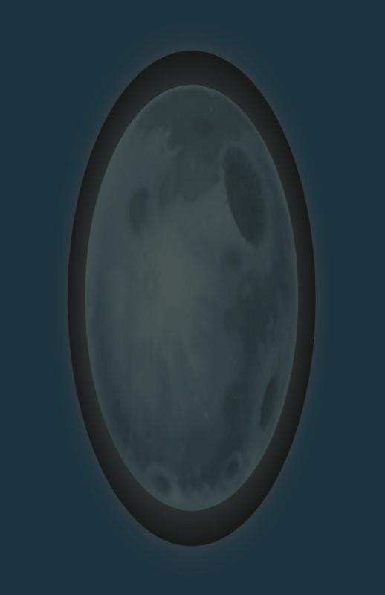
SPU
gameplay
Joe Valenzuela
joe@insomniacgames.com
GDC 2009

Slide 2
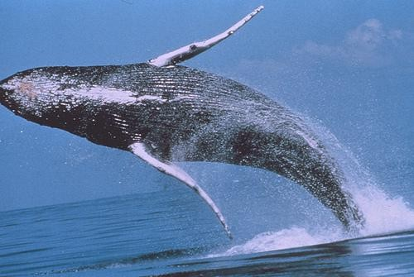
glossary
•
mobys
– class
– instances update
classes
AsyncMobyUpdate
– Guppys
– Async
aggregateupdate
•
•
•

Slide 3
spu
gameplay
difficulties
•
•
•
•
multiprocessor
NUMA
different ISA
it’s different
– takes time and
effort to
retrofit code
– unfamiliarity with the necessary upfront design

Slide 4
your
virtual
functions
don’t
work
PPU
vtable
0x0128020
preupdate
update
draw
0x012C050
0x011F070
SPU
vtable
0x0128020
?
?
?
0x012C050
0x011F070

Slide 5
your
pointers
don’t
work
foo_t
m_t
4.0
struct foo_t
{
float m_t;
float m_scale;
u32 m_flags;
u16* m_points;
};
m_scale
1.0
m_flags
0x80100013
m_points
0x4050c700

Slide 6
your
code
doesn’t
compile
x:/core/code/users/jvalenzu/shared/igCore/igsys/igDebug.h(19,19): error:
libsn.h: No such file or directory
x:/core/code/users/jvalenzu/shared/igCore/igTime/igTimer.h(15,27): error:
sys/time_util.h: No such file or directory
pickup/pickupbase_preupdate_raw.inc(160): error: 'DEFAULT_FLAGS' is not a member of 'COLL'
pickup/pickupbase_preupdate_raw.inc(160): error: 'EXCLUDE_HERO_ONLY' is
not a member of 'COLL'
x:/core/code/users/jvalenzu/shared/igCore/igPhysics/ppu/igPhysics.h(293):
error: expected unqualified-id before '*' token
x:/core/code/users/jvalenzu/shared/igCore/igPhysics/ppu/igPhysics.h(293):
error: expected ',' or '...' before '*' token
x:/core/code/users/jvalenzu/shared/igCore/igPhysics/ppu/igPhysics.h(293):
error: ISO C++ forbids declaration of 'parameter' with no type
x:/core/code/users/jvalenzu/shared/igCore/igg/igShaderStructs.h: At global
scope:
x:/core/code/users/jvalenzu/shared/igCore/igg/igShaderStructs.h(22):
error: redefinition of 'struct VtxVec4'
x:/core/code/users/jvalenzu/shared/igCore/igsys/igTypes.h(118): error:
previous definition of 'struct VtxVec4'

Slide 7
object
driven
update
for(i = 0; i < num_entities; ++i) {
entity* e = &g_entity_base[i];
e->collect_info();
e->update();
e->move();
e->animate();
e->etc();
}
•
•
can’t amortize setup costs
can’t hide much deferred work

Slide 8
more
modular
update
for(i = 0, e = &g_entity_base[0]; i < num_ent; ++i, ++e) {
e->collect_info();
e->issue_anim_request();
}
for(i = 0, e = &g_entity_base[0]; i < num_ent; ++i, ++e)
e->update();
finalize_animation();
for(i = 0, e = &g_entity_base[0]; i < num_ent; ++i, ++e)
e->postupdate();
1
2

Slide 9
aggregate
updating
•
group instances by type
– further sort each group to minimize state change
one aggregate updater per type, with multiple code fragments
combined ppu & spu update
more opportunity to amortize cost of
expensive setup
•
•
•

Slide 10
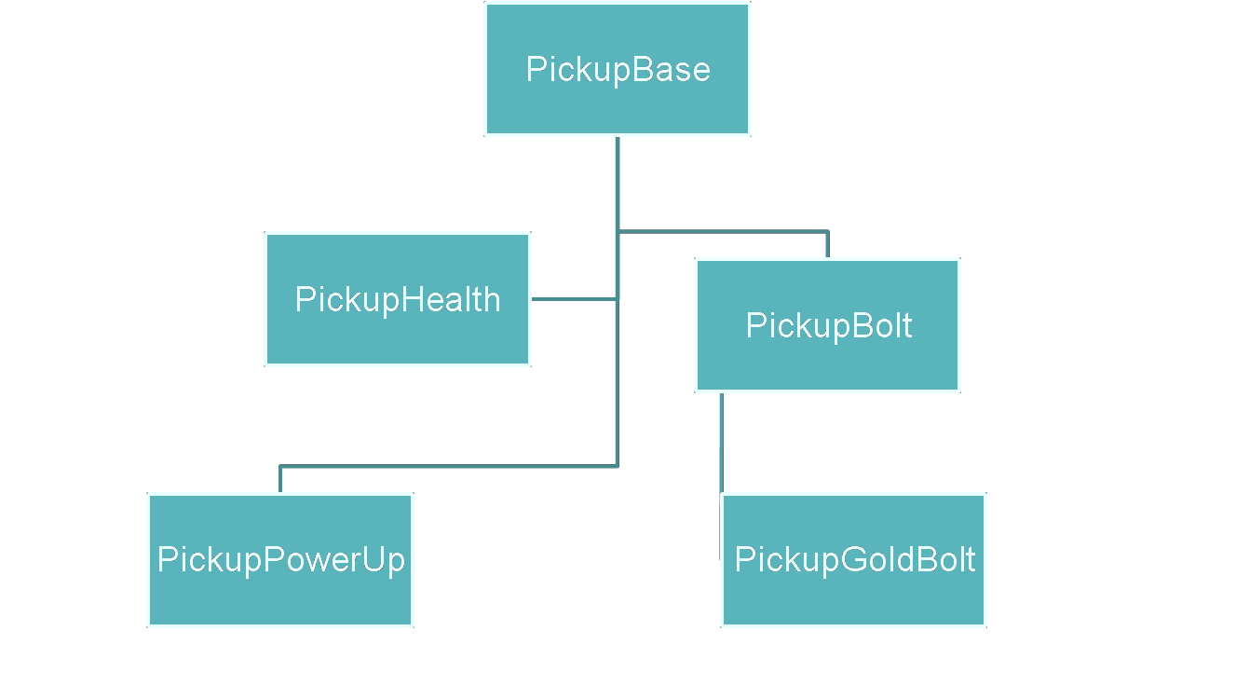
aggregate
example
(pickup)

Slide 11
aggregate
example
cont…
Pickup Instances
PickupBolt
pickupbolt_preupdate
pickupbolt_update
PickupBolt
PickupHealth
PickupHealth
pickupheatlh_preupdate
pickuphealth_postupdate
pickuphealth_update
PickupHealth

Slide 12
a
trivial
optimization
void TruckUpdate::Update()
{
if(m_wait_frame > TIME::GetCurrentFrame())
{
return;
}
// … more work
}

Slide 13
a
trivial
optimization
void TruckUpdate::Update()
{
if(m_wait_frame > TIME::GetCurrentFrame())
{
return;
}
// … more work
}

Slide 14
a
trivial
optimization (cont)
void Aggregate_TruckUpdate_Update()
{
u32 current_frame = TIME::GetCurrentFrame();
for(u32 i = 0; i < m_count; ++i)
{
TruckUpdate* self = &m_updates[i];
if(self->m_wait_frame > current_frame)
{
continue;
}
// … more work
}
}

Slide 15
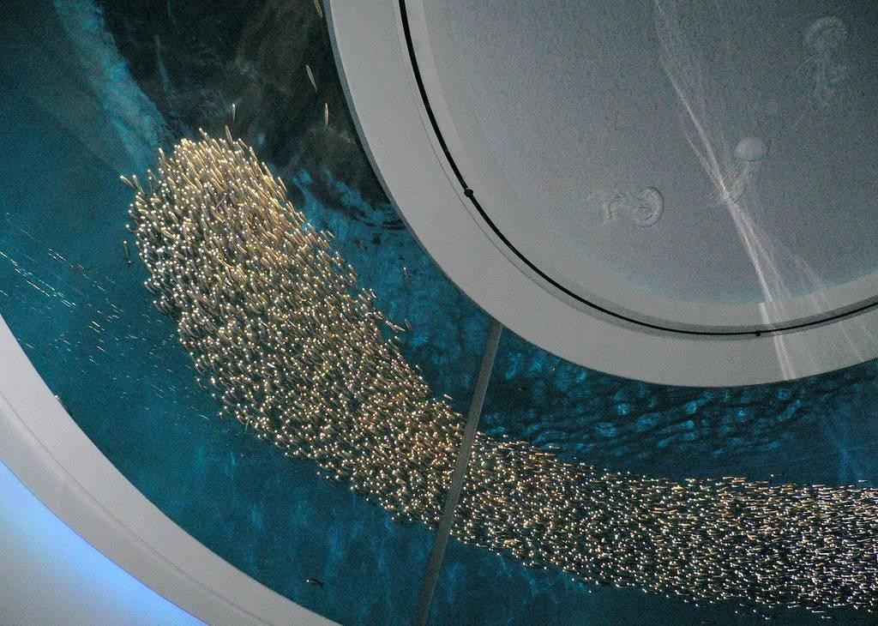
SPU
gameplay
systems

Slide 16
SPU
gameplay
intro
•
systems built around applying
homogenous data
shaders
to
lots
of
–
–
–
AsyncMobyUpdate
Guppys
AsyncEffect
•
small, simple code
overlays
–
–
–
–
user-supplied
compiled offline
debuggable
analogous to graphics shaders

Slide 17
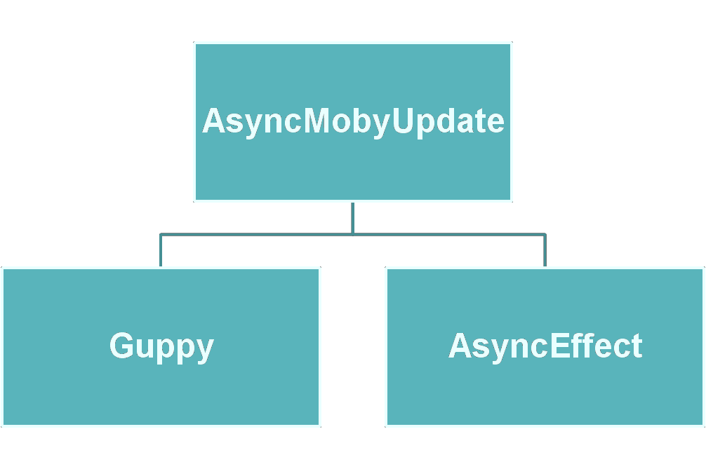
async moby
update
overview

Slide 18
overview
AsyncMobyUpdate
– base framework, meant to work classes
– retains MobyInstance rendering
Guppys
•
with update
pipeline
•
–
–
–
“light” MobyInstance replacement
100% SPU update, no update class
90% MobyInstance rendering pipeline
•
AsyncEffect
– very easy fire & forget SPU “effects”
– user-selectable, not user-written, shaders

Slide 19
async moby
update
•
•
designed to move update classes to SPU
user supplied update routine in code fragment
multiple code fragments per update class
•
– one per AI
user-defined
user-defined
state, for example
instance data format
common data
•
•
•
extern code provided through function
pointer tables

Slide 20
async
moby
update
(cont...)
Update Groups
Instances
jet_follow_path
0x0128020
0x012C050
jet_circle
0x011F070
jet_crash
0x0128020
0x012C050
0x011F070
•
•
update group per code fragment
instances bound to update group each frame

Slide 21
instance
instance data
vs
common
•
– data transformed by your update routine
– e.g. a Jet, or zombie limb
common data
– data common to all instances of the same
type
– e.g. class-static variables, current frame
•

Slide 22
function
pointer
table
interface
struct global_funcs_t
{
void
// …
f32
u32
u32
void
};
(*print)(const char *fmt, ...);
(*get_current_time)();
(*read_decrementer)(); (*coll_swept_sphere)(qword p0, qword
p1,
u32
u32
flags);
(*coll_get_result)
(COLL::Result *dest,
id,
u32
tag);
•
•
•
debug, print functions
access to common data, timestep
collision & FX routines

Slide 23
simple
API
setup:
u32 tag = AsyncMobyUpdate::AllocTag();
AsyncMobyUpdate::RegisterType (tag, truck_frag_start, truck_frag_size);
// common setup
AsyncMobyUpdate::SetNumCommonBlocks(tag, 1);
AsyncMobyUpdate::SetCommonBlock (tag, 0,
&g_TruckCommon, sizeof g_TruckCommon);
// instance setup AsyncMobyUpdate::SetNumInstanceStreams(tag, 1);
AsyncMobyUpdate::SetOffset (tag, 0, 0);
AsyncMobyUpdate::SetStride (tag, 0, sizeof(TruckClass));
use:
AsyncMobyUpdate::AddInstances (tag, instance_block, count);

Slide 24
allocate
tag
setup:
u32 tag = AsyncMobyUpdate::AllocTag();
AsyncMobyUpdate::RegisterType (tag, truck_frag_start, truck_frag_size);
// common setup
AsyncMobyUpdate::SetNumCommonBlocks(tag, 1);
AsyncMobyUpdate::SetCommonBlock (tag, 0,
&g_TruckCommon, sizeof g_TruckCommon);
// instance setup AsyncMobyUpdate::SetNumInstanceStreams(tag, 1);
AsyncMobyUpdate::SetOffset (tag, 0, 0);
AsyncMobyUpdate::SetStride (tag, 0, sizeof(TruckClass));
use:
AsyncMobyUpdate::AddInstances (tag, instance_block, count);

Slide 25
register
fragment
setup:
u32 tag = AsyncMobyUpdate::AllocTag();
AsyncMobyUpdate::RegisterType (tag, truck_frag_start, truck_frag_size);
// common setup
AsyncMobyUpdate::SetNumCommonBlocks(tag, 1);
AsyncMobyUpdate::SetCommonBlock (tag, 0,
&g_TruckCommon, sizeof g_TruckCommon);
// instance setup AsyncMobyUpdate::SetNumInstanceStreams(tag, 1);
AsyncMobyUpdate::SetOffset (tag, 0, 0);
AsyncMobyUpdate::SetStride (tag, 0, sizeof(TruckClass));
use:
AsyncMobyUpdate::AddInstances (tag, instance_block, count);

Slide 26
set
common
block
info
setup:
u32 tag = AsyncMobyUpdate::AllocTag();
AsyncMobyUpdate::RegisterType (tag, truck_frag_start, truck_frag_size);
// common setup
AsyncMobyUpdate::SetNumCommonBlocks(tag, 1);
AsyncMobyUpdate::SetCommonBlock (tag, 0,
&g_TruckCommon, sizeof g_TruckCommon);
// instance setup AsyncMobyUpdate::SetNumInstanceStreams(tag, 1);
AsyncMobyUpdate::SetOffset (tag, 0, 0);
AsyncMobyUpdate::SetStride (tag, 0, sizeof(TruckClass));
use:
AsyncMobyUpdate::AddInstances (tag, instance_block, count);

Slide 27
set
instances
info
setup:
u32 tag = AsyncMobyUpdate::AllocTag();
AsyncMobyUpdate::RegisterType (tag, truck_frag_start, truck_frag_size);
// common setup
AsyncMobyUpdate::SetNumCommonBlocks(tag, 1);
AsyncMobyUpdate::SetCommonBlock (tag, 0,
&g_TruckCommon, sizeof g_TruckCommon);
// instance setup AsyncMobyUpdate::SetNumInstanceStreams(tag, 1);
AsyncMobyUpdate::SetOffset (tag, 0, 0);
AsyncMobyUpdate::SetStride (tag, 0, sizeof(TruckClass));
use:
AsyncMobyUpdate::AddInstances (tag, instance_block, count);

Slide 28
add
setup:
instances
per
frame
u32 tag = AsyncMobyUpdate::AllocTag();
AsyncMobyUpdate::RegisterType (tag, truck_frag_start, truck_frag_size);
// common setup
AsyncMobyUpdate::SetNumCommonBlocks(tag, 1);
AsyncMobyUpdate::SetCommonBlock (tag, 0,
&g_TruckCommon, sizeof g_TruckCommon);
// instance setup AsyncMobyUpdate::SetNumInstanceStreams(tag, 1);
AsyncMobyUpdate::SetOffset (tag, 0, 0);
AsyncMobyUpdate::SetStride (tag, 0, sizeof(TruckClass));
use:
AsyncMobyUpdate::AddInstances (tag, instance_block, count);

Slide 29
our
gameplay
shaders
•
•
32k relocatable programs
makefile
data into
instance
driven process combines
fragment
types
code,
•
– user defined (Async Moby Update)
– predefined (Guppys, AsyncEffect)

Slide 30
more shader
talk
•
What do our code fragments do?
–
–
–
–
dma up instances
transform instance state, position
maybe set some global state dma down instances
•
typical gameplay stuff
– preupdate, update, postupdate

Slide 31
more
about
instance
data
•
what is our instance data?
–
–
–
not an object
generally, a subset of an update class different visibility across PU/SPU
•
where does instance data live?
–
–
–
could be copied into a separate array
could read directly from the update classes we support and use both forms

Slide 32
packed
advantages
– simplicity
instance
array
PPU
SPU
•
pack instance
pack instance
– lifetime guarantees
– compression
disadvantages
– explicit
fragmentation
– pack each frame
pack instance
•
update instances
unpack instance
unpack instance
unpack instance

Slide 33
data
inside
update
class
•
advantages
– pay memory cost as you go
– don’t need to know about every detail
an update class
disadvantages
– no longer control “lifetime” of objects
specify interesting data with stride/offset
of
•
•

Slide 34
instance
prefetch
problem
•
•
ea_base = starting address of our instances
num_instances = number of instances
Instance pipe[2];
dma_get(&pipe[0], ea_base, sizeof(Instance), tag);
for(int i = 0; i < num_instances; ++i) {
Instance* cur_inst = &pipe[i&1];
Instance* next_inst = &pipe[(i+1)&1];
dma_sync(tag);
dma_get(next_inst, ea_base + (i+1) * sizeof(Instance), tag);
// ... do work
}

Slide 35
instance
prefetch
problem
(cont)
•
... we almost always need to fetch an associated data
member out of our instances immediately
Instance pipe[2];
dma_get(&pipe[0], ea_base, sizeof(Instance), tag);
for(int i = 0; i < num_instances; ++i) {
Instance* cur_inst = &pipe[i&1];
Instance* next_inst = &pipe[(i+1)&1];
dma_sync(tag);
dma_get(next_inst, ea_base + (i+1) * sizeof(Instance), tag);
MobyInstance cur_moby;
dma_get(&cur_moby, cur_inst->m_moby_ea, sizeof(MobyInstance), tag);
dma_sync(tag);
// do work
}

Slide 36
instance
“streams”
•
instances are available as “streams”
– each has its own base, count, offset, stride, and addressing mode
allows one to prefetch multiple associated elements without stalling
also useful for getting slices of interesting
data out of an untyped blob
•
•

Slide 37
TruckUpdate (PPU) instance

Slide 38
TruckInfo
(interesting data)

Slide 39
offset
stride

Slide 40
memory addressing
•
direct
– contiguous block of instances
direct indexed
•
– indices used to deference
instances
indirect indexed
– indices used to source an instance pointers
an array
of
•
array of

Slide 41
More Memory
common blocks are
shaders must DMA up
Addressing
preloaded
•
•
•
their own
instances
meta-information is preloaded
– indices
– EA base pointer (direct)
– EA pointer array (indirect)
buffering logic is very context sensitive
•

Slide 42
indirect indexed
example
struct DroneInfo
{
u32 m_stuff;
};
class DroneUpdate : public AI::Component
{
// …
DroneInfo m_info;
MobyInstance* m_moby;
};

Slide 43
indirect indexed example (cont)…
// once AsyncMobyUpdate::SetNumInstanceStreams(amu_tag, 2);
AsyncMobyUpdate::SetStride(amu_tag, 0, sizeof DroneUpdate);
AsyncMobyUpdate::SetOffset(amu_tag, 0, OFFSETOF(DroneUpdate,
m_info));
AsyncMobyUpdate::SetStride(amu_tag, 1, sizeof MobyInstance);
AsyncMobyUpdate::SetOffset(amu_tag, 1, 0);
// per frame
AsyncMobyUpdate::BeginAddInstances(amu_tag);
AsyncMobyUpdate::SetStreamIndirect(0,
/* base */ m_updates,
/* indices */ m_truck_update_indices,
/* count */ m_num_trucks,
/* max_index */ m_num_trucks);
AsyncMobyUpdate::SetStream(1, IGG::g_MobyInsts.m_array,
m_moby_indices, m_num_trucks);
AsyncMobyUpdate::EndAddInstance ();

Slide 44
indirect indexed example (cont)…
// once AsyncMobyUpdate::SetNumInstanceStreams(amu_tag, 2);
AsyncMobyUpdate::SetStride(amu_tag, 0, sizeof DroneUpdate);
AsyncMobyUpdate::SetOffset(amu_tag, 0, OFFSETOF(DroneUpdate,
m_info));
AsyncMobyUpdate::SetStride(amu_tag, 1, sizeof MobyInstance);
AsyncMobyUpdate::SetOffset(amu_tag, 1, 0);
// per frame
AsyncMobyUpdate::BeginAddInstances(amu_tag);
AsyncMobyUpdate::SetStreamIndirect(0,
/* base */ m_updates,
/* indices */ m_truck_update_indices,
/* count */ m_num_trucks,
/* max_index */ m_num_trucks);
AsyncMobyUpdate::SetStream(1, IGG::g_MobyInsts.m_array,
m_moby_indices, m_num_trucks);
AsyncMobyUpdate::EndAddInstance ();

Slide 45
typical
usage:
two
streams
void async_foo_update(global_funcs_t* gt, update_set_info_t* info,
common_blocks_t* common_blocks,
instance_streams_t* instance_streams,
u8* work_buffer, u32 buf_size, u32 tags[4]) {
u32* drone_array = instance_streams[0].m_ea_array;
u16* drone_indices = instance_streams[0].m_indices;
u32 drone_offset = instance_streams[0].m_offset;
u32* moby_array = instance_streams[1].m_ea_array;
u16* moby_indices = instance_streams[1].m_indices;
u32 moby_offset = instance_streams[1].m_offset;
DroneInfo inst;
MobyInstance moby;
for(int i = 0; i < instance_streams[0].m_count; ++i) {
gt->dma_get(&inst, drone_array[drone_indices[i]] + drone_offset,
sizeof inst, tags[0]);
gt->dma_get(&moby, moby_array[moby_indices[i]] + moby_offset,
sizeof moby, tags[0]);
gt->dma_wait(tags[0]);
// …
}
1
2
}

Slide 46
indirect indexed
example #2
struct TruckInfo
{
u32 m_capacity;
u32 m_type_info;
f32 m_hp;
u32 m_flags;
};
class TruckUpdate : public AI::Component
{
protected:
…;
public:
u32 m_ai_state;
TruckInfo m_info attribute ((aligned(16)));
};

Slide 47
indirect indexed example 2 (cont)…
// once AsyncMobyUpdate::SetNumInstanceStreams(amu_tag, 2);
AsyncMobyUpdate::SetStride(amu_tag, 0, sizeof TruckUpdate);
AsyncMobyUpdate::SetOffset(amu_tag, 0, OFFSETOF(TruckUpdate, m_info));
AsyncMobyUpdate::SetStride(amu_tag, 1, sizeof TruckUpdate);
AsyncMobyUpdate::SetOffset(amu_tag, 1, OFFSETOF(TruckUpdate, m_info));
// per frame
AsyncMobyUpdate::BeginAddInstances(amu_tag);
AsyncMobyUpdate::SetStreamIndirect(0,
/* base */ m_updates,
/* indices */ m_truck_update_indices,
/* count */ m_num_trucks,
/* max_index */ m_num_trucks);
AsyncMobyUpdate::SetStreamIndirect(1, m_updates,
m_truck_update_indices,
m_num_trucks, m_num_trucks);
AsyncMobyUpdate::EndAddInstance ();

Slide 48
indirect indexed example 2 (cont)…
// once AsyncMobyUpdate::SetNumInstanceStreams(amu_tag, 2);
AsyncMobyUpdate::SetStride(amu_tag, 0, sizeof TruckUpdate);
AsyncMobyUpdate::SetOffset(amu_tag, 0, OFFSETOF(TruckUpdate, m_info));
AsyncMobyUpdate::SetStride(amu_tag, 1, sizeof TruckUpdate);
AsyncMobyUpdate::SetOffset(amu_tag, 1, OFFSETOF(TruckUpdate, m_info));
// per frame
AsyncMobyUpdate::BeginAddInstances(amu_tag);
AsyncMobyUpdate::SetStreamIndirect(0,
/* base */ m_updates,
/* indices */ m_truck_update_indices,
/* count */ m_num_trucks,
/* max_index */ m_num_trucks);
AsyncMobyUpdate::SetStreamIndirect(1, m_updates,
m_truck_update_indices,
m_num_trucks, m_num_trucks);
AsyncMobyUpdate::EndAddInstance ();

Slide 49
dma
up
slice
of
update
class
void async_foo_update(global_funcs_t* gt, update_set_info_t* info,
common_blocks_t* common_blocks,
instance_streams_t* instance_streams,
u8* work_buffer, u32 buf_size, u32 tags[4])
{
u32* earray = instance_streams[0].m_ea_array;
u16* indices = instance_streams[0].m_indices;
u32 offset = instance_streams[0].m_offset;
TruckInfo inst;
for(int i = 0; i < instance_streams[0].m_count; ++i)
{
gt->dma_get(&inst, earray[ indices[i] ] + offset,
sizeof inst, tags[0]);
gt->dma_wait(tags[0]);
// update
}
1
2
}

Slide 50
dma
full
update
class,
slice
info
out
u32* earray = instance_streams[0].m_ea_array;
u16* indices = instance_streams[0].m_indices;
u32 offset = instance_streams[0].m_offset;
u32 stride = instance_streams[0].m_stride;
u32* ai_earray = instance_streams[1].m_ea_array;
u16* ai_indices = instance_streams[1].m_indices;
u32 ai_offset = instance_streams[1].m_offset;
u8* blob = (u8*) alloc(instance_streams[1].m_stride);
for(int i = 0; i < instance_streams[0].m_count; ++i)
{
gt->dma_get(&blob, earray[ indices[i] ], stride, tags[0]);
gt->dma_wait(tags[0]);
TruckInfo *inst = (TruckInfo*) (blob + instance_streams[0].m_offset);
u32 *ai_state = (u32*) (blob + instance_streams[1].m_offset);
// …
}
1
2
3

Slide 51
code
fragment
signature
extern "C" void
async_foo_update(global_funcs_t* gt,
update_set_info_t* info,
common_blocks_t* common_blocks,
instance_streams_t* instance_streams,
u8* work_buffer, u32 buf_size, u32 tags[4])
•
•
•
•
•
•
global_funcs_t
- global function pointer table
update_set_info_t - meta info
common blocks_t - stream array for common blocks
instance_streams_t - stream array for instances
work_buffer & buf_size - access to LS
dma_tags - 4 preallocated dma tags

Slide 52
guppys
lightweight alternative to MobyInstance
update runs entirely on SPU
one 128byte instance type
common data contained in “schools”
simplified rendering
•
•
•
•
•

Slide 53
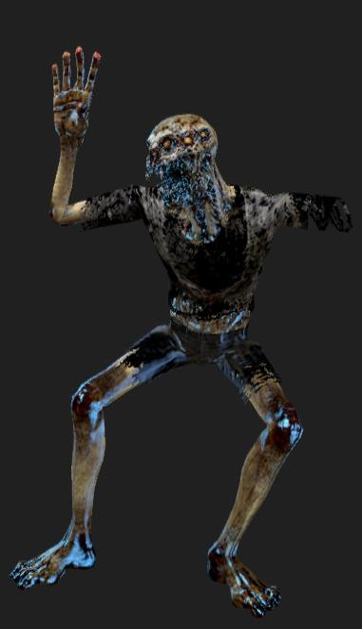
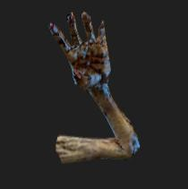
guppys
•
common use case:
“bangles”
to cleave a mesh, we previously required an entire new MobyInstance to cleave a mesh
– turn off arm mesh segment on
main instance
– turn off all other mesh segments
on spawned instance
spawn a guppy now instead
•
•

Slide 54
the
guppy
instance
•
•
•
•
•
•
position/orientation EA
1 word flags
block of “misc” float/int
animation joints EA
joint remap table
union data
Insomniac “special sauce”

Slide 55
Async Effect
simplified API for launching SPU-updating
effects
no code fragment writing necessary specialized at initialization
•
•
•
–
–
–
linear/angular movement
rigid body physics rendering parameters

Slide 56
Async
Effect
API
u16 moby_iclass = LookupMobyClassIndex( ART_CLASS_BOT_HYBRID_2_ORGANS );
MobyClass* mclass = &IGG::g_MobyCon.m_classes[ moby_iclass ];
u32 slot = AsyncEffect::BeginEffectInstance(AsyncEffect::EFFECT_STATIONARY,
mclass);
AsyncEffect::SetEffectInstancePo (slot, moby->m_mat3, moby->m_pos);
AsyncEffect::SetEffectInstanceF32(slot, AsyncEffect::EFFECT_PARAM_LIFESPAN,
20.0f);
u32 name = AsyncEffect::Spawn(slot);
• stationary effect with 20 second life
•
name can be used to kill the effect

Slide 57

SPU
invoked
code

Slide 58
different
immediate
– via global function
deferred
– command buffer
adhoc
– PPU shims
mechanisms
•
table
•
•
– direct data injection

Slide 59
deferred
•
PPU shims
– flags set in SPU update, querys/events triggered subsequently on PPU
command buffer
•
– small buffer in LS filled with command
byte-code, flushed to PPU
atomic allocators
specific
•
– relevant data structures packed on SPU,
atomically inserted

Slide 60
command
buffer:
swept
sphere
u32
CMD_SWEPT_SPHERE
u32
IGNORE_TRIS
u32
pad
<job#><id>
vec4
point0
vec4
point1

Slide 61
command
buffer:
results
frame n
handle_base = ((stage << 5) | (job_number & 0x1f)) << 24;
// …
handle = handle_base + request++;
frame n+1
offset table
frame n, stage 0, job 1
frame n, stage 1, job 1
frame n, stage 2, job 1
result
frame n, stage 0, job 2

Slide 62
direct
data
•
patch into atomically allocated, double
buffered data structures
instance allocates fresh instance each frame, forwards state between old and new
deallocation == stop code fragment
used for rigid body physics
•
•
•

Slide 63

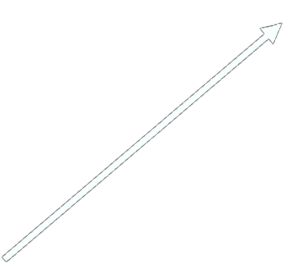
direct
data
SPU
main memory
1
new_ea = rigid body #0
rigid body #0
rigid body #1
get(&ls_rigidbody, old_ea)
rigid body #2
2
update ls_rigidbody
unallocated
put(&ls_rigidbody, new_ea)
3
old_ea = new_ea

Slide 64
SPU
API
•
SPU-API
–
mechanism to expose new functionality
through to the AsyncMobyUpdate system
library of code fragment code and common
data (“fixup”)
function pointer table (“interface”) oriented
hides immediate or deferred commands
–
–
–

Slide 65
SPU
API
h
struct rcf_api_interface
{
u32 (*derived_from)(u32 update_class, u32 base_class);
u32 (*add_bolts) (u32 update_class, u32 value);
};
cpp
rcf_api_interface* rcf_api = gt->get_spu_api(“rcf2”);
if(rcf_api->derived_from(inst->m_update_class, HERO_Ratchet_CLASS))
{
rci_api->add_bolts(inst->m_update_class, 25);
}

Slide 66
example
#1
•
Jets
–
–
–
–
–
uses AsyncMobyUpdate along with
packed instance array code fragment per AI state
an Update
Class
little initialization setup, state changes
events triggered using adhoc method
• flags checked at pack/unpack time
rare
•
inputs:
– position/orientation
– state info
output:
– position/orientation
•

Slide 67
example
#2
•
zombie limbs
–
–
–
guppy
not much update logic
direct data interface
to
rigid
body
physics
•
input:
–
–
–
position/orientation
animation joints
collision info
•
output:
– packed rigid bodies

Slide 68

porting
code

Slide 69
porting
code
sucks
•
•
•
•
difficult to retrofit code
different set of constraints
expensive use of time
can result in over-abstracted
systems
– like, software cache for transparent pointers

Slide 70
couple of
tips
Separate interesting information from non-necessary data structures
struct foo_t : bar_t
{
// stuff
u32 m_first;
u32 m_second;
u32 m_third;
u32 m_fourth;
// more stuff
};
struct foo_info_t
{
u32 m_first;
u32 m_second;
u32 m_third;
u32 m_fourth;
};
struct foo_t : bar_t
{
// stuff
foo_info_t m_info;
// more stuff
};

Slide 71
couple of tips
(cont)…
avoid pointer fixup, define pointer types to unsigned ints
struct baz_t
{
u32 m_foo;
#ifdef PPU
MobyInstance* m_moby;
#else
u32 m_moby_ea;
#endif
f32 m_scale;
};

Slide 72
living with
polymorphism
•
the described mechanisms have problems
with virtual functions
– would
vtable
– would
need to port and patch up all possible
destinations
end up duplicating/shadowing virtual
class hierarchy on SPU
could work, but we don’t do that
•

Slide 73
compile-time polymorphism
•
do a trace of the class hierarchy: one code
fragment per leaf class
separate base functions into .inc files
virtual functions selected through sequential macro define/undef pairs
not described:
– deferred resolution of base function calls to
derived function via preprocessor pass
•
•
•

Slide 74
living with
polymorphism (cont)
pickupbolt_preupdate.cpp
#include "code_fragment_pickup.inl"
#include "code_fragment_pickup_bolt.inl"
code_fragment_pickup.inl
void base_on_pickup(CommonInfo* common, InstanceInfo* inst) {
inst->m_base_info->m_spu_flags |= PICKUP_SPU_FLAGS_PICKED_UP;
}
#define ON_PICKUP(c,i) base_on_pickup(c, i)
code_fragment_pickup_bolt.inl
void bolt_on_pickup(CommonInfo* common, InstanceInfo* inst) {
common->m_active_bolt_delta--;
}
#undef ON_PICKUP
#define ON_PICKUP(c,i) bolt_on_pickup(c, i)

Slide 75
living with
polymorphism (cont)
pickupbolt_preupdate.cpp
#include "code_fragment_pickup.inl"
#include "code_fragment_pickup_bolt.inl"
code_fragment_pickup.inl
void base_on_pickup(CommonInfo* common, InstanceInfo* inst) {
inst->m_base_info->m_spu_flags |= PICKUP_SPU_FLAGS_PICKED_UP;
}
#define ON_PICKUP(c,i) base_on_pickup(c, i)
code_fragment_pickup_bolt.inl
void bolt_on_pickup(CommonInfo* common, InstanceInfo* inst) {
common->m_active_bolt_delta--;
}
#undef ON_PICKUP
#define ON_PICKUP(c,i) bolt_on_pickup(c, i)

Slide 76
living with
polymorphism (cont)
pickupbolt_preupdate.cpp
#include "code_fragment_pickup.inl"
#include "code_fragment_pickup_bolt.inl"
code_fragment_pickup.inl
void base_on_pickup(CommonInfo* common, InstanceInfo* inst) {
inst->m_base_info->m_spu_flags |= PICKUP_SPU_FLAGS_PICKED_UP;
}
#define ON_PICKUP(c,i) base_on_pickup(c, i)
code_fragment_pickup_bolt.inl
void bolt_on_pickup(CommonInfo* common, InstanceInfo* inst) {
common->m_active_bolt_delta--;
}
#undef ON_PICKUP
#define ON_PICKUP(c,i) bolt_on_pickup(c, i)

Slide 77
design
from scratch
•
parameterized systems
– not specialized by code
use atomic allocators as programming interfaces
no virtual functions in update phase
separate perception, cognition, action
plan to interleave ppu/spu
•
•
•
•

Slide 78
In
conclusion
•
design up front for deferred, SPU-friendly
systems.
don’t worry too much about writing optimized code, just make it difficult to write unoptimizable code
•
•
remember, this is supposed to be fun.
programming is fun.
SPU

Slide 79
all pictures U.S. Fish & Wildlife Service except
The Whale Fishery - NOAA National Marine Fisheries
Service
jurvetson@flickr
“Swarm Intelligence” photo
Thanks
joe@insomniacgames.com

