Slide 1
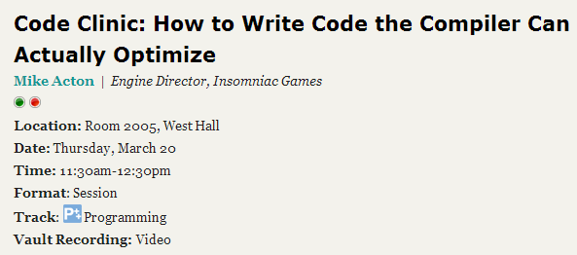
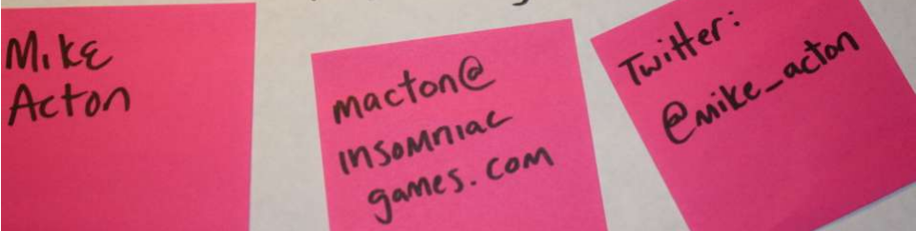

Slide 2
What is good code?
Our role is not to write "good" code. Our role is to solve our problems well.
With fixed hardware resources, that often means reducing waste or at least having the potential to reduce waste (i.e. optimizable) so that we can solve bigger and more interesting problems in the same space.
"Good" code in that context is the code that was written based on a rational and reasoned analysis of the actual problems that need solving, hardware resources, and available production time.
i.e. At the very least not using the "pull it out your ass" design method combined with a goal to "solve all problems for everyone, everywhere."

Slide 3
“Can’t the compiler do it?”

Slide 4
A little review…

Slide 5
The purpose of all programs, and all parts of those programs, is to transform data from one form to another.

Slide 6

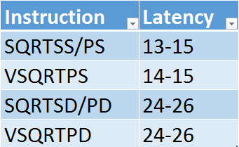
(AMD Piledriver)
http://www.agner.org/optimize/instruction_tables.pdf

Slide 7
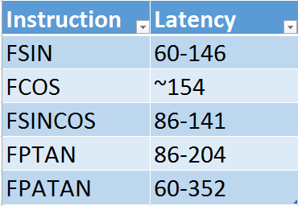
(AMD Piledriver)
http://www.agner.org/optimize/instruction_tables.pdf

Slide 8

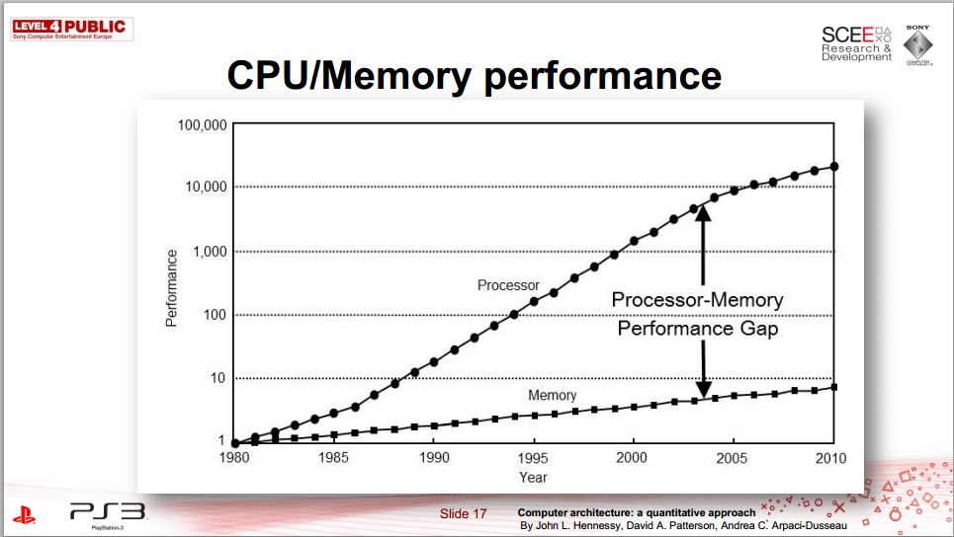
http://research.scee.net/files/presentations/gcapaustralia09/Pitfalls_of_Object_Oriented_Programming_GCAP_09.pdf

Slide 9
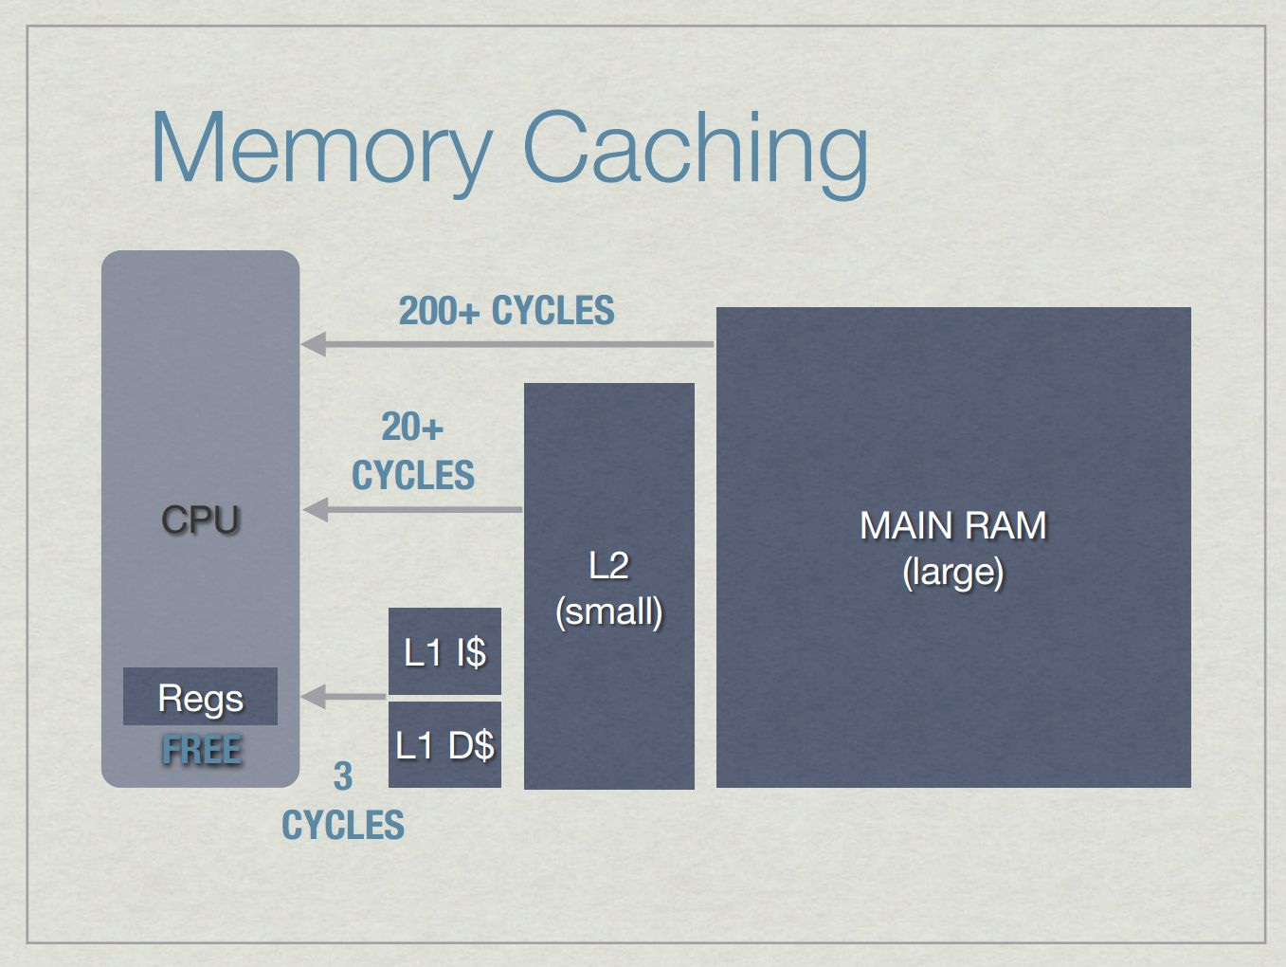
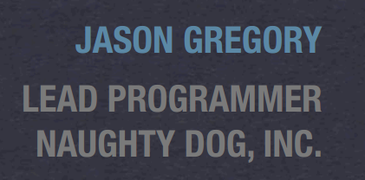
http://www.gameenginebook.com/SINFO.pdf

Slide 10

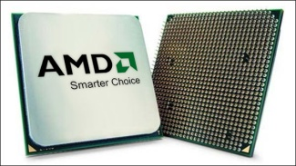
The Battle of North Bridge
L1
L2
RAM

Slide 11
L2 cache misses/frame
(Most significant component)

Slide 12
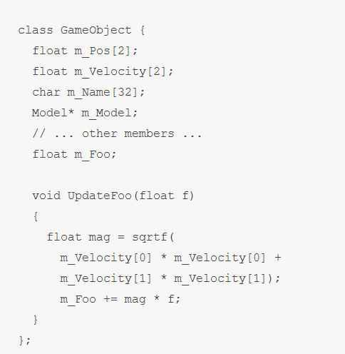
http://deplinenoise.wordpress.com/2013/12/28/optimizable-code/

Slide 13
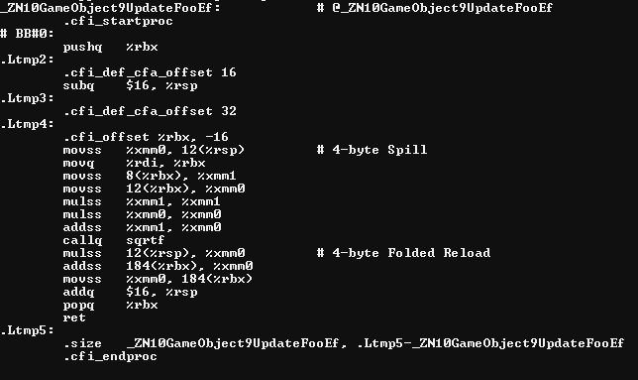

Slide 14
2 x 32bit read; same cache line = ~200

Slide 15
Float mul, add = ~10

Slide 16
Let’s assume callq is replaced. Sqrt = ~30

Slide 17
Mul back to same addr; in L1; = ~3

Slide 18
Read+add from new line
= ~200

Slide 19
Time spent waiting for L2 vs. actual work
~10:1

Slide 20
Time spent waiting for L2 vs. actual work
~10:1
This is the compiler’s space.

Slide 21

Time spent waiting for L2 vs. actual work
~10:1
This is the compiler’s space.

Slide 22
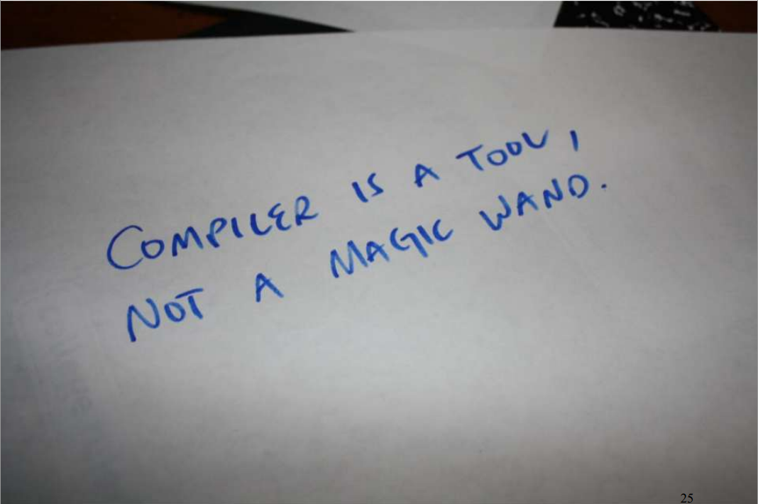
Compiler cannot solve the most significant problems.

Slide 23


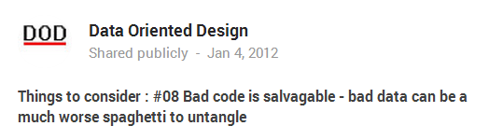
See also:
https://plus.google.com/u/0/+Dataorienteddesign/posts

Slide 24
Today’s subject: The 90% of problem space we need to solve that the compiler cannot.
(And how we can help it with the 10% that it can.)

Slide 25
Simple, obvious things to look for + Back of the envelope calculations = Substantial wins

Slide 26
What’s the most common cause of waste?

Slide 27
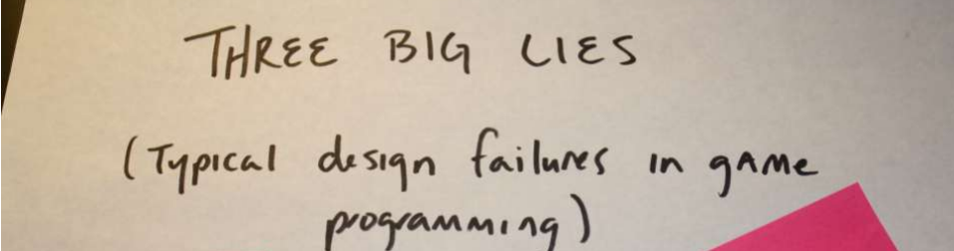
What’s the cause?
http://www.insomniacgames.com/three-big-lies-typical-design-failures-in-game-programming-gdc10/

Slide 28
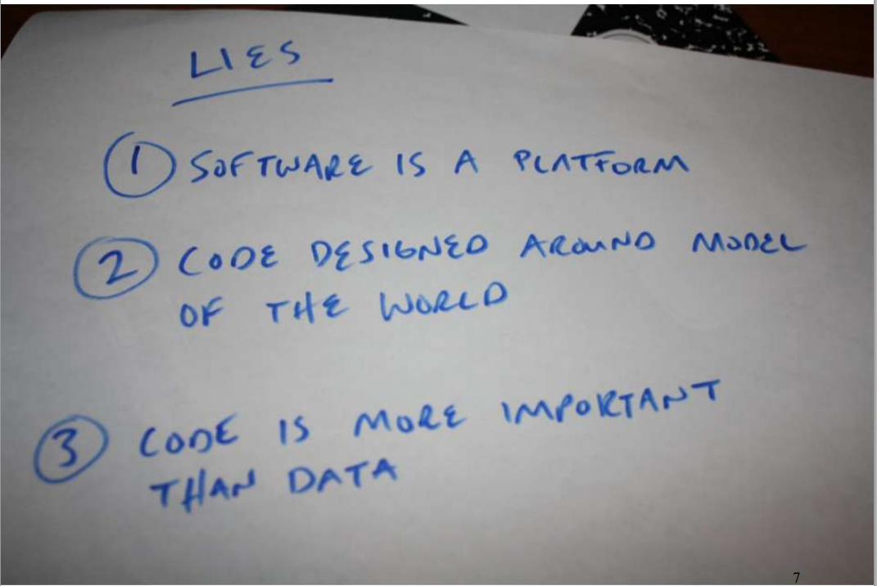

Slide 29
http://deplinenoise.wordpress.com/2013/12/28/optimizable-code/
So how do we solve for it?

Slide 30
L2 cache misses/frame
(Don’t waste them!)

Slide 31
Waste 56 bytes / 64 bytes

Slide 32
Waste 60 bytes / 64 bytes

Slide 33
90% waste!

Slide 34
Alternatively,
Only 10% capacity used*
* Not the same as “used well”, but we’ll start here.

Slide 35
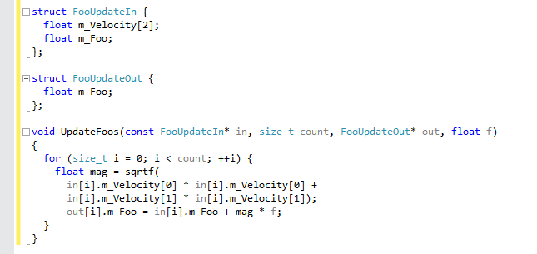

Slide 36
12 bytes x count(5) = 72

Slide 37
12 bytes x count(5) = 72
4 bytes x count(5) = 20

Slide 38
12 bytes x count(32) = 384 = 64 x 6
4 bytes x count(32) = 128 = 64 x 2

Slide 39
12 bytes x count(32) = 384 = 64 x 6
4 bytes x count(32) = 128 = 64 x 2
(6/32) = ~5.33 loop/cache line

Slide 40
12 bytes x count(32) = 384 = 64 x 6
4 bytes x count(32) = 128 = 64 x 2
(6/32) = ~5.33 loop/cache line
Sqrt + math = ~40 x 5.33 = 213.33 cycles/cache line

Slide 41
12 bytes x count(32) = 384 = 64 x 6
4 bytes x count(32) = 128 = 64 x 2
(6/32) = ~5.33 loop/cache line
Sqrt + math = ~40 x 5.33 = 213.33 cycles/cache line
+ streaming prefetch bonus

Slide 42
12 bytes x count(32) = 384 = 64 x 6
4 bytes x count(32) = 128 = 64 x 2
Using cache line to capacity* =
10x speedup
* Used. Still not necessarily as efficiently as possible
(6/32) = ~5.33 loop/cache line
Sqrt + math = ~40 x 5.33 = 213.33 cycles/cache line
+ streaming prefetch bonus

Slide 43
In addition…
Code is maintainable
Code is debugable
Can REASON about cost of change
(6/32) = ~5.33 loop/cache line
Sqrt + math = ~40 x 5.33 = 213.33 cycles/cache line
+ streaming prefetch bonus

Slide 44
In addition…
Code is maintainable
Code is debugable
Can REASON about cost of change
Ignoring inconvenient facts is not engineering;
It’s dogma.
(6/32) = ~5.33 loop/cache line
Sqrt + math = ~40 x 5.33 = 213.33 cycles/cache line
+ streaming prefetch bonus

Slide 45
Let’s review some code…

Slide 46
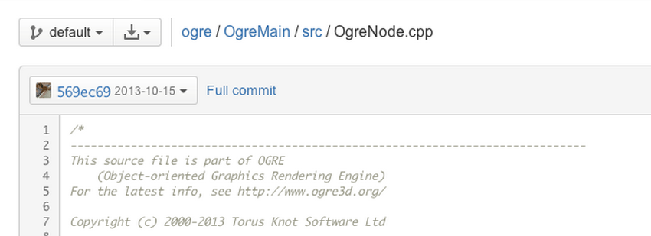

Slide 47

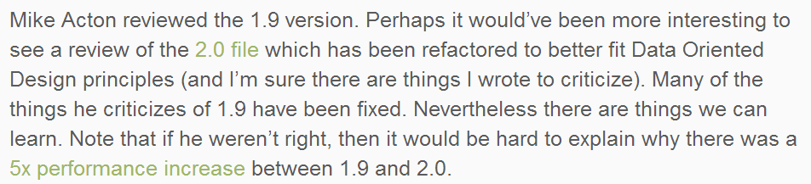
http://yosoygames.com.ar/wp/2013/11/on-mike-actons-review-of-ogrenode-cpp/

Slide 48
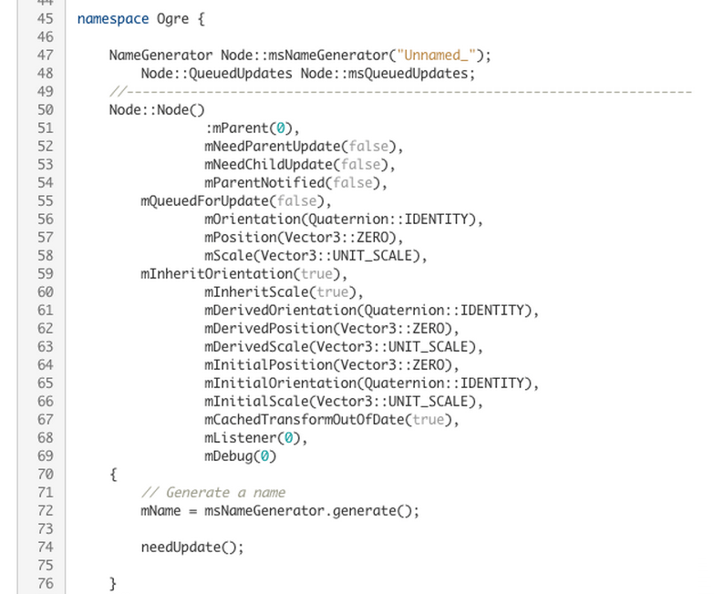

Slide 49
(1) Can’t re-arrange memory (much)
Limited by ABI
Can’t limit unused reads
Extra padding

Slide 50
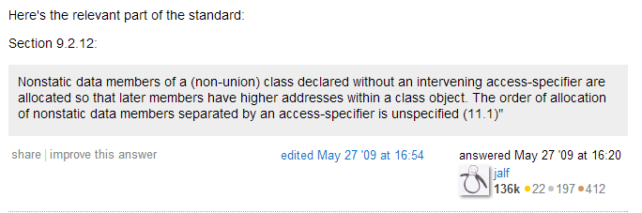
http://stackoverflow.com/questions/916600/can-a-c-compiler-re-order-elements-in-a-struct
In theory…

Slide 51
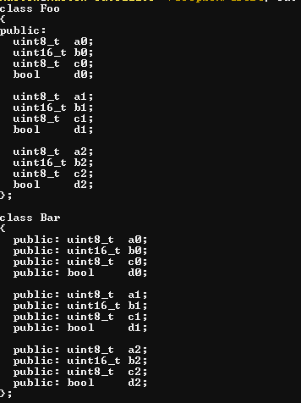
In practice…

Slide 52
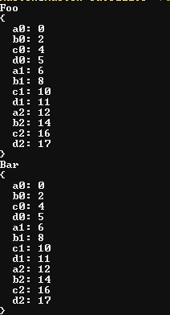
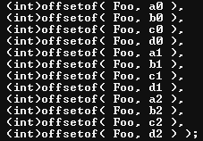
In practice…

Slide 53
(2) Bools and last-minute decision making

Slide 54
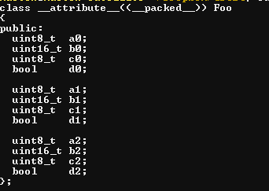
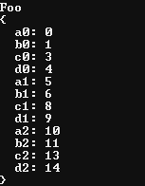
bools in structs…
(3) Extremely low information density

Slide 55
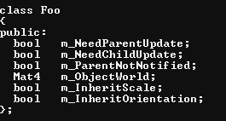
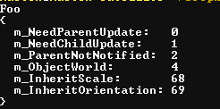
bools in structs…
(3) Extremely low information density
How big is your cache line?

Slide 56
bools in structs…
(3) Extremely low information density
How big is your cache line?
What’s the most commonly accessed data?
64b?

Slide 57
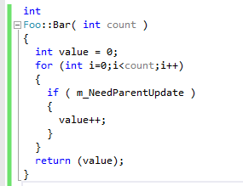
How is it used? What does it generate?
(2) Bools and last-minute decision making

Slide 58
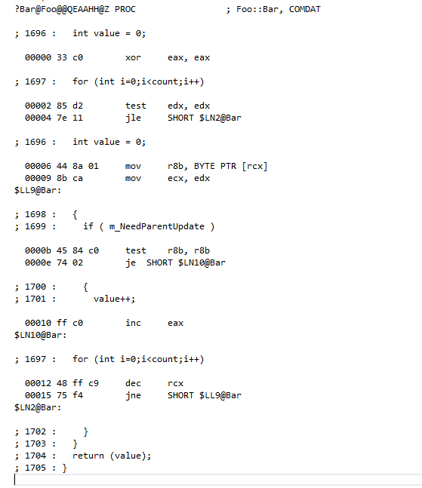
MSVC

Slide 59
MSVC
Re-read and re-test…
Increment and loop…

Slide 60

Why?
Re-read and re-test…
Super-conservative aliasing rules…?
Member value might change?
Increment and loop…

Slide 61


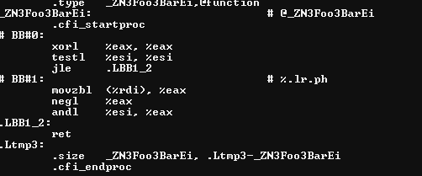
What about something more aggressive…?

Slide 62
What about something more aggressive…?
Test once and return…

Slide 63
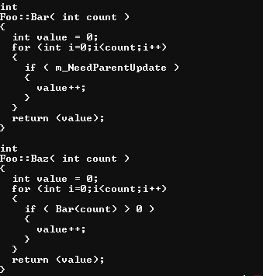
Okay, so what about…

Slide 64
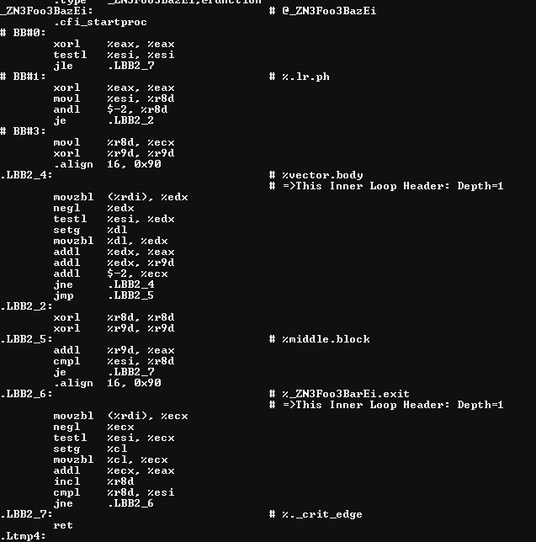
…well at least it inlined it?

Slide 65
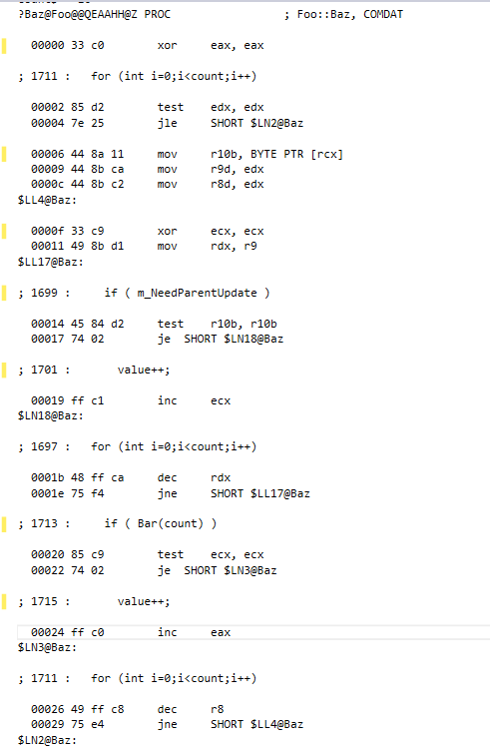
MSVC doesn’t fare any better…

Slide 66
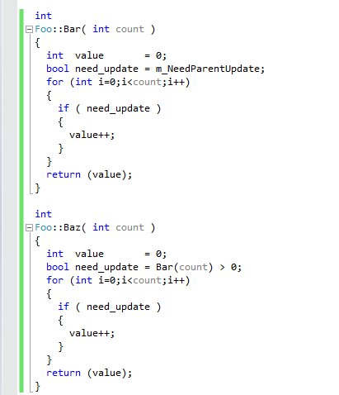
(4) Ghost reads and writes
Don’t re-read member values or re-call functions when
you already have the data.

Slide 67
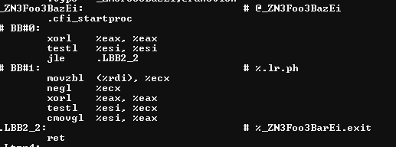
BAM!

Slide 68
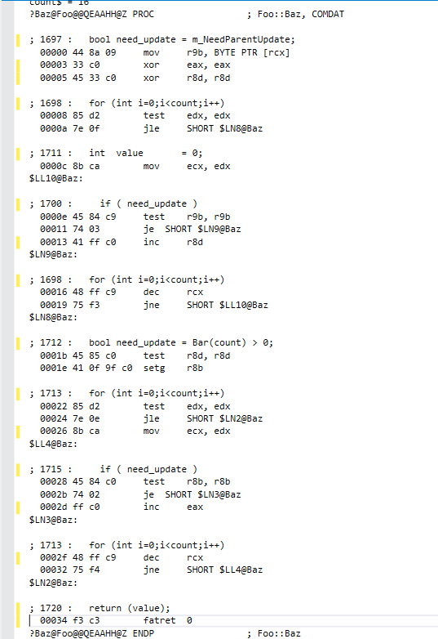
:(

Slide 69
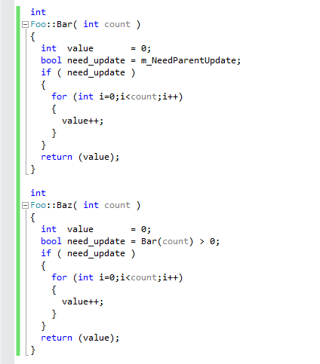
(4) Ghost reads and writes
Don’t re-read member values or re-call functions when
you already have the data.
Hoist all loop-invariant reads and branches. Even super- obvious ones that should already be in registers.

Slide 70
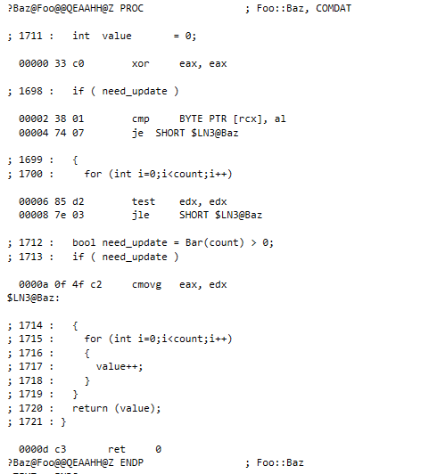
:)

Slide 71
:)
A bit of unnecessary branching, but more-or-less equivalent.

Slide 72
Note I’m not picking on MSVC in particular. It’s an arbitrary example that could have gone either way for either compiler. The point to note is that all compilers are limited in their ability to reason about the problem and can’t solve nearly as sophisticated problems even within their space as people imagine.

Slide 73
(4) Ghost reads and writes
Don’t re-read member values or re-call functions when
you already have the data.
Hoist all loop-invariant reads and branches. Even super- obvious ones that should already be in registers.
Applies to any member fields especially.
(Not particular to bools)

Slide 74
The story so far… How can you help the compiler?

Slide 75
The story so far… How can you help the compiler?
(1) Can’t re-arrange memory (much)

Slide 76
The story so far… How can you help the compiler?
(1) Can’t re-arrange memory (much)
Arrange memory by probability of access.

Slide 77
The story so far… How can you help the compiler?
(1) Can’t re-arrange memory (much)
(2) Bools and last-minute decision making

Slide 78
The story so far… How can you help the compiler?
(1) Can’t re-arrange memory (much)
(2) Bools and last-minute decision making
Hoist decision making to first-opportunity.

Slide 79
The story so far… How can you help the compiler?
(1) Can’t re-arrange memory (much)
(2) Bools and last-minute decision making
(3) Extremely low information density

Slide 80
The story so far… How can you help the compiler?
(1) Can’t re-arrange memory (much)
(2) Bools and last-minute decision making
(3) Extremely low information density
Maximize memory read value.

Slide 81
The story so far… How can you help the compiler?
(1) Can’t re-arrange memory (much)
(2) Bools and last-minute decision making
(3) Extremely low information density
Maximize memory read value.
How can we measure this?

Slide 82
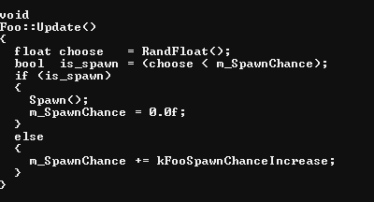
(3) Extremely low information density

Slide 83
(3) Extremely low information density
What is the information density for is_spawn
over time?

Slide 84
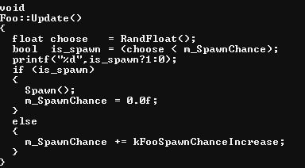
(3) Extremely low information density
What is the information density for is_spawn
over time?
The easy way.

Slide 85
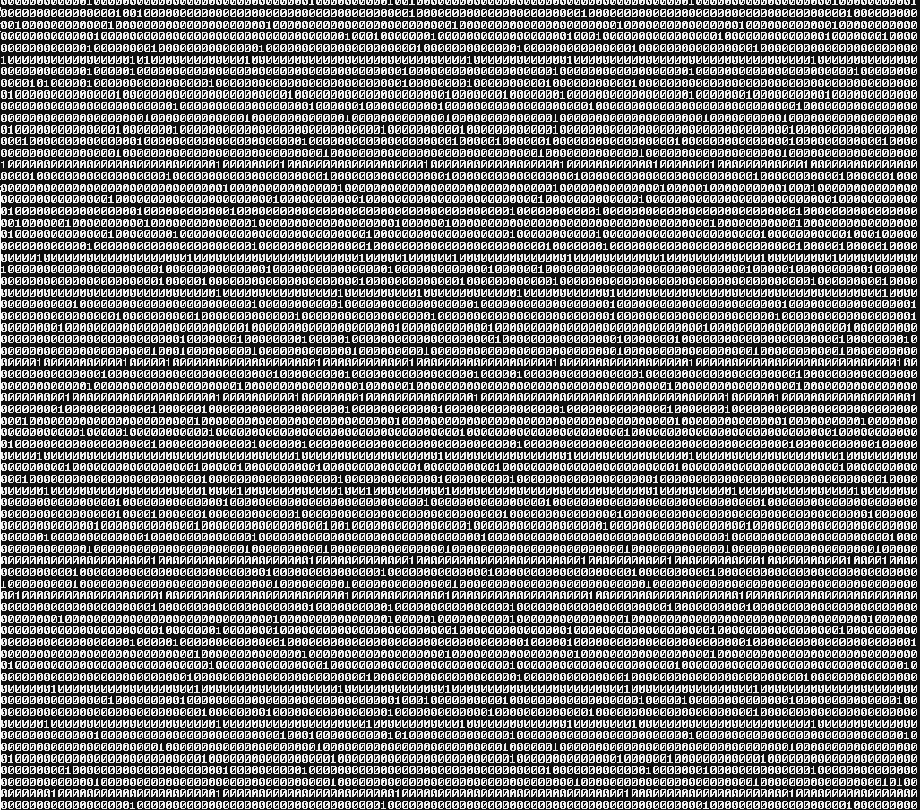

Slide 86
Zip the output
10,000 frames
= 915 bytes
= (915*8)/10,000
= 0.732 bits/frame

Slide 87

Zip the output
10,000 frames
= 915 bytes
= (915*8)/10,000
= 0.732 bits/frame
Alternatively,
Calculate Shannon Entropy:

Slide 88
(3) Extremely low information density
What does that tell us?

Slide 89
(3) Extremely low information density
What does that tell us?
Figure (~2 L2 misses each frame ) x 10,000
If each cache line = 64b,
128b x 10,000 = 1,280,000 bytes

Slide 90
(3) Extremely low information density
What does that tell us?
Figure (~2 L2 misses each frame ) x 10,000
If each cache line = 64b,
128b x 10,000 = 1,280,000 bytes
If avg information content = 0.732bits/frame
X 10,000 = 7320 bits
/ 8 = 915 bytes

Slide 91

(3) Extremely low information density
What does that tell us?
Figure (~2 L2 misses each frame ) x 10,000
If each cache line = 64b,
128b x 10,000 = 1,280,000 bytes
If avg information content = 0.732bits/frame
X 10,000 = 7320 bits
/ 8 = 915 bytes
Percentage waste (Noise::Signal) =
(1,280,000-915)/1,280,000

Slide 92
What’re the alternatives?

Slide 93
(1) Per-frame…

Slide 94
(1) Per-frame…
(decision table)
1 of 512 (8*64) bits used…

Slide 95
(1) Per-frame…
(decision table)
1 of 512 (8*64) bits used…
(a) Make same decision x 512

Slide 96
(1) Per-frame…
(decision table)
1 of 512 (8*64) bits used…
(a) Make same decision x 512
(b) Combine with other reads / xforms

Slide 97
(1) Per-frame…
(decision table)
1 of 512 (8*64) bits used…
(a) Make same decision x 512
(b) Combine with other reads / xforms
Generally simplest.
But things cannot exist in abstract bubble.
Will require context.

Slide 98
(2) Over-frames…

Slide 99
(2) Over-frames…
i.e. Only read when needed

Slide 100
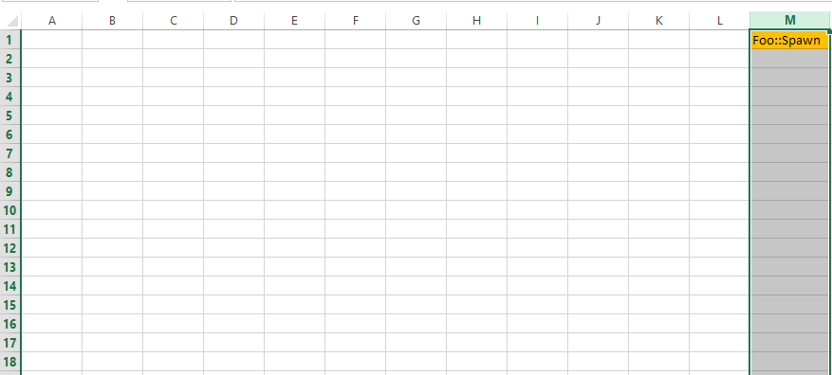
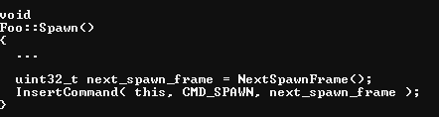
Arrays of command buffers for future frames…
(2) Over-frames…
i.e. Only read when needed
e.g.

Slide 101
The story so far… How can you help the compiler?
(1) Can’t re-arrange memory (much)
(2) Bools and last-minute decision making
(3) Extremely low information density
Maximize memory read value.
How can we measure this?
(Try it.)

Slide 102
The story so far… How can you help the compiler?
(1) Can’t re-arrange memory (much)
(2) Bools and last-minute decision making
(3) Extremely low information density
Maximize memory read value.
How can we measure this?
(Try it.)
All these “code smells” can be viewed as symptoms of information density problems…

Slide 103
The story so far… How can you help the compiler?
(1) Can’t re-arrange memory (much)
(2) Bools and last-minute decision making
(3) Extremely low information density
(4) Ghost reads and writes

Slide 104
The story so far… How can you help the compiler?
(1) Can’t re-arrange memory (much)
(2) Bools and last-minute decision making
(3) Extremely low information density
(4) Ghost reads and writes
Don’t re-read member values or re-call functions when
you already have the data.

Slide 105
The story so far… The compiler can’t help with:
The story so far… How can you help the compiler?
(1) Can’t re-arrange memory (much)
(2) Bools and last-minute decision making
(3) Extremely low information density
(4) Ghost reads and writes
Don’t re-read member values or re-call functions when
you already have the data.
Easy to confuse compiler, even within the 10% space

Slide 106
Are we done with the constructor?

Slide 107
Are we done with the constructor?
(5) Over-generalization

Slide 108
Are we done with the constructor?
(5) Over-generalization
Complex constructors tend to imply that…
Reads are unmanaged (one at a time…)

Slide 109
Are we done with the constructor?
(5) Over-generalization
Complex constructors tend to imply that…
Reads are unmanaged (one at a time…)
Unnecessary reads/writes in destructors

Slide 110
Are we done with the constructor?
(5) Over-generalization
Complex constructors tend to imply that…
Reads are unmanaged (one at a time…)
Unnecessary reads/writes in destructors
Unmanaged icache (i.e. virtuals)
=> unmanaged reads/writes

Slide 111
Are we done with the constructor?
(5) Over-generalization
Complex constructors tend to imply that…
Reads are unmanaged (one at a time…)
Unnecessary reads/writes in destructors
Unmanaged icache (i.e. virtuals)
=> unmanaged reads/writes
Unnecessarily complex state machines (back to bools)
E.g. 2^7 states

Slide 112
Are we done with the constructor?
(5) Over-generalization
Complex constructors tend to imply that…
Reads are unmanaged (one at a time…)
Unnecessary reads/writes in destructors
Unmanaged icache (i.e. virtuals)
=> unmanaged reads/writes
Unnecessarily complex state machines (back to bools)
E.g. 2^7 states
Rule of thumb:
Store each state type separately
Store same states together
(No state value needed)

Slide 113
Are we done with the constructor?
(5) Over-generalization
(6) Undefined or under-defined constraints

Slide 114
Are we done with the constructor?
(5) Over-generalization
(6) Undefined or under-defined constraints
Imply more (wasted) reads because pretending you
don’t know what it could be.

Slide 115
Are we done with the constructor?
(5) Over-generalization
(6) Undefined or under-defined constraints
Imply more (wasted) reads because pretending you
don’t know what it could be.
e.g. Strings, generally. Filenames, in particular.

Slide 116
Are we done with the constructor?
(5) Over-generalization
(6) Undefined or under-defined constraints
Imply more (wasted) reads because pretending you
don’t know what it could be.
e.g. Strings, generally. Filenames, in particular.
Rule of thumb:
The best code is code that doesn’t need to exist.
Do it offline. Do it once.
e.g. precompiled string hashes

Slide 117
Are we done with the constructor?
(5) Over-generalization
(6) Undefined or under-defined constraints
(7) Over-solving (computing too much)
Compiler doesn’t have enough context to know
how to simplify your problems for you.

Slide 118
Are we done with the constructor?
(5) Over-generalization
(6) Undefined or under-defined constraints
(7) Over-solving (computing too much)
Compiler doesn’t have enough context to know
how to simplify your problems for you.
But you can make simple tools that do…
E.g. Premultiply matrices

Slide 119
Are we done with the constructor?
(5) Over-generalization
(6) Undefined or under-defined constraints
(7) Over-solving (computing too much)
Compiler doesn’t have enough context to know
how to simplify your problems for you.
But you can make simple tools that do…
E.g. Premultiply matrices
Work with the (actual) data you have.
E.g. Sparse or affine matrices

Slide 120


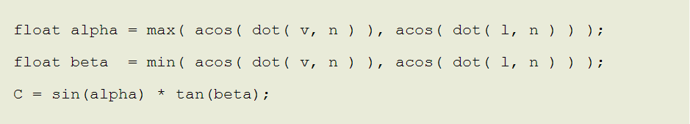
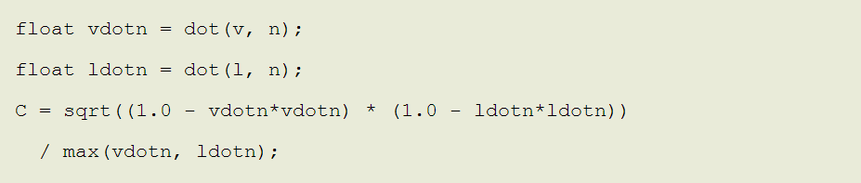
http://fgiesen.wordpress.com/2010/10/21/finish-your-derivations-please/
Is the compiler going to transform this…
Into this… for you?

Slide 121

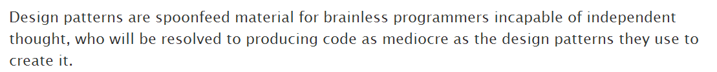
While we’re on the subject…
DESIGN PATTERNS:
“
http://realtimecollisiondetection.net/blog/?p=81
http://realtimecollisiondetection.net/blog/?p=44

Slide 122
Okay… Now a quick pass through some other functions.

Slide 123
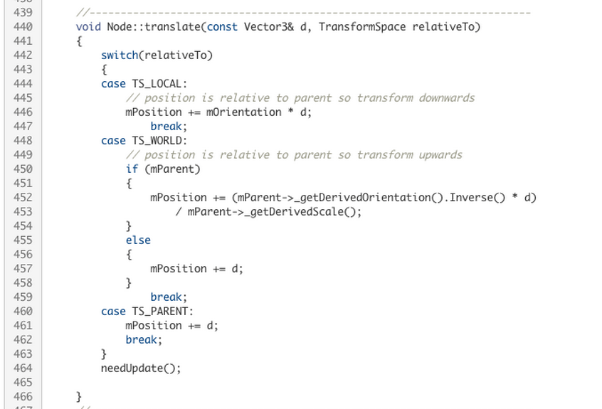

Slide 124
(2) Bools and last-minute decision making

Slide 125
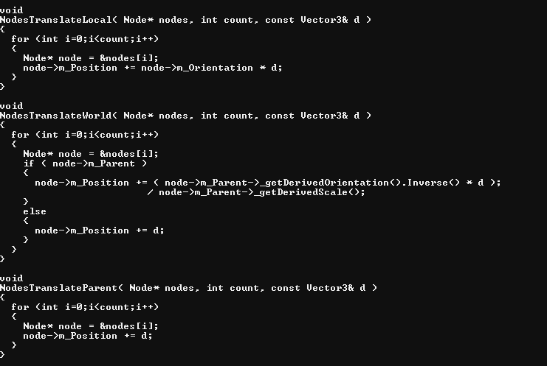
Step 1: organize
Separate states so you can reason about them

Slide 126
Step 1: organize
Separate states so you can reason about them
Step 2: triage
What are the relative values of each case
i.e. p(call) * count

Slide 127
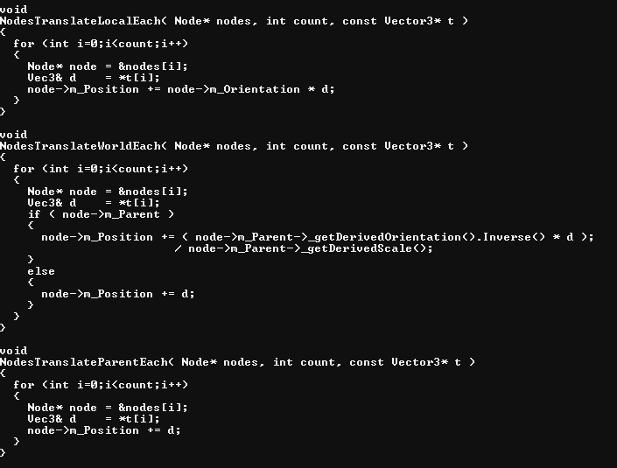
Step 1: organize
Separate states so you can reason about them
Step 2: triage
What are the relative values of each case
i.e. p(call) * count
e.g. in-game vs. in-editor

Slide 128
Step 1: organize
Separate states so you can reason about them
Step 2: triage
What are the relative values of each case
i.e. p(call) * count
Step 3: reduce waste

Slide 129
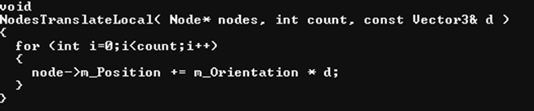
(back of the envelope read cost)
~200 cycles x 2 x count

Slide 130
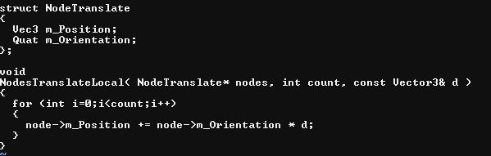
(back of the envelope read cost)
~200 cycles x 2 x count
~2.28 count per 200 cycles
= ~88

Slide 131
(back of the envelope read cost)
~200 cycles x 2 x count
~2.28 count per 200 cycles
= ~88
t = 2 * cross(q.xyz, v)
v' = v + q.w * t + cross(q.xyz, t)

Slide 132
(back of the envelope read cost)
~200 cycles x 2 x count
~2.28 count per 200 cycles
= ~88
(close enough to dig in and
measure)
t = 2 * cross(q.xyz, v)
v' = v + q.w * t + cross(q.xyz, t)

Slide 133

Apply the same steps recursively…

Slide 134
Apply the same steps recursively…
Step 1: organize
Separate states so you can reason about them
Root or not; Calling function with context can distinguish

Slide 135
Apply the same steps recursively…
Step 1: organize
Separate states so you can reason about them
Root or not; Calling function with context can distinguish

Slide 136

Apply the same steps recursively…
Step 1: organize
Separate states so you can reason about them

Slide 137
Apply the same steps recursively…
Step 1: organize
Separate states so you can reason about them
Can’t reason well about the cost from…

Slide 138

Step 1: organize
Separate states so you can reason about them

Slide 139
Step 1: organize
Separate states so you can reason about them
Step 2: triage
What are the relative values of each case
i.e. p(call) * count
Step 3: reduce waste

Slide 140

And here…

Slide 141
Before we close, let’s revisit…

Slide 142
12 bytes x count(32) = 384 = 64 x 6
4 bytes x count(32) = 128 = 64 x 2

Slide 143
12 bytes x count(32) = 384 = 64 x 6
4 bytes x count(32) = 128 = 64 x 2
e.g. use zip trick to determine that information density of input is still pretty low…
Use knowledge of constraints (how fast can velocity be *really*?) to reduce further.

Slide 144
Good News: Most problems are easy to see.

Slide 145
Good News: Side-effect of solving the 90% well, compiler can solve the 10% better.

Slide 146
Good News: Organized data makes maintenance, debugging and concurrency much easier

Slide 147
Bad News: Good programming is hard. Bad programming is easy.

Slide 148
PS: Let’s get more women in tech

Slide 149
EXTRAS

Slide 150
Data-Oriented Design Principles
(Mike Acton)
The purpose of all programs, and all parts of those programs, is to transform data from one form to another.

Slide 151
Data-Oriented Design Principles
(Mike Acton)
If you don’t understand the data you don’t understand the problem.

Slide 152
Data-Oriented Design Principles
(Mike Acton)
Conversely, understand the problem by understanding the data.

Slide 153
Data-Oriented Design Principles
(Mike Acton)
Different problems require different solutions.

Slide 154
Data-Oriented Design Principles
(Mike Acton)
If you have different data, you have a different problem.

Slide 155
Data-Oriented Design Principles
(Mike Acton)
If you don’t understand the cost of solving the problem, you don’t understand the problem.

Slide 156
Data-Oriented Design Principles
(Mike Acton)
If you don’t understand the hardware, you can’t reason about the cost of solving the problem.

Slide 157
Data-Oriented Design Principles
(Mike Acton)
Everything is a data problem. Including usability, maintenance, debug-ability, etc. Everything.

Slide 158
Data-Oriented Design Principles
(Mike Acton)
Solving problems you probably don’t have creates more problems you definitely do.

Slide 159
Data-Oriented Design Principles
(Mike Acton)
Latency and throughput are only the same in sequential systems.

Slide 160
Data-Oriented Design Principles
(Mike Acton)
Latency and throughput are only the same in sequential systems.

Slide 161
Data-Oriented Design Principles
(Mike Acton)
Rule of thumb: Where there is one, there are many. Try looking on the time axis.

Slide 162
Data-Oriented Design Principles
(Mike Acton)
Rule of thumb: The more context you have, the better you can make the solution. Don’t throw away data you need.

Slide 163
Data-Oriented Design Principles
(Mike Acton)
Rule of thumb: NUMA extends to I/O and pre-built data all the way back through time to original source creation.

Slide 164
Data-Oriented Design Principles
(Mike Acton)
Software does not run in a magic fairy aether powered by the fevered dreams of CS PhDs.

