Slide 1
How?

Slide 2
The magic of one person

Slide 3
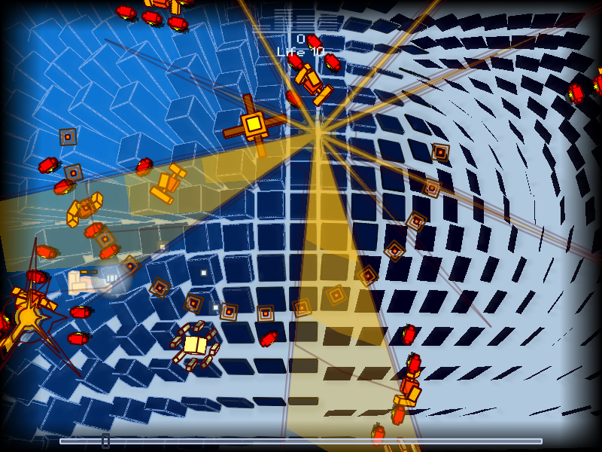
Everyday Shooter, Jonathan Mak

Slide 4
Impact on a team

Slide 5
Our job is what we make it.

Slide 6
Prediction: 50% - 5 years 100% - 10 years

Slide 7
Growth (2x)

Slide 8
Engines enable

Slide 9
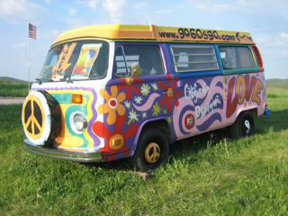
Vehicle for passion

Slide 10
Reflect developers’ vision

Slide 11
Technology-driven industry cycle
Experimental (One person only)
Sophisticated (Many people)
Simple (Combine, disruptive, chaos)
Ubiquitous
Experimental (One person can)

Slide 12
The Programmer Bias

Slide 13
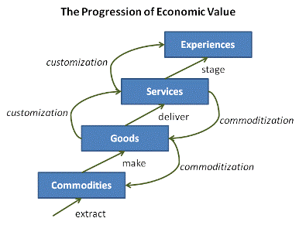
Games, for sure.
Joseph Pine, The Experience Economy

Slide 14
(For developers)
Joseph Pine, The Experience Economy

Slide 15
(For developers)
In hardware
Joseph Pine, The Experience Economy

Slide 16
(For developers)
Programmers
Joseph Pine, The Experience Economy

Slide 17
(For developers)
Basic
Tools
Joseph Pine, The Experience Economy

Slide 18
(For developers)
Make it happen!
Joseph Pine, The Experience Economy

Slide 19
Negativity Bias

Slide 20
Realtime

Slide 21
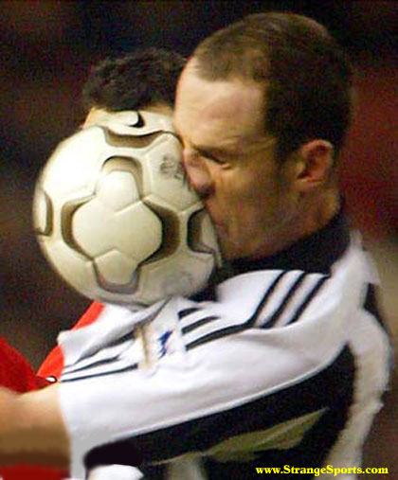
Realtime = Reflect player choice

Slide 22


Slide 23
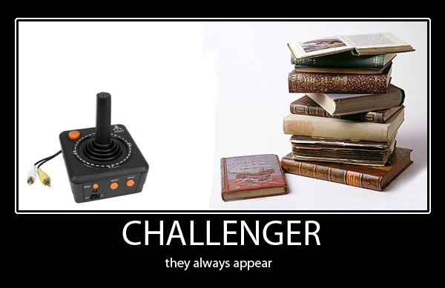

Slide 24
Post
Shaders
Camera
Environment
How else can you reflect players’ choices?

Slide 25
The uncanny valley

Slide 26
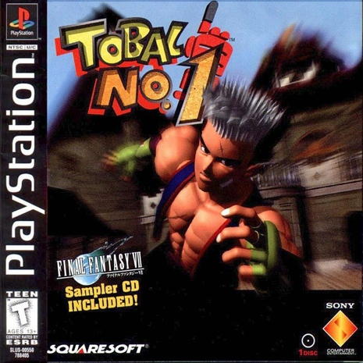

Slide 27
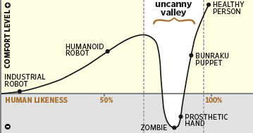
We are here

Slide 28
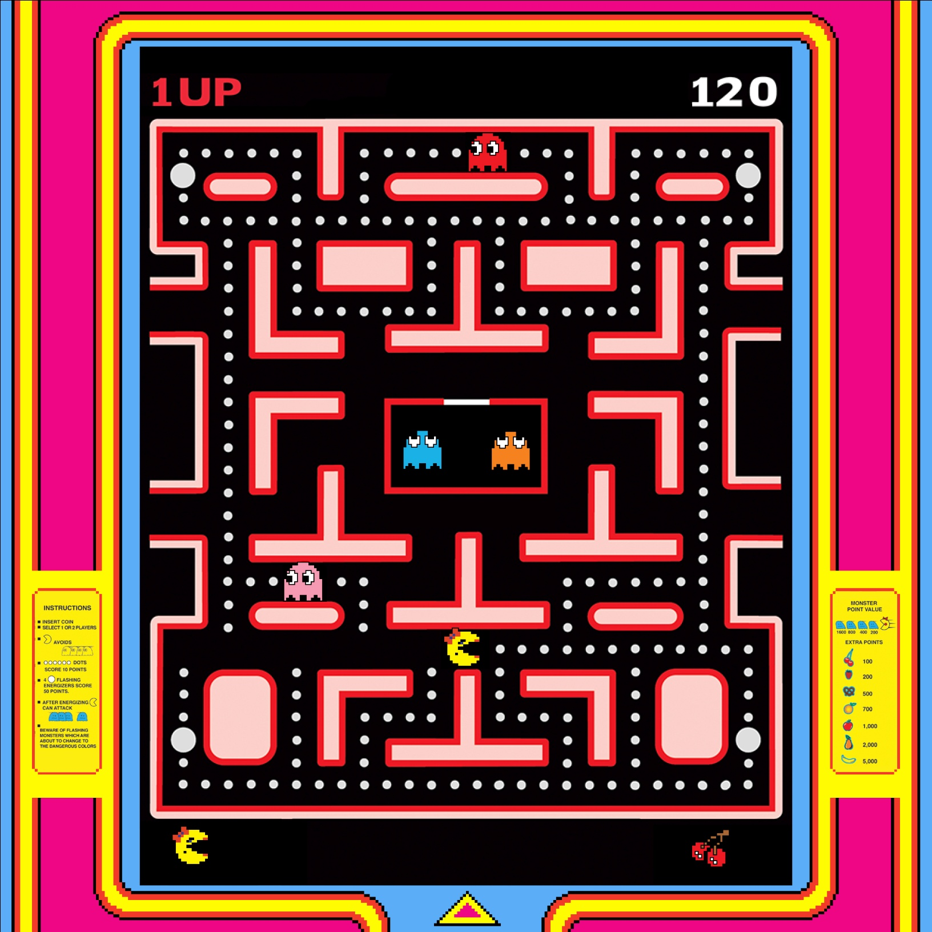

Slide 29
Usability

Slide 30
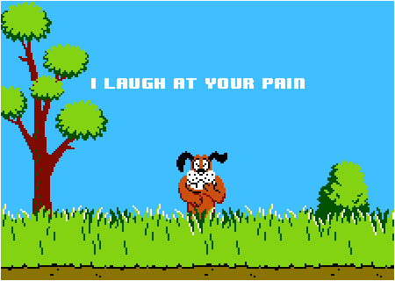

Slide 31
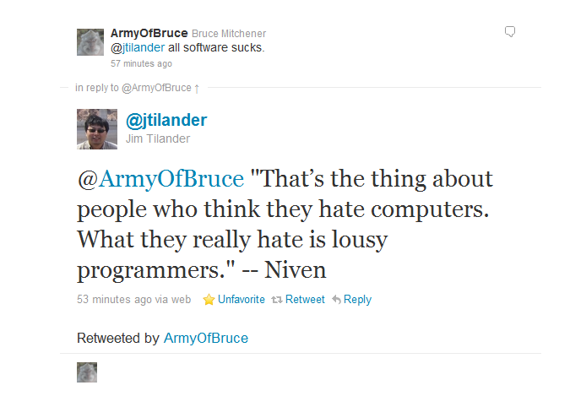

Slide 32
Usability cart stories

Slide 33
Feedback

Slide 34
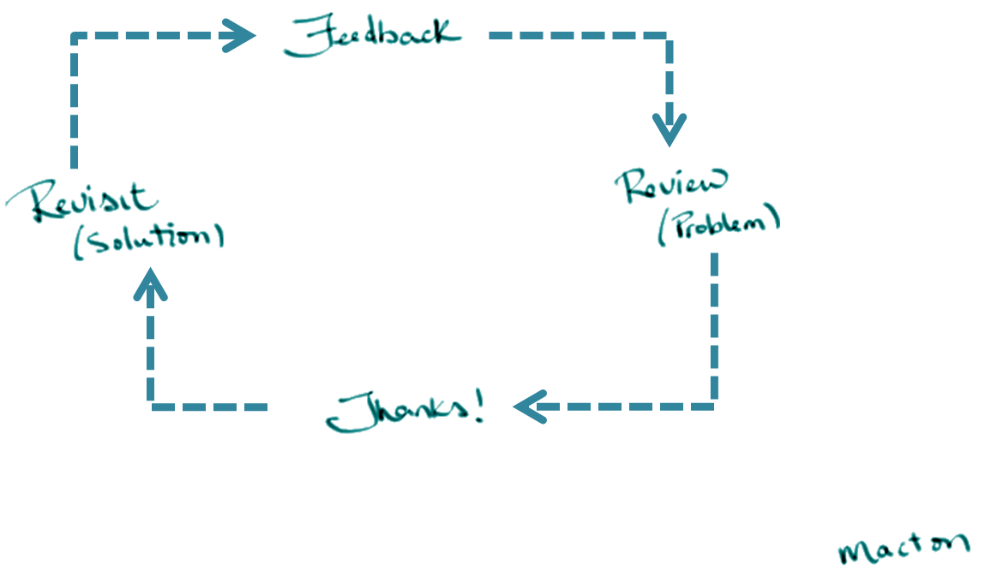

Slide 35
I Believe …
Games are important.
Games make a difference.
Games are art.
Games as pop.
Innovation by degrees.
Engines enable.
Realtime.
Usability
Feedback.
Performance.
Hardware.
Data.

Slide 36
Anything Else?

Slide 37
I Believe …
Games are important.
Games make a difference.
Games are art.
Games as pop.
Innovation by degrees.
Engines enable.
Realtime.
Usability
Feedback.
Performance.
Hardware.
Data.
Magic.

